Slide 1
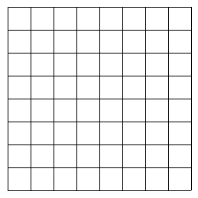
A
Unreliable Hessian
B
C
2R
N_{P}
L
C_{P}
Dist
Possible candidates

