Slide 1
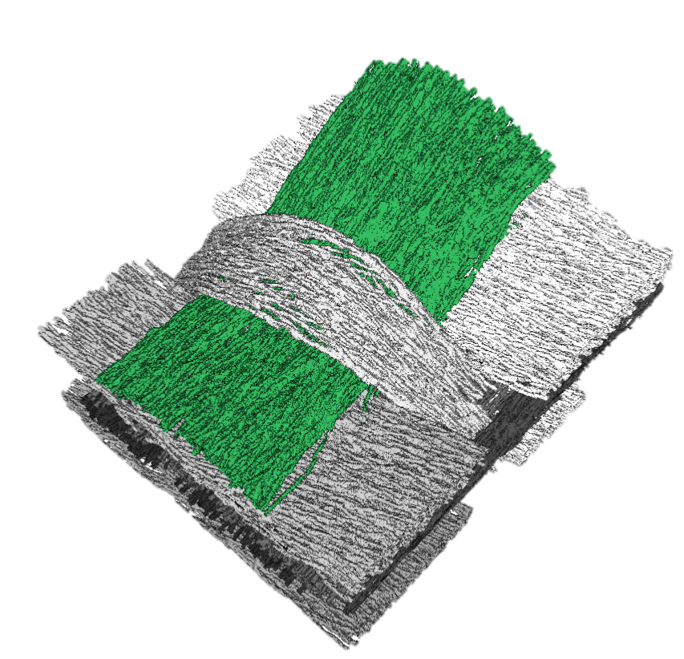
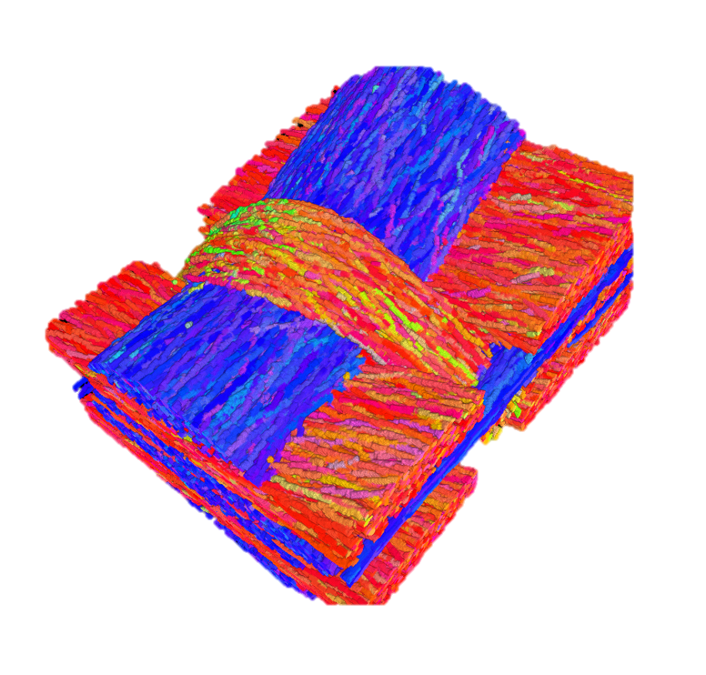
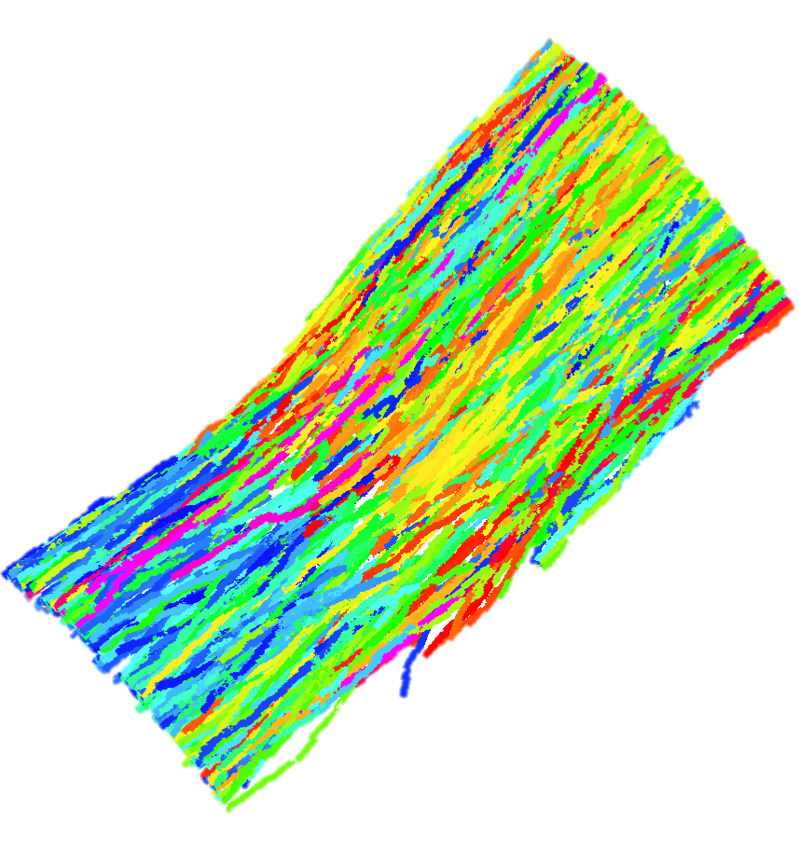

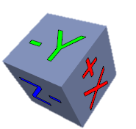
A
B
MetaTracts color mapped to the major axis directions
Length distribution of MetaTracts in fiber bundle 1
1
132
264
396
529

Slide 2
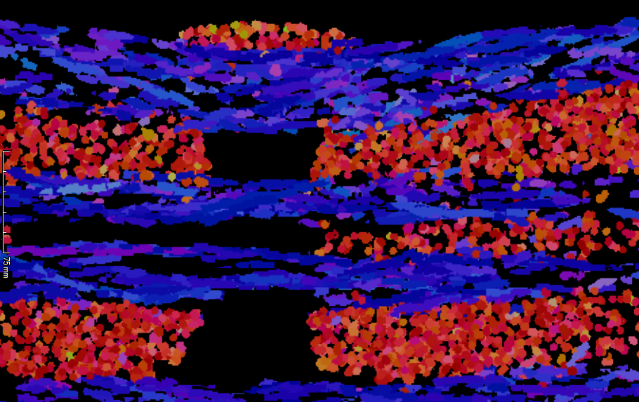
A
B
MetaTracts color mapped to the major axis directions
Length distribution of MetaTracts in fiber bundle 1
1
Y Z Plane
132
264
396
529

