Slide 1
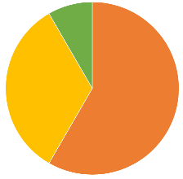
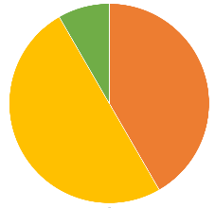

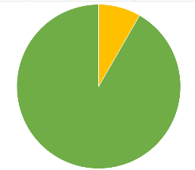
Where: MTs - MetaTracts
DVR - Direct volume rendering
Likert Scale
Task Solving
Question/Task
1 2 3 4 5
Find number of fiber bundles from volume rendering of dataset 1
Find number of fiber bundles from the color-mapped eigenvector of hessian matrix
Hessian based visualizations perform better than DVR
Find number of fiber bundles from MTs fiber bundles
MTs visualizations perform better than DVR
MTs 2D slices perform better than 2D slices of original data
Find largest fiber bundle from set of MTs fiber bundles
Find smallest fiber bundle from set of MTs fiber bundles
Find most similar fiber bundle to given fiber bundle using MTs
MTs better than DVR in finding largest, smallest and similar bundles
Correct
Minor mistake
Meshes generated from MTs give better spatial context than DVR
Wrong

