Slide 1
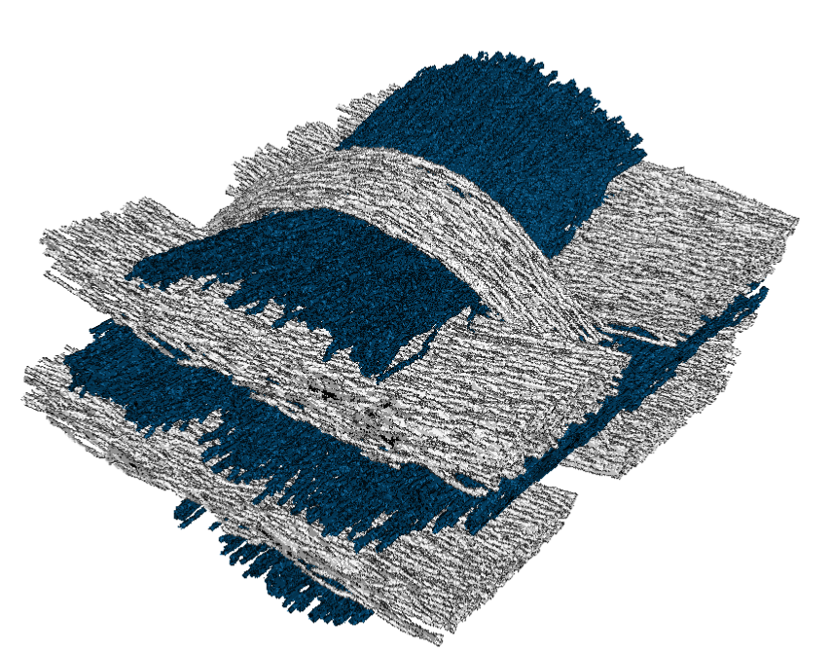
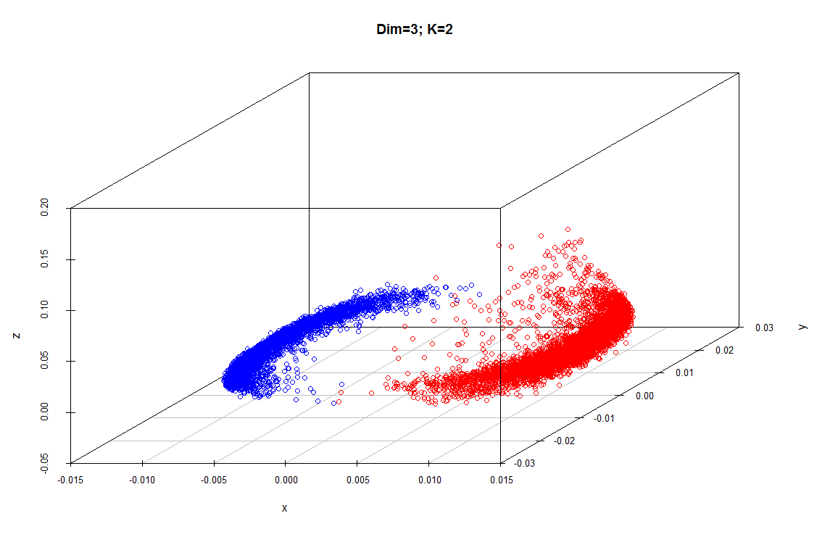
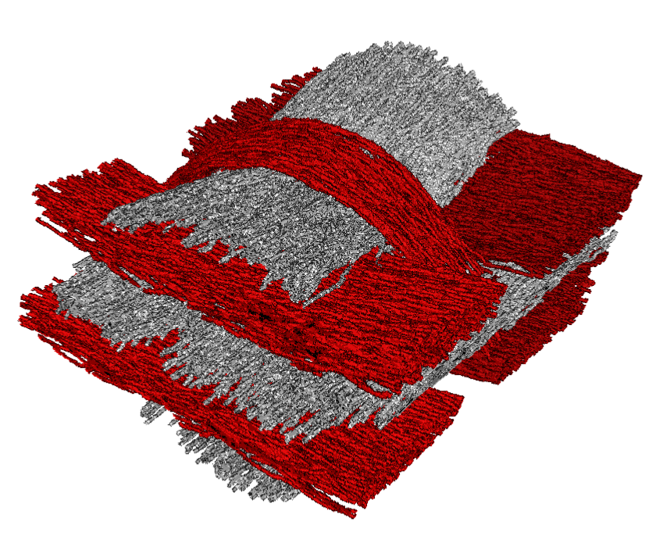
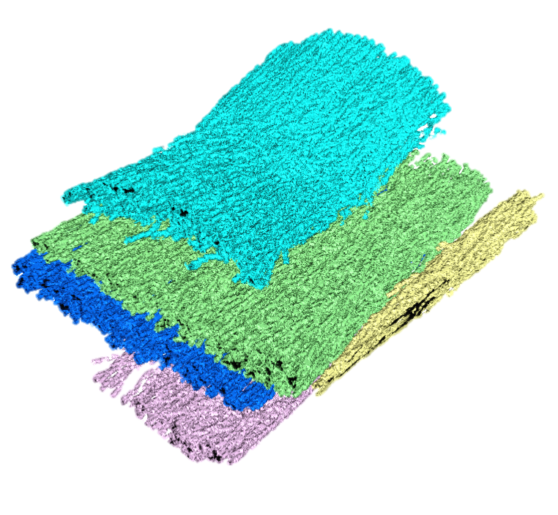
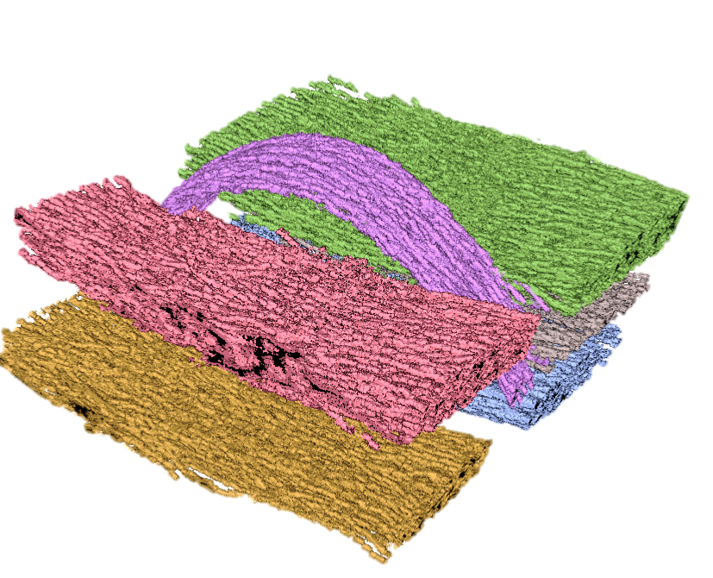
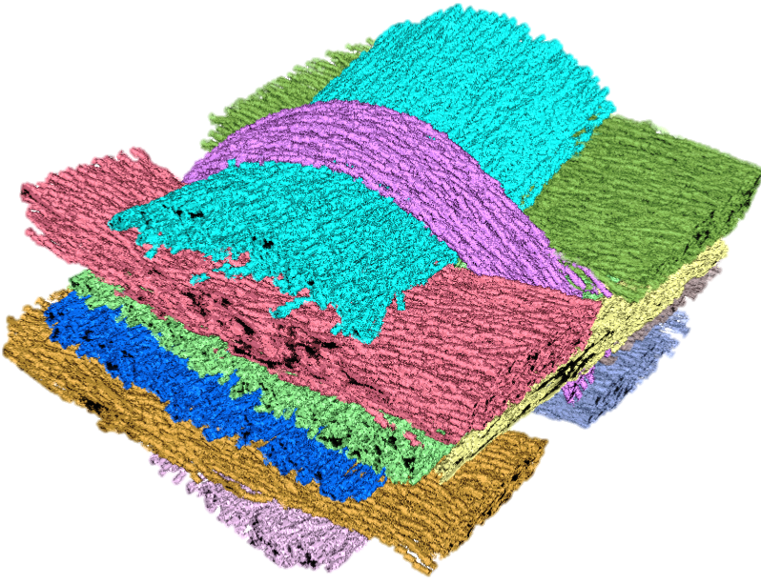
A
B
C
Eigenvector 3
Eigenvector 2
MetaTracts in
Cluster 1
MetaTracts in
Cluster 2
Eigenvector 1
MetaTracts projected on top three eigenvectors and clustered into 2.
D
1
E
7
5
6
2
8
3
9
4
11
10
Hierarchical Clustering: Cluster 1
Hierarchical Clustering: Cluster 1
Combined Fiber Bundles
F

