Slide 1
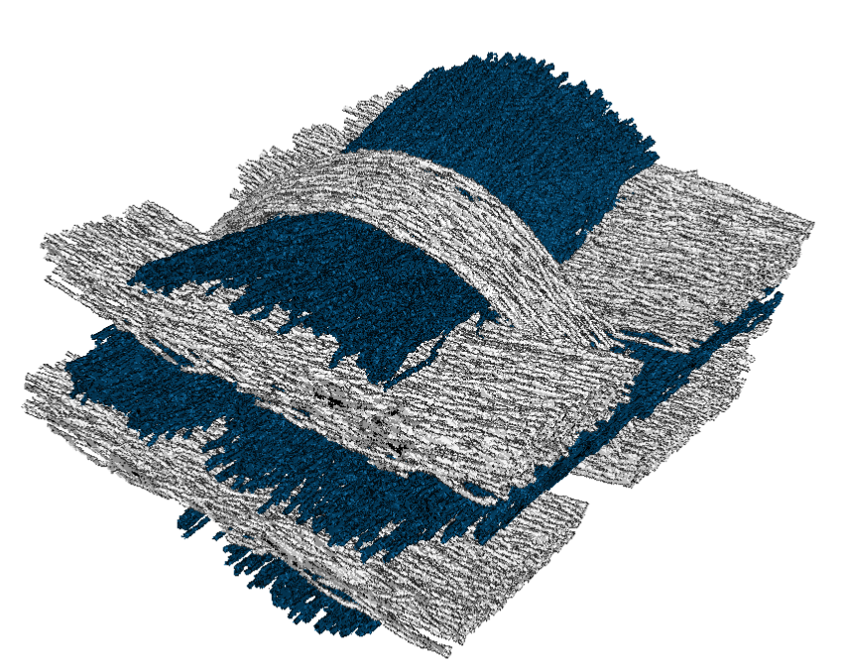
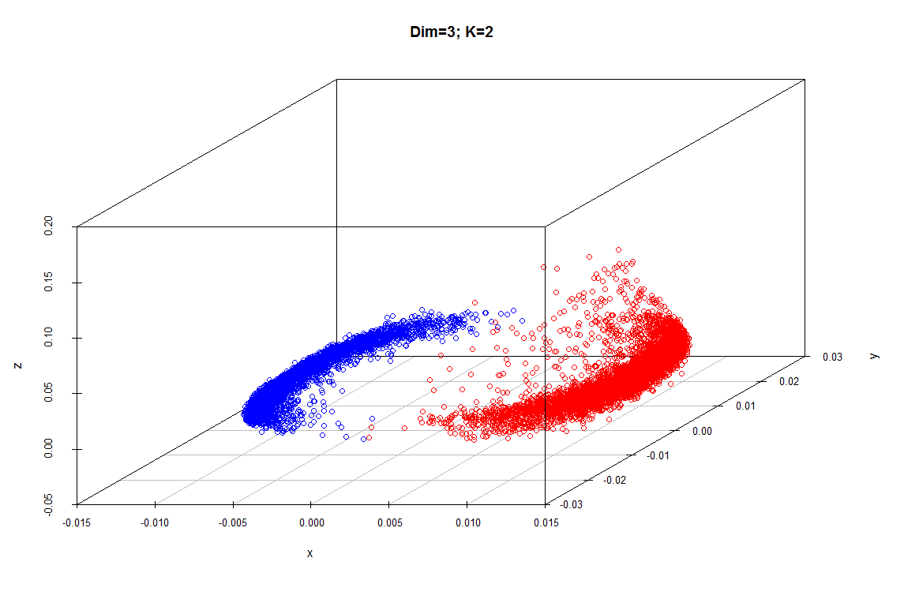
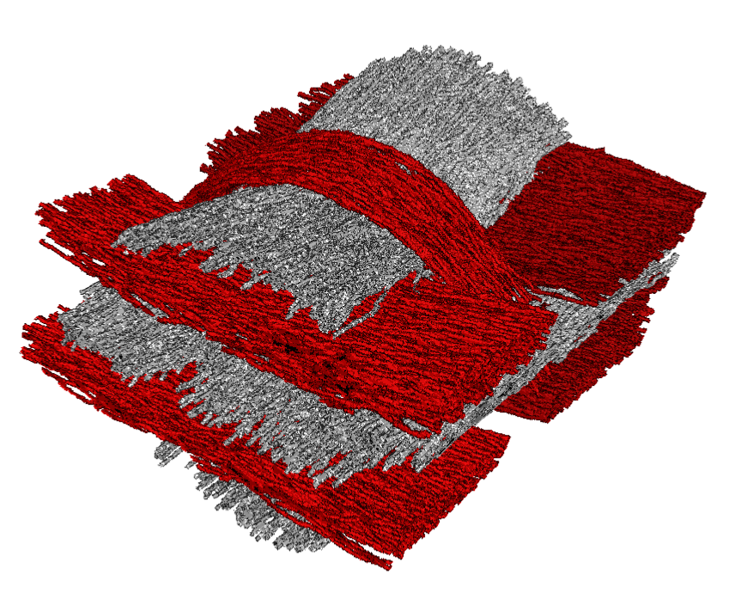
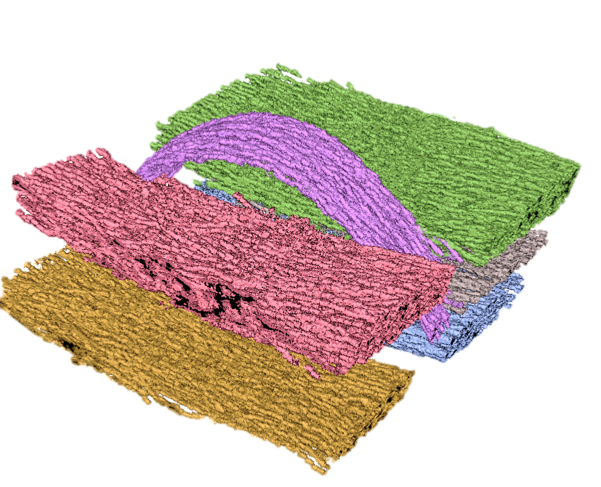
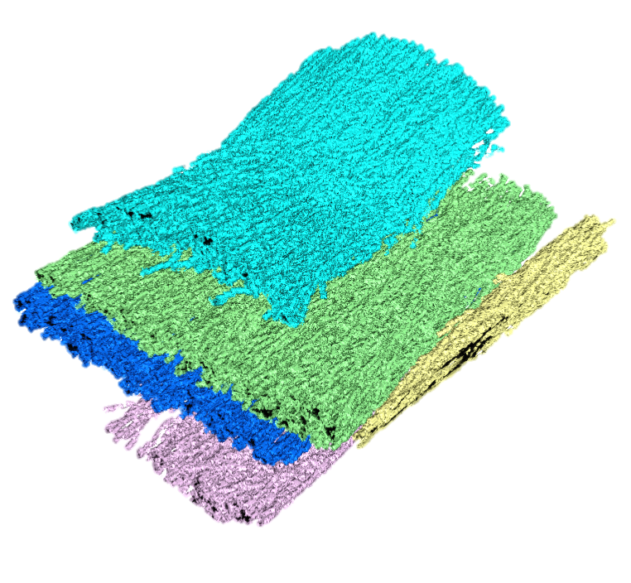
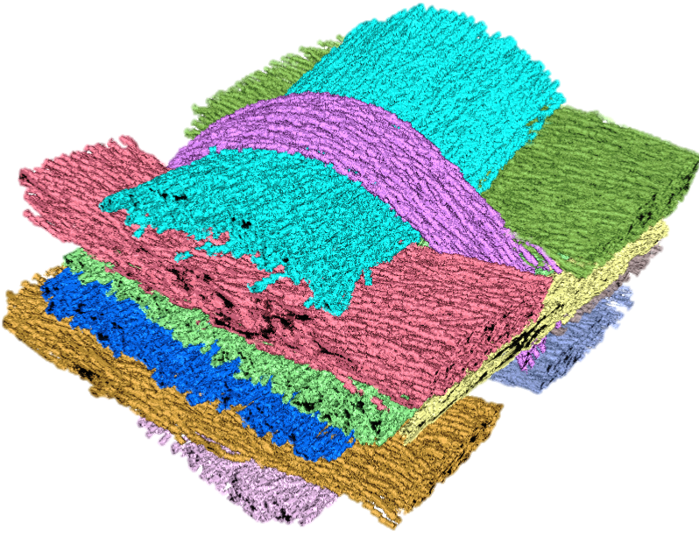
A
MetaTracts in Cluster 1
B
Clustering
C
MetaTracts in Cluster 2
Eigenvector 3
Eigenvector 2
Eigenvector 1
D
Hierarchical Clustering: Cluster 1
E
Hierarchical Clustering: Cluster 1
1
7
5
6
2
8
F
Combined Fiber Bundles
3
9
11
10
4

Slide 2
MetaTracts in Cluster 1
Clustering
MetaTracts in Cluster 2
Eigenvector 3
Eigenvector 2
Eigenvector 1
Hierarchical Clustering: Cluster 1
Hierarchical Clustering: Cluster 1
1
7
5
6
2
8
3
Combined Fiber Bundles
9
11
10
4

Slide 3
7
6
8
9
11
10

Slide 4
1
5
2
3
4

