Slide 1


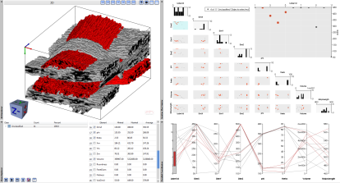





Clustered Fiber
Bundle Dataset
Calculated Fiber
Bundle Characteristics
Interactive Fiber
Bundle Analysis
Bundles Exploration
Write CSV File
Data
Computations
Visualization

Slide 2
Voxelized Fiber
Bundle Dataset
Calculated Fiber
Bundle Features
Interactive Fiber
Bundle Analysis
Labeled Bundles
Bundle Exploration
Write CSV File
Data
Computations
Visualization

