Slide 1
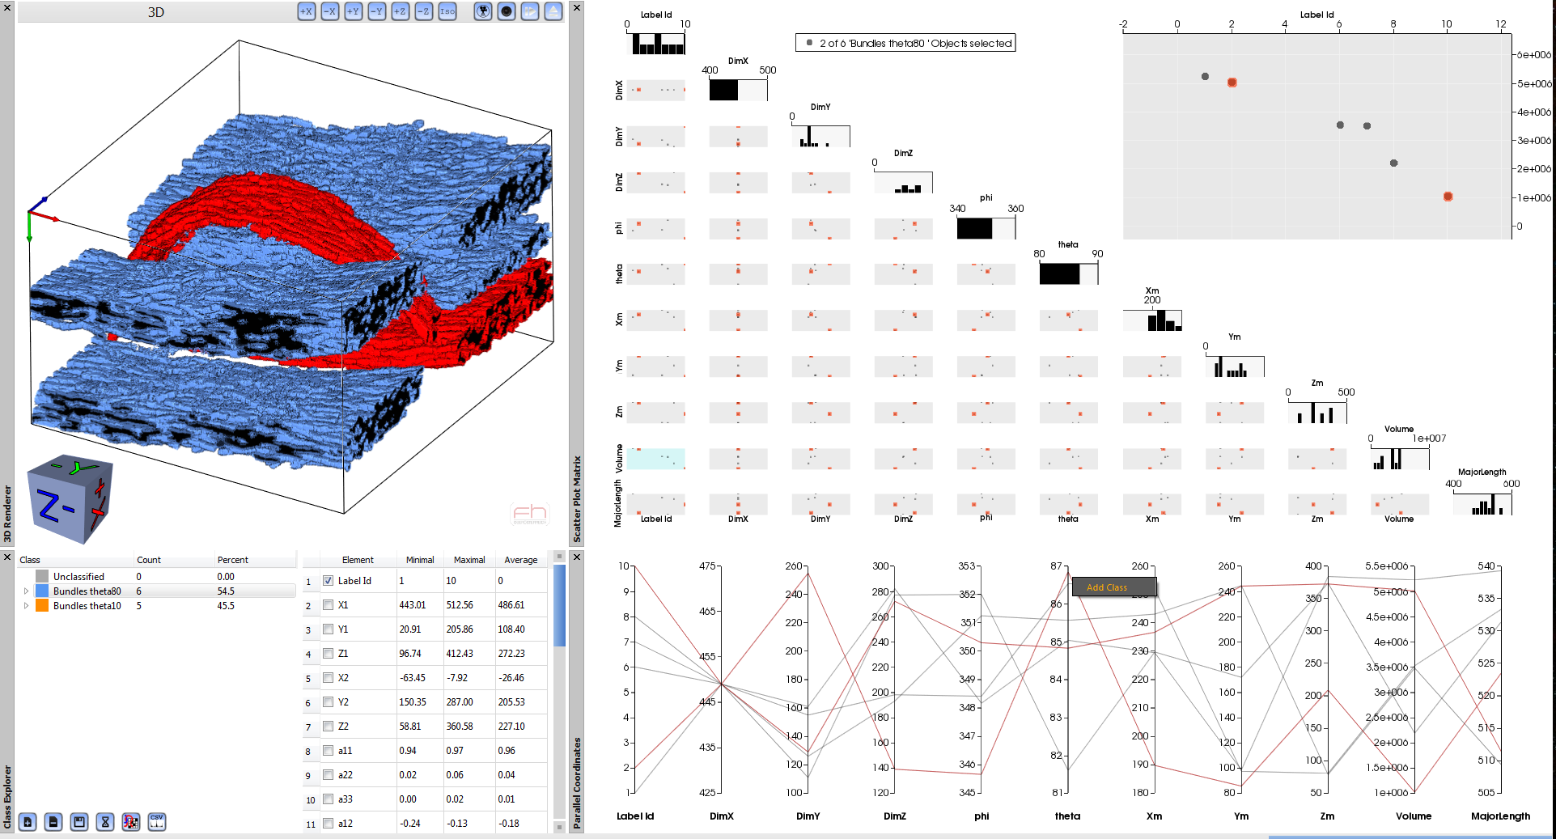
FiberScout’s Graphical User Interface
A
D
B
C

Slide 2
Graphical User Interface of the FiberScout tool
A
D
B
C

