Slide 1


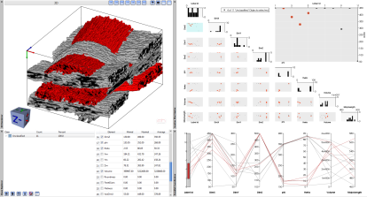





Clustered Fiber
Bundles Dataset
Calculate Fiber
Bundles Characteristics
Interactive Fiber
Bundles Analysis
Write CSV File
FiberScout
Data
Computations
Visualization

