Slide 1
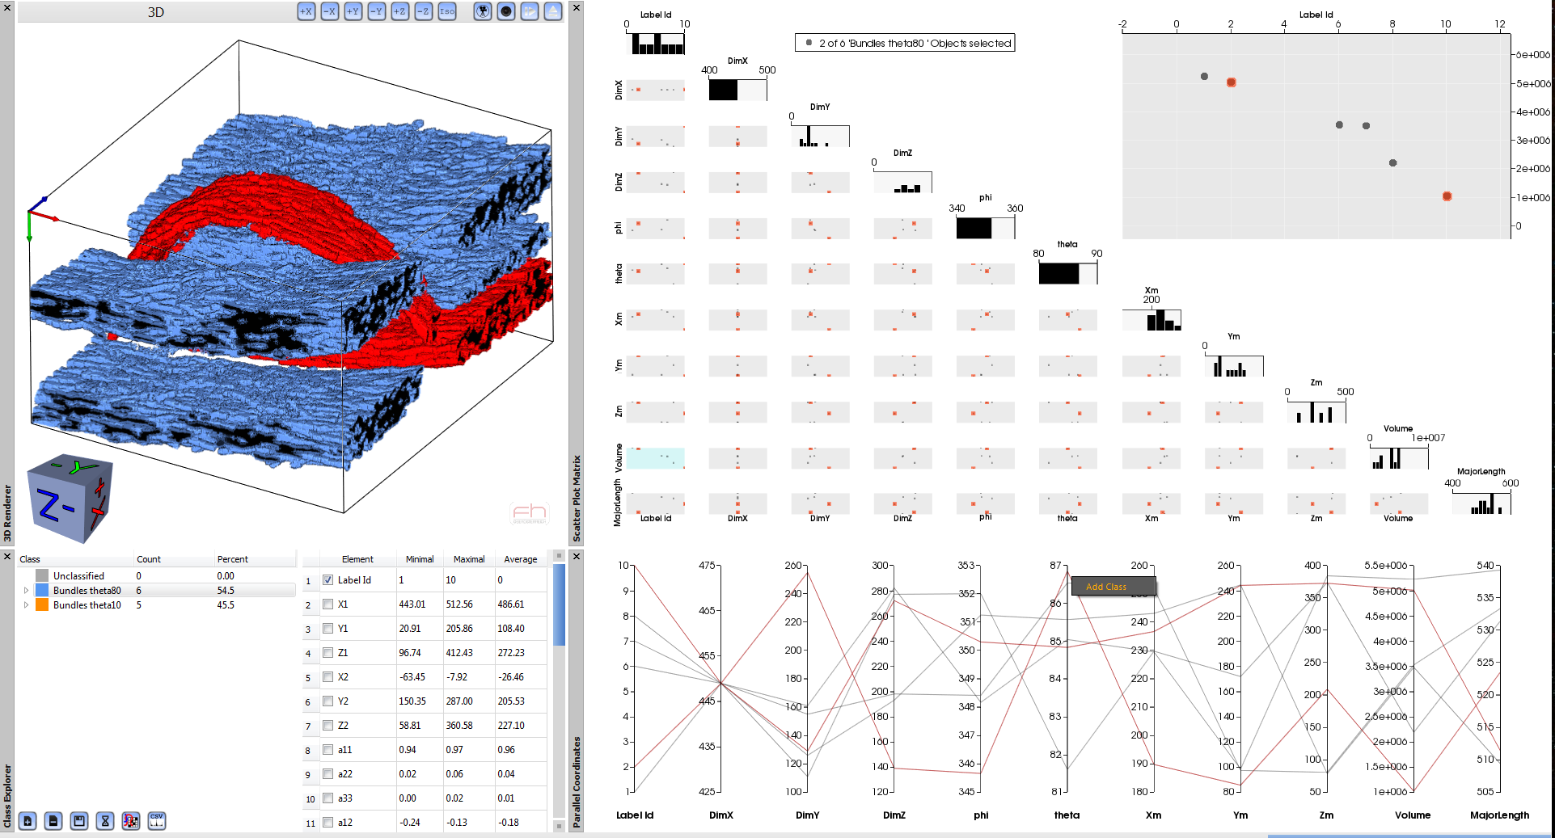
FiberScout’s Graphical User Interface
A
D
B
C

Slide 2
Interactive fiber bundles analysis and exploration tool
A
D
C
B
C

