Slide 1


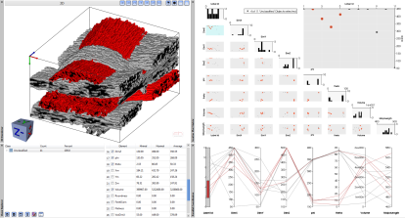





Clustered Fiber
Bundles Dataset
Calculated Fiber
Bundles Characteristics
Interactive Fiber
Bundles Analysis
Bundles Exploration
Write CSV File
Data
Computations
Visualization

Slide 2
Voxelized Fiber
Bundles Dataset
Calculated Fiber
Bundles Features
Interactive Fiber
Bundles Analysis
Labeled Bundles
Bundles Exploration
Write CSV File
Data
Computations
Visualization

