Slide 1
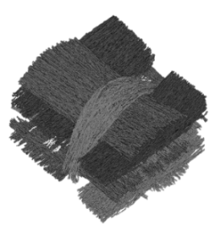
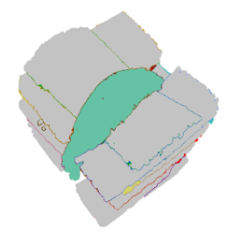
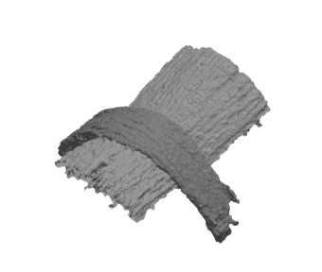
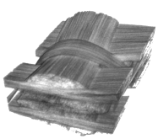



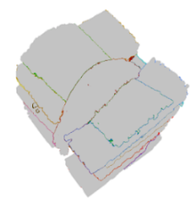

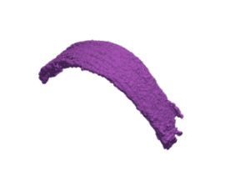
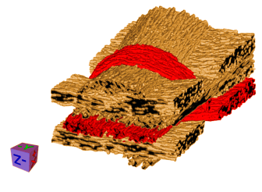
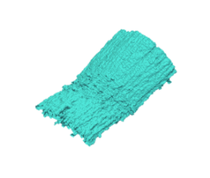


XCT Dataset
MetaTract
Generation
Fiber Bundle
Generation
Fiber Bundle
Visualization
Reliable Hessians
Orientation
Clustering
Hierarchical Clustering
Volume Visualization
Surface Extraction
Interactive Analysis
MetaTracts
Data
Computations
Clustering
Visualization

