Slide 1
Evolution of Concurrency Producer-Consumer Problem Revisited
Rajbir Bhattacharjee

Slide 2
What is the Producer-Consumer problem?

Slide 3
Implementation with Shared Memory & Semaphores
In the early days of operating systems, processes were the only units of containment
Processes communicated via IPC which took many forms
The most common IPCs that are used are shared memory and signals
Semaphores can be used for synchronization tasks
function V(semaphore S, integer I):
[S ← S + I]
function P(semaphore S, integer I):
repeat:
[
if S ≥ I:
S ← S − I
break
]

Slide 4
Shared Memory & Semaphores in action

Slide 5
Threads
Invented in the early 1990s
Processes are containers for resources
Threads are units of execution
A process has one or more threads
All threads share the resources within the container of the process
Mutexes and condition variables are used for synchronization
Mutexes and condition variables are faster than semaphores because they are implemented in the library layer and no system call needs to be made

Slide 6
POSIX Threads in Action

Slide 7
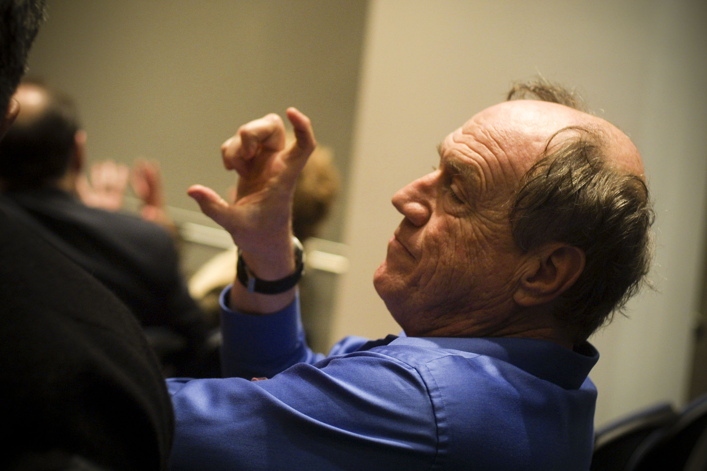
Actors
A universal modular ACTOR formalism for artificial intelligence, Carl Hewitt, et. al., 1973

Slide 8
Languages & Actors
Smalltalk was the first programming language to properly implement message passing
Simula was the first language to support actors
A host of languages support actors today
Erlang/Elexir (Ericson attributes Nine 9s uptime of its server partially to Erlang)
Akka/JVM
Orleans (.NET) (Halo 3d multiplayer uses Orleans)
CAF (C++)
Celluloid (Ruby)
Pulsar (Python)

Slide 9
What are actors…
An actor is a computational entity that, in response to a message it receives, can concurrently:
send a finite number of messages to other actors
create a finite number of new actors
designate the behavior to be used for the next message it receives
Actors are persistent, their lifetime is beyond that of a process
Actors have one or more addresses to which messages may be sent
The mailbox is persistent, if an actor dies, the messages are not lost and another actor can be spawned up to take up those messages (this is the theory, a specific implementation may not stick to the theory)
The transport mechanism is immaterial, which means that actors can reside on different machines and communicate with TCP/IP with little or no code change

Slide 10
What are Actors… (cont.)
There can be load balancing actors that hide worker actors behind them
Actors are supervised by other actors to check for failure and error handling
Who supervises the supervisors? Other supervisors
This means that there is a supervisor tree
Actors can have internal states

Slide 11
What do Actors do…
Receive a message (one at a time)
Do some work when a message is received
Send one or more messages to other actors

Slide 12
Actors in work, Erlang example.

