Slide 1
Evolution of Concurrency Producer-Consumer Problem Revisited
Rajbir Bhattacharjee

Slide 2
Background and Topics Covered
Concurrency, parallelism, synchronization and the producer-consumer problem
Concurrency with Shared Memory and Semaphores
Concurrency with threads
Actors Model
Communicating Sequential Processes (CSP)
Messaging and Message Queues (ZeroMQ)
Miscellaneous concurrency mechanisms
Futures and Promises
Coroutines

Slide 3
Samples written in the frameworks discussed in the slides can be found in the link below:
https://github.com/bhattacharjee/producer-consumer

Slide 4
What is the Producer-Consumer problem?

Slide 5
Implementation with Shared Memory & Semaphores
In the early days of operating systems, processes were the only units of containment
Processes communicated via IPC which took many forms
The most common IPCs that are used are shared memory and signals
Semaphores can be used for synchronization tasks
function V(semaphore S, integer I):
[S ← S + I]
function P(semaphore S, integer I):
repeat:
[
if S ≥ I:
S ← S − I
break
]

Slide 6
Shared Memory & Semaphores in action

Slide 7
Threads
Invented in the early 1990s
Processes are containers for resources
Threads are units of execution
A process has one or more threads
All threads share the resources within the container of the process
Mutexes and condition variables are used for synchronization
Mutexes and condition variables are faster than semaphores because they are implemented in the library layer and no system call needs to be made

Slide 8
POSIX Threads in Action

Slide 9
Problems with Mutexes and Semaphores
Difficult constructs
Easy to get wrong
Not having a fine grained granularity of locking, reduces performance
Not having a sequence of lock acquisition leads to deadlocks
Classical conditions for deadlock to occur
Mutual Exclusion
Hold and Wait
No Pre-emption
Circular wait
Difficult to test all possible scenarios
Difficult to debug
Missing synchronization where it is required

Slide 10
Advantages of Mutexes and Semaphores
Low Level, hence fast
Flexible, doesn’t tie one down to a particular model

Slide 11
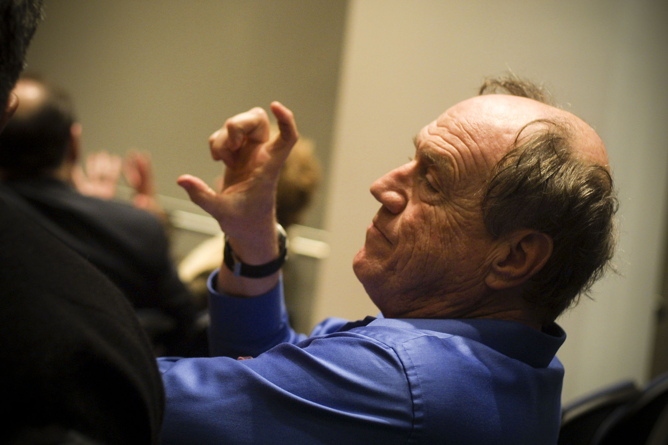
Actors
A universal modular ACTOR formalism for artificial intelligence, Carl Hewitt, et. al., 1973

Slide 12
Languages & Actors
Smalltalk was the first programming language to properly implement message passing
Simula was the first language to support actors
A host of languages support actors today
Erlang/Elexir (Ericson attributes Nine 9s uptime of its server partially to Erlang)
Akka/JVM
Orleans (.NET) (Halo 3d multiplayer uses Orleans)
CAF (C++)
Celluloid (Ruby)
Pulsar (Python)

Slide 13
What are actors…
An actor is a computational entity that, in response to a message it receives, can concurrently:
send a finite number of messages to other actors
create a finite number of new actors
designate the behavior to be used for the next message it receives
Actors are persistent, their lifetime is beyond that of a process
Actors have one or more addresses to which messages may be sent
The mailbox is persistent, if an actor dies, the messages are not lost and another actor can be spawned up to take up those messages (this is the theory, a specific implementation may not stick to the theory)
The transport mechanism is immaterial, which means that actors can reside on different machines and communicate with TCP/IP with little or no code change

Slide 14
What are Actors… (cont.)
There can be load balancing actors that hide worker actors behind them
Actors are supervised by other actors to check for failure and error handling
Who supervises the supervisors? Other supervisors
This means that there is a supervisor tree
Actors can have internal states

Slide 15
What do Actors do…
Receive a message (one at a time)
Do some work when a message is received
Send one or more messages to other actors

Slide 16
Actors in work, Erlang example.

Slide 17

Communicating Sequential Processes (CSP)
Communicating Sequential Processes, Hoare,1978

Slide 18
What is CSP
Hoare described the ideas mathematically in his paper
Since then, the ideas have been expanded mathematically to form π-calculus and ρ-calculus
Based on concurrently running processes
Concurrency is not necessarily the same thing as parallelly running processes
Processes can have their own state and can share data, although it is best if they do not share data in traditional ways
Processes can communicate with each other via established channels

Slide 19
Go and CSP
Go follows the CSP model
GoRoutines are equivalent of CSP processes
Go Routines are lightweight green threads
They are managed by the Go runtime
Having O(10000) GoRoutines is not uncommon
Go Runtime doesn’t spawn O(10000) OS threads
Processes communicate with channels
Channels are a first class data type in Go
Channels can be passed as data members while sending messages over other channels

Slide 20
Guiding Principle of Go
Do not communicate by sharing memory, share memory by communicating.

Slide 21
CSP in action with Go

Slide 22
Message Queues - ZeroMQ
High performance Messaging library
Supports a wide variety of paradigms
Provides interfaces in a host of languages – C, C#, Perl, Python, Q, Smalltalk, Scala, Swift, Ruby, Objective-C, Java, Julia, Fortran, Flex, Go, Haskell, Haxe, Javascript, Lua, F#, Lisp, Basic, Ada, PHP
Allows one to build distributed and scalable architectures independent of language facilities

Slide 23
ZeroMQ in Action
ZeroMQ supports multiple paradigms
PUSH-PULL
REQUEST-RESPONSE
PUBLISH-SUBSCRIBE
ROUTER-DEALER
We’ll use the PUSH-PULL paradigm in the example, but it can be coded up using other paradigms as well
The ZMQ guide makes a very good general read about concurrency
https://zguide.zeromq.org/

Slide 24
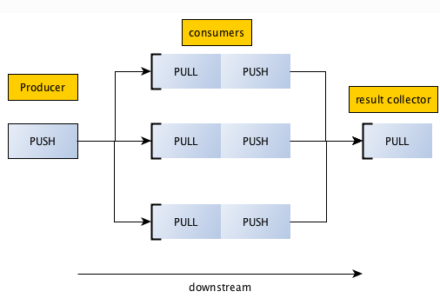
ZeroMQ in Action

Slide 25
ZeroMQ alternatives
IBM Websphere MQ Series
MQTT (McAfee DXL is based on this)
Amazon Kinesis
Amazon SQS
RabbitMQ
Apache Kafka
Google Cloud Messaging
Azure Service Bus
… the list goes on and on …

Slide 26
Other Concurrency Oechanisms
Coroutines
Cumbersome mechanism, rarely used now
May still be useful in some low-level programming scenarios
See source code for idea
Futures and Promises
Useful if a task needs to be performed, but not necessarily now
The producer posts a task to the framework, the framework returns a promise that when the result is queried, it will be made available
The producer continues execution
At some point later, the producer asks the system for the result it promised and the system makes the result available
Check the source code for a better understanding

Slide 27
Thank you
Rajbir Bhattacharjee

