Slide 1

Notes:
LaTeX/Beamer source is the editable master.
STITCH
Robust Appearance-Invariant
Visual Place Recognition for Anchoring
Social AR Content in the Real World
Summer Internship Presentation
INDIAN INSTITUTE OF TECHNOLOGY ROORKEE

Slide 2

Notes:
LaTeX/Beamer source is the editable master.
PRONOB
BHATTACHARJEE
25565017
M.Tech Artiﬁcial Intelligence
2025–2027
Mehta Family School of Data Science
and Artiﬁcial Intelligence
Under the guidance of
Dr. R. Balasubramanian
Professor (HAG) and Head
Department of Computer Science and
Engineering
Joint Faculty
Mehta Family School of Data Science
and Artiﬁcial Intelligence
IIT ROORKEE · MEHTA FAMILY SCHOOL OF DATA SCIENCE AND ARTIFICIAL INTELLIGENCE
INDIAN INSTITUTE OF TECHNOLOGY ROORKEE

Slide 3
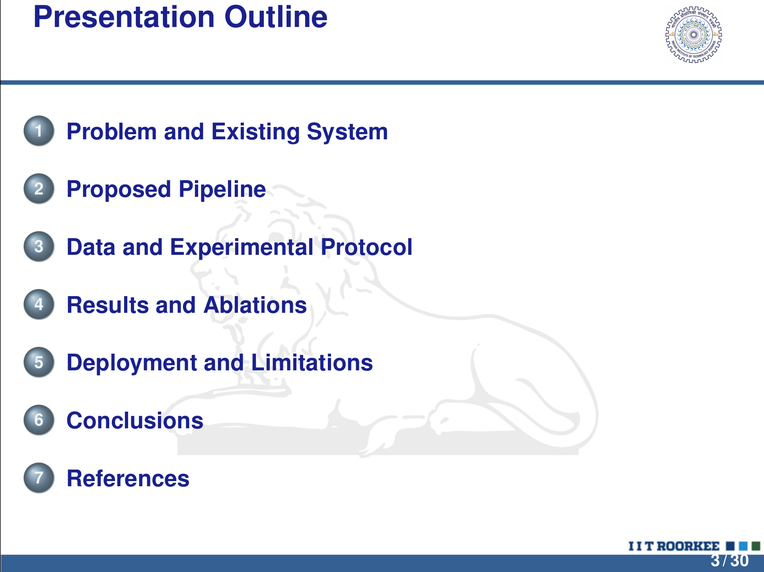
Notes:
LaTeX/Beamer source is the editable master.
Presentation Outline
1 Problem and Existing System
2 Proposed Pipeline
3 Data and Experimental Protocol
4 Results and Ablations
5 Deployment and Limitations
6 Conclusions
7 References
3 / 30

Slide 4
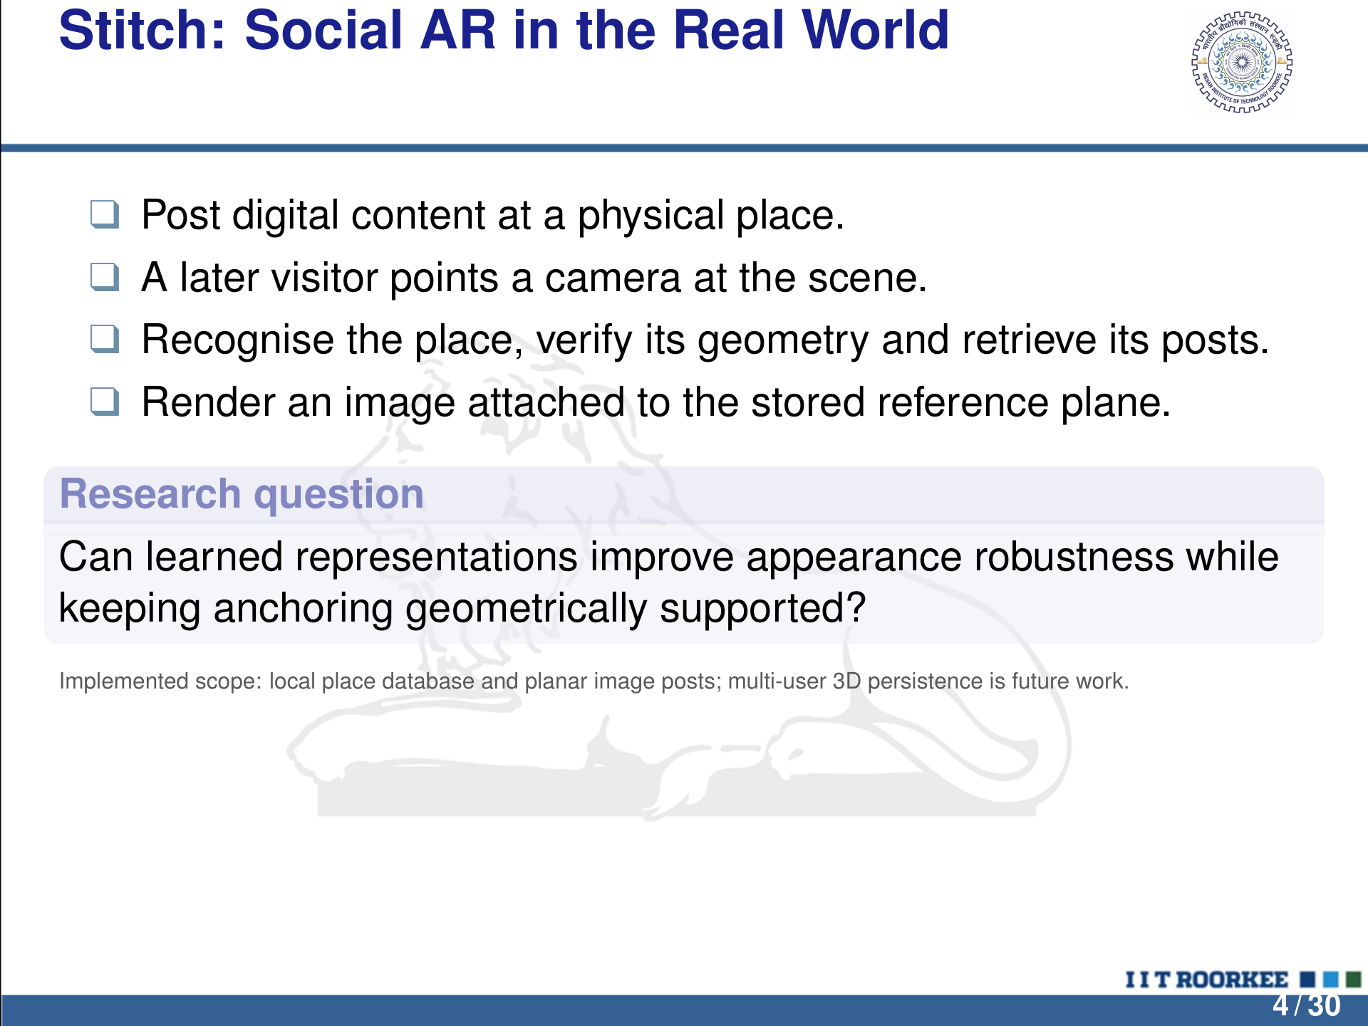
Notes:
LaTeX/Beamer source is the editable master.
Stitch: Social AR in the Real World
q Post digital content at a physical place.
q A later visitor points a camera at the scene.
q Recognise the place, verify its geometry and retrieve its posts.
q Render an image attached to the stored reference plane.
Research question
Can learned representations improve appearance robustness while
keeping anchoring geometrically supported?
Implemented scope: local place database and planar image posts; multi-user 3D persistence is future work.
4 / 30

Slide 5
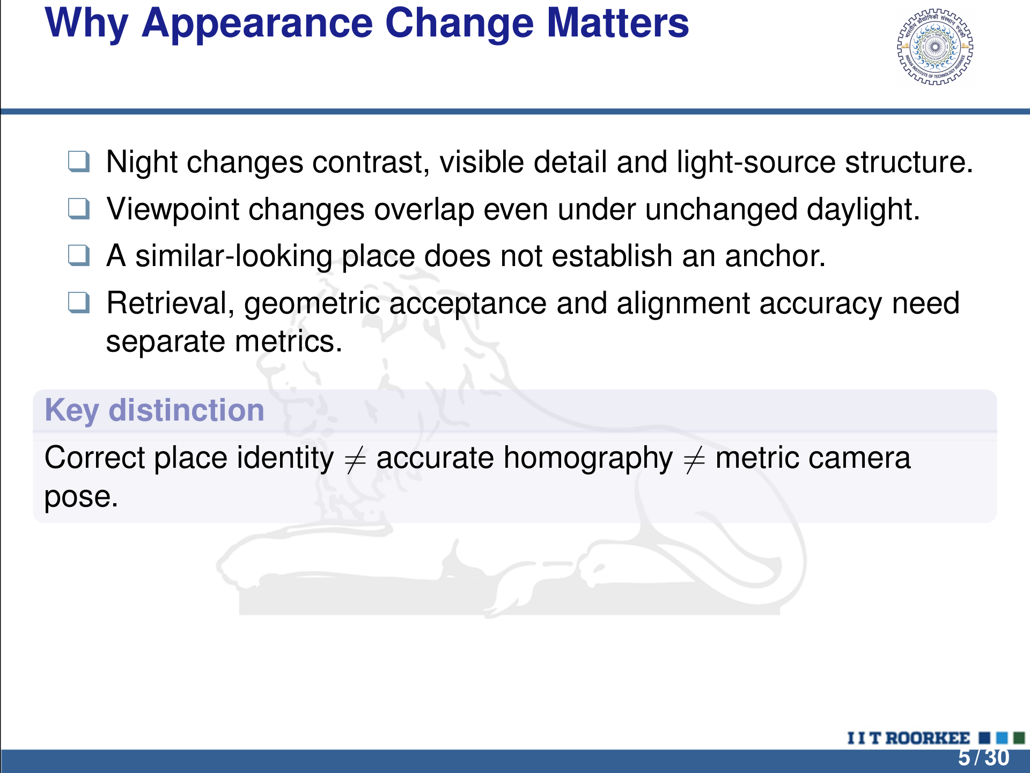
Notes:
LaTeX/Beamer source is the editable master.
Why Appearance Change Matters
q Night changes contrast, visible detail and light-source structure.
q Viewpoint changes overlap even under unchanged daylight.
q A similar-looking place does not establish an anchor.
q Retrieval, geometric acceptance and alignment accuracy need
separate metrics.
Key distinction
Correct place identity ̸= accurate homography ̸= metric camera
pose.
5 / 30

Slide 6
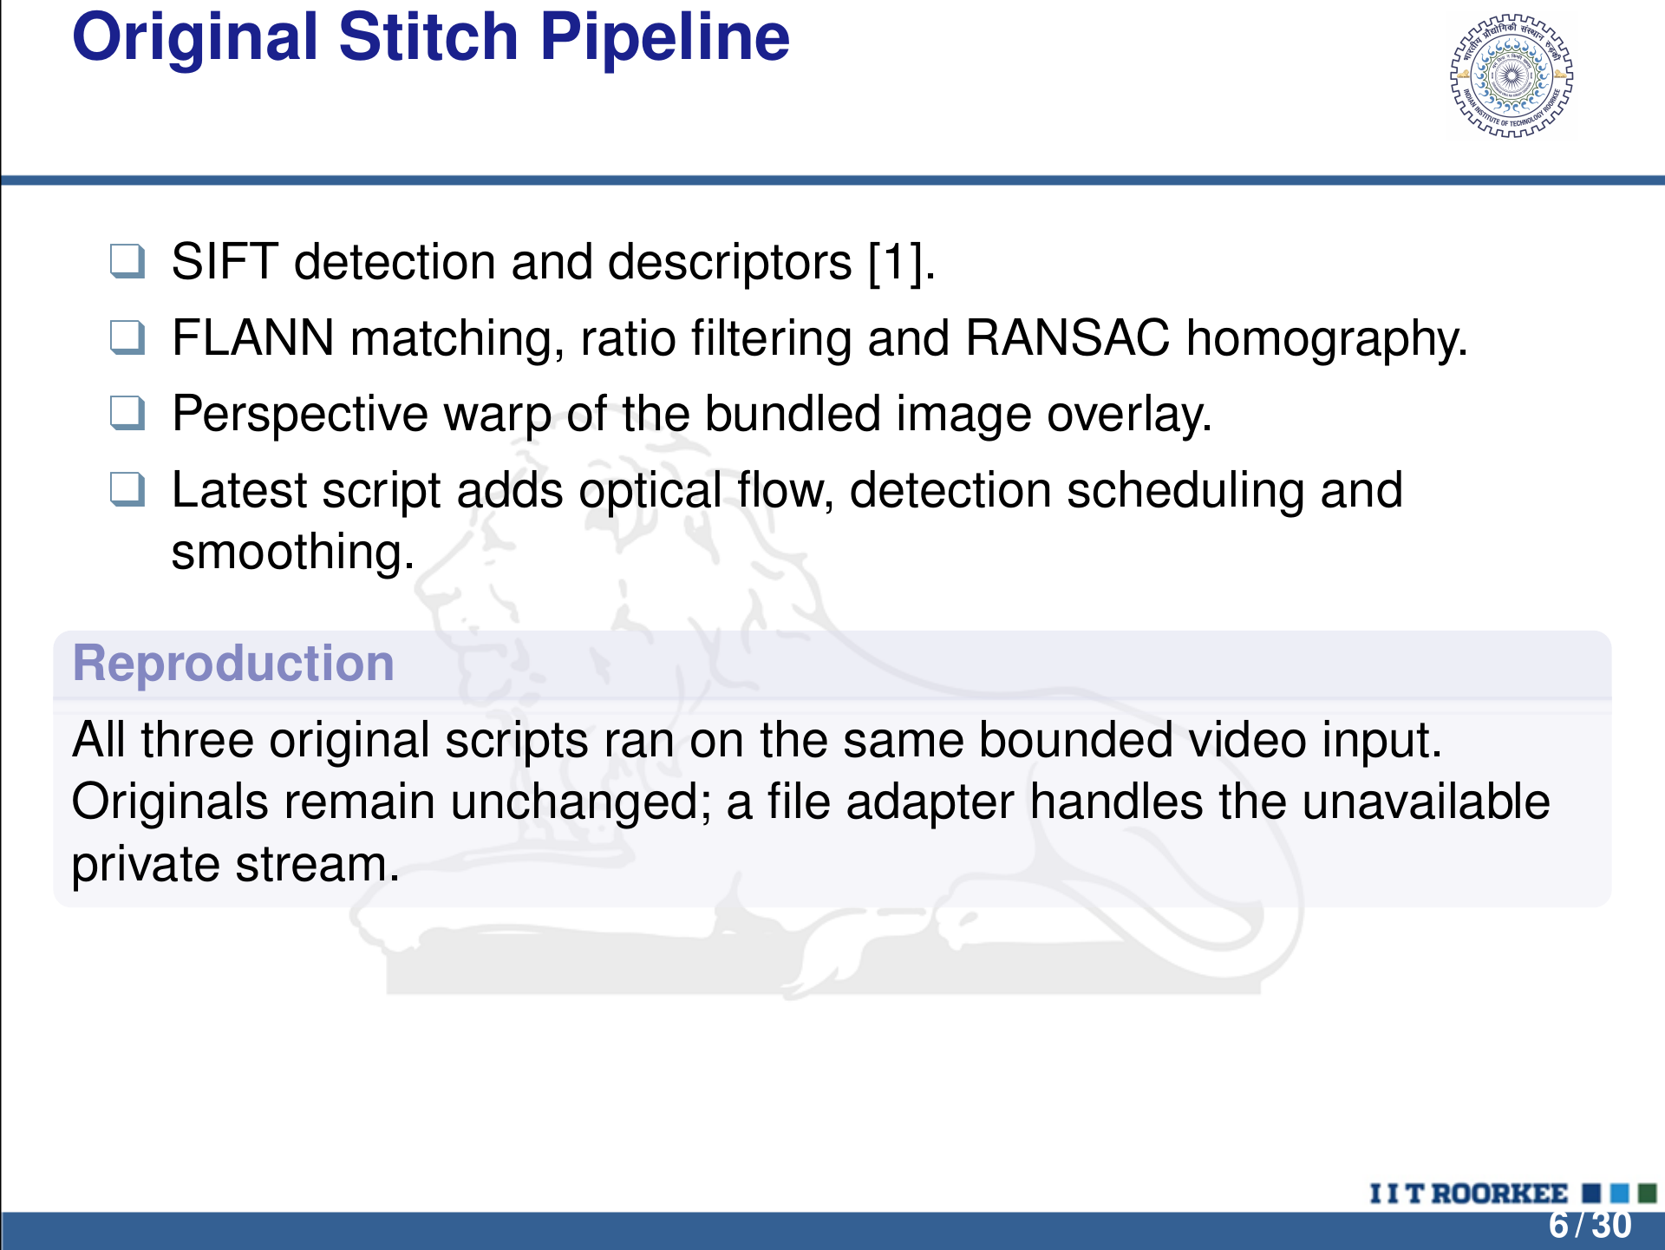
Notes:
LaTeX/Beamer source is the editable master.
Original Stitch Pipeline
q SIFT detection and descriptors [ 1].
q FLANN matching, ratio ﬁltering and RANSAC homography.
q Perspective warp of the bundled image overlay.
q Latest script adds optical ﬂow, detection scheduling and
smoothing.
Reproduction
All three original scripts ran on the same bounded video input.
Originals remain unchanged; a ﬁle adapter handles the unavailable
private stream.
6 / 30

Slide 7
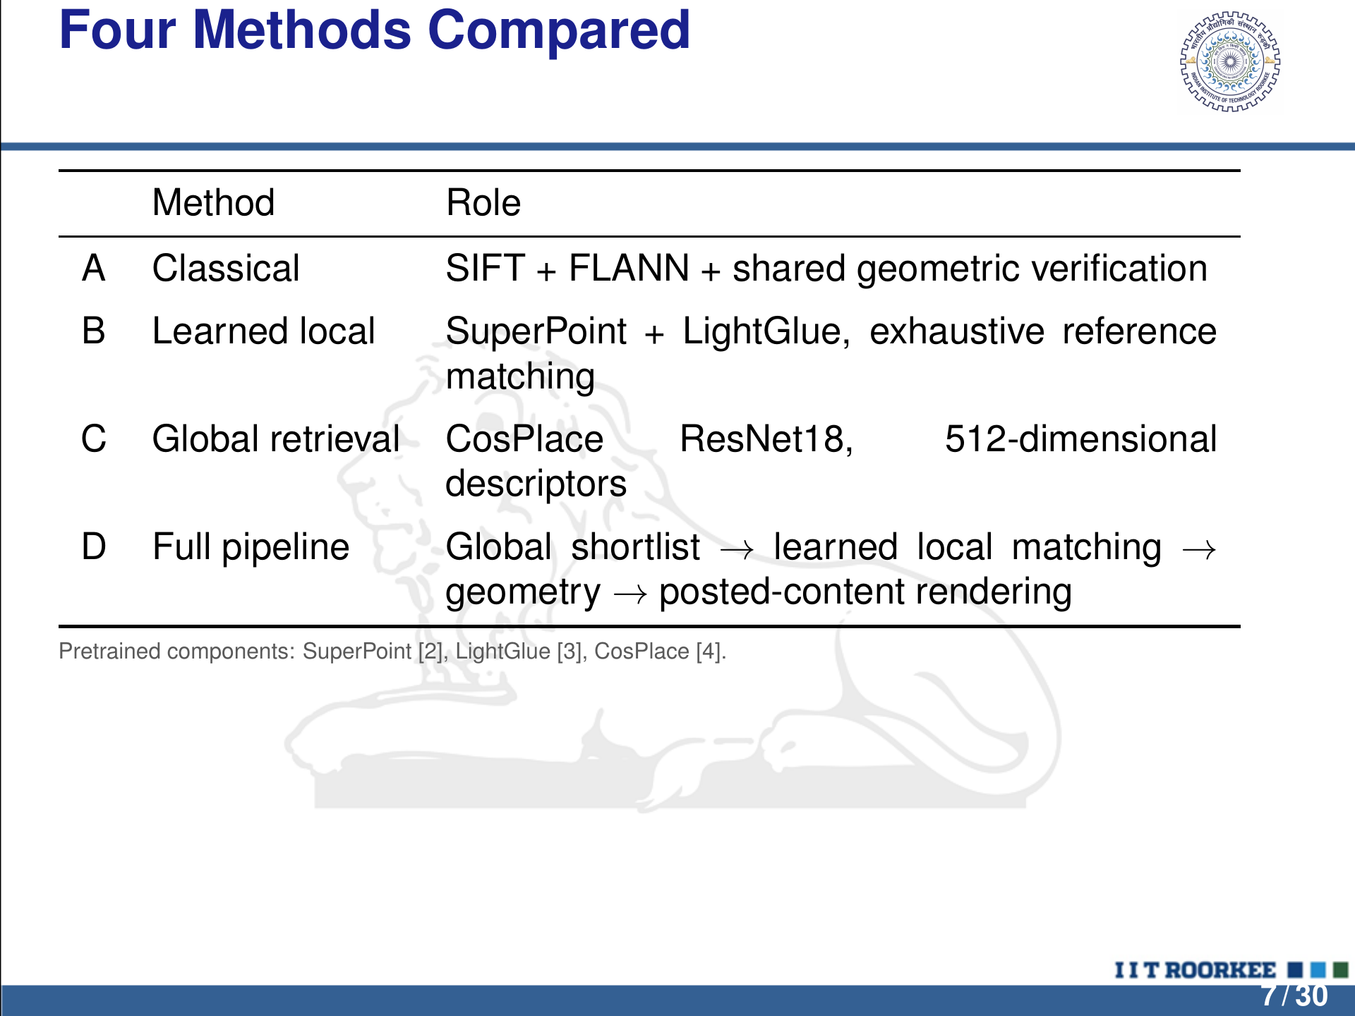
Notes:
LaTeX/Beamer source is the editable master.
Four Methods Compared
Method Role
A Classical SIFT + FLANN + shared geometric veriﬁcation
B Learned local SuperPoint + LightGlue, exhaustive reference
matching
C Global retrieval CosPlace ResNet18, 512-dimensional
descriptors
D Full pipeline Global shortlist → learned local matching →
geometry → posted-content rendering
Pretrained components: SuperPoint [ 2], LightGlue [ 3], CosPlace [ 4].
7 / 30

Slide 8
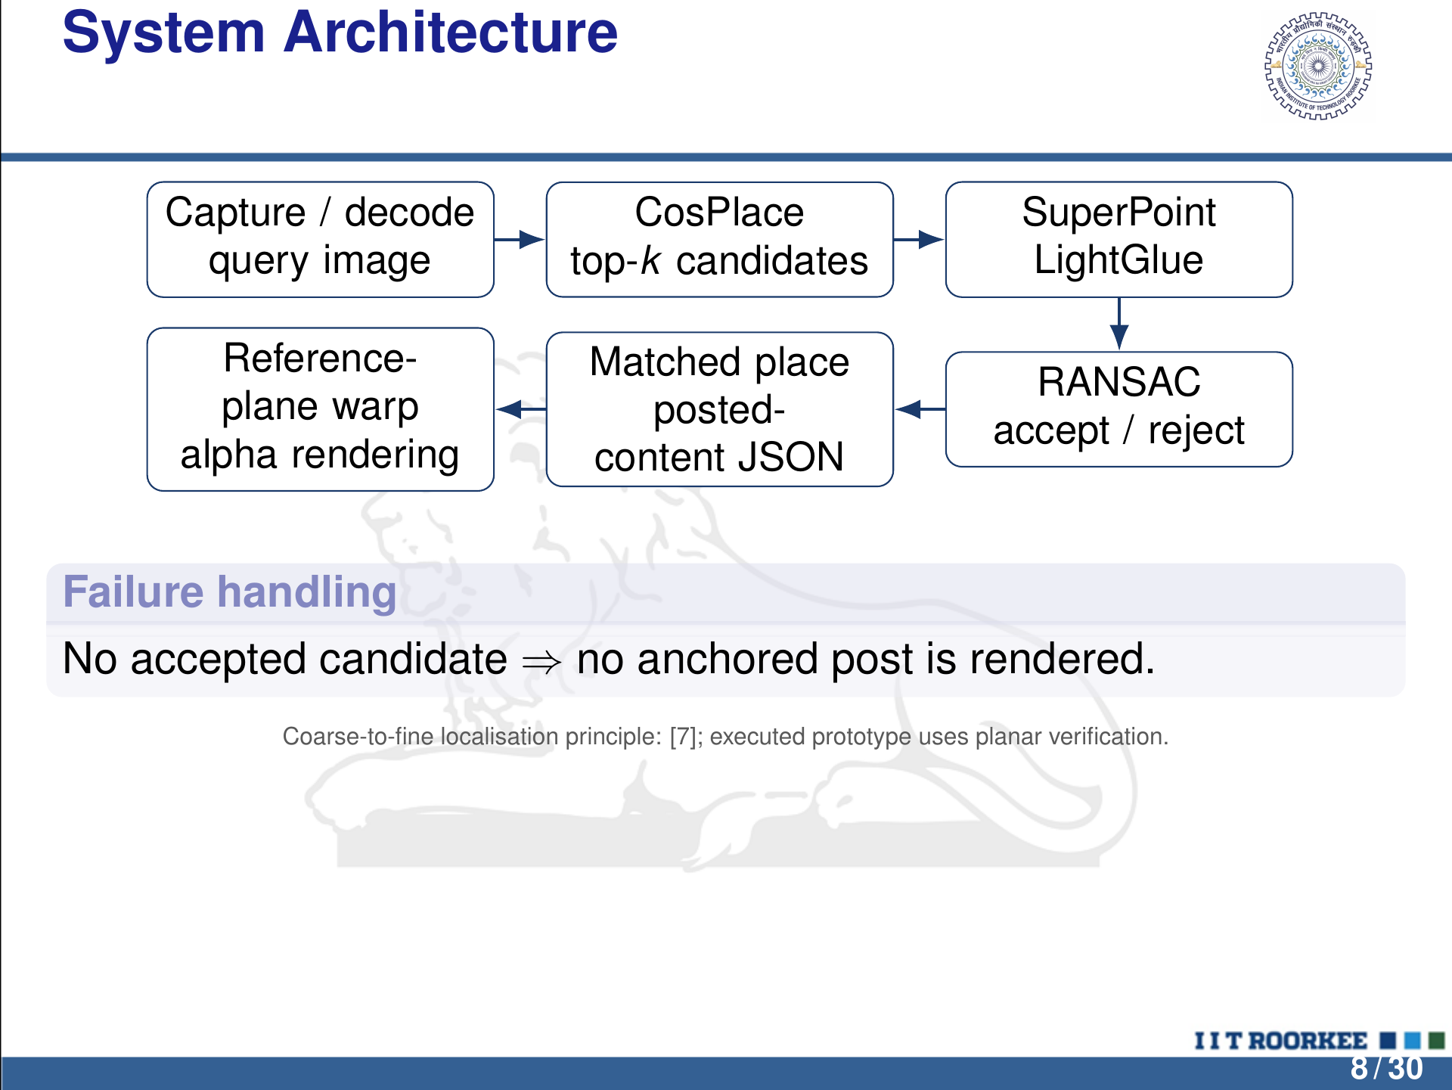
Notes:
LaTeX/Beamer source is the editable master.
System Architecture
Capture / decode
query image
CosPlace
top-k candidates
SuperPoint
LightGlue
RANSAC
accept / reject
Matched place
posted-
content JSON
Reference-
plane warp
alpha rendering
Failure handling
No accepted candidate ⇒ no anchored post is rendered.
Coarse-to-ﬁne localisation principle: [ 7]; executed prototype uses planar veriﬁcation.
8 / 30

Slide 9
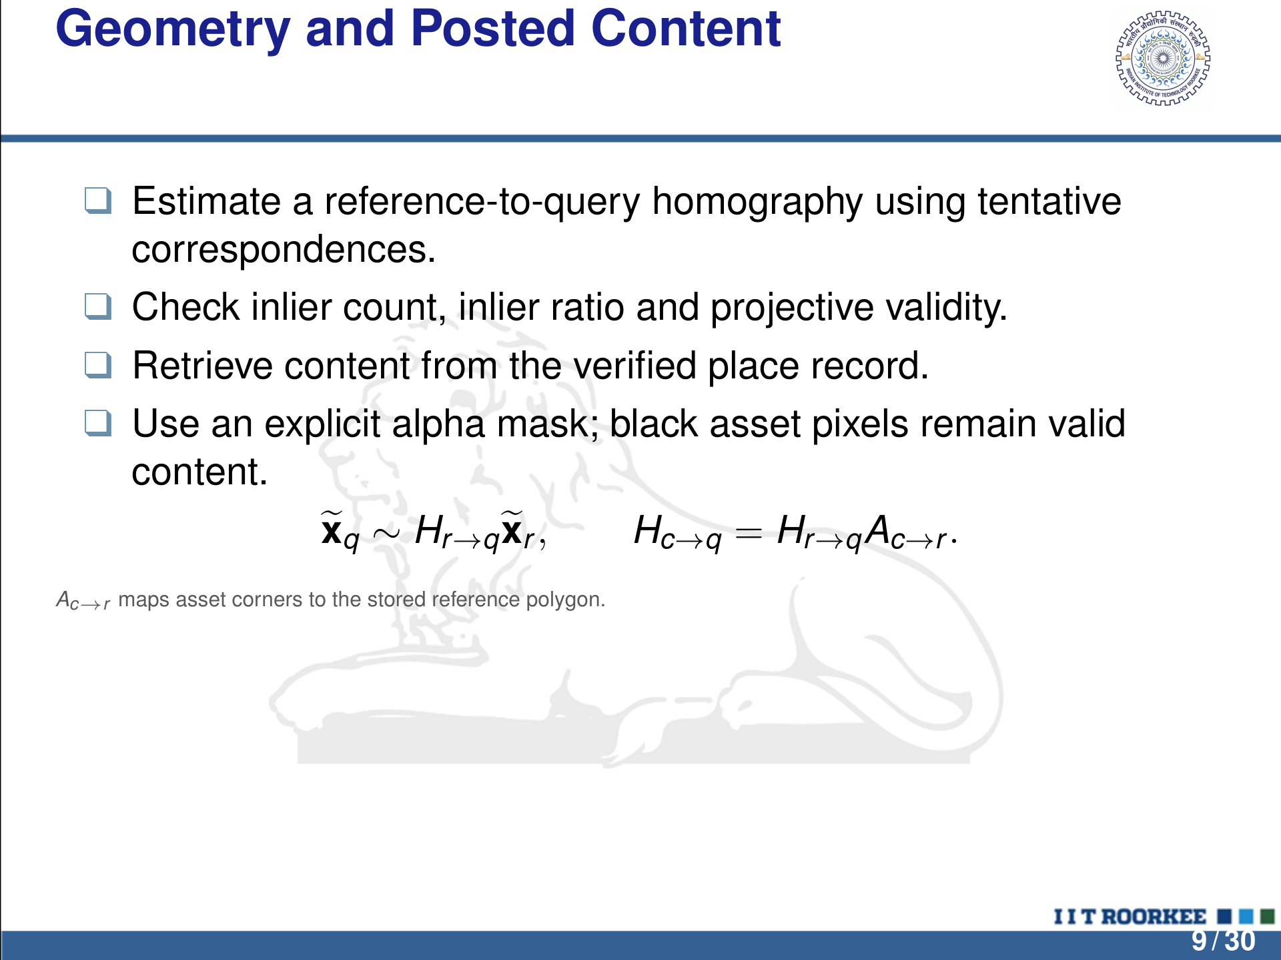
Notes:
LaTeX/Beamer source is the editable master.
Geometry and Posted Content
q Estimate a reference-to-query homography using tentative
correspondences.
q Check inlier count, inlier ratio and projective validity.
q Retrieve content from the veriﬁed place record.
q Use an explicit alpha mask; black asset pixels remain valid
content.
exq ∼ Hr→qexr , Hc→q = Hr→qAc→r .
Ac→r maps asset corners to the stored reference polygon.
9 / 30

Slide 10
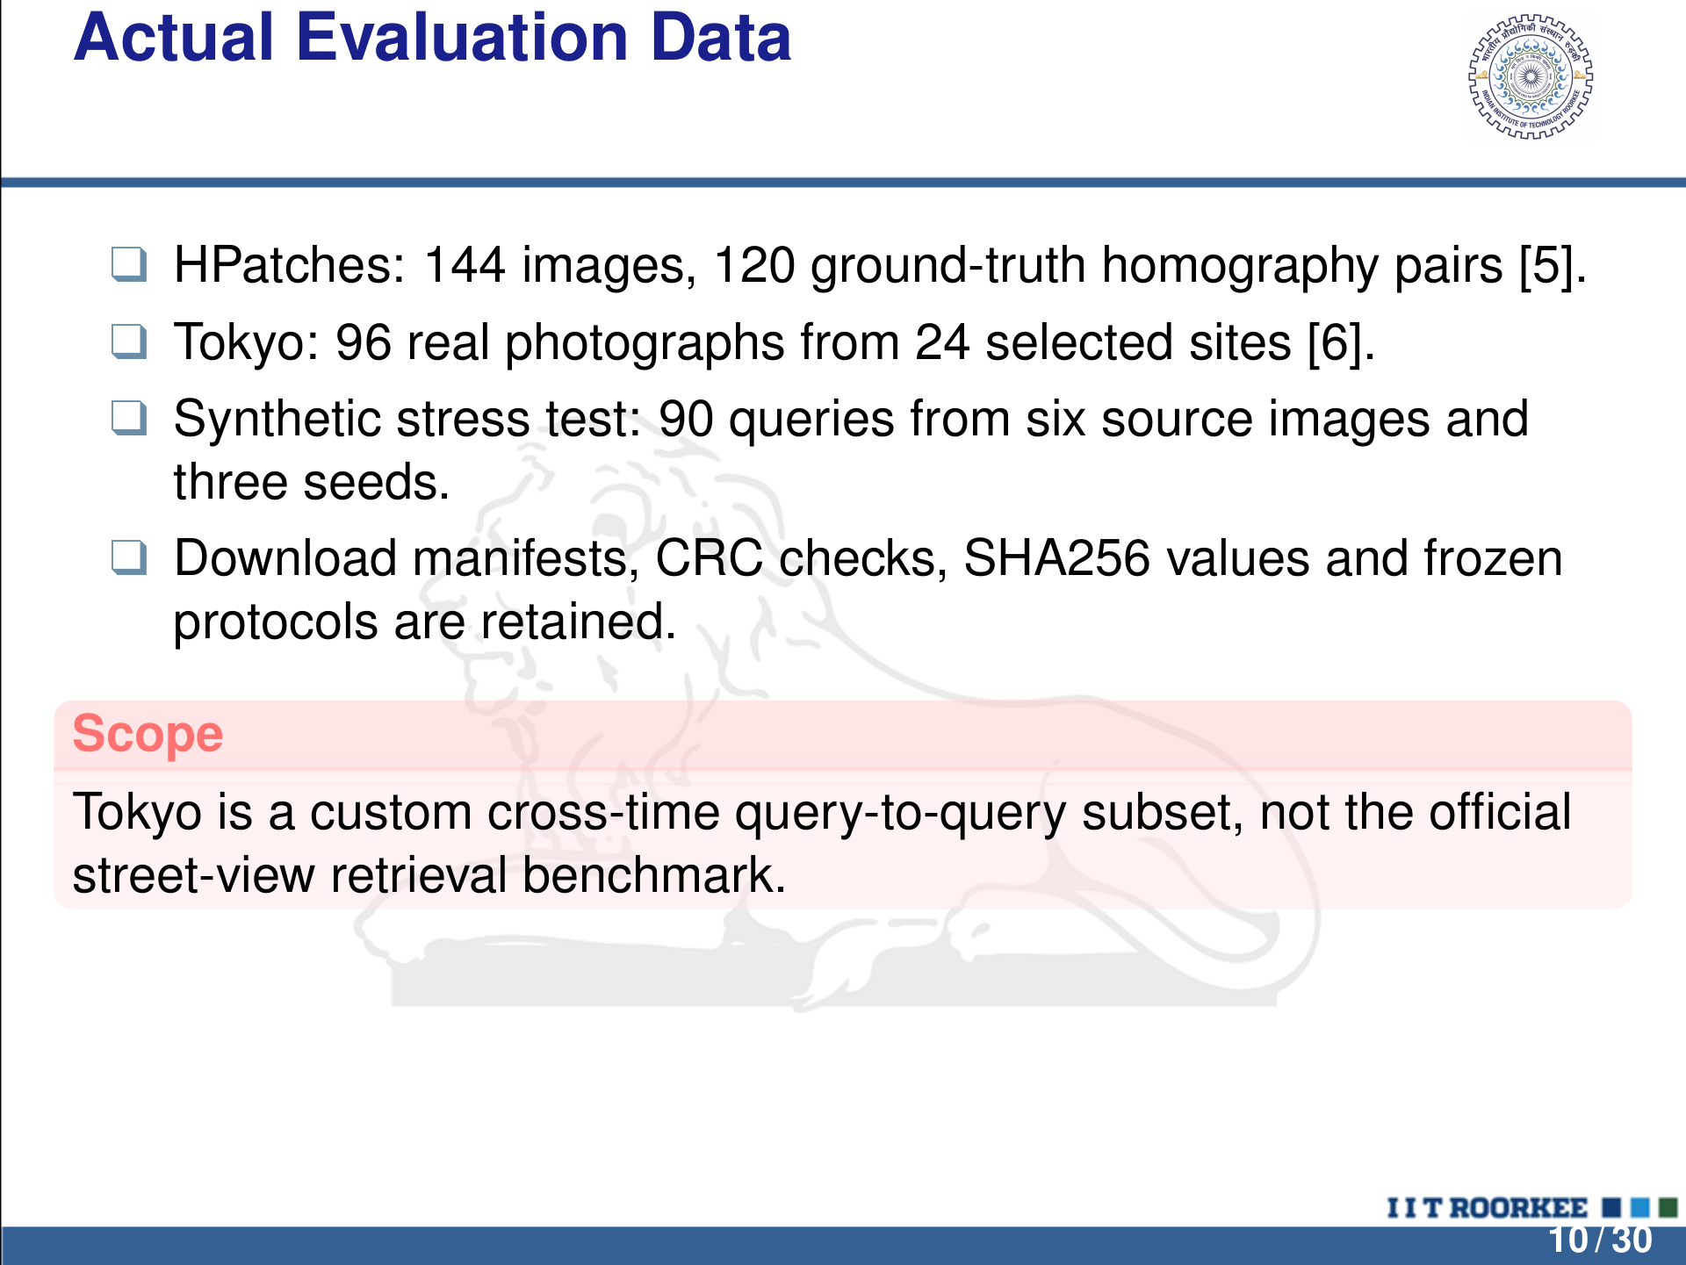
Notes:
LaTeX/Beamer source is the editable master.
Actual Evaluation Data
q HPatches: 144 images, 120 ground-truth homography pairs [ 5].
q Tokyo: 96 real photographs from 24 selected sites [ 6].
q Synthetic stress test: 90 queries from six source images and
three seeds.
q Download manifests, CRC checks, SHA256 values and frozen
protocols are retained.
Scope
Tokyo is a custom cross-time query-to-query subset, not the ofﬁcial
street-view retrieval benchmark.
10 / 30

Slide 11
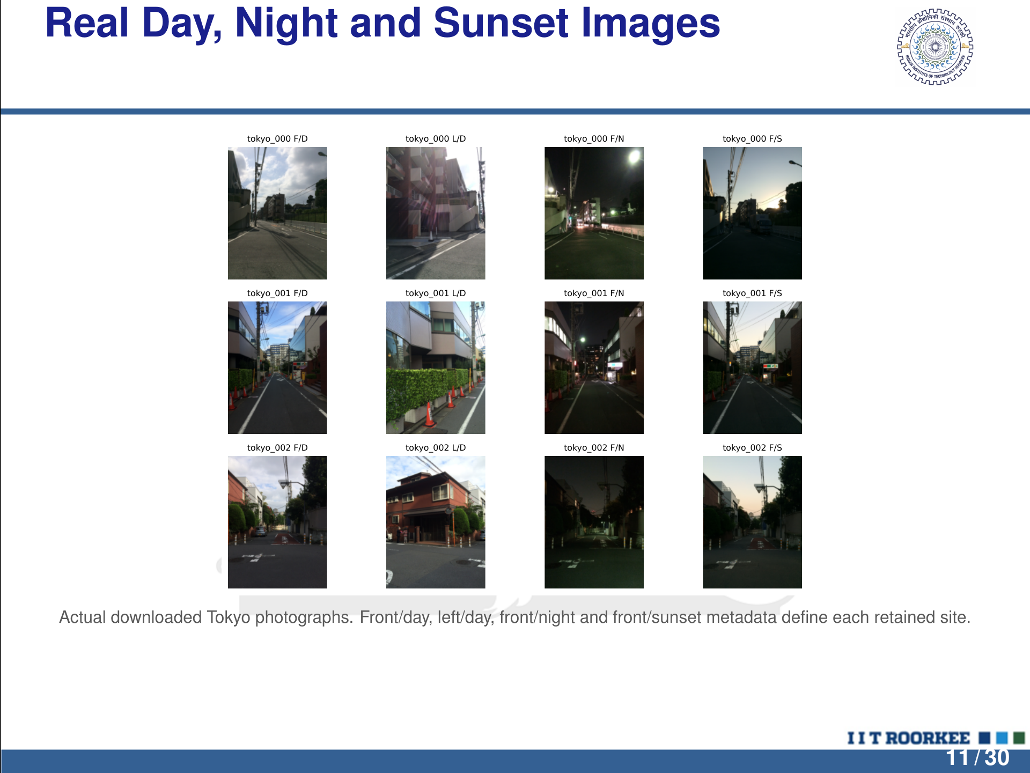
Notes:
LaTeX/Beamer source is the editable master.
Real Day, Night and Sunset Images
tokyo_000 F/D
tokyo_000 L/D
tokyo_000 F/N
tokyo_000 F/S
tokyo_001 F/D
tokyo_001 L/D
tokyo_001 F/N
tokyo_001 F/S
tokyo_002 F/D
tokyo_002 L/D
tokyo_002 F/N
tokyo_002 F/S
Actual downloaded Tokyo photographs. Front/day, left/day, front/night and front/sunset metadata deﬁne each retained site.
11 / 30

Slide 12
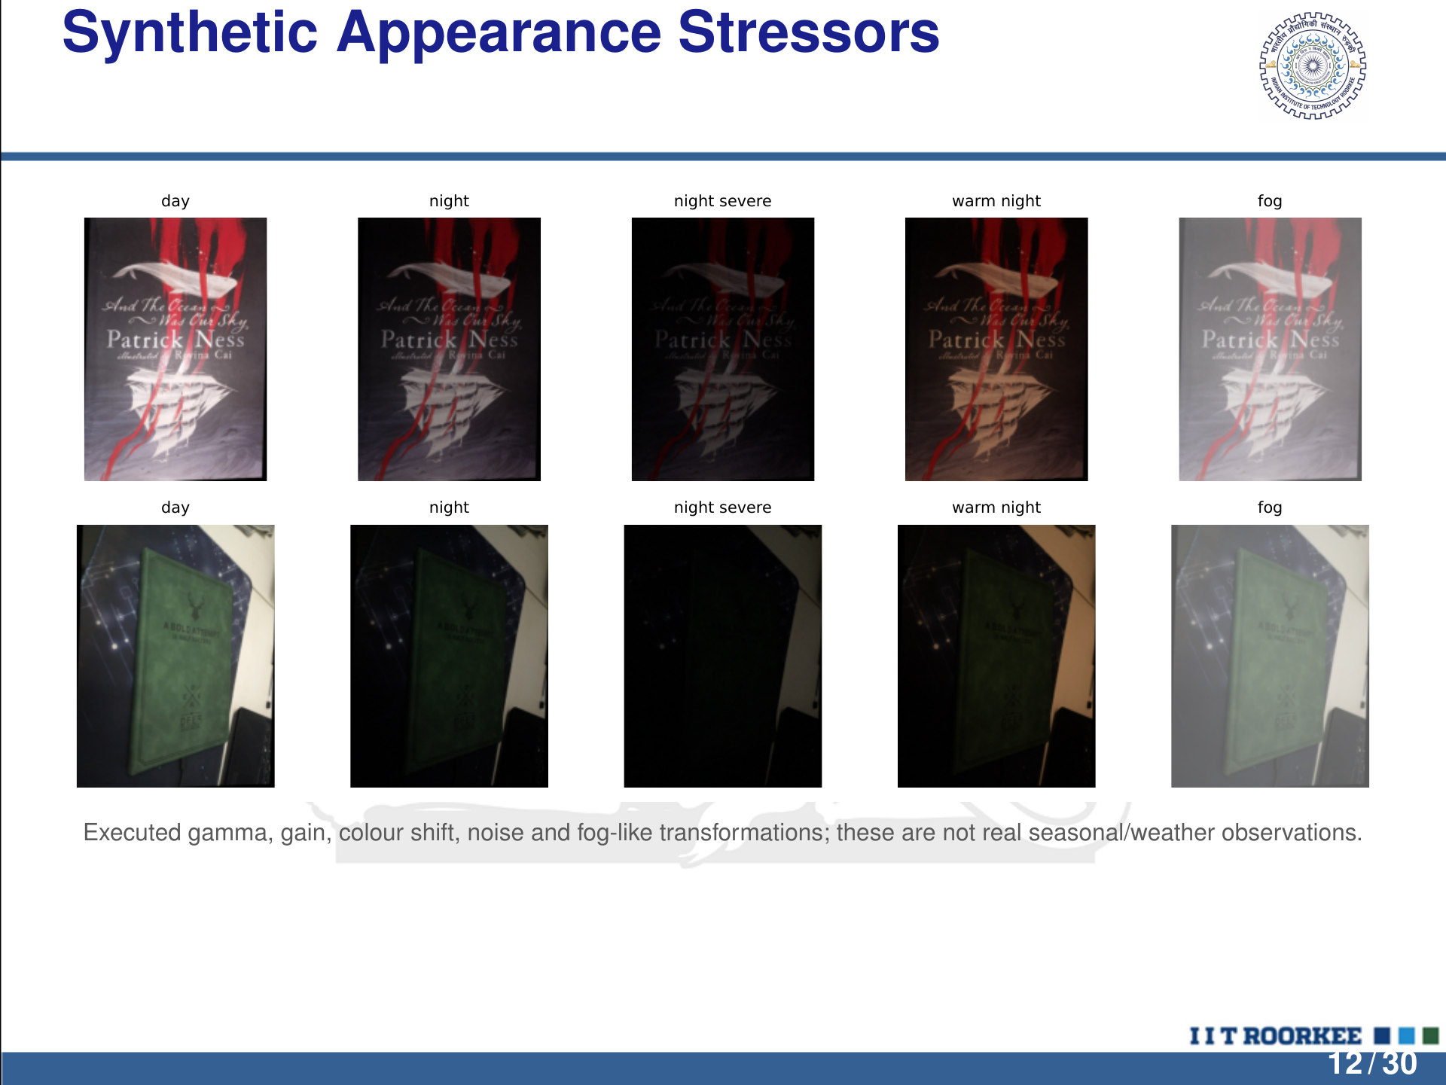
Notes:
LaTeX/Beamer source is the editable master.
Synthetic Appearance Stressors
day
night
night severe
warm night
fog
day
night
night severe
warm night
fog
Executed gamma, gain, colour shift, noise and fog-like transformations; these are not real seasonal/weather observations.
12 / 30

Slide 13
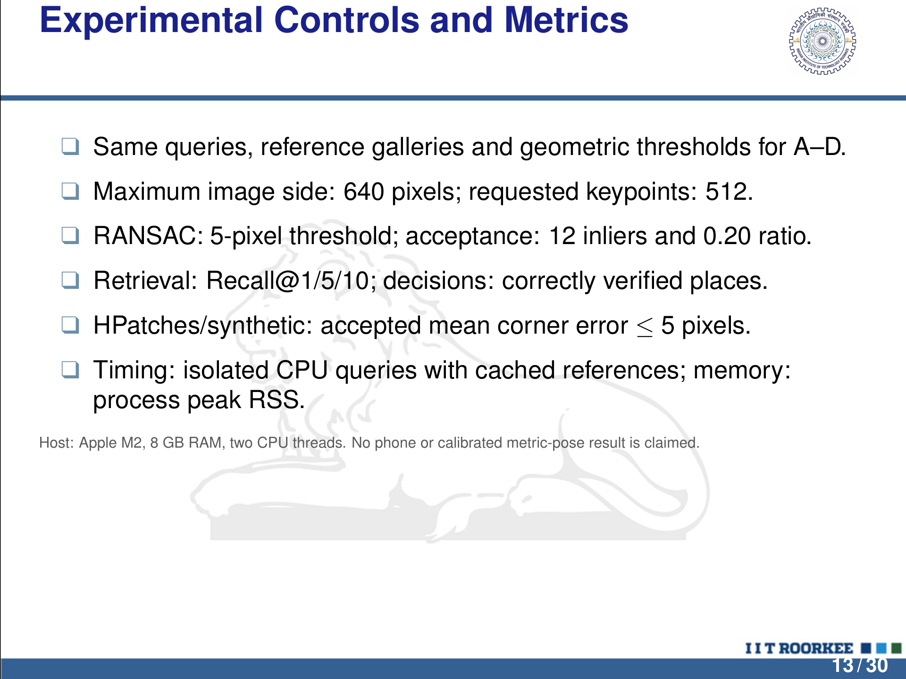
Notes:
LaTeX/Beamer source is the editable master.
Experimental Controls and Metrics
q Same queries, reference galleries and geometric thresholds for A–D.
q Maximum image side: 640 pixels; requested keypoints: 512.
q RANSAC: 5-pixel threshold; acceptance: 12 inliers and 0.20 ratio.
q Retrieval: Recall@1/5/10; decisions: correctly veriﬁed places.
q HPatches/synthetic: accepted mean corner error ≤ 5 pixels.
q Timing: isolated CPU queries with cached references; memory:
process peak RSS.
Host: Apple M2, 8 GB RAM, two CPU threads. No phone or calibrated metric-pose result is claimed.
13 / 30

Slide 14
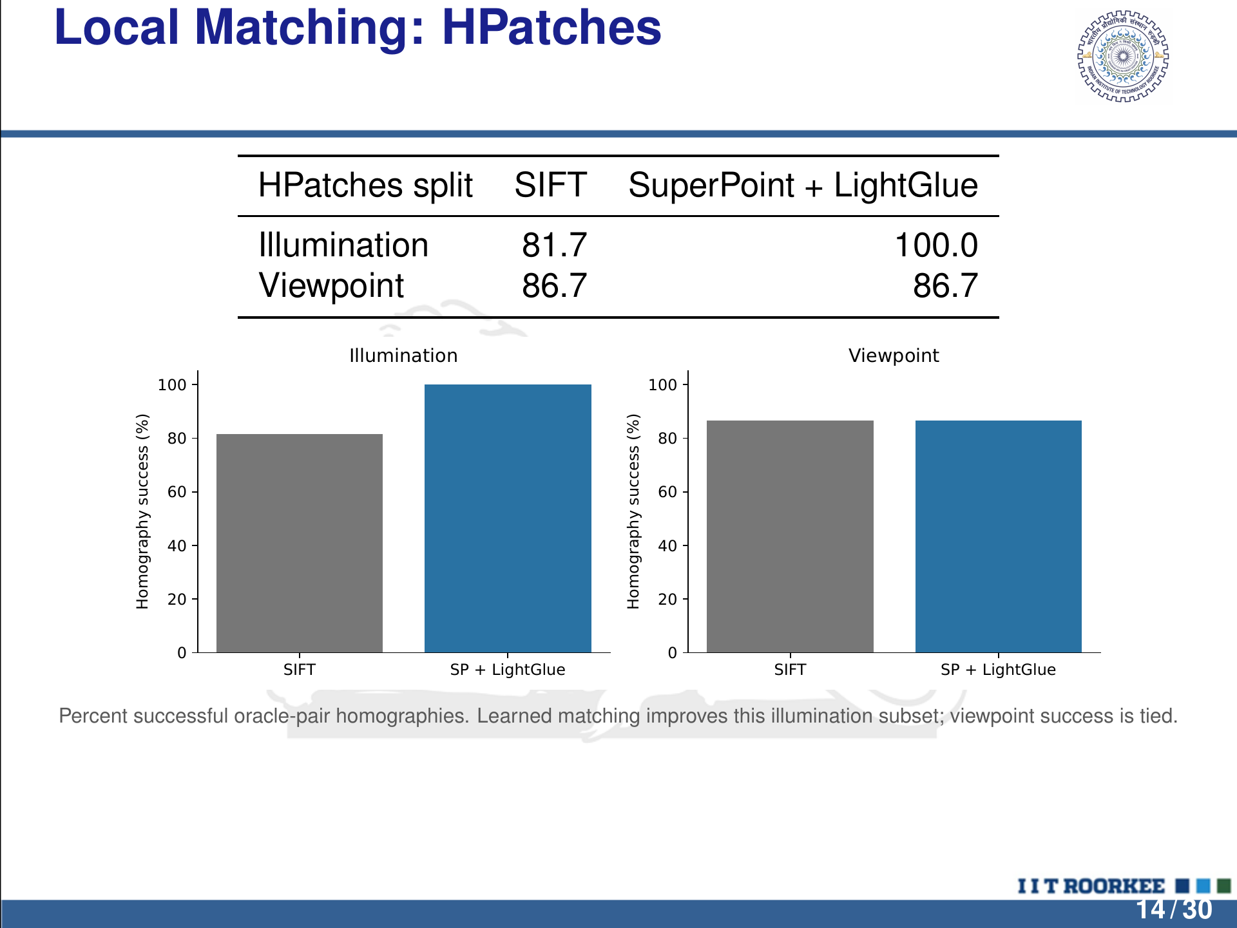
Notes:
LaTeX/Beamer source is the editable master.
Local Matching: HPatches
HPatches split SIFT SuperPoint + LightGlue
Illumination 81.7 100.0
Viewpoint 86.7 86.7
SIFT SP + LightGlue
0
20
40
60
80
100Homography success (%)
Illumination
SIFT SP + LightGlue
0
20
40
60
80
100Homography success (%)
Viewpoint
Percent successful oracle-pair homographies. Learned matching improves this illumination subset; viewpoint success is tied.
14 / 30

Slide 15
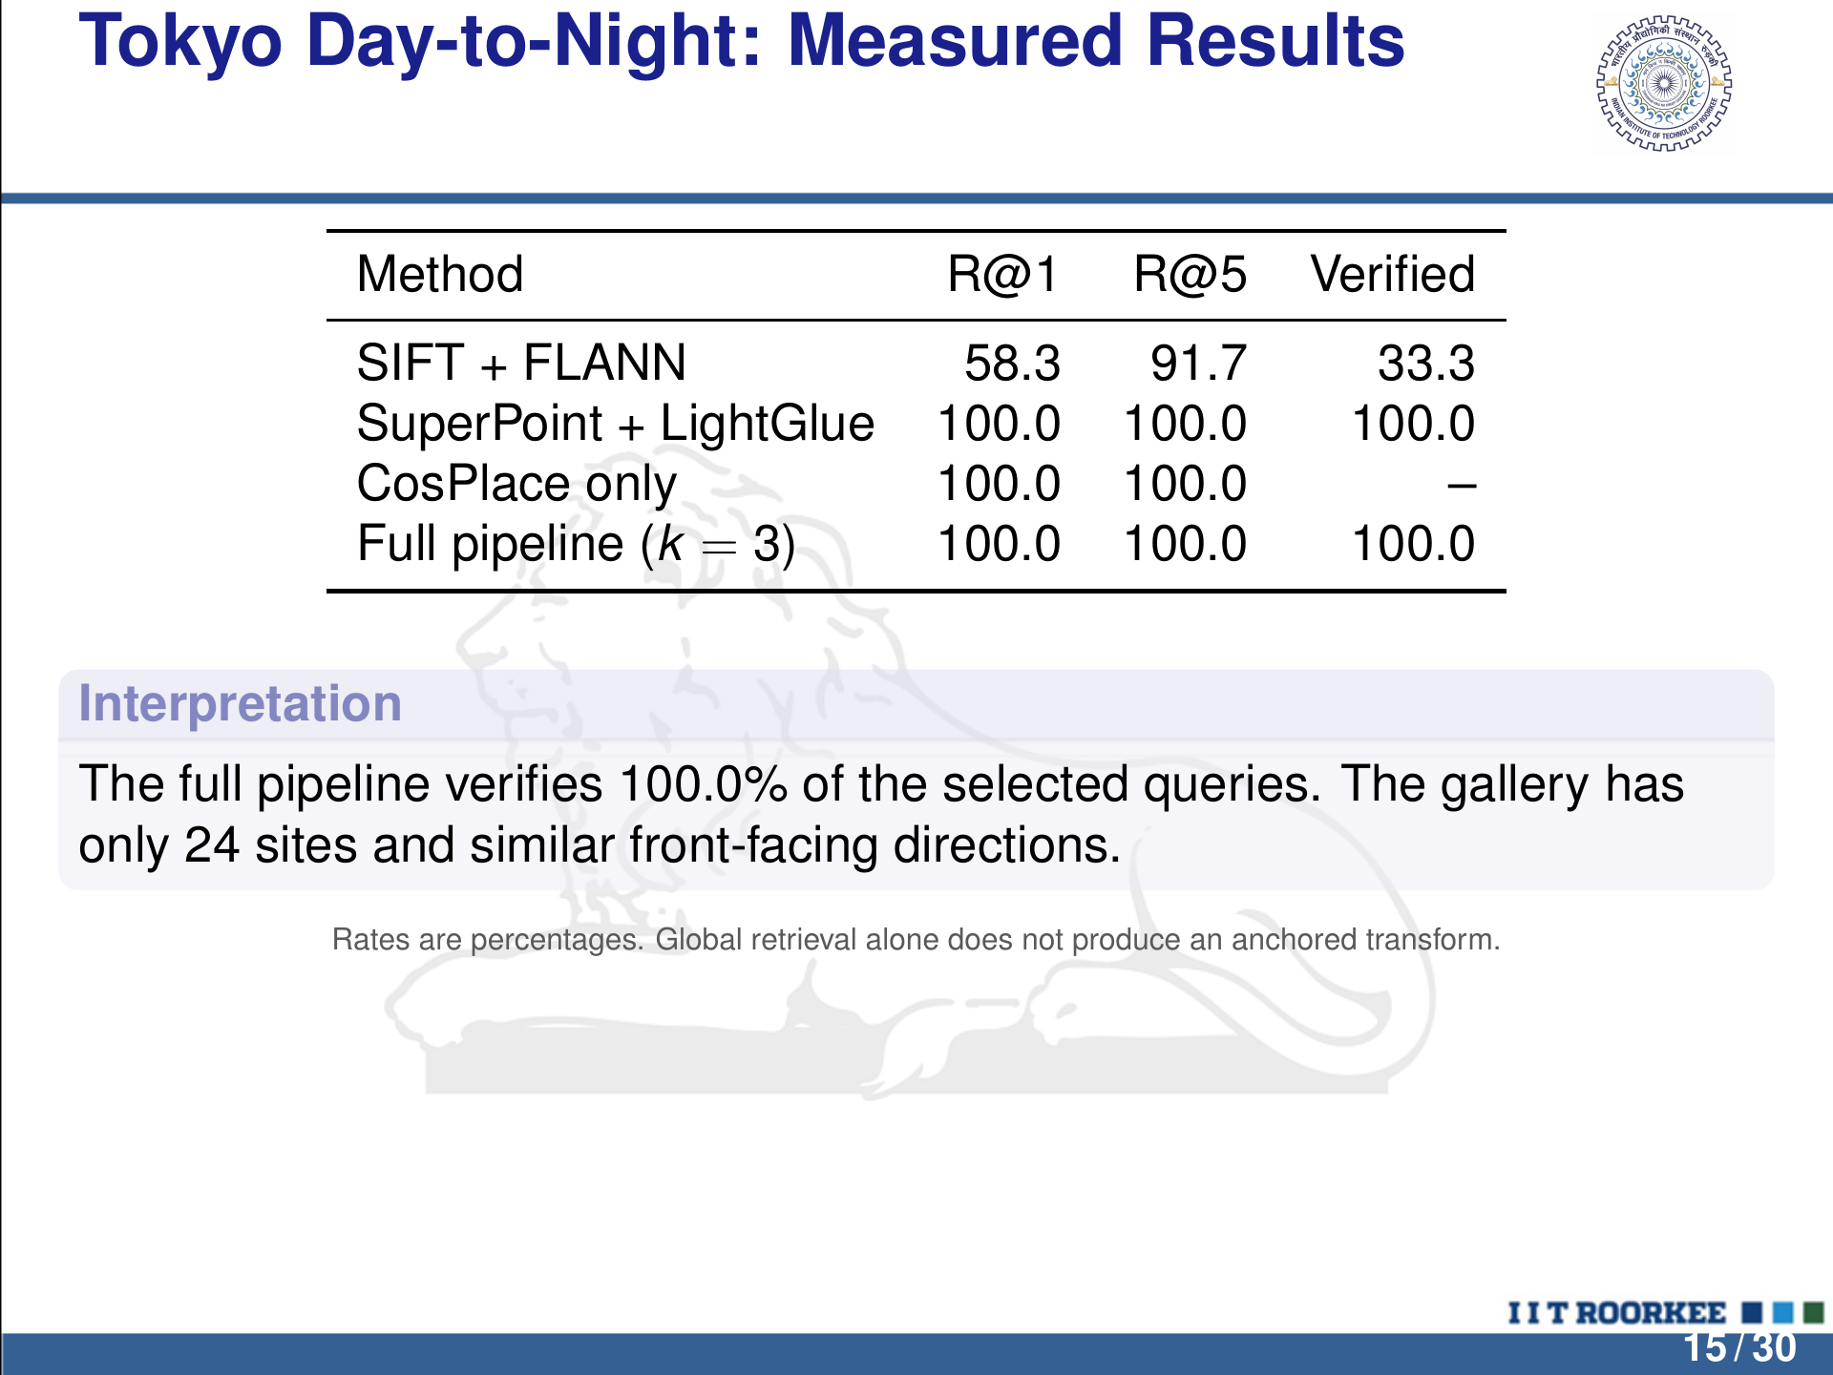
Notes:
LaTeX/Beamer source is the editable master.
Tokyo Day-to-Night: Measured Results
Method R@1 R@5 Veriﬁed
SIFT + FLANN 58.3 91.7 33.3
SuperPoint + LightGlue 100.0 100.0 100.0
CosPlace only 100.0 100.0 –
Full pipeline ( k = 3) 100.0 100.0 100.0
Interpretation
The full pipeline veriﬁes 100.0% of the selected queries. The gallery has
only 24 sites and similar front-facing directions.
Rates are percentages. Global retrieval alone does not produce an anchored transform.
15 / 30

Slide 16
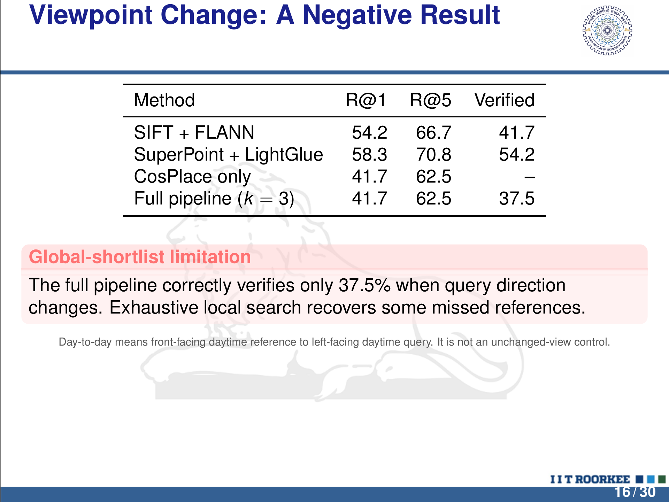
Notes:
LaTeX/Beamer source is the editable master.
Viewpoint Change: A Negative Result
Method R@1 R@5 Veriﬁed
SIFT + FLANN 54.2 66.7 41.7
SuperPoint + LightGlue 58.3 70.8 54.2
CosPlace only 41.7 62.5 –
Full pipeline ( k = 3) 41.7 62.5 37.5
Global-shortlist limitation
The full pipeline correctly veriﬁes only 37.5% when query direction
changes. Exhaustive local search recovers some missed references.
Day-to-day means front-facing daytime reference to left-facing daytime query. It is not an unchanged-view control.
16 / 30

Slide 17
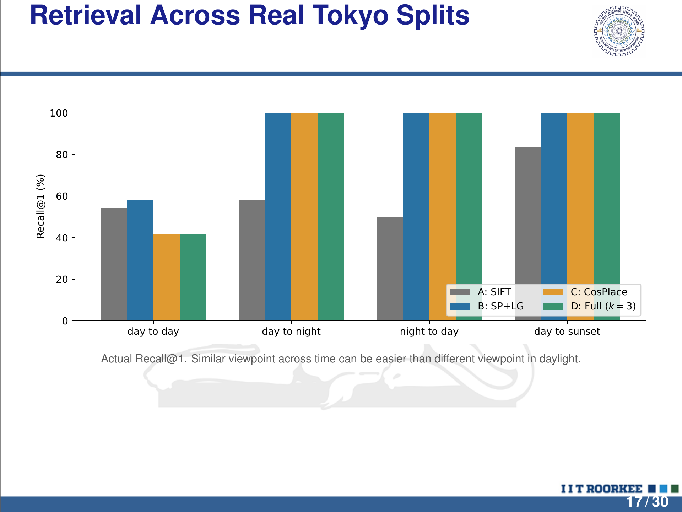
Notes:
LaTeX/Beamer source is the editable master.
Retrieval Across Real Tokyo Splits
day to day day to night night to day day to sunset
0
20
40
60
80
100Recall@1 (%)
A: SIFT
B: SP+LG
C: CosPlace
D: Full (k = 3)
Actual Recall@1. Similar viewpoint across time can be easier than different viewpoint in daylight.
17 / 30

Slide 18
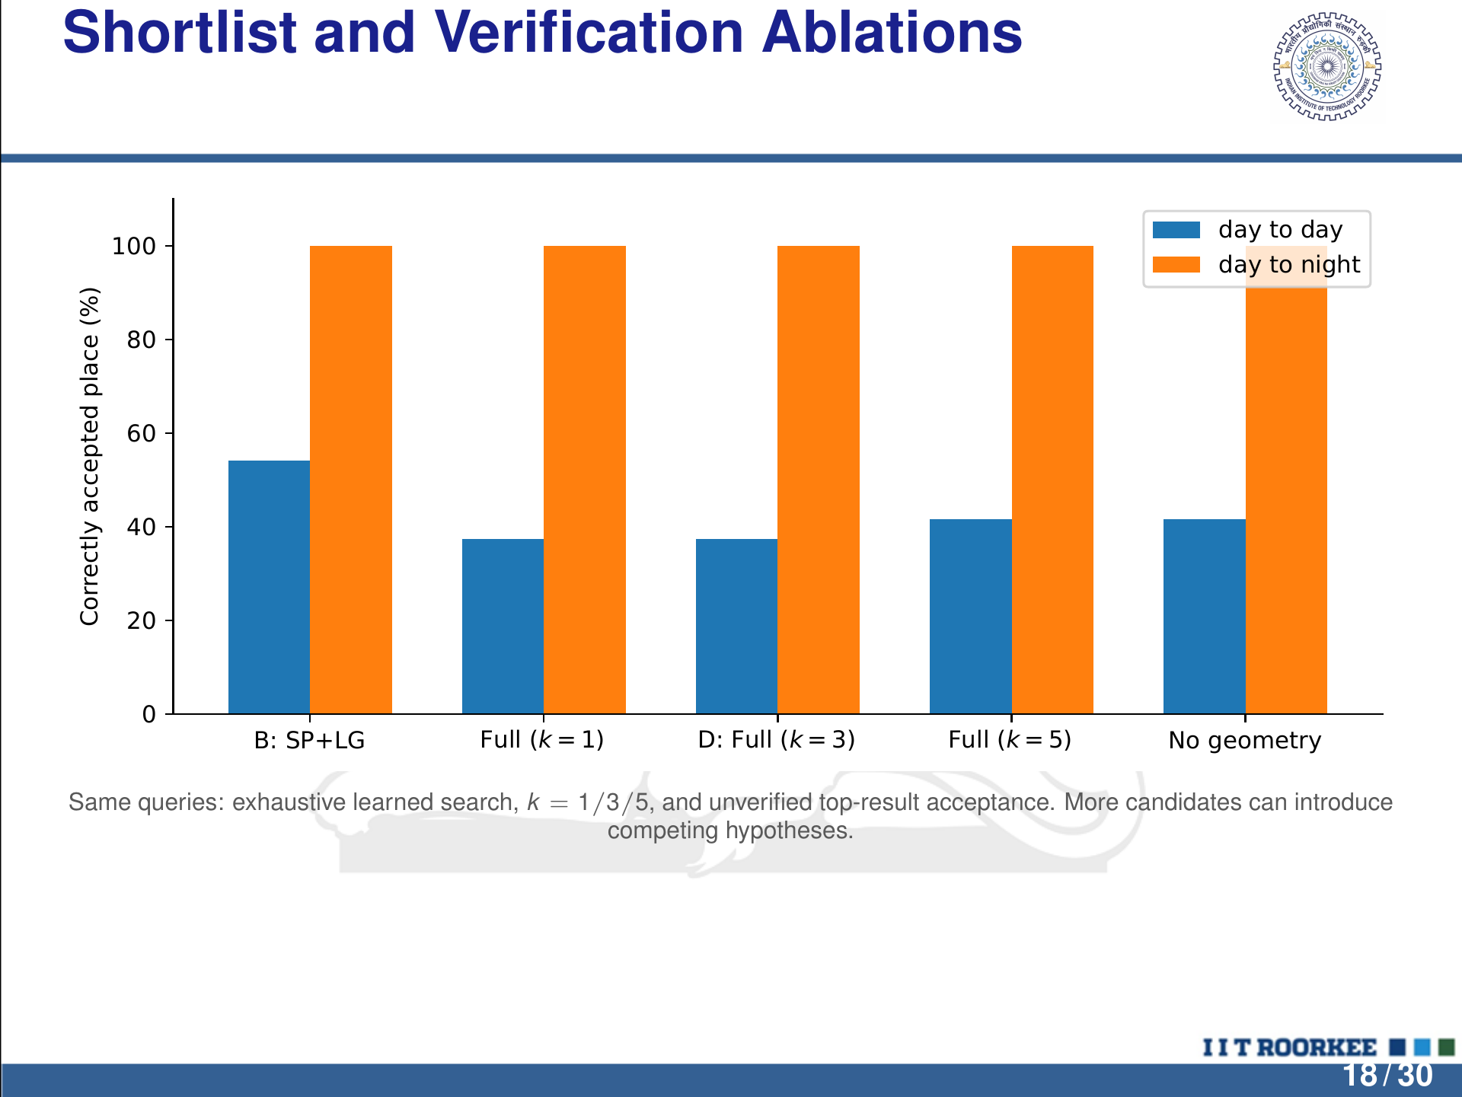
Notes:
LaTeX/Beamer source is the editable master.
Shortlist and Veriﬁcation Ablations
B: SP+LG Full (k = 1) D: Full (k = 3) Full (k = 5) No geometry
0
20
40
60
80
100Correctly accepted place (%)
day to day
day to night
Same queries: exhaustive learned search, k = 1/3/5, and unveriﬁed top-result acceptance. More candidates can introduce
competing hypotheses.
18 / 30

Slide 19
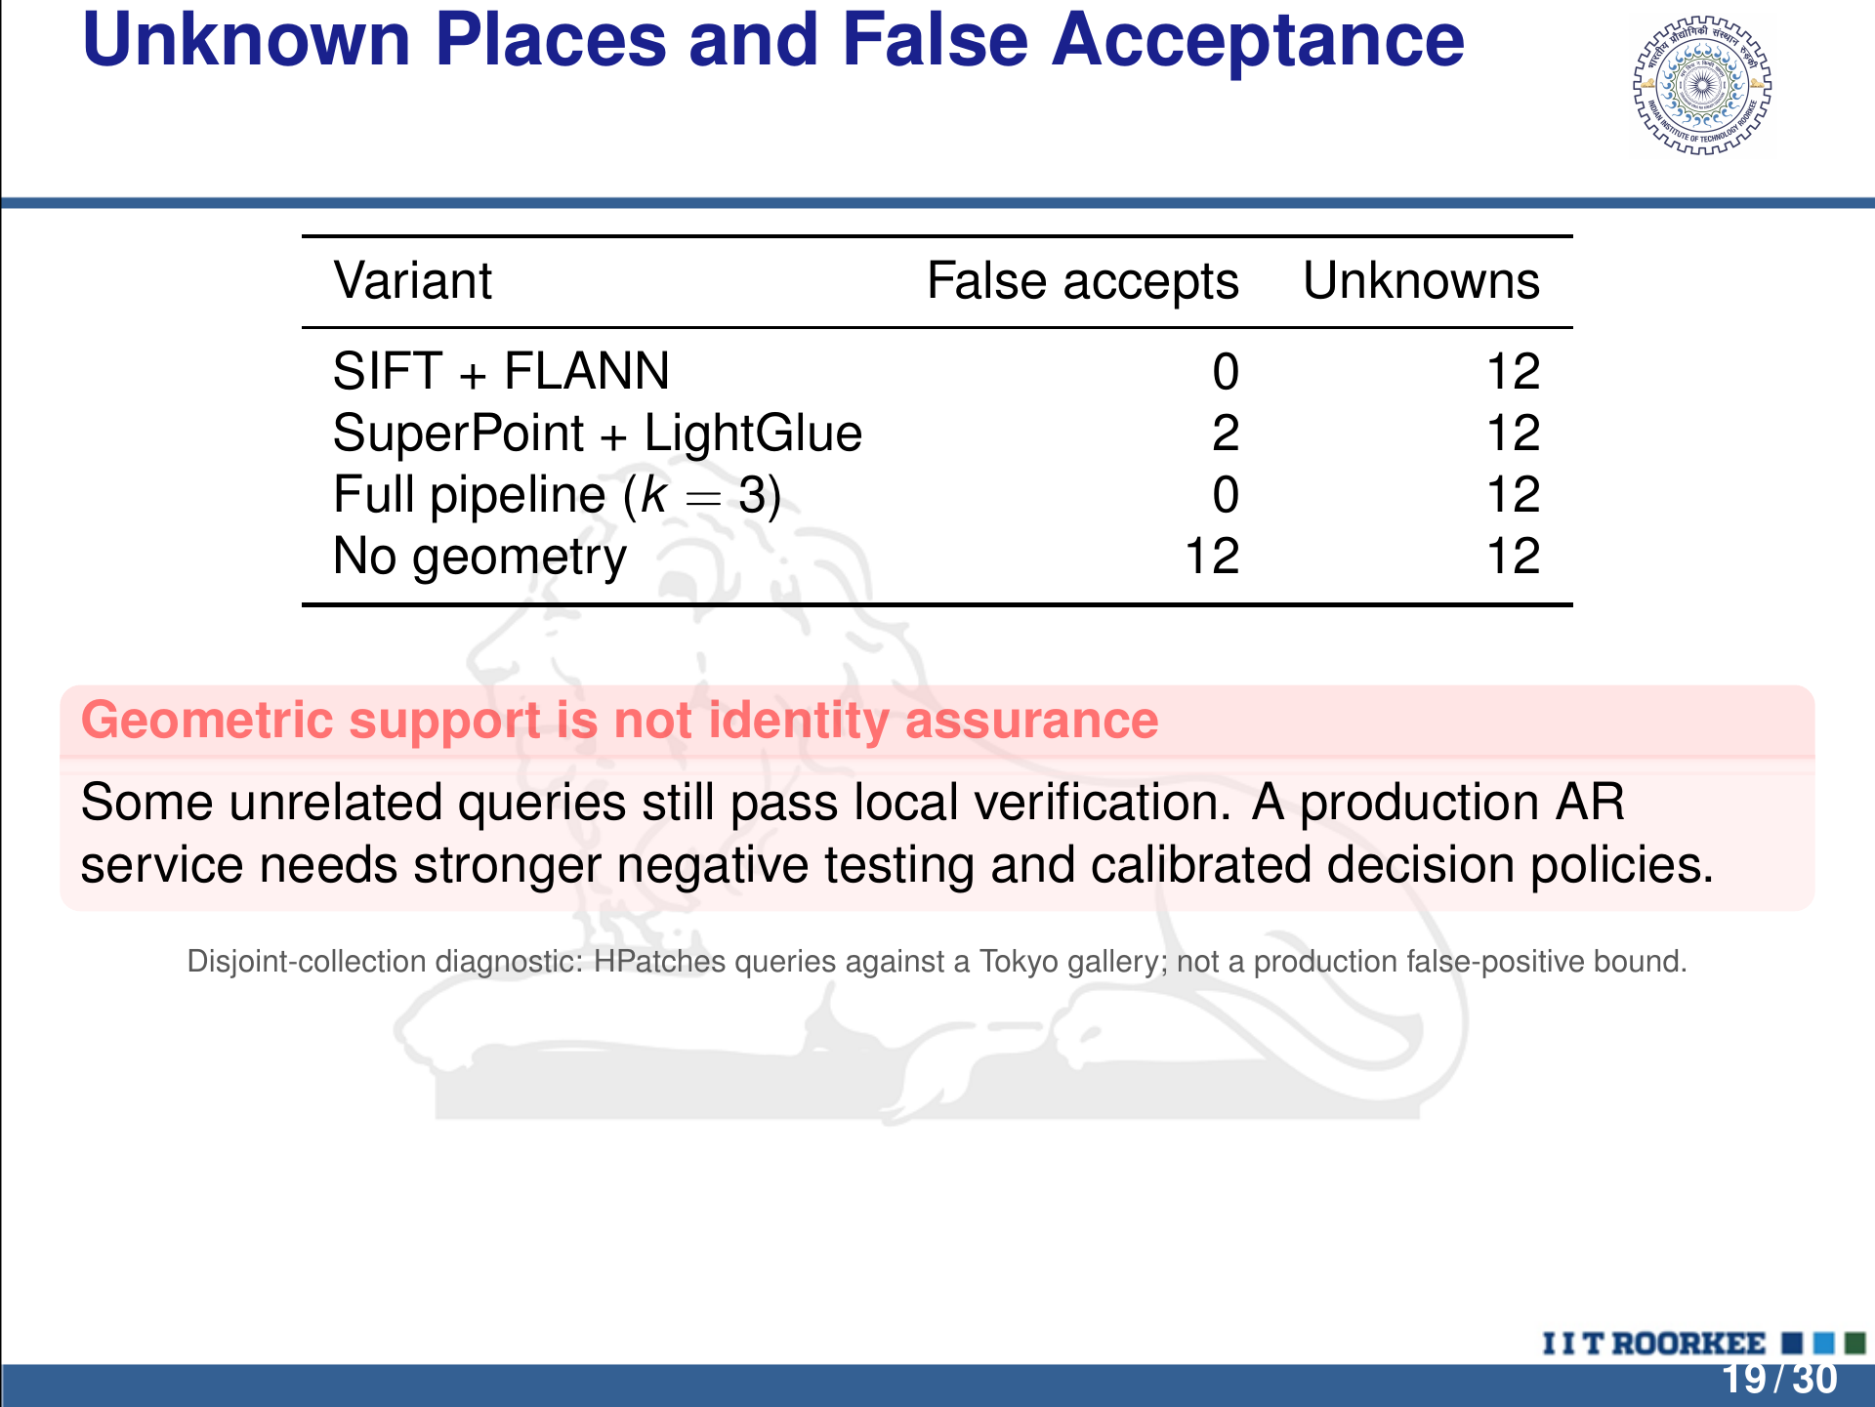
Notes:
LaTeX/Beamer source is the editable master.
Unknown Places and False Acceptance
Variant False accepts Unknowns
SIFT + FLANN 0 12
SuperPoint + LightGlue 2 12
Full pipeline ( k = 3) 0 12
No geometry 12 12
Geometric support is not identity assurance
Some unrelated queries still pass local veriﬁcation. A production AR
service needs stronger negative testing and calibrated decision policies.
Disjoint-collection diagnostic: HPatches queries against a Tokyo gallery; not a production false-positive bound.
19 / 30

Slide 20
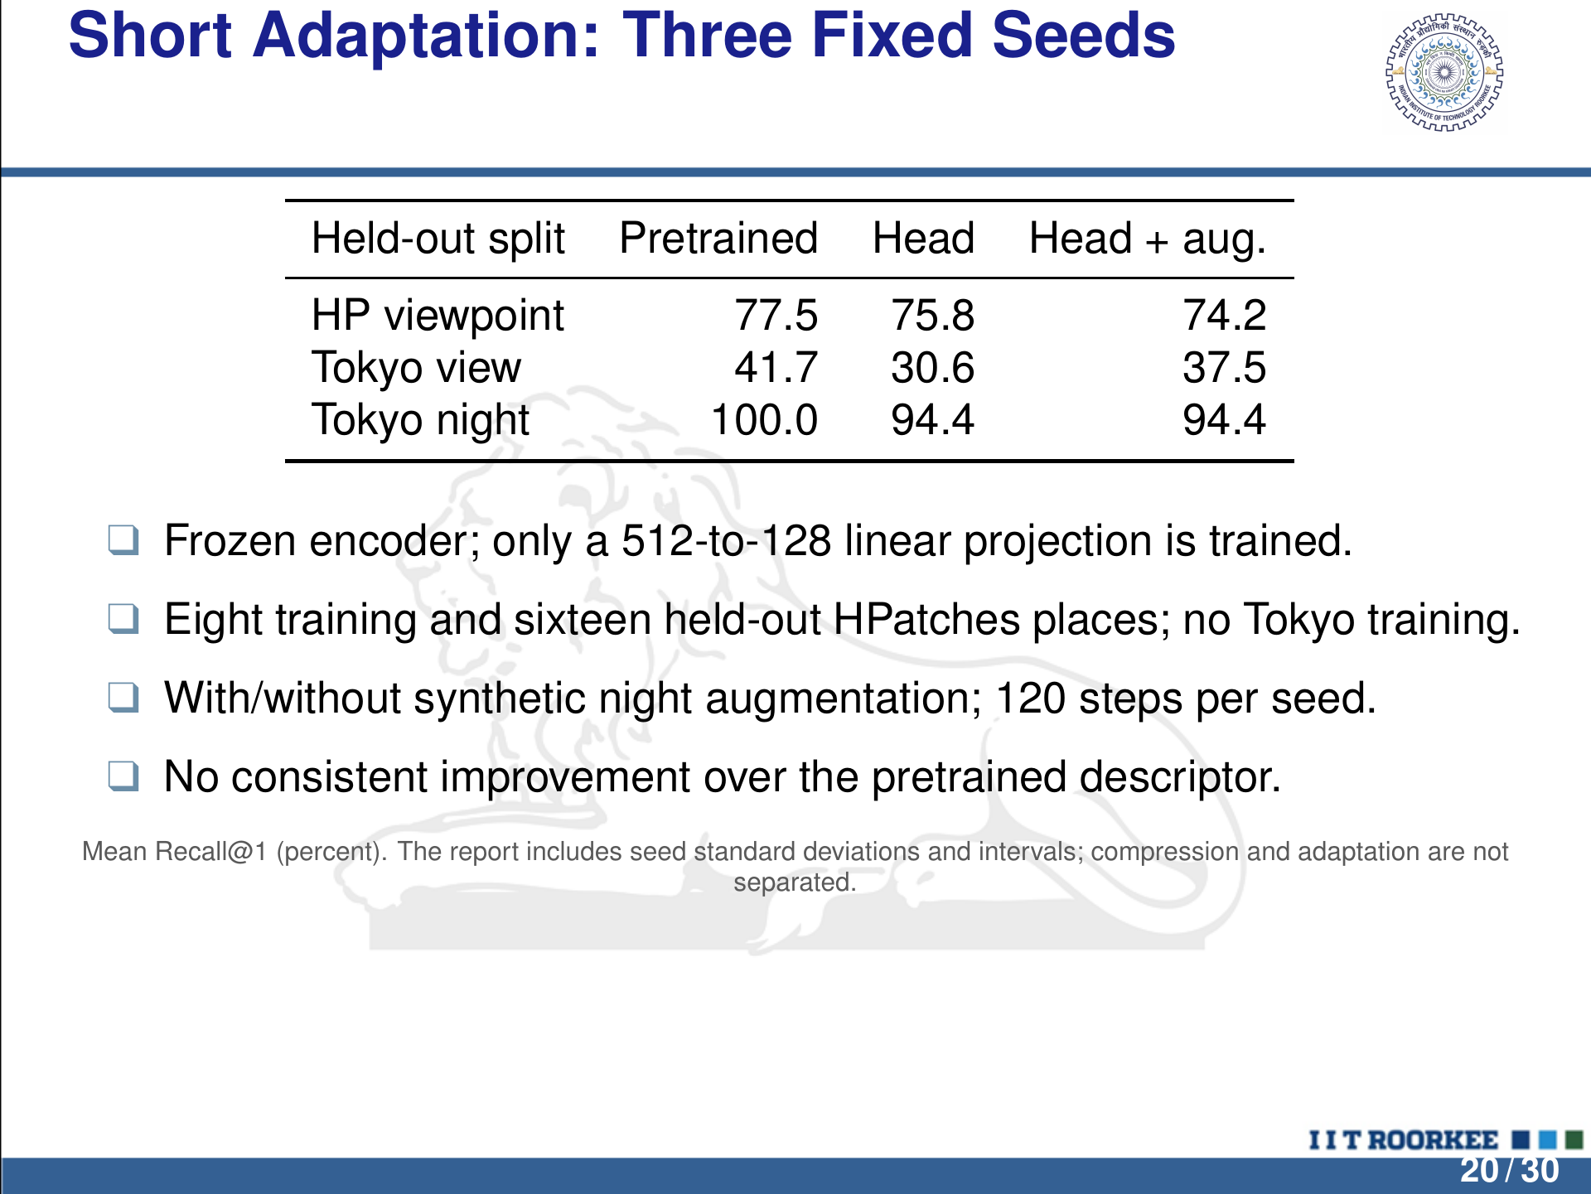
Notes:
LaTeX/Beamer source is the editable master.
Short Adaptation: Three Fixed Seeds
Held-out split Pretrained Head Head + aug.
HP viewpoint 77.5 75.8 74.2
Tokyo view 41.7 30.6 37.5
Tokyo night 100.0 94.4 94.4
q Frozen encoder; only a 512-to-128 linear projection is trained.
q Eight training and sixteen held-out HPatches places; no Tokyo training.
q With/without synthetic night augmentation; 120 steps per seed.
q No consistent improvement over the pretrained descriptor.
Mean Recall@1 (percent). The report includes seed standard deviations and intervals; compression and adaptation are not
separated.
20 / 30

Slide 21
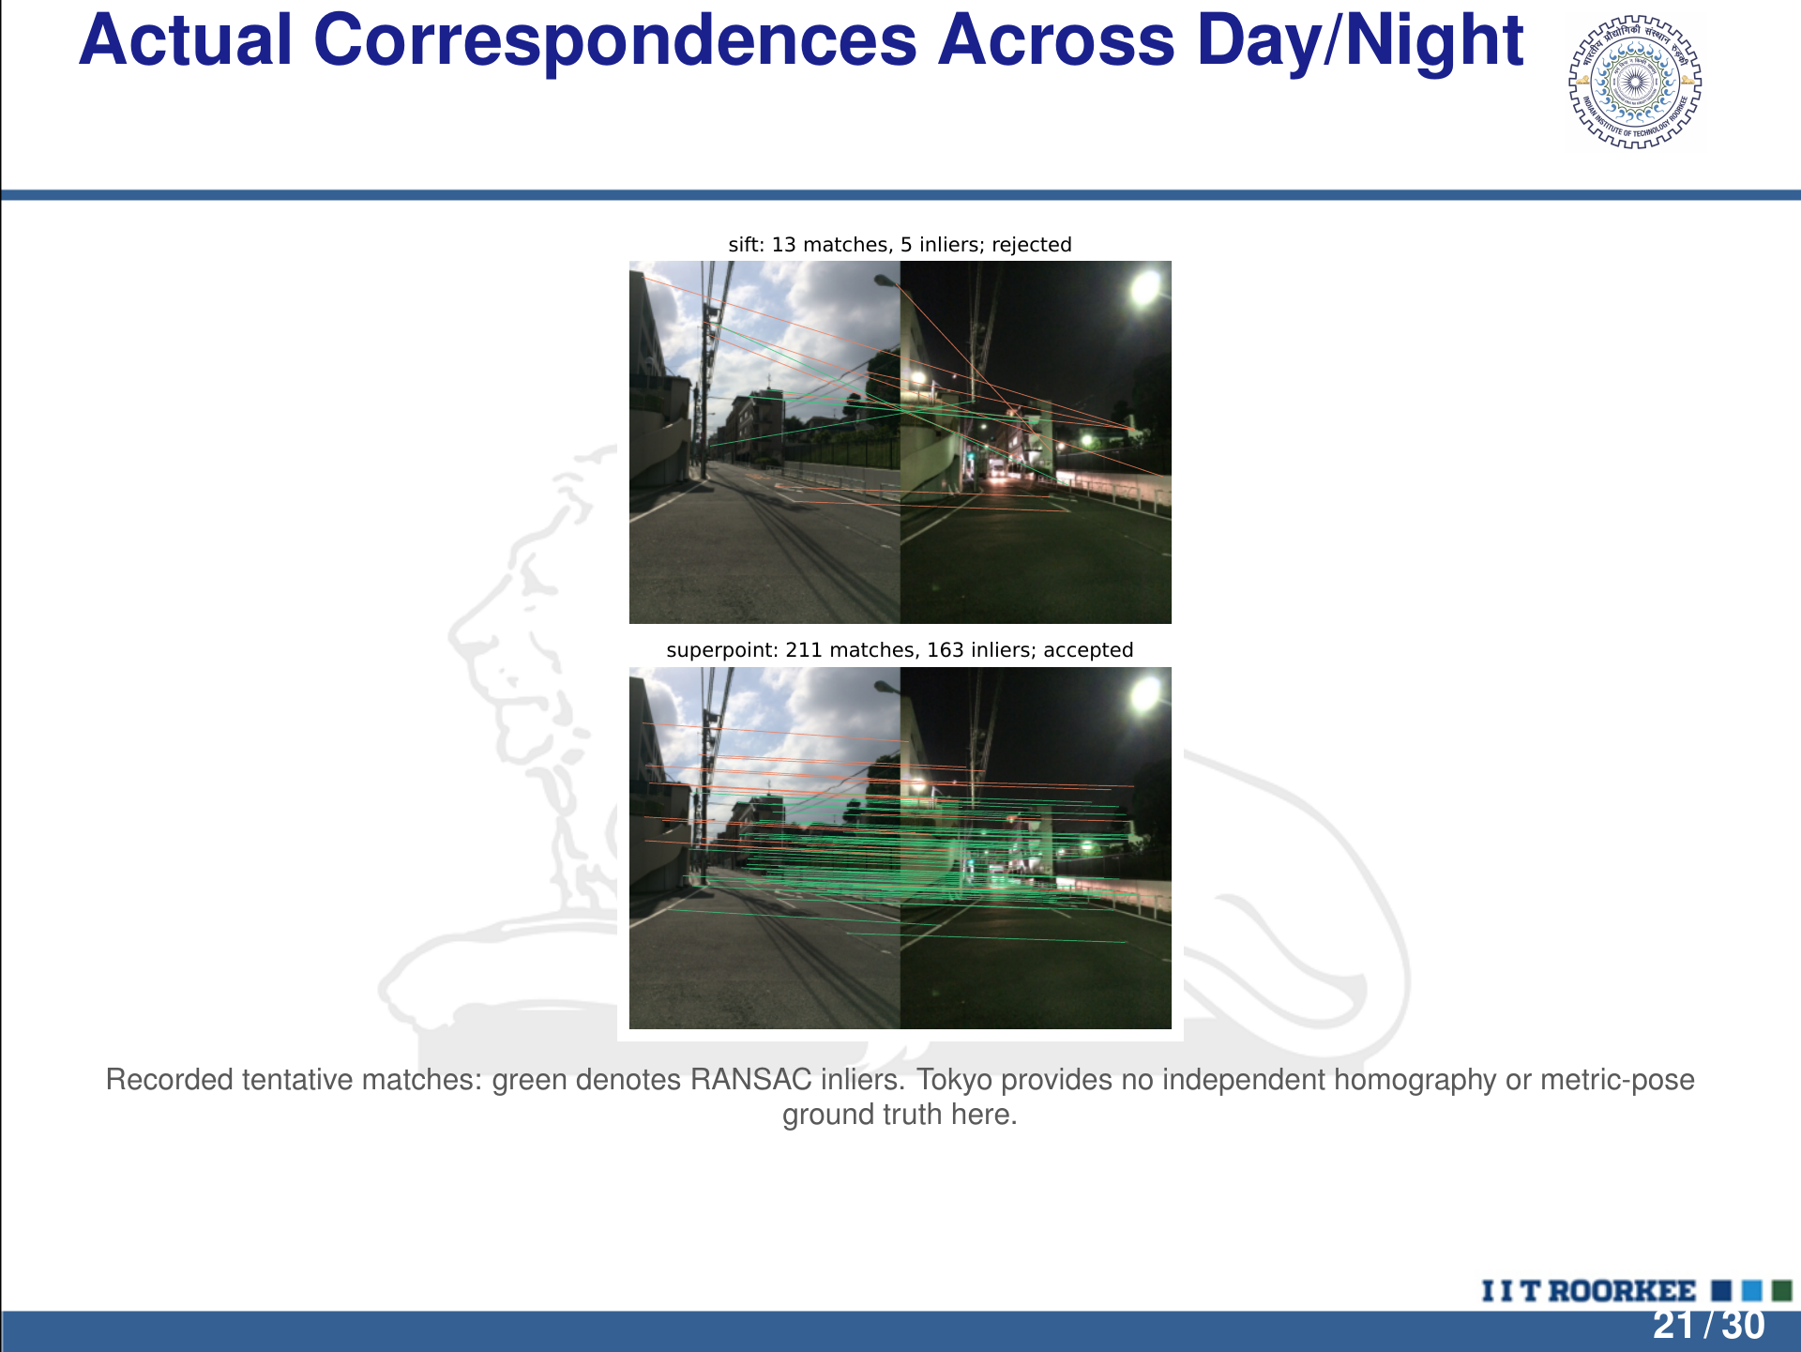
Notes:
LaTeX/Beamer source is the editable master.
Actual Correspondences Across Day/Night
sift: 13 matches, 5 inliers; rejected
superpoint: 211 matches, 163 inliers; accepted
Recorded tentative matches: green denotes RANSAC inliers. Tokyo provides no independent homography or metric-pose
ground truth here.
21 / 30

Slide 22
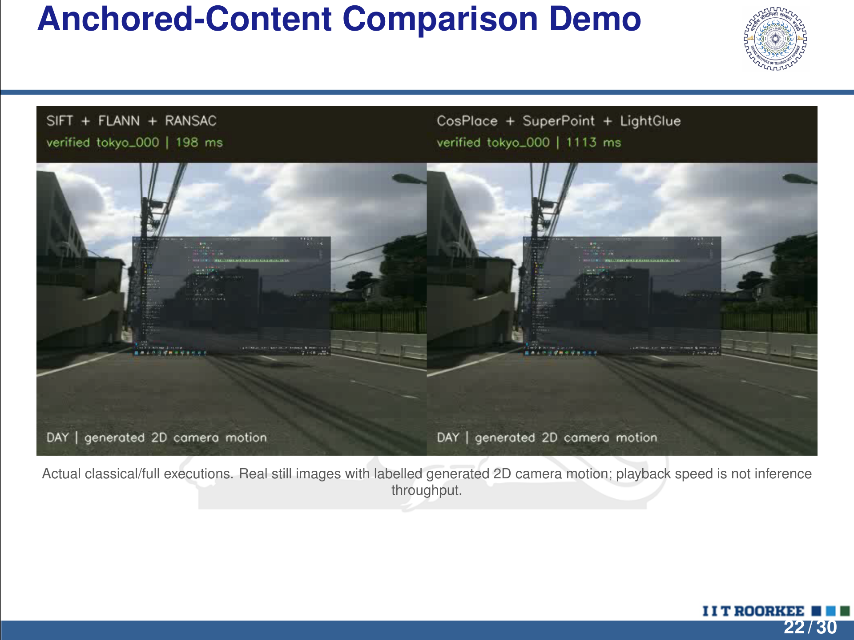
Notes:
LaTeX/Beamer source is the editable master.
Anchored-Content Comparison Demo
Actual classical/full executions. Real still images with labelled generated 2D camera motion; playback speed is not inference
throughput.
22 / 30

Slide 23
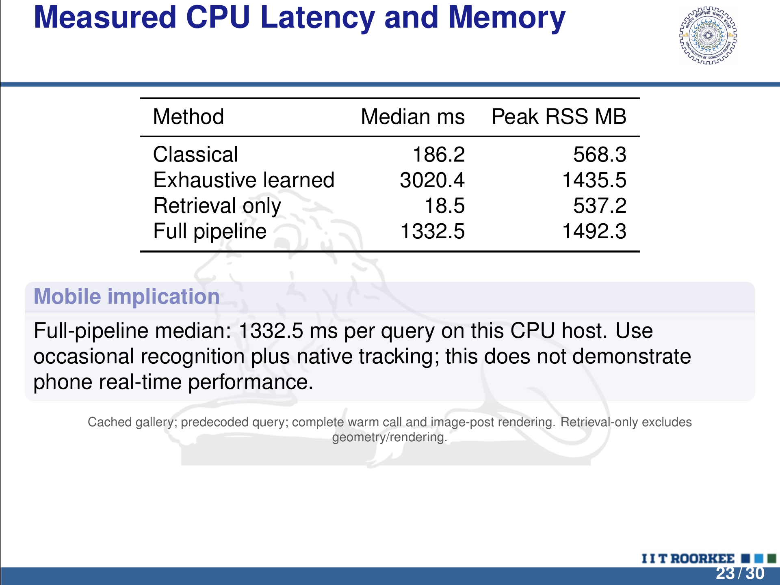
Notes:
LaTeX/Beamer source is the editable master.
Measured CPU Latency and Memory
Method Median ms Peak RSS MB
Classical 186.2 568.3
Exhaustive learned 3020.4 1435.5
Retrieval only 18.5 537.2
Full pipeline 1332.5 1492.3
Mobile implication
Full-pipeline median: 1332.5 ms per query on this CPU host. Use
occasional recognition plus native tracking; this does not demonstrate
phone real-time performance.
Cached gallery; predecoded query; complete warm call and image-post rendering. Retrieval-only excludes
geometry/rendering.
23 / 30

Slide 24
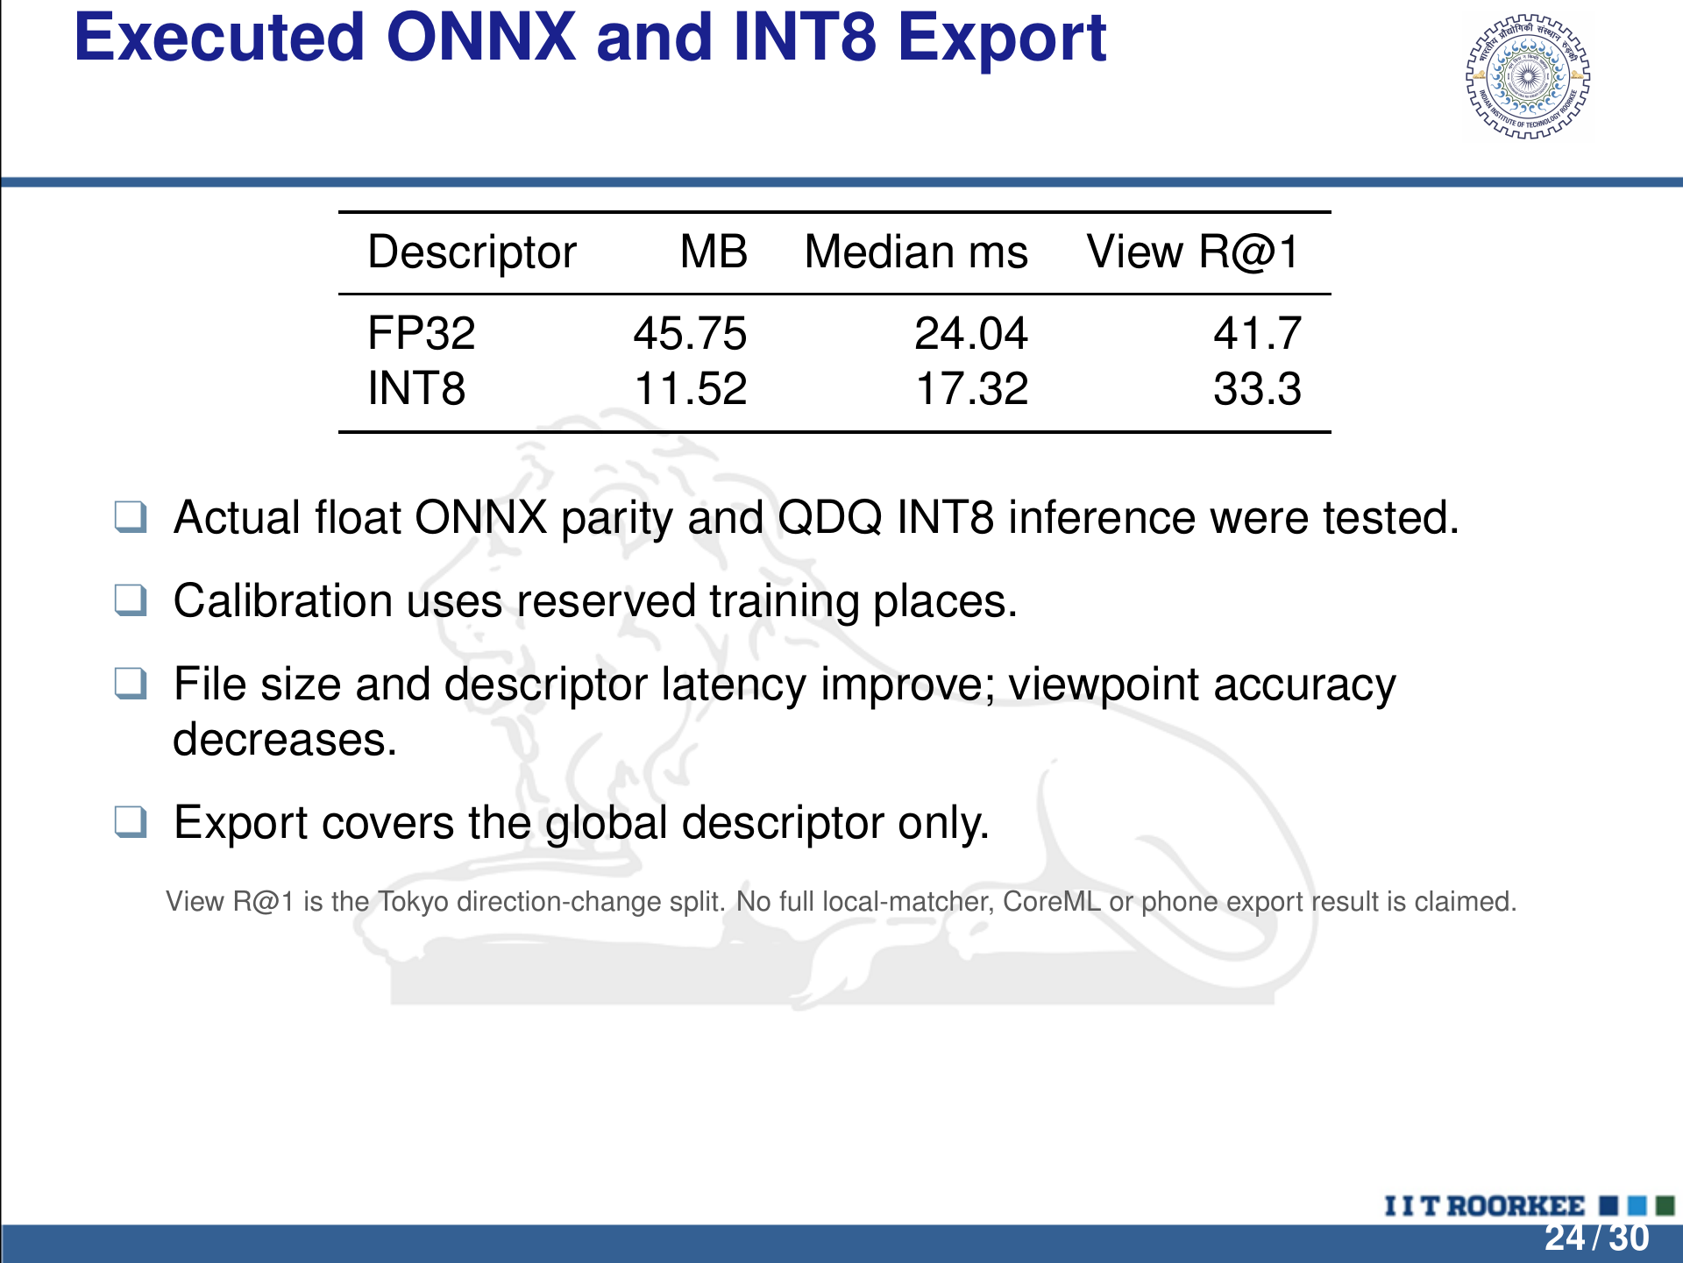
Notes:
LaTeX/Beamer source is the editable master.
Executed ONNX and INT8 Export
Descriptor MB Median ms View R@1
FP32 45.75 24.04 41.7
INT8 11.52 17.32 33.3
q Actual ﬂoat ONNX parity and QDQ INT8 inference were tested.
q Calibration uses reserved training places.
q File size and descriptor latency improve; viewpoint accuracy
decreases.
q Export covers the global descriptor only.
View R@1 is the Tokyo direction-change split. No full local-matcher, CoreML or phone export result is claimed.
24 / 30

Slide 25
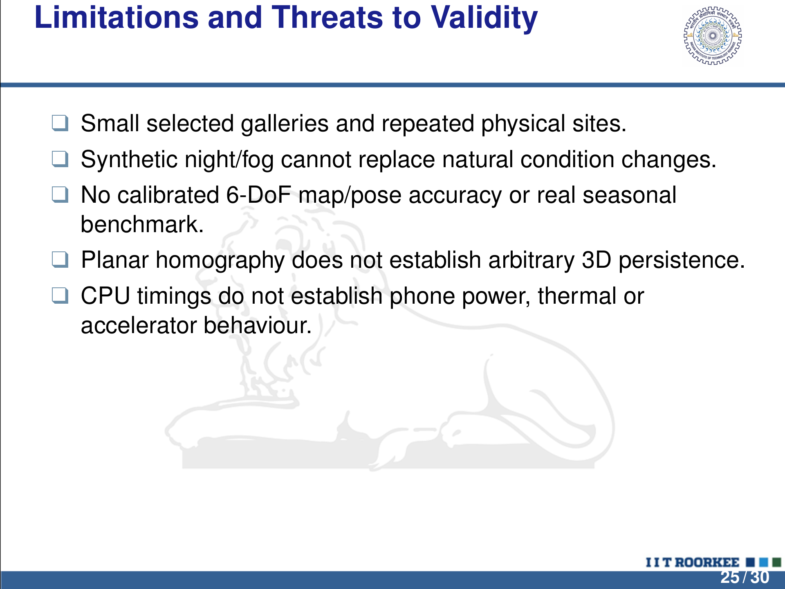
Notes:
LaTeX/Beamer source is the editable master.
Limitations and Threats to Validity
q Small selected galleries and repeated physical sites.
q Synthetic night/fog cannot replace natural condition changes.
q No calibrated 6-DoF map/pose accuracy or real seasonal
benchmark.
q Planar homography does not establish arbitrary 3D persistence.
q CPU timings do not establish phone power, thermal or
accelerator behaviour.
25 / 30

Slide 26
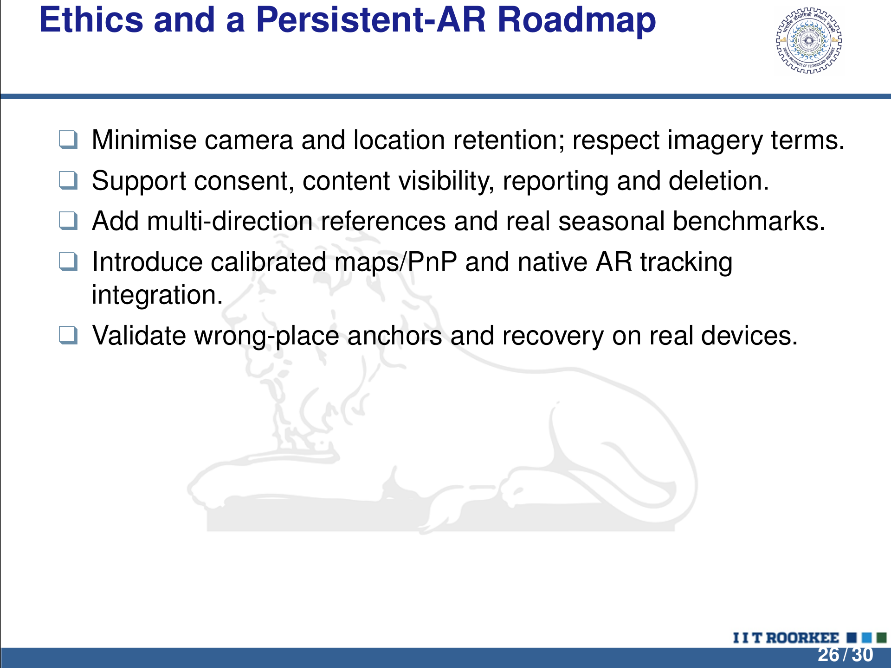
Notes:
LaTeX/Beamer source is the editable master.
Ethics and a Persistent-AR Roadmap
q Minimise camera and location retention; respect imagery terms.
q Support consent, content visibility, reporting and deletion.
q Add multi-direction references and real seasonal benchmarks.
q Introduce calibrated maps/PnP and native AR tracking
integration.
q Validate wrong-place anchors and recovery on real devices.
26 / 30

Slide 27
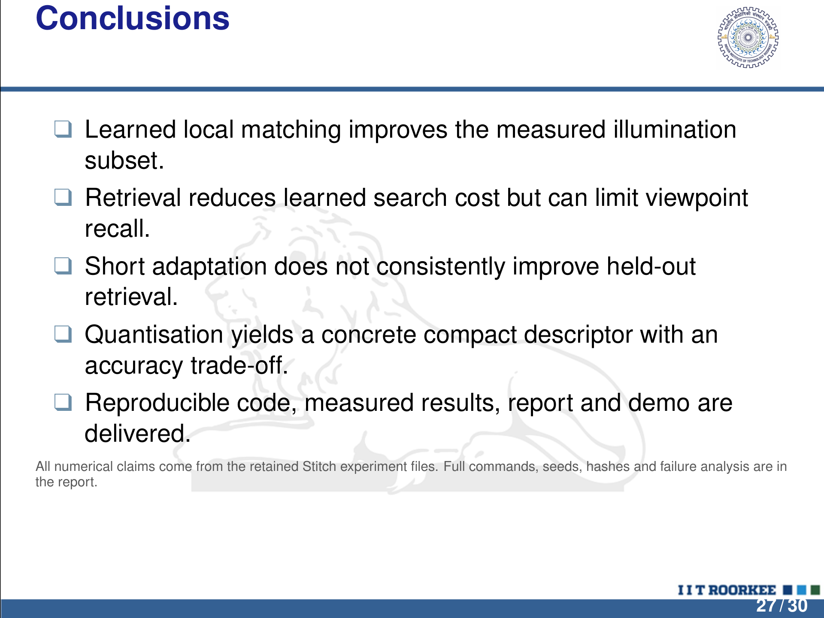
Notes:
LaTeX/Beamer source is the editable master.
Conclusions
q Learned local matching improves the measured illumination
subset.
q Retrieval reduces learned search cost but can limit viewpoint
recall.
q Short adaptation does not consistently improve held-out
retrieval.
q Quantisation yields a concrete compact descriptor with an
accuracy trade-off.
q Reproducible code, measured results, report and demo are
delivered.
All numerical claims come from the retained Stitch experiment ﬁles. Full commands, seeds, hashes and failure analysis are in
the report.
27 / 30

Slide 28
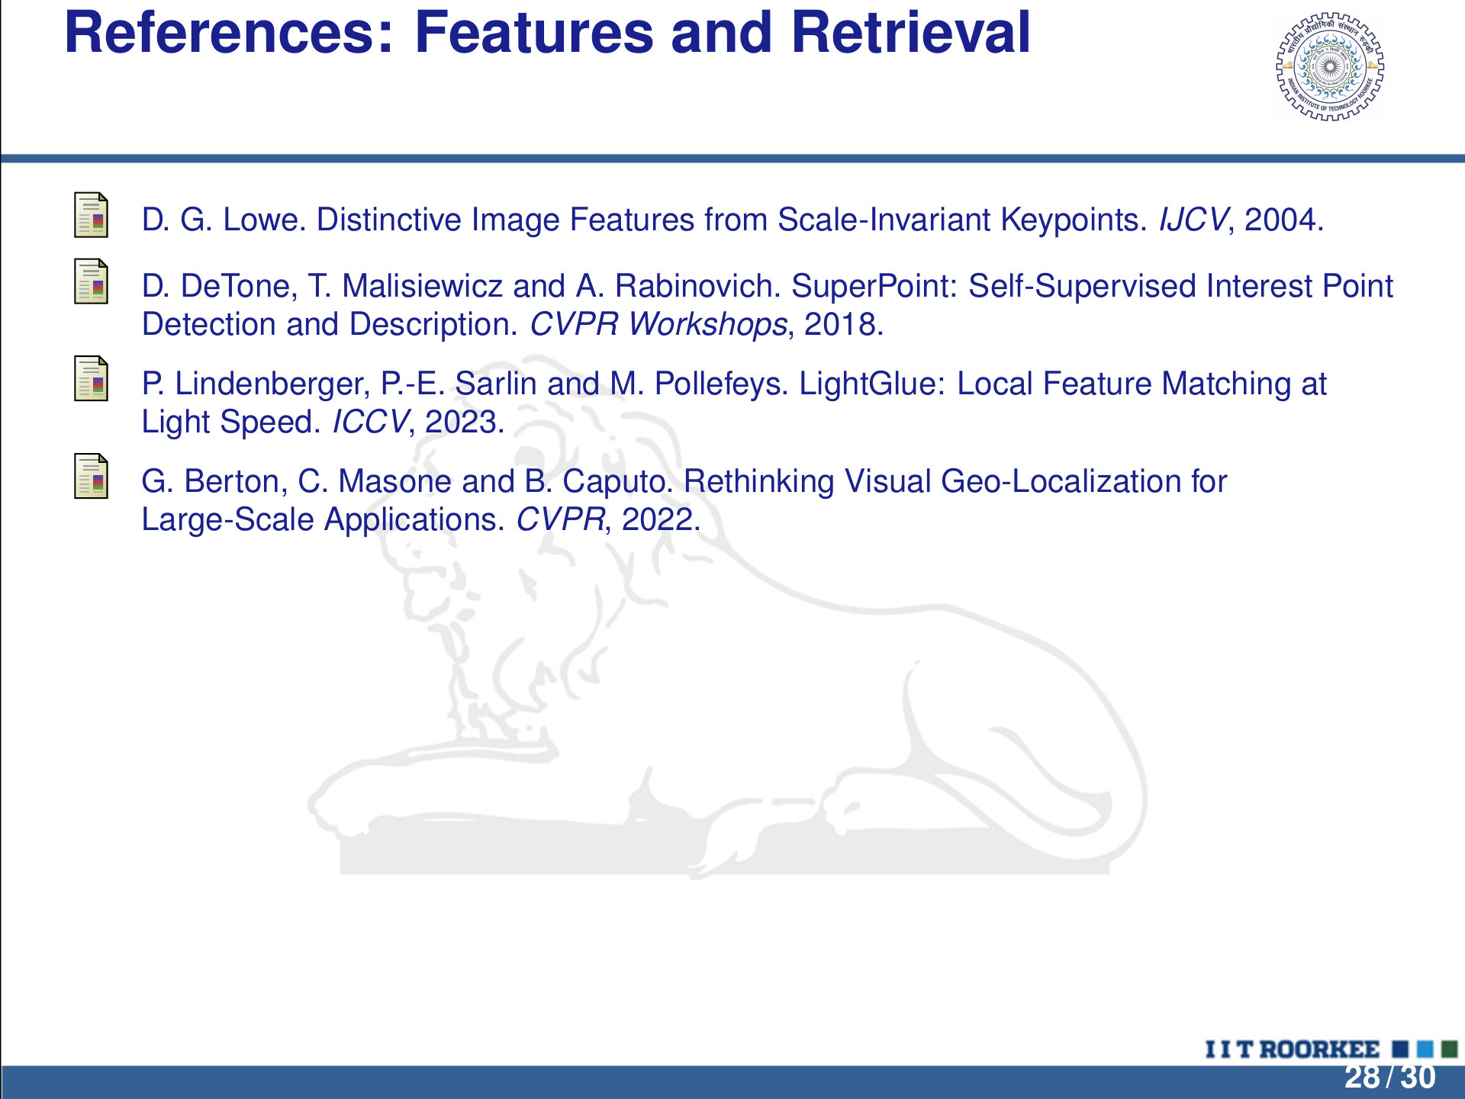
Notes:
LaTeX/Beamer source is the editable master.
References: Features and Retrieval
D. G. Lowe. Distinctive Image Features from Scale-Invariant Keypoints. IJCV, 2004.
D. DeTone, T. Malisiewicz and A. Rabinovich. SuperPoint: Self-Supervised Interest Point
Detection and Description. CVPR Workshops, 2018.
P . Lindenberger, P .-E. Sarlin and M. Pollefeys. LightGlue: Local Feature Matching at
Light Speed. ICCV, 2023.
G. Berton, C. Masone and B. Caputo. Rethinking Visual Geo-Localization for
Large-Scale Applications. CVPR, 2022.
28 / 30

Slide 29
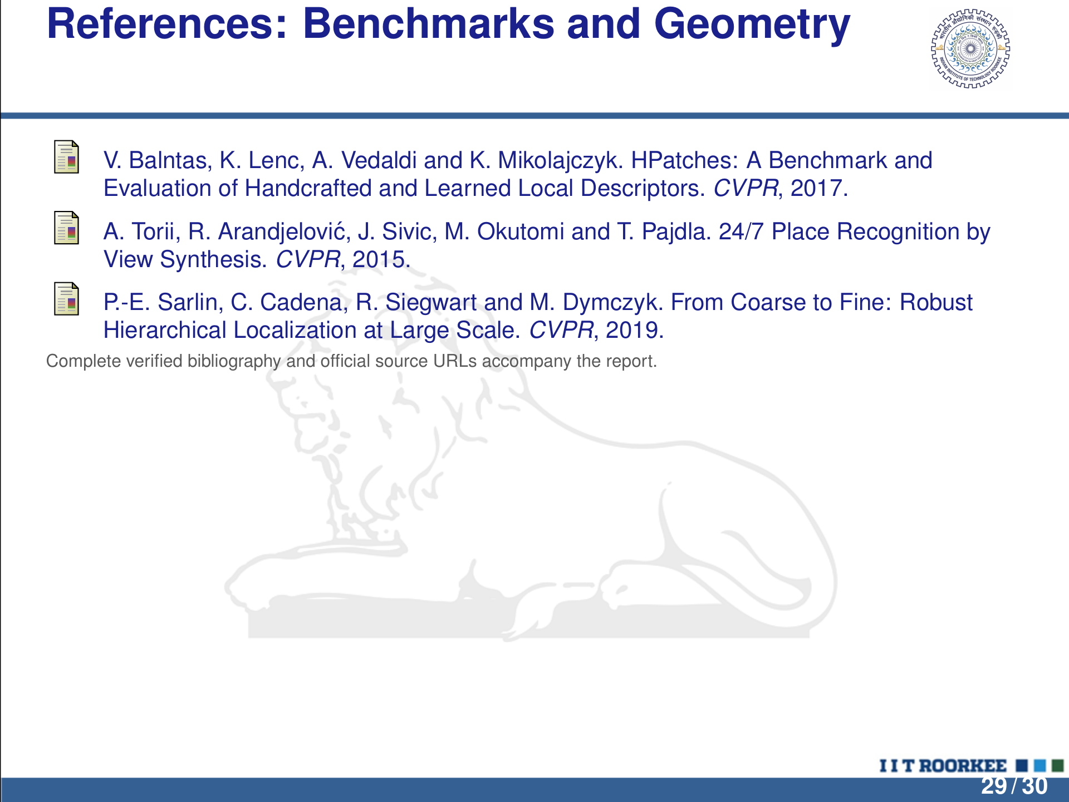
Notes:
LaTeX/Beamer source is the editable master.
References: Benchmarks and Geometry
V. Balntas, K. Lenc, A. Vedaldi and K. Mikolajczyk. HPatches: A Benchmark and
Evaluation of Handcrafted and Learned Local Descriptors. CVPR, 2017.
A. Torii, R. Arandjelovi ´c, J. Sivic, M. Okutomi and T. Pajdla. 24/7 Place Recognition by
View Synthesis. CVPR, 2015.
P .-E. Sarlin, C. Cadena, R. Siegwart and M. Dymczyk. From Coarse to Fine: Robust
Hierarchical Localization at Large Scale. CVPR, 2019.
Complete veriﬁed bibliography and ofﬁcial source URLs accompany the report.
29 / 30

Slide 30

Notes:
LaTeX/Beamer source is the editable master.
THANK YOU
PRONOB BHATTACHARJEE
Mehta Family School of Data Science and Artiﬁcial Intelligence
Questions and Discussion

