Slide 1
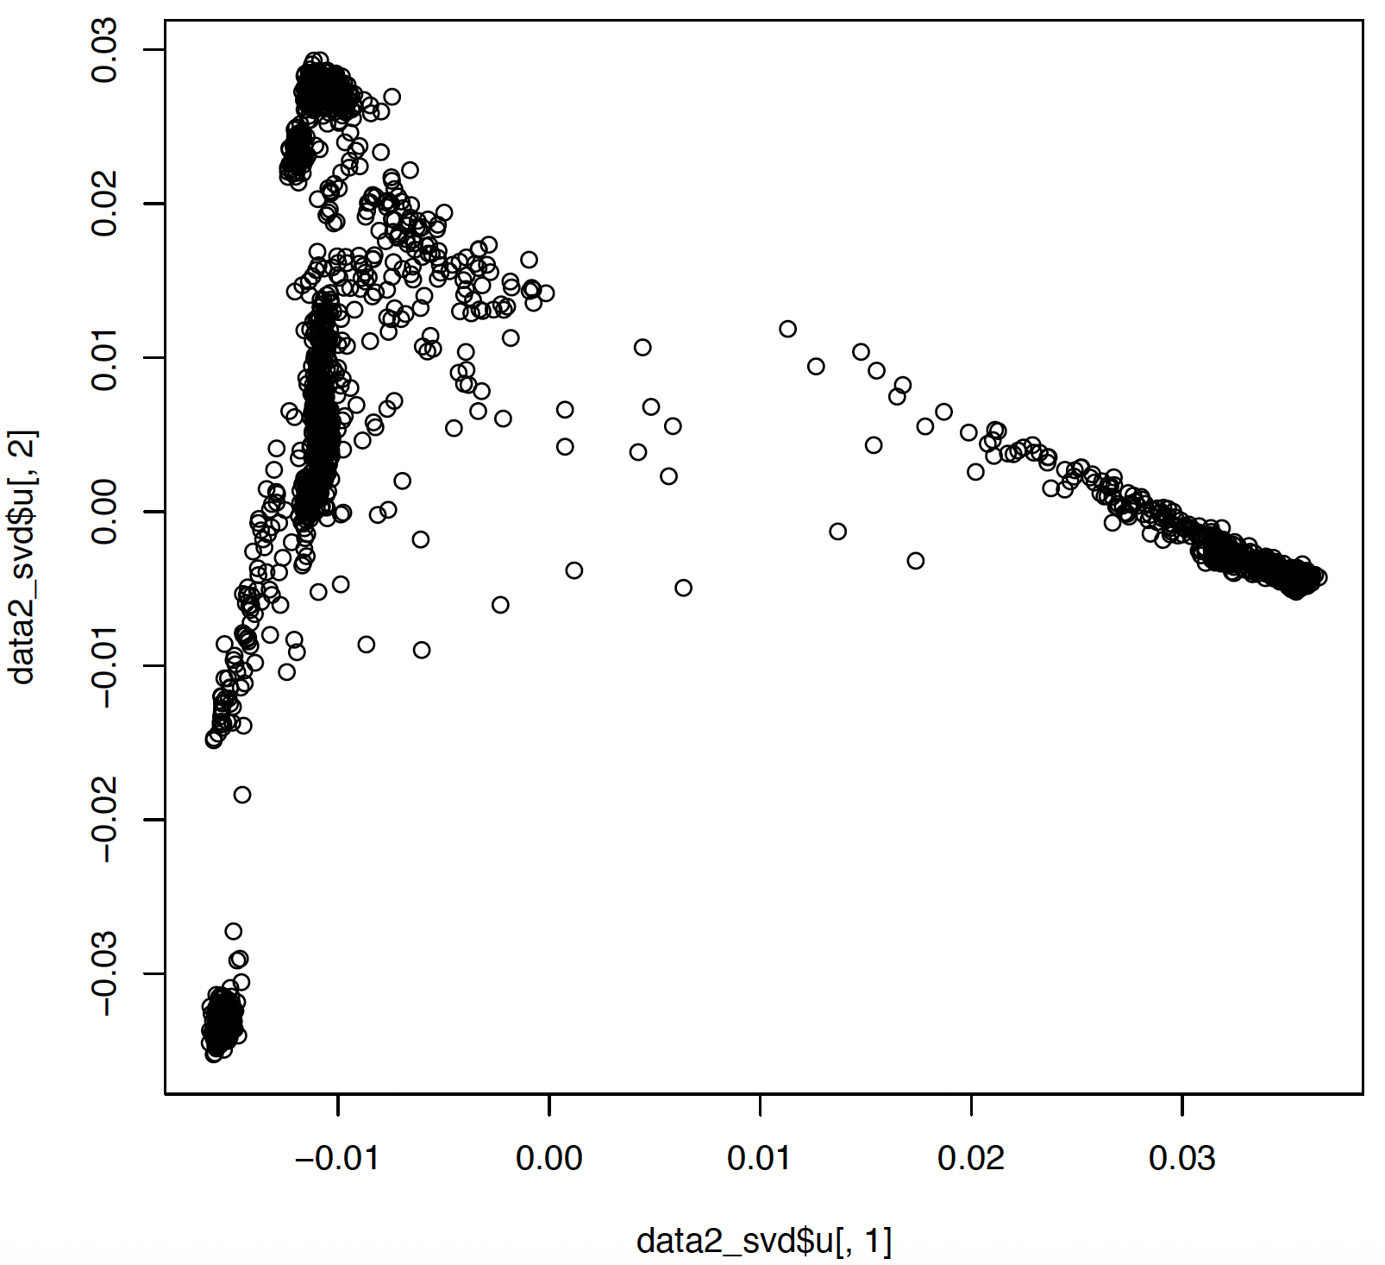
European ancestry
Peng et al 2017, Bhattacharya et al 2022
Hispanic/Latin American ancestry
RICHS + ELGAN (~100 samples)
East and South Asian ancestry
GUSTO (~100 samples)
African (American) ancestry
RICHS + ELGAN (~100 samples)

