Slide 1
Working on the Hoffman2 cluster

Slide 2
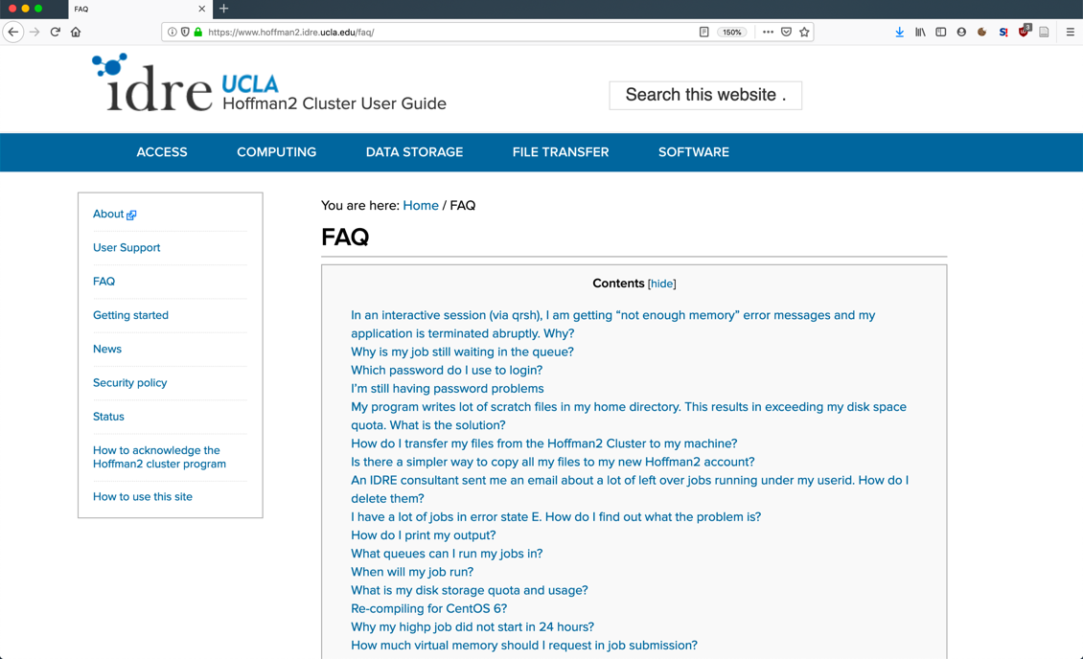
Working on the Hoffman2 cluster
Homepage & Resources:
https://www.hoffman2.idre.ucla.edu/
Also, https://idre.ucla.edu/

Slide 3
Connecting to the cluster
Remote shell ssh USER@hoffman2.idre.ucla.edu
Once connected, start an “interactive job” requesting 2 hours and 8GB memory: qrsh -l h_rt=2:00:00,h_data=8G N.B. spaces or their absence DO MATTER; there must be no spaces around commas.
Remote File transfer Download: scp USER@hoffman2.idre.ucla.edu:/PATH/TO/FILE ~/Desktop/ Upload: scp ~/Desktop/FILE USER@hoffman2.idre.ucla.edu:~/
Interactive clients exist: Cyberduck, FileZilla…

Slide 4

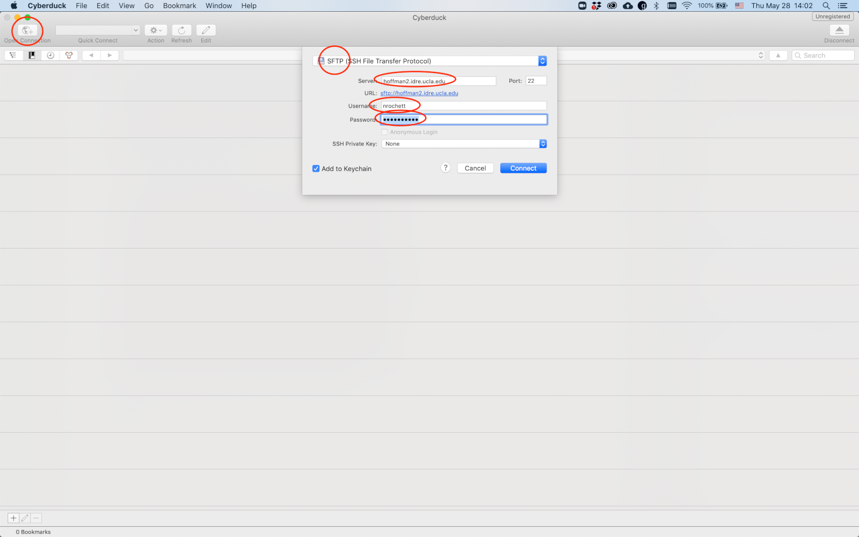
Cyberduck: setup for Hoffman2

Slide 5
Essential Hoffman2 commands
Request an interactive job: qrsh (Do not run computationally heavy commands on the login node!)
Submit a batch/script job: qsub –N JOBNAME script.sh
Main resource options for jobs: Time: -l h_rt=4:00:00 Memory / RAM: -l h_data=8G
List current jobs: myjobs (or qstat –u $USER Main job states are r (for running) and qw (for queued-waiting)
Modules: module load NAME module avail

Slide 6
Hoffman2 disk spaces
Home directory /u/home/?/USER N.B. 20 GB max. — but the workshop files are light enough so that we will be able to work there.
Scratch space /u/flashscratch/?/USER N.B. 2 TB max, but data on the scratch disk is considered abandoned after two weeks, as it is intended for "temporary" files.
Purchased space (cf. IDRE website): /u/project/LABNAME/USERNAME

