Slide 1
Estimation and testing in linear regression
Arjun Bhattacharya

Slide 2
Overview
What we’ll cover:
Some basic mathematical theory and assumptions
Estimation and hypothesis testing of parameters
Interpretation of a linear regression model
Implementation of linear regression in R
These slides and all code/data are available online: github.com/bhattacharya-a-bt/qcbio_trial.

Slide 3
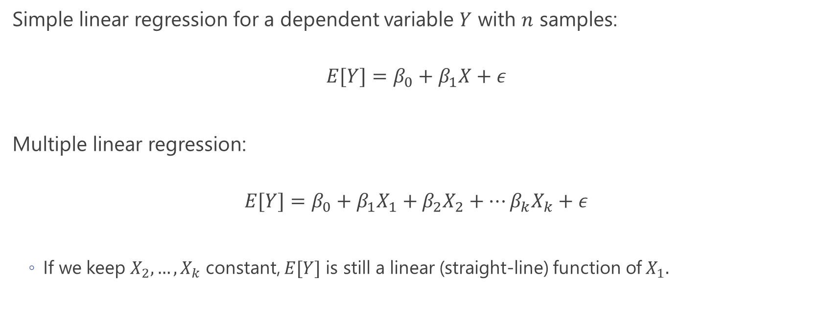
The linear regression model
Simple linear regression for a dependent variable $Y$ with $n$ samples:
$$E[Y]=β_{0}+β_{1}X+ε$$
Multiple linear regression:
$$E[Y]=β_{0}+β_{1}X_{1}+β_{2}X_{2}+…β_{k}X_{k}+ε$$
If we keep $X_{2},…,X_{k}$ constant, $E[Y]$ is still a linear (straight-line) function of $X_{1}.$

Slide 4
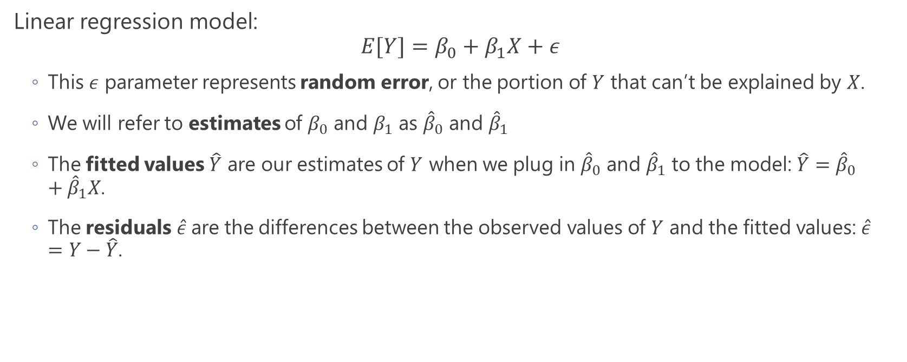
A few specifications and definitions
Linear regression model:
$$E[Y]=β_{0}+β_{1}X+ε$$
This $ε$ parameter represents random error, or the portion of $Y$ that can’t be explained by $X$.
We will refer to estimates of $β_{0}$ and $β_{1}$ as ${\hat{β}}_{0}$ and ${\hat{β}}_{1}$
The fitted values $\hat{Y}$ are our estimates of $Y$ when we plug in ${\hat{β}}_{0}$ and ${\hat{β}}_{1}$ to the model: $\hat{Y}={\hat{β}}_{0}+{\hat{β}}_{1}X$.
The residuals $\hat{ε}$ are the differences between the observed values of $Y$ and the fitted values: $\hat{ε}=Y−\hat{Y}$.

Slide 5
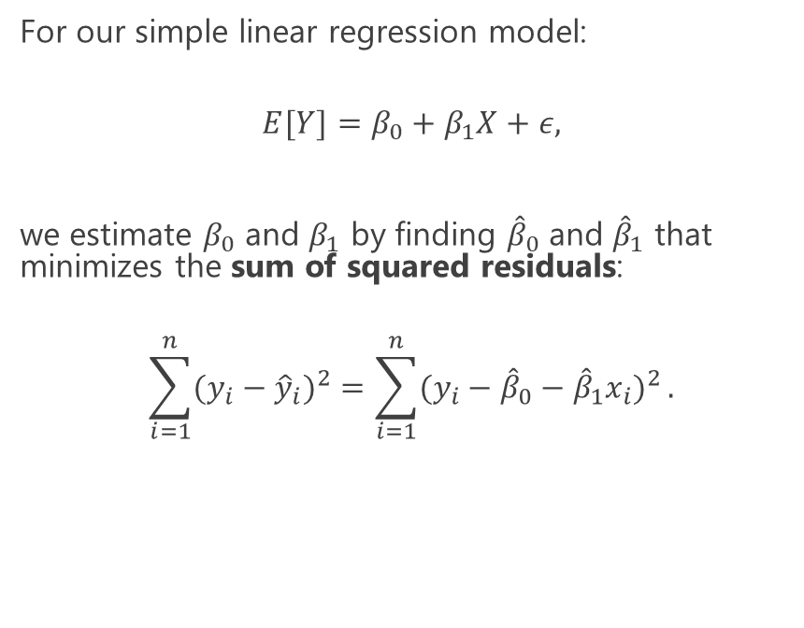
Ordinary least squares
For our simple linear regression model:
$$E[Y]=β_{0}+β_{1}X+ε,$$
we estimate $β_{0}$ and $β_{1}$ by finding ${\hat{β}}_{0}$ and ${\hat{β}}_{1}$ that minimizes the sum of squared residuals:
$$\sum_{i=1}^{n}{(y_{i}−{\hat{y}}_{i})^{2}}=\sum_{i=1}^{n}{(y_{i}−{\hat{β}}_{0}−{\hat{β}}_{1}x_{i})^{2}}.$$

Slide 6
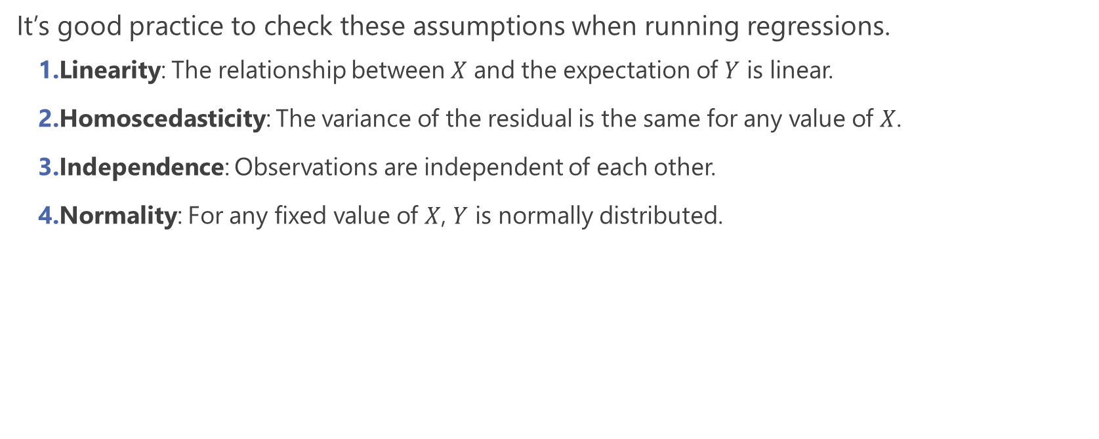
Key assumptions for linear regression
It’s good practice to check these assumptions when running regressions.
Linearity: The relationship between $X$ and the expectation of $Y$ is linear.
Homoscedasticity: The variance of the residual is the same for any value of $X$.
Independence: Observations are independent of each other.
Normality: For any fixed value of $X$, $Y$ is normally distributed.

Slide 7
Example: eQTL analysis
An expression quantitative trait locus (eQTL) is a genomic locus associated with expression of a gene.
Traditionally, a preliminary eQTL analysis is a series of linear regressions between all genetic variants (SNPs) in the genome with all genes in the transcriptome.
Here, we’ll be looking through a single eQTL: 1 SNP, 1 gene, and the potential influence of age on the SNP-gene relationship.

