Slide 1
Practical notes for linear regression
Arjun Bhattacharya
Notes:
This mini-workshop will be covering some practical considerations for linear regression.

Slide 2
Overview
What we’ll cover today:
Assessing the assumptions of linear regression
Interpretation of a linear regression model
Implementation of linear regression in R
In a full workshop – some more intuition about theory, estimation, and hypothesis testing
These slides and all code/data are available online: github.com/bhattacharya-a-bt/qcbio_trial.
Notes:
Linear regression is a statistical tool that models the relationship between a dependent variable and a set of predictors. Today, we’ll cover assumptions for linear regression and practical interpretation and implementation of regression in R. During the full workshop, I’ll add more intuition about theory, estimation, and hypothesis testing to complement today’s material. These slides and code are all available online at this github repository.

Slide 3
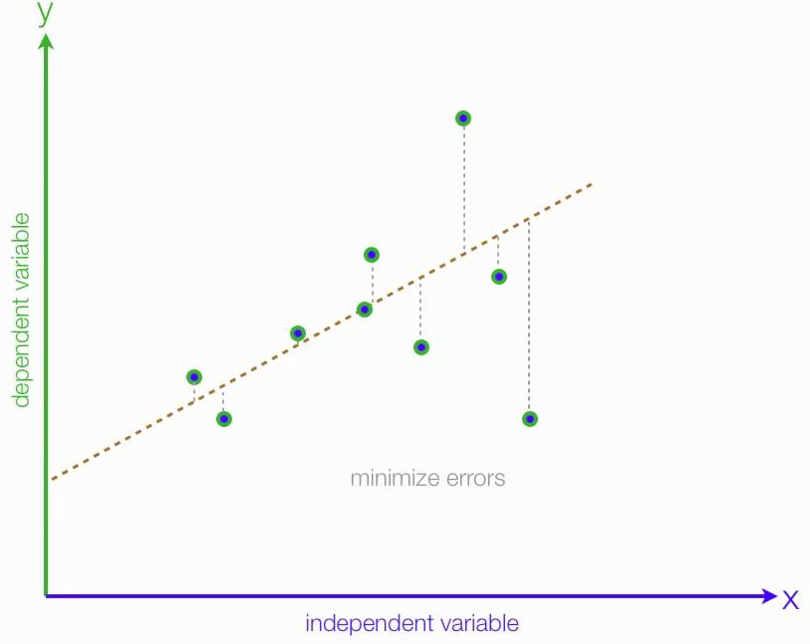
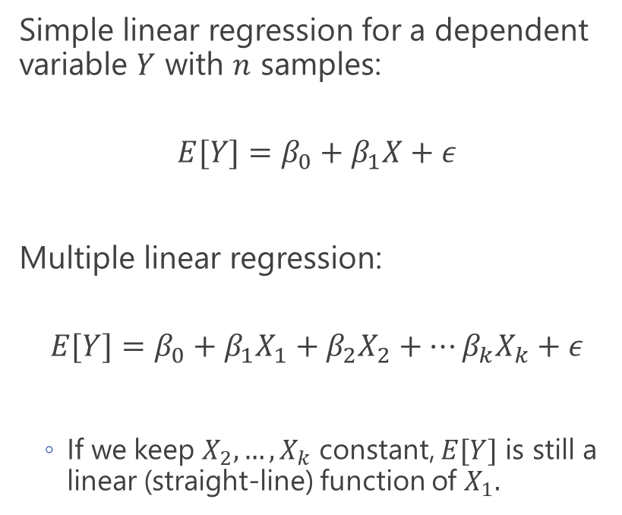
The linear regression model
Simple linear regression for a dependent variable $Y$ with $n$ samples:
$$E[Y]=β_{0}+β_{1}X+ε$$
Multiple linear regression:
$$E[Y]=β_{0}+β_{1}X_{1}+β_{2}X_{2}+…β_{k}X_{k}+ε$$
If we keep $X_{2},…,X_{k}$ constant, $E[Y]$ is still a linear (straight-line) function of $X_{1}.$
Notes:
Let’s put some math on the board. Linear regression models the mean or expectation of Y, denoted E(Y), as a straight line function of a predictor variable X. The figure on the right shows data observations as points, and the regression line as the dotted line. In regression, the beta0 is the intercept of the line of best fit and the slope of the line is beta1. We can extend to multiple regression by adding on more predictors, X_2 to X_k. If we keep X2 to Xk constant, that portion of the right-hand side gets absorbed into the intercept and we still have a linear function of X1.

Slide 4
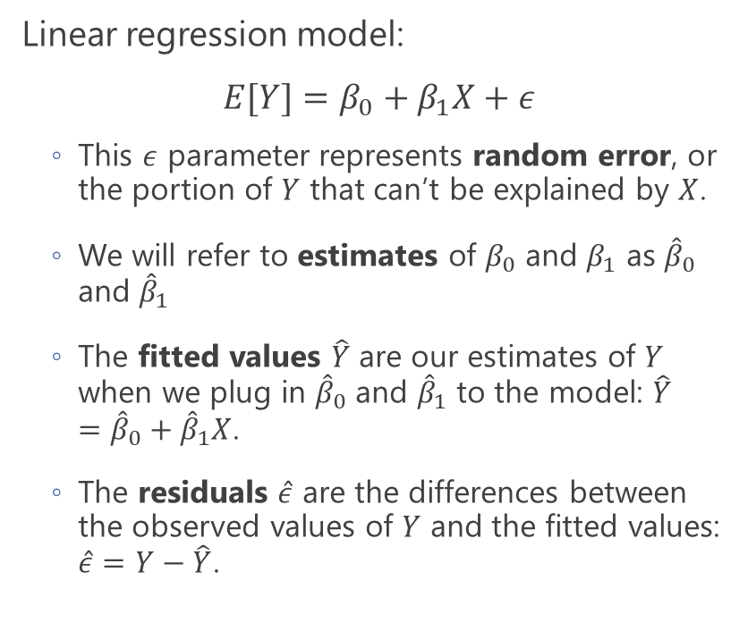
A few specifications and definitions
Linear regression model:
$$E[Y]=β_{0}+β_{1}X+ε$$
This $ε$ parameter represents random error, or the portion of $Y$ that can’t be explained by $X$.
We will refer to estimates of $β_{0}$ and $β_{1}$ as ${\hat{β}}_{0}$ and ${\hat{β}}_{1}$
The fitted values $\hat{Y}$ are our estimates of $Y$ when we plug in ${\hat{β}}_{0}$ and ${\hat{β}}_{1}$ to the model: $\hat{Y}={\hat{β}}_{0}+{\hat{β}}_{1}X$.
The residuals $\hat{ε}$ are the differences between the observed values of $Y$ and the fitted values: $\hat{ε}=Y−\hat{Y}$.
Fitted value
Residual
Notes:
Let’s also go through some simple definitions. Linear regression models the mean or expectation of Y, denoted E(Y), as a straight line function of a predictor variable X, where Beta0 is the intercept of the line and beta1 is the slope. The epsilon parameter represents random error, or the portion of Y that can’t be explained by X. We’re assuming this error is normally distributed. We’ll refer to estimates of parameters by throwing hats on the parameters. So the estimated intercept is beta hat 0. Fitted values Yhat are estimates of Y when we plug in the parameter estimates. So, in this figure, the fitted value for this observation is this point here on the regression line. Accordingly, the residual is the difference between the fitted value of Y and the observed value.

Slide 5
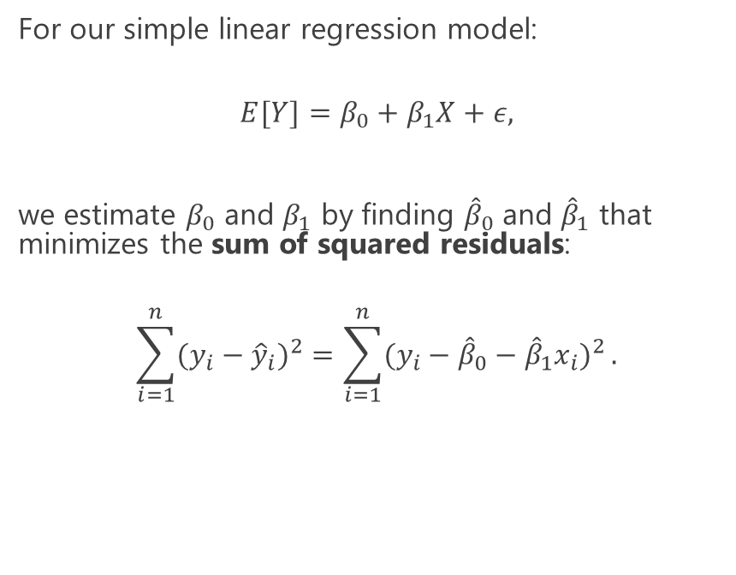
Ordinary least squares
For our simple linear regression model:
$$E[Y]=β_{0}+β_{1}X+ε,$$
we estimate $β_{0}$ and $β_{1}$ by finding ${\hat{β}}_{0}$ and ${\hat{β}}_{1}$ that minimizes the sum of squared residuals:
$$\sum_{i=1}^{n}{(y_{i}−{\hat{y}}_{i})^{2}}=\sum_{i=1}^{n}{(y_{i}−{\hat{β}}_{0}−{\hat{β}}_{1}x_{i})^{2}}.$$
Notes:
We fit linear regression using a procedure called ordinary least squares. Essentially we’re searching for beta hat values that minimize the sum of squared residuals, shown here. From the last slide, the residual is y minus yhat, we square it and the sum over all samples, and we end up with the sum of squared residuals. This gif here is illustrative. The gray diagonal line is the eventual regression line for the observations in black. The blue line swings around, searching through various estimates for the slope and intercept, but it stabilizes on the grey line that minimizes the sum of squared residuals, which are shown by these gray springy lines.

Slide 6
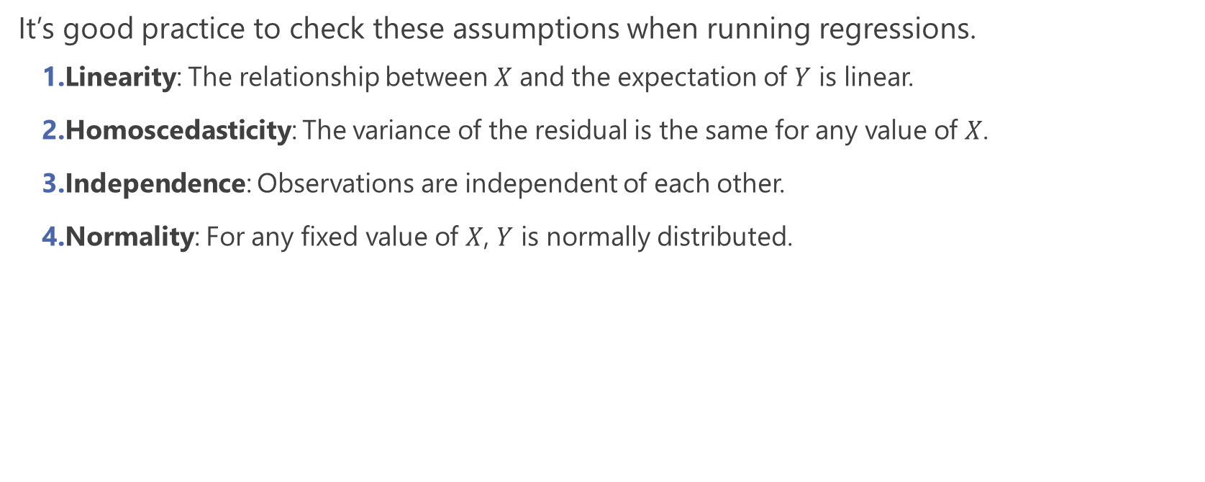
Key assumptions for linear regression
It’s good practice to check these assumptions when running regressions.
Linearity: The relationship between $X$ and the expectation of $Y$ is linear.
Homoscedasticity: The variance of the residual is the same for any value of $X$.
Independence: Observations are independent of each other.
Normality: For any fixed value of $X$, $Y$ is normally distributed.
Notes:
Linear regression has 4 key assumptions, and it’s important to evaluate these when running a regression. First, linearity – that the predictors and dependent variable have a linear relationship, this straight line relationship. Next, homoscedasticity, where the variable of the residuals are the same across any value of X. Third is independence, where we assume that the observations in our data are not related to one another. And lastly, normality, which is the most often misinterpreted assumption. Here, given X, Y is normally distributed. This isn’t that Y itself is normally distributed, but the residuals are. We’ll cover simple ways to check these assumptions shortly.

Slide 7
Example: eQTL analysis
An expression quantitative trait locus (eQTL) is a genomic locus associated with expression of a gene.
Traditionally, a preliminary eQTL analysis is a series of linear regressions between all genetic variants (SNPs) in the genome with all genes in the transcriptome.
Here, we’ll be looking through a single eQTL: 1 SNP, 1 gene, and the potential influence of age on the SNP-gene relationship.
Notes:
We’ll now go through a practical example through eQTL analysis. eQTLs are expression quantitative trait loci, or a part of the genome that associated with gene expression. Traditionally, the important step of eQTL analysis is a series of linear regressions between all genetic variants in the genome and genes in the transcriptome. But here, we’ll look at 1 eQTL – so 1 SNP, 1 gene, and 1 covariate.

