Slide 1

Weather Prediction
Quad Squad
Ramya Hebbar 001057766
Megha Bhattad 001088352
Bharathi Madhu 001086000
Lakshmi Holemadlu Venkatesh 001067089

Slide 2
PROBLEM STATEMENT
Weather Forecasting is important because it helps in determining future climate expectations.
The problem we will tackle in this project is predicting the weather of Seattle using over 3 years of past weather data. We will be using appropriate algorithm for processing large chunks of data where massive quantity of historic weather datasets could be utilized for forecasting.

Slide 3
Workflow
Data Acquisition
Data Preprocessing
Model Architecture and Training
Prediction

Slide 4
Data Acquisition
Data set is downloaded from Google
CSV file contains date, precipitation, maximum temperature, minimum temperature, wind and weather for Seattle city from year 2012 to 2015.
There were 1461 records in total.

Slide 5
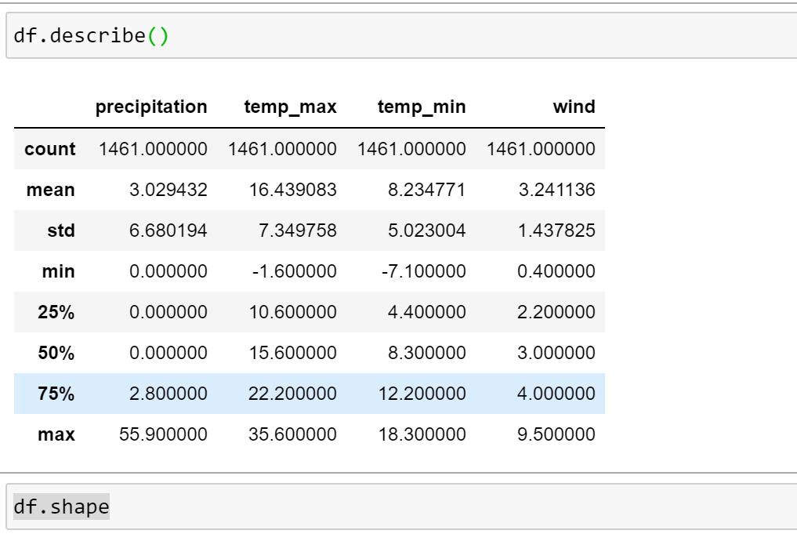
Data preprocessing
Explore the data
Generate descriptive statistics, dispersion and shape of a dataset’s distribution, excluding NaN values

Slide 6
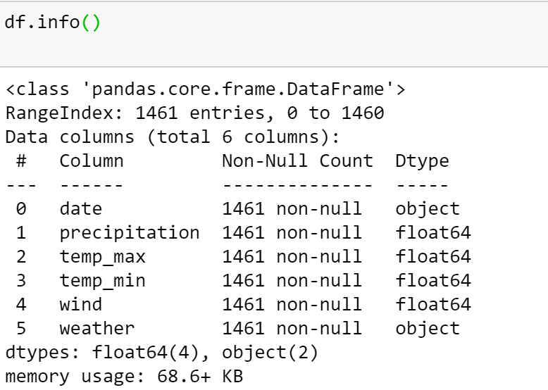
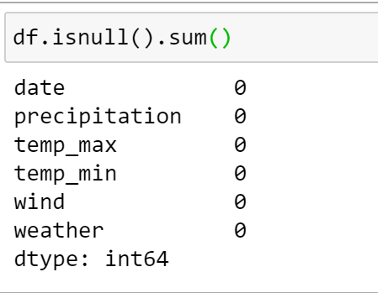
Data preprocessing
Identify Anomalies/ Missing Data
Missing data can impact analysis immensely, as can incorrect data or outliers.
To identify anomalies, use the info() method on dataframe.
To find the total amount of missing values in each column, use the “.isnull()” and “.sum()” methods on dataframe.

Slide 7
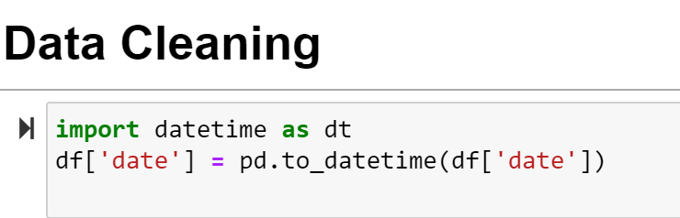
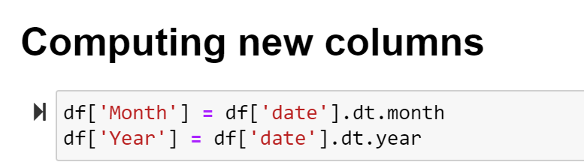
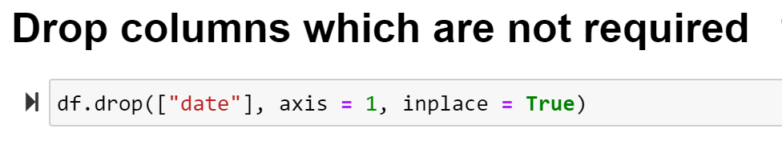
Data preprocessing
Prepare the data by cleaning/wrangling
Convert Date variable which is object to Pandas compatible datetime datatype
Compute new columns (month and year)
Drop columns which are not required (date)

Slide 8
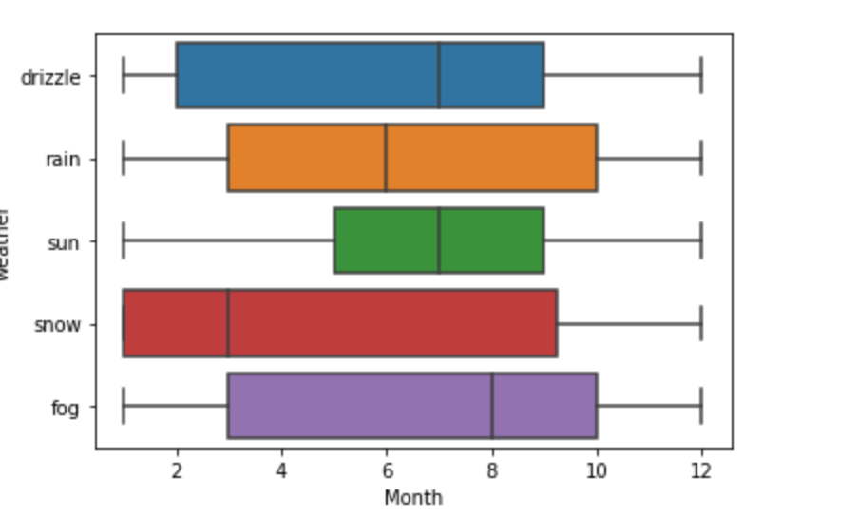
Data Visualization
Plotting helps to get an understanding of how related each columns are to each other.
The target, also known as Y, is the value we want to predict, in this case, weather and the features are all the columns (minus our target) the model uses to make a prediction.
sns.boxplot(x= df['Month'], y=df["weather"])

Slide 9
Splitting Data into train set and Test set
Split the data into training and testing sets to get a representation of all data points.

Slide 10

Algorithms

Slide 11
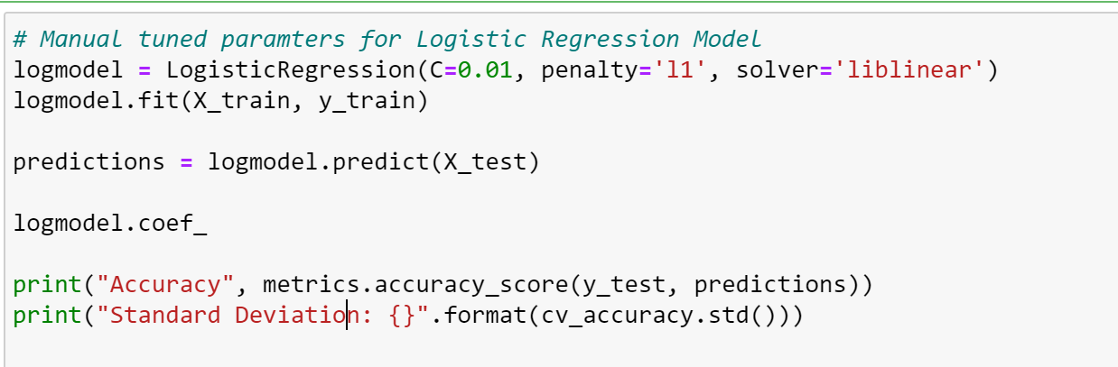
Logistic Regression
Logistic regression is a statistical model that in its basic form uses a logistic function to model a binary dependent variable, although many more complex extensions exist.
In statistics, the logistic model is used to model the probability of a certain class or event existing such as pass/fail, win/lose, alive/dead or healthy/sick.
Mean accuracy: 0.7826127806982021
Standard Deviation: 0.027982321411295922

Slide 12
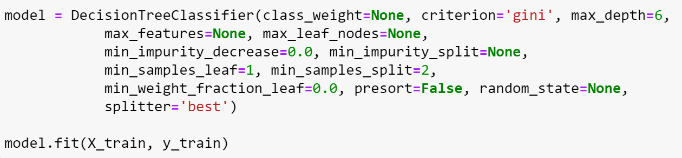
Decision tree
0
A decision tree is a machine learning algorithm that partitions the data into subsets.
The partitioning process starts with a binary split and continues until no further splits can be made. Various branches of variable length are formed.
The goal of a decision tree is to encapsulate the training data in the smallest possible tree.
Mean Accuracy: 0.847498565877806
Standard Deviation: 0.02457562461829965

Slide 13
Conclusion
We were successful in implementing weather prediction using logistic regression and decision model on our dataset.
After training and testing our dataset we got good accuracy of over 78% using logistic regression and over 84% using decision tree algorithms.
Logistic Regression becomes significantly slower as the volume of data increases making them an impractical choice in environments where predictions need to be made rapidly.
Hence Decision Tree emerges as the algorithm of choice.

Slide 14

Thank You !

