Slide 1
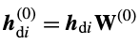
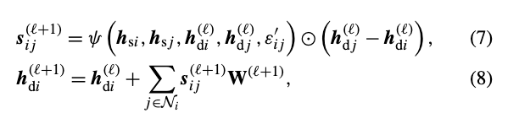

High dimensional representation of static, dynamic and edge features of node i and its neighbor j
Gradient between two nodes based on dynamic features like flood depth at previous time step, precipitation etc.
Concatenating two by element wise dot product results in edge flux
Parameter matrices
Depth at l+1 = depth at layer l + change in depth caused by flux exchange between i and j

