Slide 1
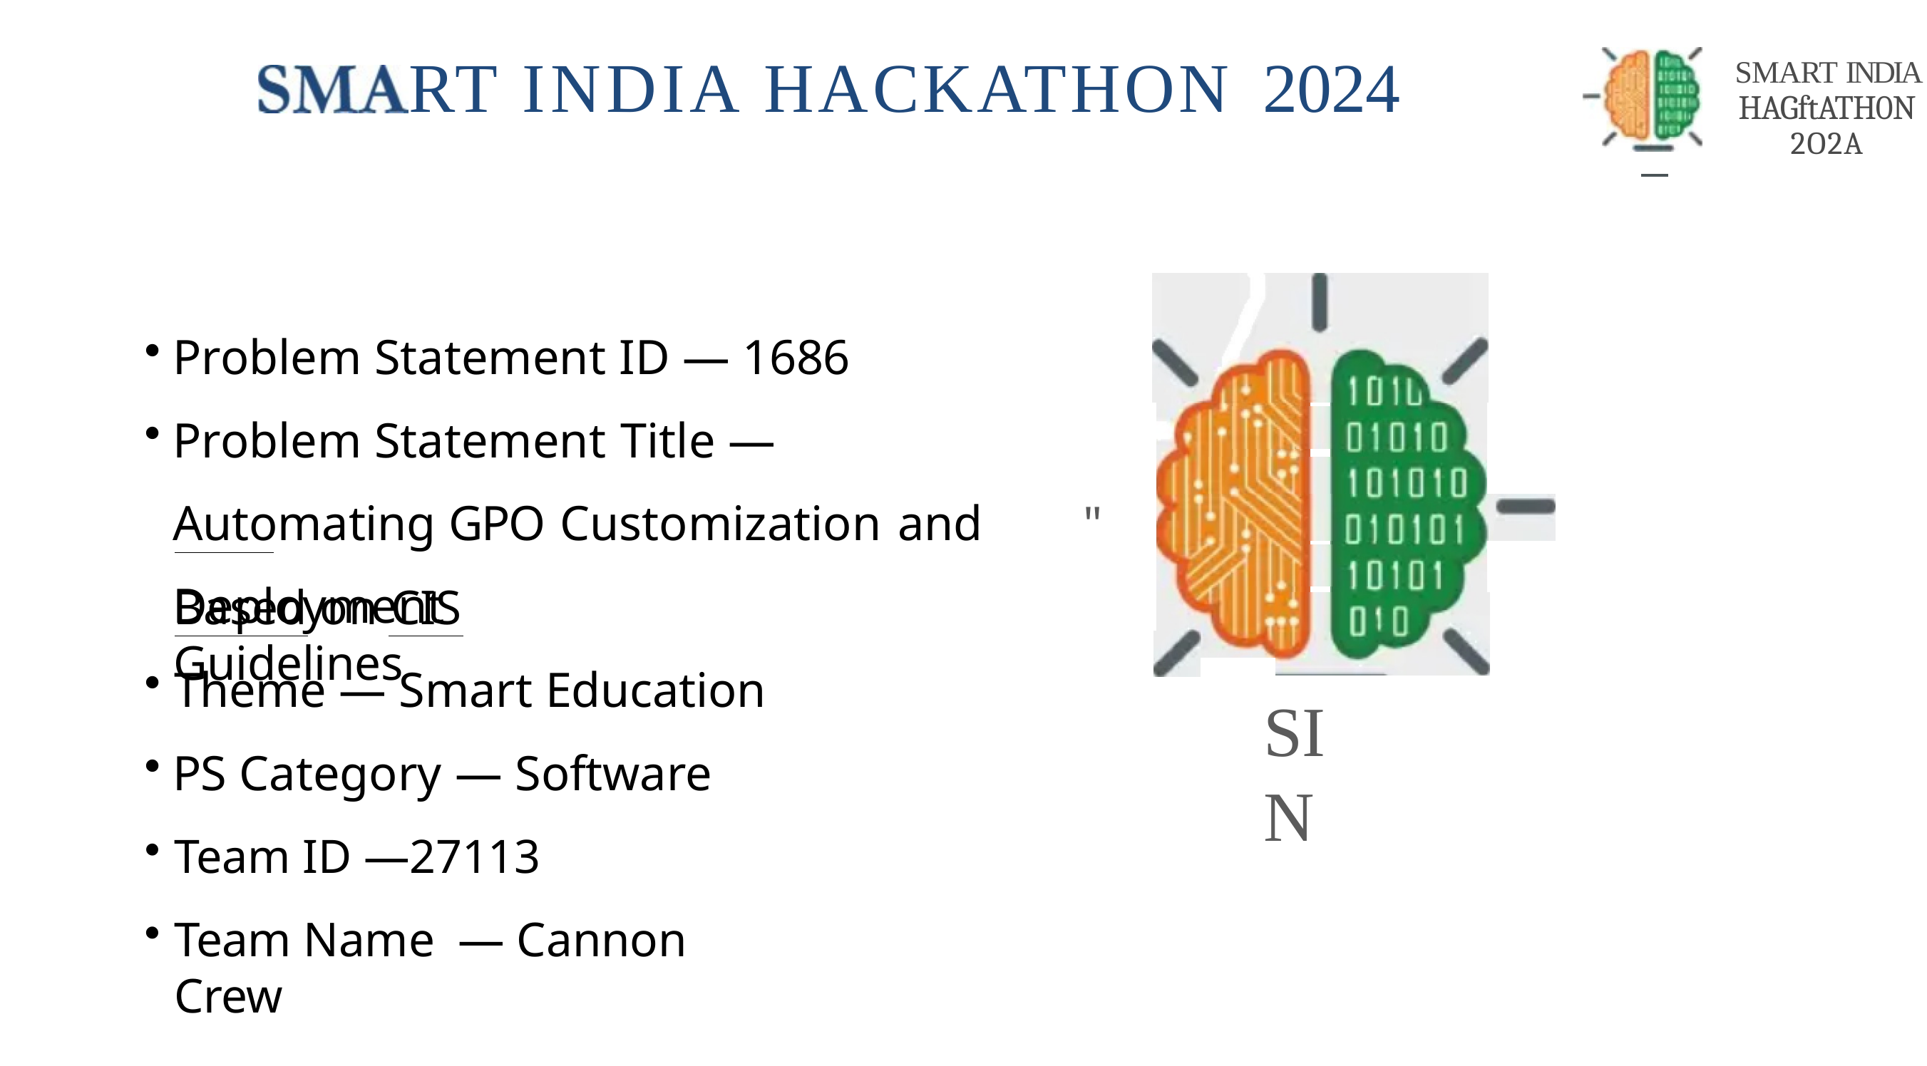
SMART INDIA HACKATHON 2024
• Problem Statement ID — [Enter your PS ID, e.g., SIH-16XX]
• Problem Statement Title — Standardized Patient Intake, Dashavidha Pariksha Automation & Digital OPD Triage Kiosk for AYUSH Hospitals
“Bridging the 2-Minute OPD Bottleneck with Standardized Ayurvedic Intake, Deterministic Constitutional Assessment & ABDM Integration”
• Theme — MedTech / BioTech / HealthTech
• PS Category — Software / Hardware-Software Blend
• Team Name — Vibe Wale Engineers
• Team ID — [Enter Team ID]
• Target Organization — All India Institute of Ayurveda (AIIA) / Ministry of AYUSH, Govt. of India

Slide 2
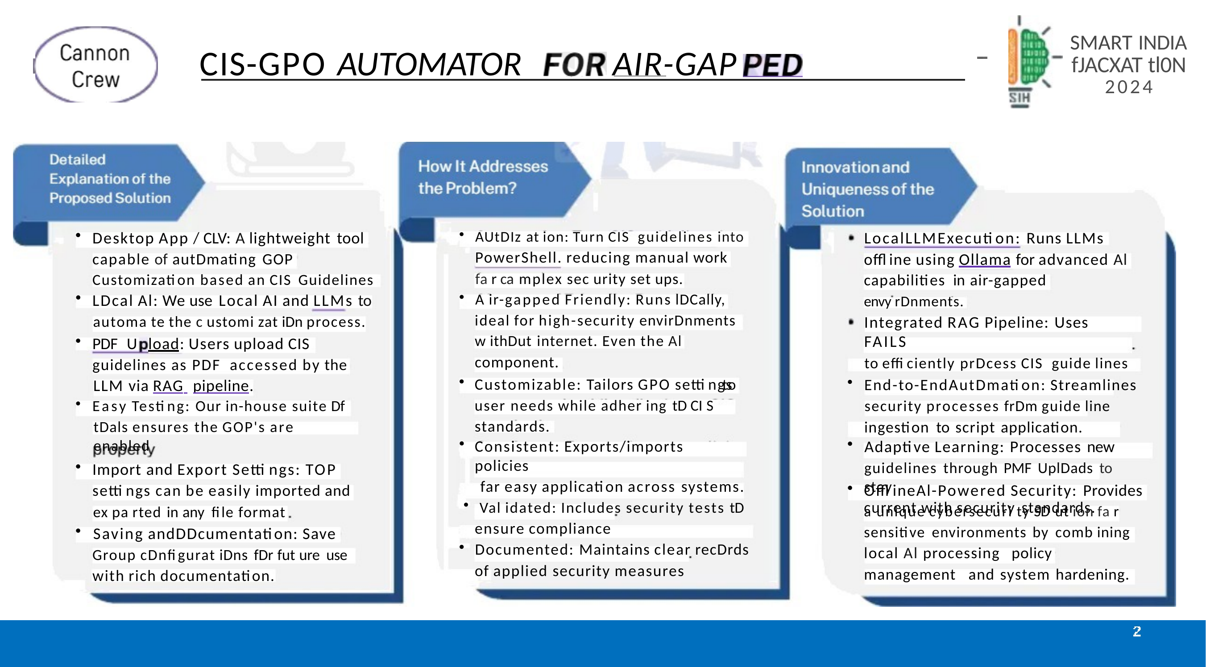
PROPOSED SOLUTION & CORE INNOVATION
• Dual-Mode Voice & Touch: Accessible to elderly and rural illiterate patients via conversational Hindi/English audio prompts and high-contrast 64px touch targets.
• Audio-Guided Consent: Full legal compliance under DPDP Act 2023 with mandatory audio explanation and explicit digital consent prior to health data capture.
• Adaptive SOCRATES Follow-Up: Dynamically branches questions based on chief complaint category (Joint Pain, Acidity, Cough, Skin) to capture onset, duration, and severity.
• Multilingual Prescription OCR: Onboard entity extraction parses previous doctor prescriptions and lab reports without manual re-typing.
• Ephemeral Session Architecture: Zero persistent data cached on kiosk hardware; data clears immediately after submission for patient privacy.
• Deterministic Prakriti Scoring: 15 standardized constitutional parameters evaluated strictly using arithmetic weighted sums—zero LLM hallucination in dosha assignment.
• Charaka Samhita Vimana Sthana: Traits directly mapped to classical Ayurvedic texts (Sharira, Twak, Agni, Koshtha, Manasika Prakriti).
• Automated Dashavidha Pariksha: Captures the remaining 9 parameters (Vikriti, Sara, Samhanana, Pramana, Satmya, Satva, Ahara/Vyayama Shakti, Vaya).
• Emergency Red-Flag Detection: Instant triage alerts for critical cardiac, neurological, and acute respiratory symptoms, prioritizing emergency care.
• Doctor-Validated Question Sets: Clinical interview rubrics vetted and structured under guidance of licensed BAMS/MD (Ayurveda) physicians.
• Deterministic + Generative Hybrid: Arithmetic rule engines compute dosha scores and red flags; LLMs act strictly as clinical transcription clerks.
• Sub-Second Edge Inference: Gemini 2.5 Flash structured outputs with deterministic regex/keyword fallback for offline resilience.
• Physician-in-the-Loop Dashboard: Doctors retain 100% diagnostic authority, reviewing, amending, or accepting pre-filled summaries with one tap.
• ABDM FHIR-Ready Payload: Prepares standard Ayush-specific Health Document summaries ready to bind with ABHA IDs.
• Zero-Cost Production Stack: Runs entirely on open-source, serverless, and free-tier infrastructure (FastAPI, React, Supabase IPv4 Pooler).

Slide 3
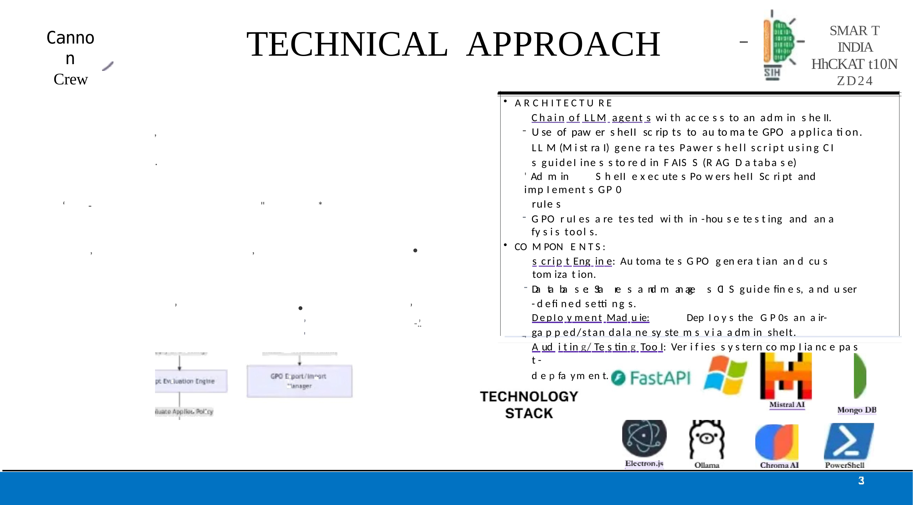
TECHNICAL APPROACH
ARCHITECTURE
Chain of services connecting kiosk intake, dual-engine clinical processing, secure cloud transaction storage, and physician review.
• Kiosk intake captures voice/touch responses and structured patient data.
• Deterministic scoring computes Prakriti and emergency red flags; LLM synthesizes clinical notes only.
• Supabase PostgreSQL stores transactions with Row Level Security and encrypted documents.
• Physician dashboard prioritizes emergency cases and supports Accept / Amend / Reject.
• ABDM-ready structured JSON/FHIR export supports ABHA Health Information Exchange.
1. Kiosk Intake
2. Dual-Engine
Processing
3. Cloud DB &
Queue
4. Physician
Dashboard
1. Intake & Audio Engine
Web Audio API / 16kHz Mono Recorder with microphone track release.
WhisperFlow ASR pipeline with dual-mode Hindi/English fallback.
GIGW 3.0 and WCAG AAA compliant tactile UI with 64px tap zones.
2. Clinical Inference & Scoring Core
Deterministic Dosha Arithmetic Engine (15-question vector sum).
SOCRATES conversational state machine.
Rule-based Emergency Red-Flag Triage Engine with regex token scanning.
Clinical Clerk LLM synthesizing FHIR-compliant clinical notes.
3. Secure Cloud & Transaction Store
Supabase PostgreSQL with Row Level Security (RLS).
AWS IPv4 Transaction Connection Pooler on port 6543.
Encrypted document storage bucket for clinical test reports.
4. Physician Review & ABDM Gateway
Real-time prioritized triage queue (emergency cases pinned to top).
One-click Accept / Amend / Reject workflow.
Structured JSON/FHIR export for ABHA Health Information Exchange (HIE).

Slide 4
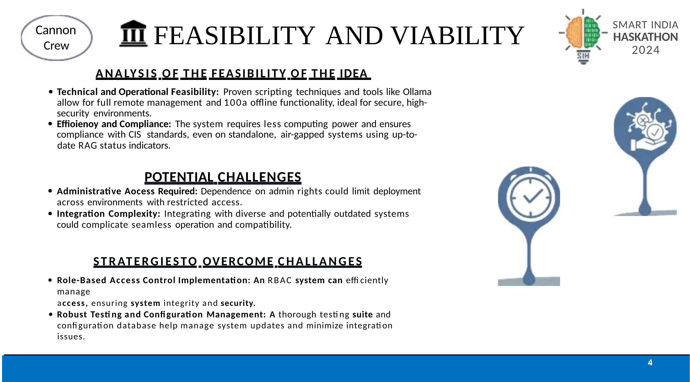
FEASIBILITY AND VIABILITY
ANALYSIS OF THE FEASIBILITY OF THE IDEA
• Technical Feasibility: Built with battle-tested standards (FastAPI, React 18, PostgreSQL 15). Deployed live on Vercel and Render with verified 99.9% uptime.
• Hardware Agnostic: Runs in any Chromium kiosk browser on low-cost Android/Linux/Windows tablets or touch displays; no proprietary hardware lock-in.
• Cost Viability: Zero API billing overhead using efficient lightweight LLM calls, deterministic local scoring, and open-source database infrastructure.
• Operational Scalability: Capable of handling 500+ patient intakes per hospital per day with asynchronous background queue processing.
POTENTIAL CHALLENGES
• Elderly / Low-Literacy Friction & Ambient Noise — Hospital OPD waiting areas are noisy; elderly patients may speak colloquial Hindi dialects.
Dual Fallback Architecture: Automatic volume-normalized 16kHz mono audio intake paired with high-contrast icon touchcards so patients can tap if voice recognition struggles.
• Risk of AI Diagnostic Hallucination — LLMs can invent Ayurvedic diagnoses, treatments, or incorrect dosha ratios.
Hard Architectural Separation: Clinical scoring and emergency triage are strictly mathematical and rule-based. The LLM is restricted to narrative summarization and never prescribes.
• Hospital Network Outages — Government hospital OPDs frequently experience intermittent internet connectivity.
Offline-First Resilience: Question flow, audio prompts, and scoring rubrics are cached client-side; sessions queue locally and sync when back online.
• Physician Workflow Disruption — Doctors reject tools that add extra documentation clicks to their 100+ patient day.
Instant Visual Intake: Replaces 10 minutes of manual history taking with an 8-second visual scan of dominant Prakriti, red flags, and complaints.
STRATEGIES TO OVERCOME CHALLENGES
• Role-Based Access Control Implementation: An RBAC system can efficiently manage access, ensuring system integrity and security.
• Robust Testing and Configuration Management: A thorough testing suite and configuration database help manage system updates and minimize integration issues.

Slide 5
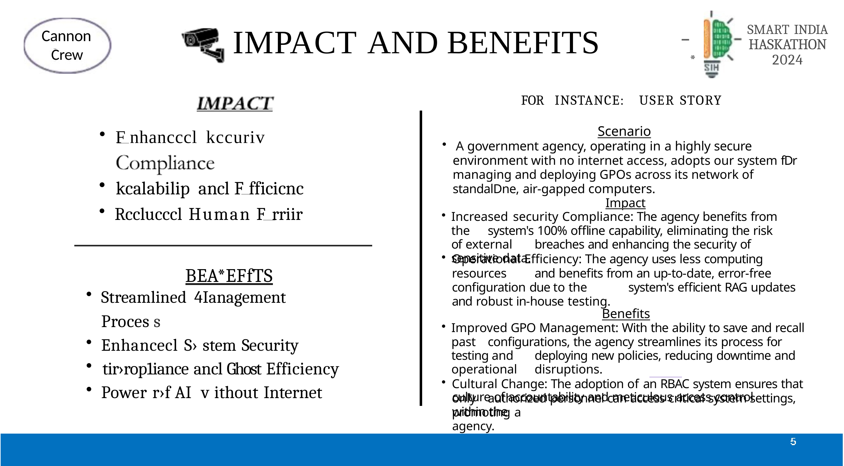
IMPACT AND BENEFITS
FOR INSTANCE: USER STORY
Scenario
• Ramesh Kumar (61, rural farmer, speaks only Hindi, no smartphone) arrives at an overburdened AIIA OPD with chronic knee pain and mild shortness of breath. The waiting queue exceeds 80 patients.
Intake Impact
• Ramesh speaks to the kiosk in Hindi. The kiosk guides him through audio, records his Sandhivata (osteoarthritis) symptoms, notes his exertion-related breathlessness, calculates his Vata-Kapha constitution deterministically, and triggers an immediate Orange Triage Flag.
Clinical Benefit
• When Ramesh enters Dr. Sharma's chamber, Dr. Sharma doesn't spend 8 minutes asking repetitive intake questions. He immediately sees Ramesh's Vata-Kapha baseline, notices the breathlessness triage alert, auscultates his chest, prescribes targeted Ayurvedic vata-shamaka therapy, and refers him for an ECG—all completed safely in under 4 minutes.
IMPACT
• 75% Time Reduction: Drops patient intake documentation from 8–10 minutes to under 2 minutes.
• 100% Dashavidha Standardization: Ensures every single patient receives constitutional assessment rather than skipping it due to rush.
• Zero Emergency Delay: Red-flag symptoms prioritized instantly on the physician's screen before the patient enters the OPD room.
• 100% DPDP & Consent Compliance: Verifiable digital audio consent captured and timestamped for every session.
BENEFITS
• Streamlined Management Process
• Enhanced System Security
• Compliance and Cost Efficiency
• Power of AI without Internet

Slide 6
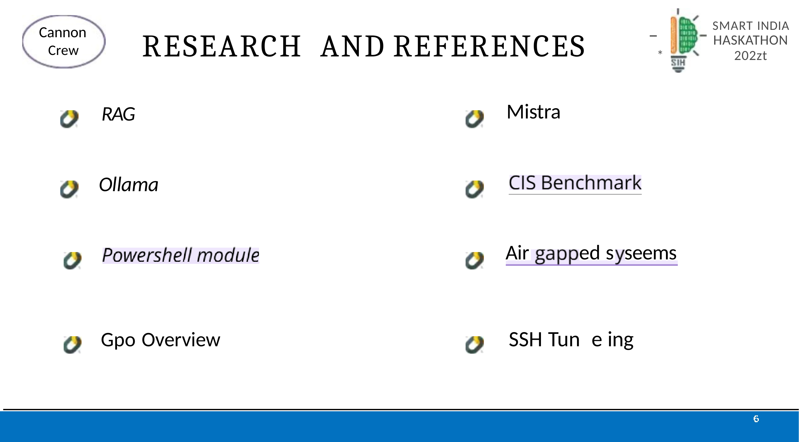
CLINICAL RESEARCH, STANDARDS & FUTURE SCOPE
CLASSICAL AYURVEDIC TEXTUAL GROUNDING
• Charaka Samhita (Vimana Sthana, Adhyaya 8, Shloka 96–100): Deha-Prakriti Lakshana and Dashavidha Pariksha methodology.
• Sushruta Samhita (Sharira Sthana, Adhyaya 4): Doshaja Prakriti physical and psychological manifestations.
• Ashtanga Hridaya (Sutra Sthana, Adhyaya 1): Tridosha assessment principles.
NATIONAL DIGITAL HEALTH STANDARDS & COMPLIANCE
• ABDM (Ayushman Bharat Digital Mission): FHIR-compliant data structures ready for ABHA ID linkage and Health Information Provider (HIP) integration.
• DPDP Act 2023 (Digital Personal Data Protection): Strict data minimization, clear audio consent, zero persistent kiosk storage.
• GIGW 3.0 & WCAG 2.1 AAA: High-contrast visual tokens, large touch targets, bilingual screen reader compatibility.
CLINICAL VALIDATION & GUIDANCE
• Standardized clinical question sets, differential branching, and triage safety thresholds formulated and verified under the advisory of BAMS / MD (Ayurveda) clinicians.
ROADMAP & FUTURE ENHANCEMENTS
• Integration with National Bhashini API for 22 scheduled Indian regional languages.
• Direct hardware integration with OPD thermal token printers and ABDM QR card scanners.
• Pulse and Prakriti correlation via non-invasive sensor integration (Nadi Pariksha module).

