Slide 1

DAB401 Supply Chain Analytics
A Case Study on Demand Forecasting in Retail Sales
Group Members
Apurv Sathwara
Bhakti Bhatt
Dhrumi Patel
Smit Arora
Vismay Lad

Slide 2






Agenda
Introduction
Demand forecasting
Average Moving Analysis
Simple Exponential Smoothing
Linear Regression
ARIMA Model
LSTM Model
Conclusion

Slide 3
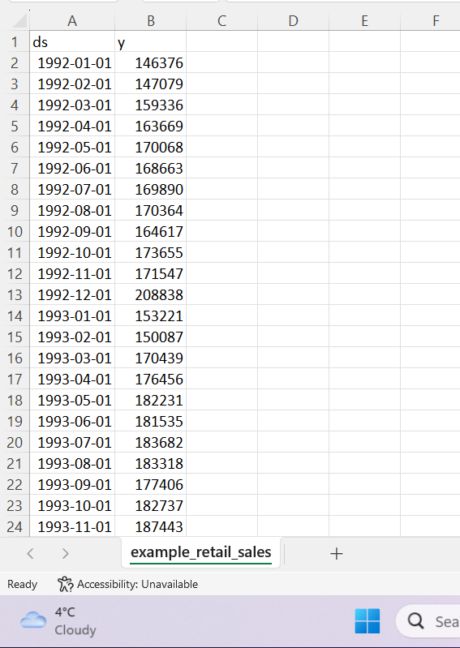
Introduction of data set
This data appears to represent a time series, with monthly measurements of some kind of metric over a period of many years.
The first column appears to be dates in the format of "yyyy-mm-dd", and the second column contains numerical values.

Slide 4
Demand forecasting for Retail Sales
Demand forecasting for retail sales is the process of using historical sales data and other relevant information to predict future sales and consumer demand for retail products.
The goal of demand forecasting is to optimize inventory management, ensure availability of products, and improve profitability.
There are various methods used in demand forecasting for retail sales, including moving average, Exponential smoothing, regression analysis, and ARIMA etc.

Slide 5
Advantages of Demand forecasting for Retail Sales
Demand forecasting for retail sales can help retailers in several ways.
It can help them make informed decisions about inventory management, pricing, and promotional activities.
By accurately predicting demand, retailers can ensure that they have the right amount of stock on hand, avoid stockouts, and minimize excess inventory.
They can also use demand forecasts to plan promotional activities and adjust prices to maximize profits.

Slide 6
Average Moving Analysis
Based on the results of the moving average analysis, it appears that the model has a bias of 4580.29, indicating a tendency to overestimate the values.
The mean absolute error (MAE) is 16186.34, which shows the average difference between the predicted and actual values.
The root mean square error (RMSE) of 21276.45 indicates the standard deviation of the differences between the predicted and actual values.
The mean squared error (MSE) of 452687525.06 provides a measure of how close the predicted values are to the actual values.
Lastly, the mean absolute percentage error (MAPE) of 5.31 shows the average percentage difference between the predicted and actual values.
These metrics provide valuable insights into the performance of the moving average model and can help guide future improvements.

Slide 7
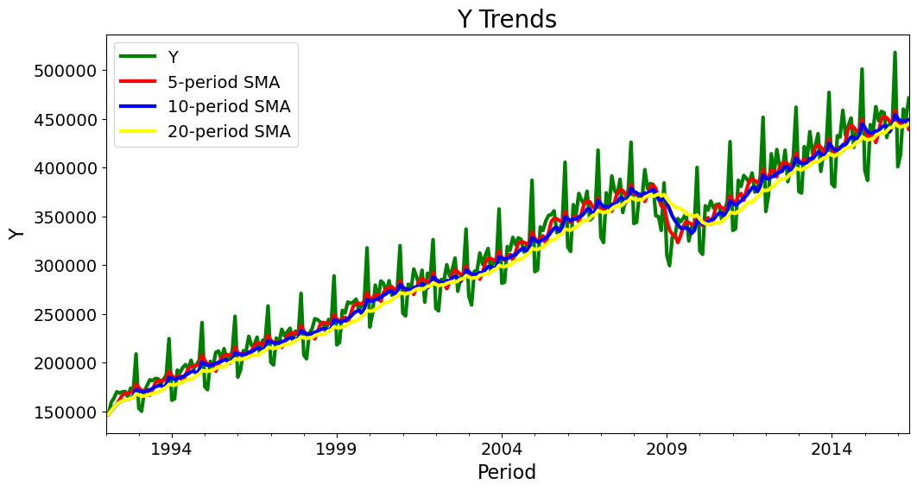
According to the findings of the moving average study, the model appears to have a bias of 4580.29, showing a propensity to overstate the values.
The average discrepancy between the predicted and actual values is represented by the mean absolute error (MAE), which is 16186.34.
The standard deviation of the variances between the predicted and actual values is shown by the root mean square error (RMSE), which is 21276.45.
How closely the predicted values match the actual values is indicated by the mean squared error (MSE), which is 452687525.06.
Finally, the mean absolute percentage error (MAPE) of 5.31 displays the typical percentage difference between the expected and actual values.
The moving average model's performance can be better understood by these indicators, which can also serve as a roadmap for future developments.

Slide 8
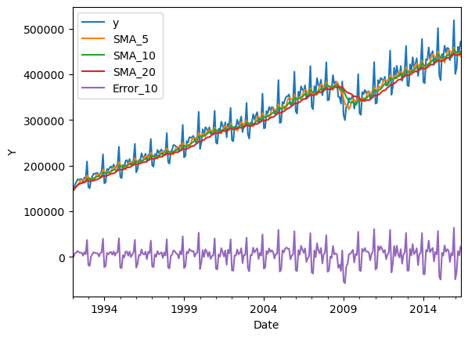
Simple Exponential Smoothing
As you can see in the plot, we have our stock's closing price as a 5-day, 10-day and 20-day simple moving average.

Slide 9
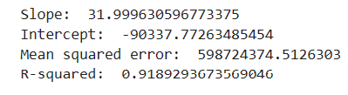
Linear Regression
The value of R-squared ranges from 0 to 1, where 0 indicates that the model explains none of the variability of the response data around its mean, and 1 indicates that the model explains all the variability of the response data around its mean.
Therefore, an R-squared value of 0.9189 suggests that 91.89% of the variance in the dependent variable can be explained by the independent variable(s) in the model, which indicates a strong fit between the model and the data.

Slide 10
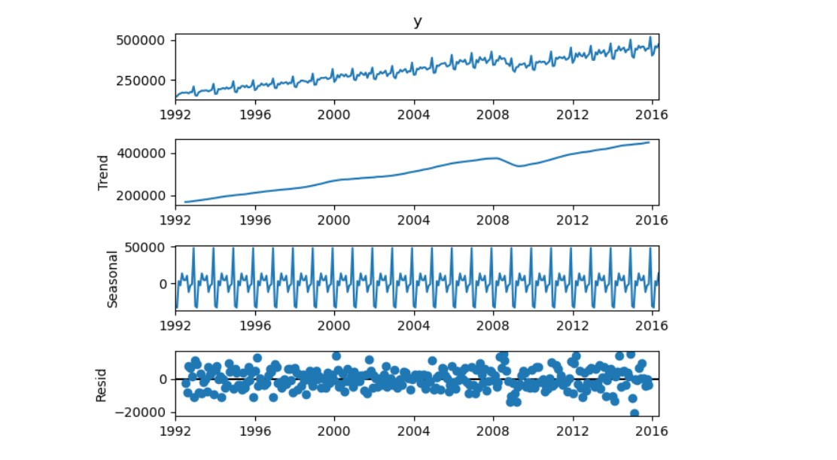
ARIMA Model

Slide 11

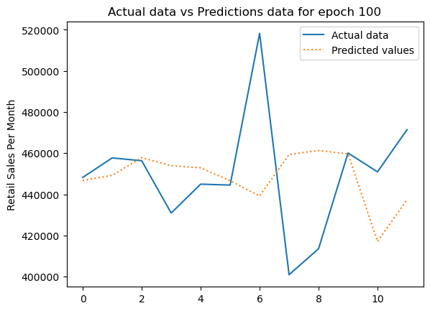
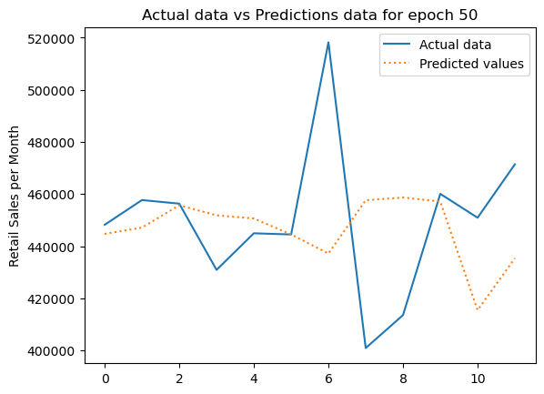

LSTM Model

Slide 12
LSTM Model
The predicted values are the same for epoch 100, epoch 50, and epoch 80 in an LSTM model, it may indicate that the model has converged and is not improving anymore with further training.
In other words, the model has reached a point where it is making the same predictions regardless of the number of epochs.
While this may seem like a good thing, it is important to note that this may also suggest that the model has overfit the training data and is not able to generalize well to new, unseen data. Therefore, it is important to evaluate the model's performance on a separate validation set to ensure that it is not overfitting.

Slide 13
Conclusion
According to the case study on demand forecasting in retail sales, precise demand forecasting is essential for the success of any retail organisation.
To effectively forecast customer demand for their products, retailers must rely on data research and market trends.
The case study emphasises the significance of employing sophisticated forecasting methods including time series analysis, regression analysis, and machine learning algorithms to precisely predict demand.
These methods can aid merchants in making well-informed choices regarding inventory management, pricing schemes, and advertising efforts.
Furthermore, it's critical for retailers to continuously review and modify their demand forecasting models considering shifting consumer preferences and market dynamics.
They can use this to maintain an advantage over the competition and make sure they are successfully satisfying customer demand.
Overall, demand forecasting is crucial to the success of retail operations, and for long-term growth and profitability, merchants should spend in creating and improving their forecasting models.

