Slide 1
EDA 02
Hotel Harmony: Data Insights for Optimized Operations
Hotel booking demand (Antonio, Almeida & Nunes; Kaggle jessemostipak/hotel-booking-demand)

Slide 2
1) Overview
• Elite Hotels International reviews city and resort booking history to stabilize occupancy, cut avoidable cancellations, and price rooms using ADR and channel mix.
• Internal: Management, Operations, Marketing, Customer Service
• External: Guests, Travel agencies, Suppliers

Slide 3
2) Problem Statement
• Booking patterns and guest satisfaction are uneven across hotels, channels, and seasons. Management needs evidence on lead time, cancellations, demand peaks, and revenue so operations and marketing can allocate rooms, staff, and promotions more effectively.

Slide 4
3) Proposed Methodology
• Clean missing agent/company/children fields, parse arrival dates, drop duplicates and zero-guest rows.
• Define metrics: lead time, cancellation rate, stay length, special requests, and ADR-based revenue.
• Profile demand by hotel type, month, market segment, and country.
• Relate lead time and deposit type to cancellations; fit a logistic baseline.
• Convert findings into overbooking, pricing, and loyalty actions.

Slide 5
4) Data Overview
• rows_raw: 119390
• rows_clean: 87229
• cancellation_rate: 0.2752
• hotels: {'City Hotel': 53273, 'Resort Hotel': 33956}
• years: [2015, 2016, 2017]
• average_stay_nights: 3.63
• realized_stay_share: 0.7248
• Data dictionary: see docs/CASE_STUDY.md

Slide 6
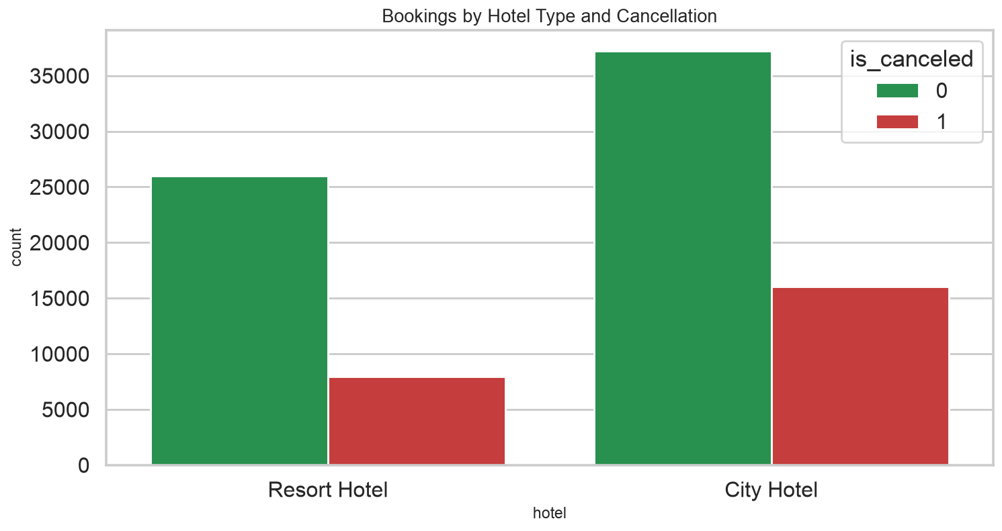
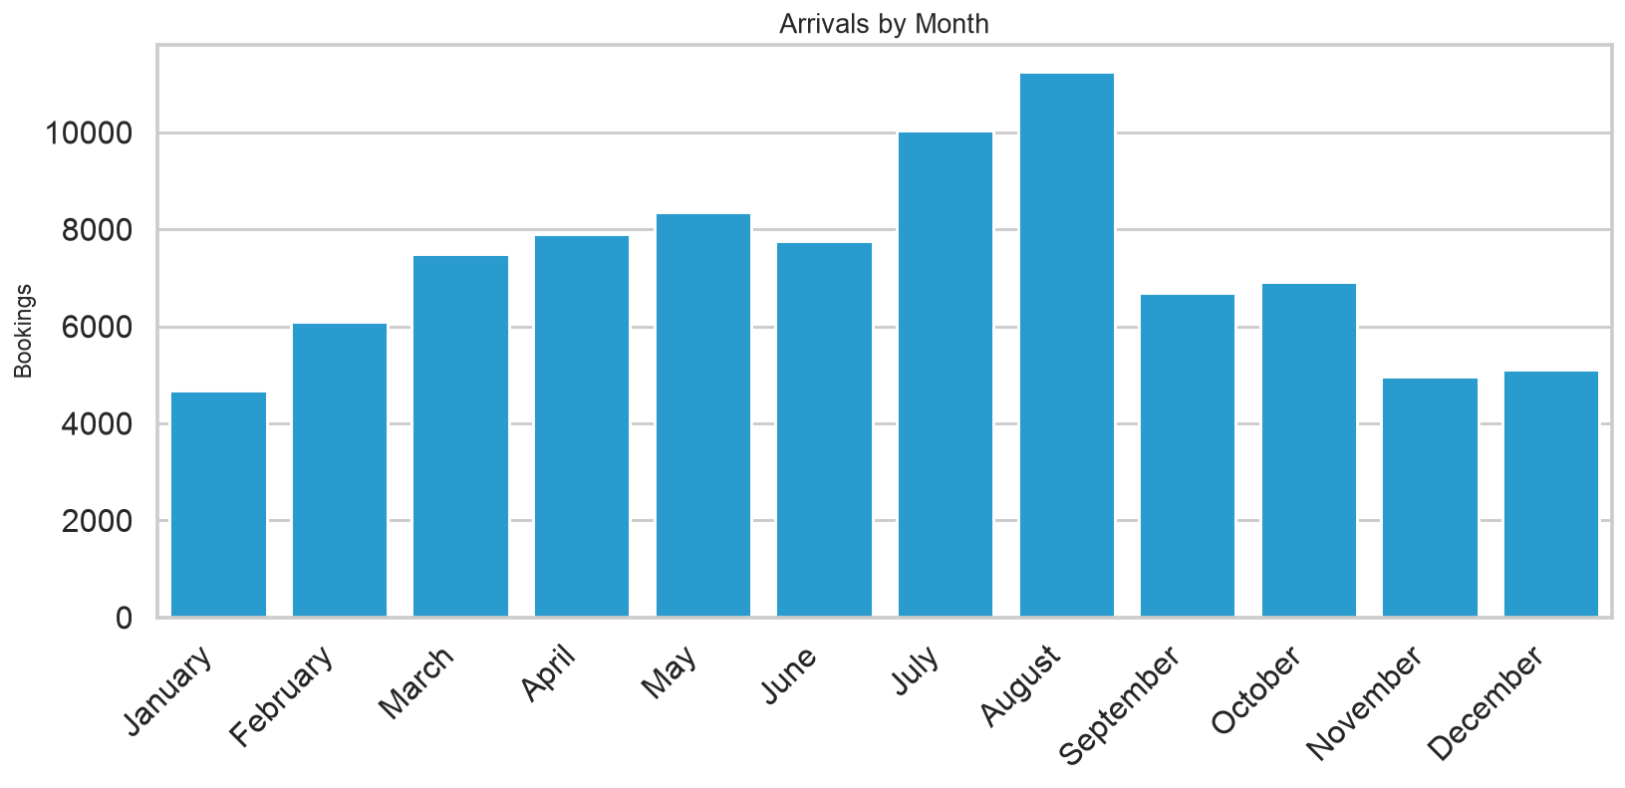
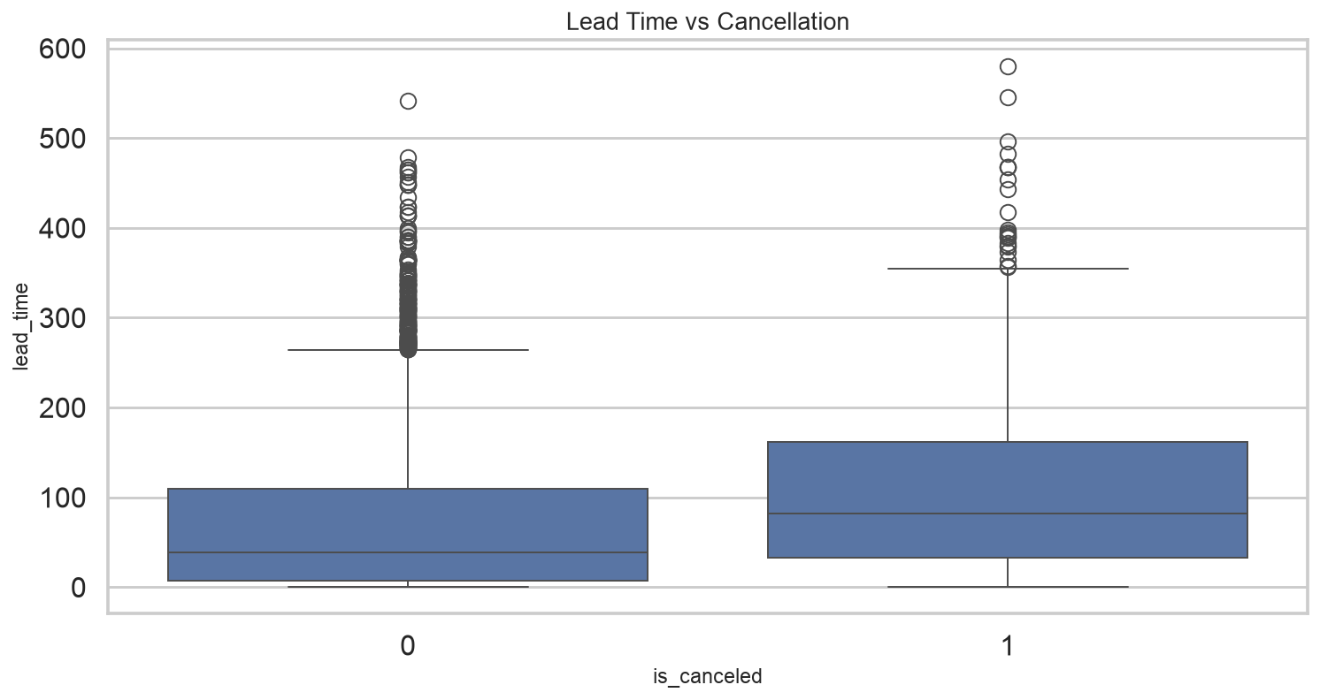
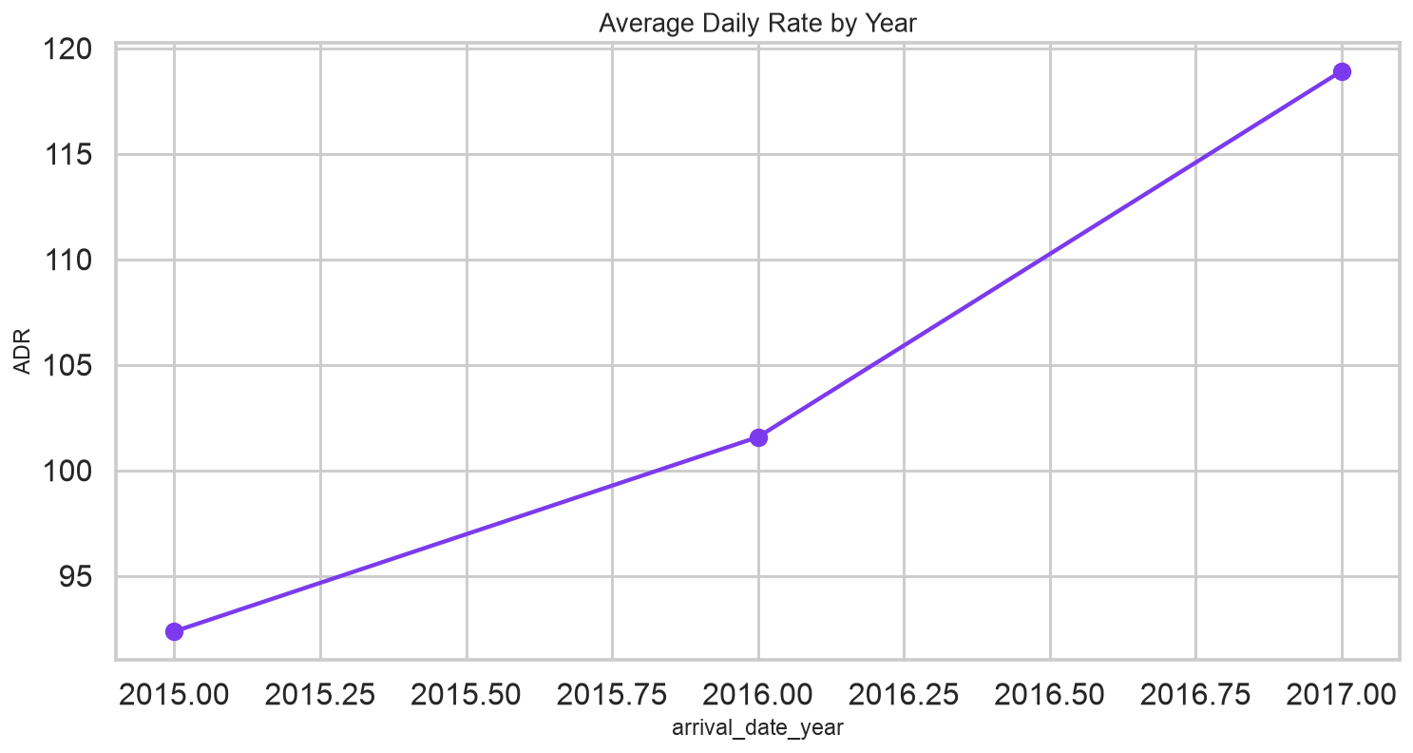
4) Data Overview — charts

Slide 7
5) Key Findings
• Overall cancellation rate is 27.5% after cleaning.
• Guests book about 80 days ahead on average; longer lead times track with more cancellations (r=0.18).
• August is the busiest arrival month; August leads ADR × stay revenue.
• PRT and other top origin markets dominate volume; PRT is the single largest country.
• A logistic model using lead time, deposit, segment, and requests reaches AUC 0.77 on a hold-out set.

Slide 8
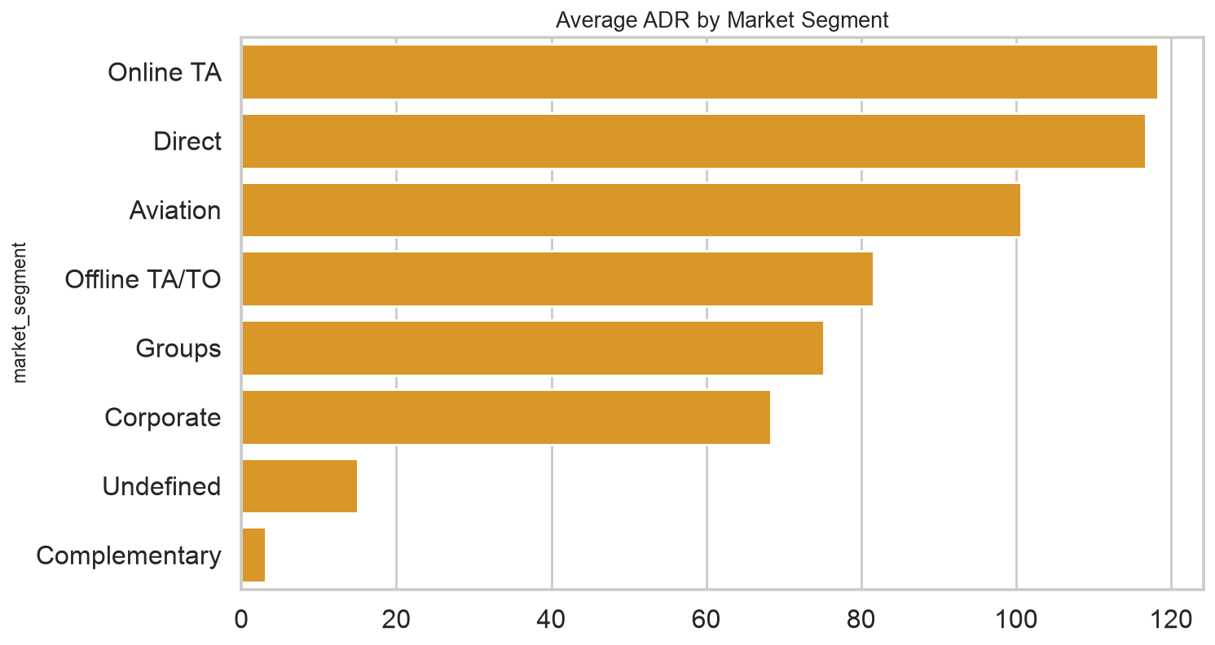
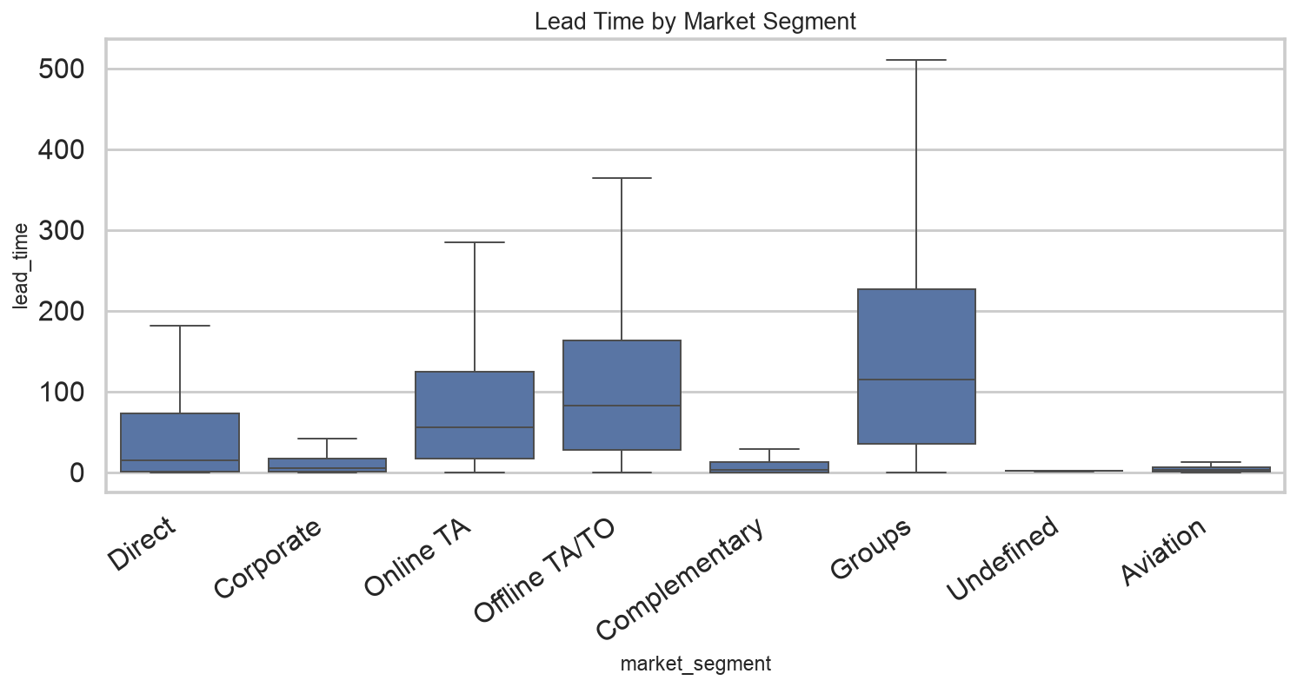
5) Key Findings — charts

Slide 9
6) Limitations
• The public dataset covers two hotels in Portugal, not a global brand.
• ADR is not full P&L; extras, commissions, and costs are missing.
• Company and agent IDs are anonymized and heavily missing.
• Guest satisfaction is proxied by requests and repeats, not survey scores.
• Cancellation model is explanatory, not a production overbooking engine.

Slide 10
7) Conclusion
• Demand is seasonal and channel-dependent. City vs resort mix, non-refundable deposits, and long lead times are the practical levers for cancellation control, while ADR and segment mix drive revenue planning.

Slide 11
8) Recommendations
• Tighten deposit or reminder policies on long-lead leisure bookings with high cancel risk.
• Staff and price for the summer/peak-month wave rather than a flat annual plan.
• Protect relationships with TA/TO and Direct channels that carry volume.
• Use parking and special-request data to design upsell packages, not only room rate.
• Build a repeat-guest offer; loyalty stays look different from first-time transient stays.

