Slide 1
EDA 03
Pulse of Prevention: Analyzing Heart Health for Better Outcomes
Heart disease clinical records (Kaggle johnsmith88/heart-disease-dataset / UCI Cleveland family)

Slide 2
1) Overview
• HealthPulse Analytics profiles cardiology patients to find demographic and clinical factors linked to heart-disease diagnosis and to support earlier prevention.
• Internal: Management, Healthcare providers, Data analysts
• External: Patients, Cardiology research institute, Policymakers

Slide 3
2) Problem Statement
• The institute needs a high-risk patient profile from age, sex, chest pain, blood pressure, cholesterol, ECG, exercise tests, fluoroscopy vessel counts, and thalassemia — then clear prevention actions for clinicians and patients.

Slide 4
3) Proposed Methodology
• Validate types, map target to binary disease, drop duplicates, and winsorize extreme labs.
• Describe demographics and clinical distributions.
• Correlate features with diagnosis; compare groups with t-tests and crosstabs.
• Fit a standardized logistic regression with a stratified hold-out set (AUC, F1).
• State ethical limits: this is decision support, not an autonomous diagnosis.

Slide 5
4) Data Overview
• rows_raw: 303
• rows_clean: 302
• disease_prevalence: 0.543
• mean_age: 54.42
• features: ['age', 'sex', 'cp', 'trestbps', 'chol', 'fbs', 'restecg', 'thalach', 'exang', 'oldpeak', 'slope', 'ca', 'thal']
• Data dictionary: see docs/CASE_STUDY.md

Slide 6
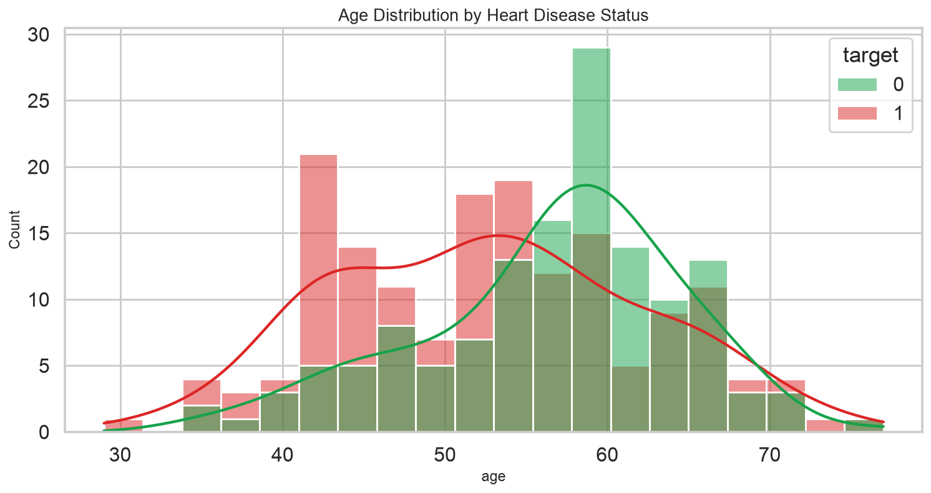
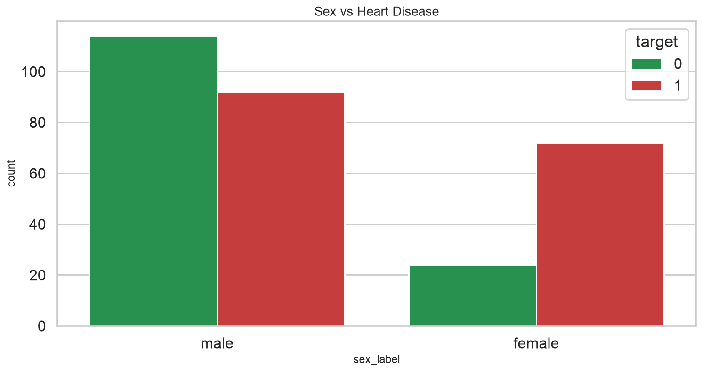
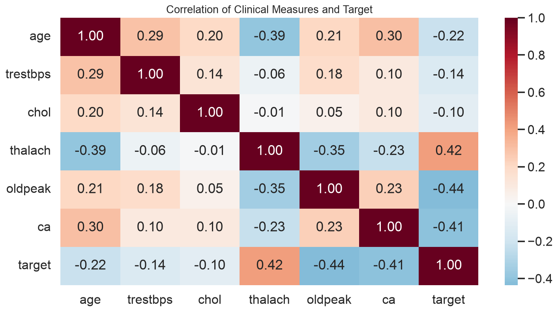
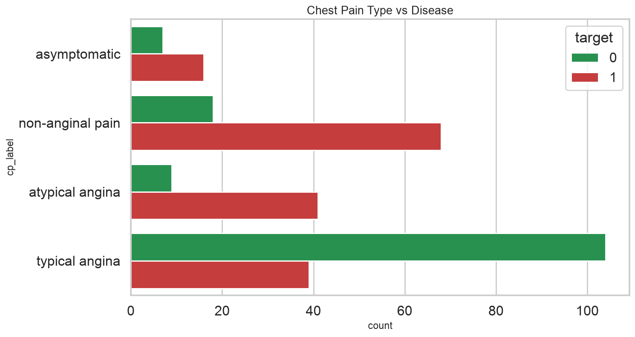
4) Data Overview — charts

Slide 7
5) Key Findings
• After cleaning, disease prevalence is 54.3% of unique patient rows.
• Mean age is 54.4 years; the cohort is mixed but typically middle-to-older adult.
• The strongest numeric association with diagnosis in this extract is exang (r=-0.44).
• Exercise angina share is 32.8%; max heart rate averages differ by angina status.
• A simple logistic model reaches AUC 0.86 on unseen rows — useful for ranking risk, not replacing ECG/clinical judgment.

Slide 8
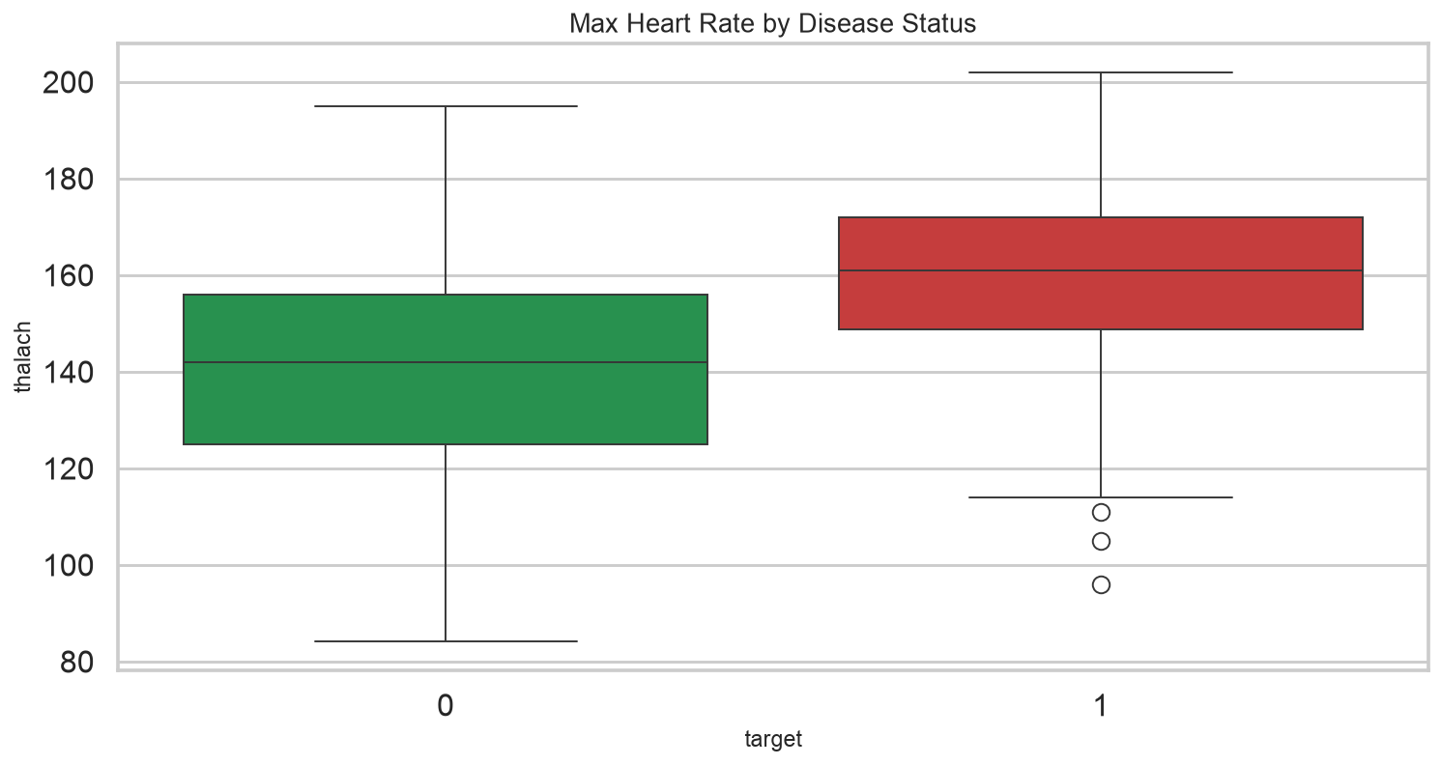
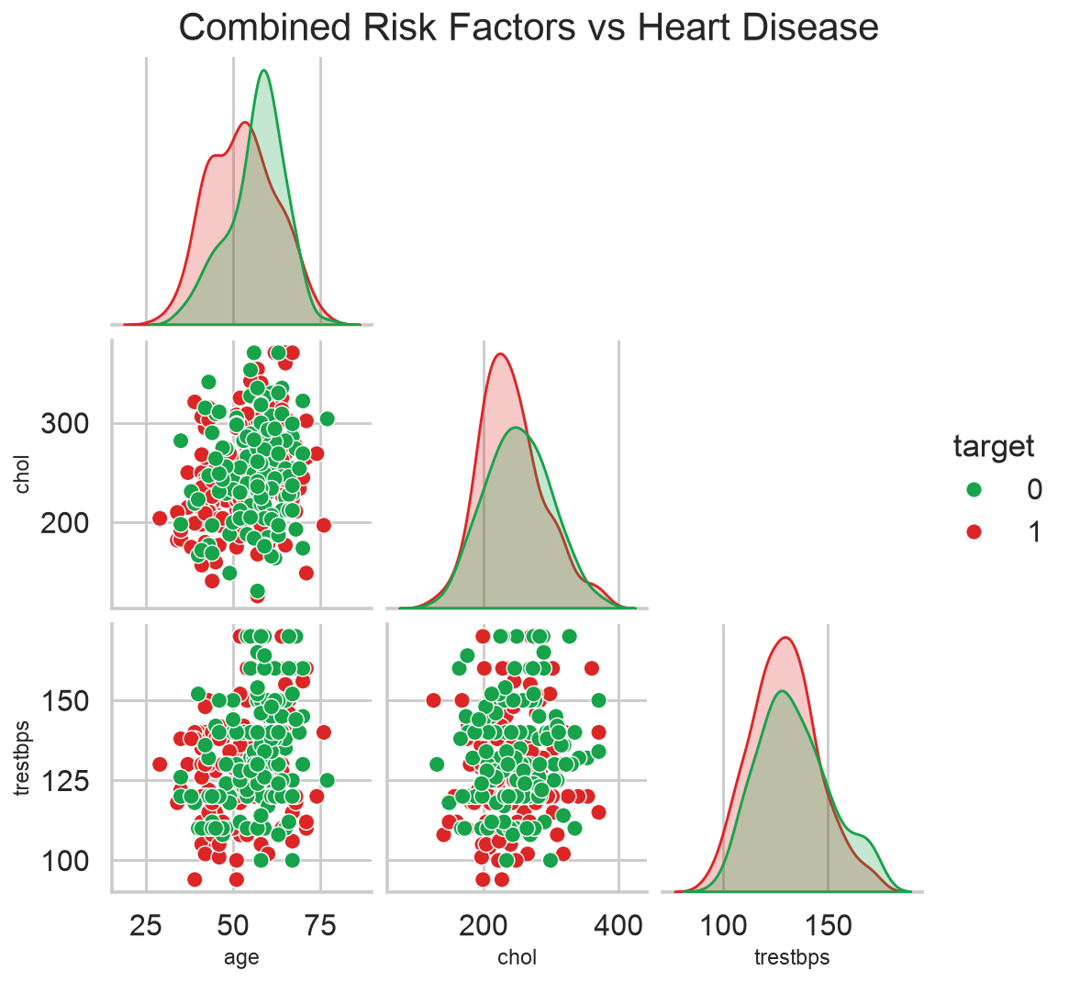
5) Key Findings — charts

Slide 9
6) Limitations
• UCI Cleveland-style data is small, referred, and historically male-skewed.
• No follow-up time, so survival analysis is not supported despite the prompt's wording.
• Coding of cp/thal/ca can differ across mirrors of the dataset.
• Outlier clipping and duplicate removal change counts versus the raw Kaggle file (often duplicated).
• Models can encode historical care bias; they must stay under clinician review and privacy controls.

Slide 10
7) Conclusion
• Heart-disease labels in this table cluster with chest-pain type, ST depression, exercise angina, vessel counts, and max heart rate. Prevention should target those markers plus blood pressure and cholesterol, with sex-aware screening rather than a single threshold.

Slide 11
8) Recommendations
• Flag patients with typical high-risk combinations (chest pain + exang + elevated oldpeak/ca) for faster cardiology review.
• Pair lipid and blood-pressure programs with the age groups that dominate the cohort.
• Do not treat fasting blood sugar alone as a sufficient screen; combine it with exercise ECG markers.
• Keep any predictive score as a triage aid; document consent, purpose limitation, and audit of errors.
• Collaborate with clinicians to recode features and refresh the model as new labeled visits arrive.

