Slide 1

Sure Independence Screening for Ultrahigh Dimensional Feature Space
Presented by: Devansh Bhatt & Charles Tan
Notes:
Authors: Jianqing Fan and Jinchi Lv

Slide 2
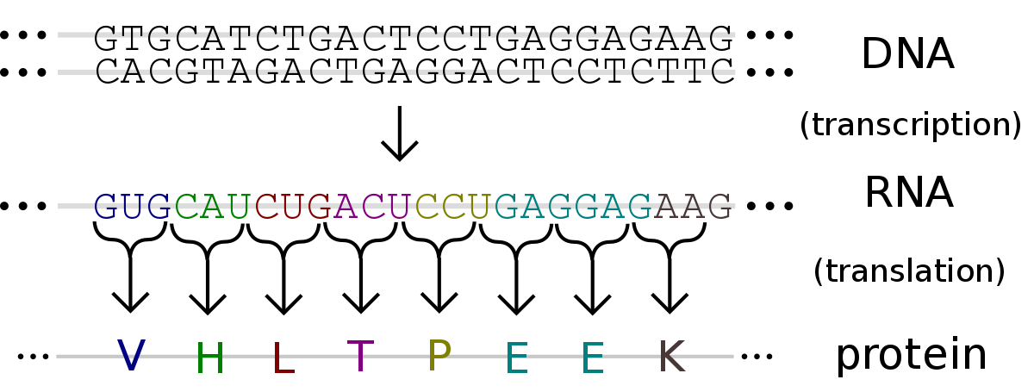
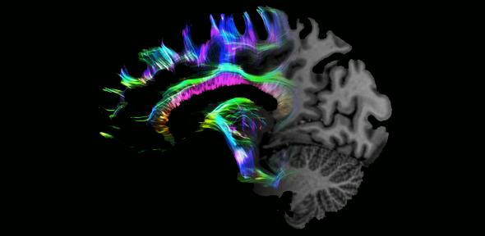
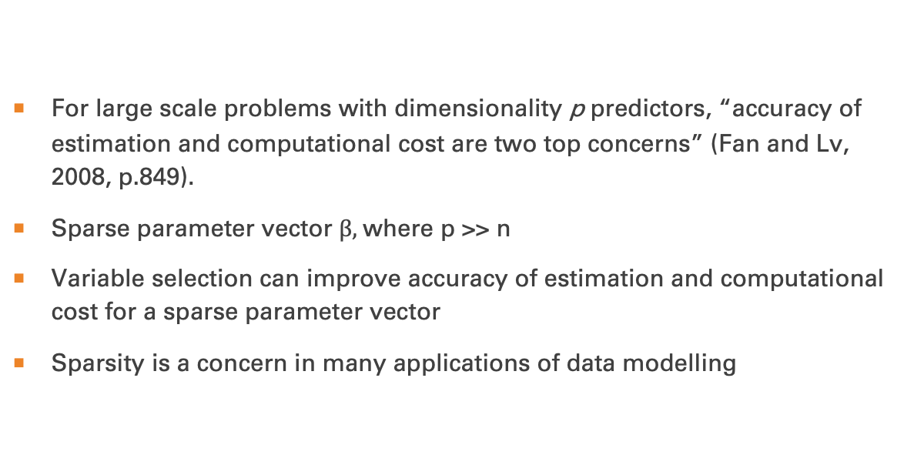
Introduction
For large scale problems with dimensionality p predictors, “accuracy of estimation and computational cost are two top concerns” (Fan and Lv, 2008, p.849).
Sparse parameter vector $β,$where p >> n
Variable selection can improve accuracy of estimation and computational cost for a sparse parameter vector
Sparsity is a concern in many applications of data modelling
This Photo by Unknown Author is licensed under CC BY-SA
This Photo by Unknown Author is licensed under CC BY
Notes:
Variable selection plays an important role in high dimensional statistical modelling which nowadays appears in many areas and is key to various scientific discoveries
When dimension p is high, it is often assumed that only a small number of predictors among X1...XP contribute to the response
With sparsity, variable selection can improve the accuracy of estimation by effectively identifying the subset of important predictors, and also enhance model interpretability with parsimonious representation.
Sparsity comes frequently with high dimensional data
Sparsity is usually a problem seen in gene expression and proteomics studies, biomedical imaging, functional magnetic resonance imaging, tomography, tumour classifications, signal processing, image analysis and finance

Slide 3

Existing Solutions
Dimensionality Reduction Methods
Dantzig Selector
Adaptive Lasso
SCAD
Bridge regression
Notes:
These are lower dimensional models which work best when n > p
Dimension reduction or feature selection is an effective strategy to deal with high dimensionality…the computational burden can be reduced drastically.
main goal in our paper: reduce dimensionality p from a huge scale to a relatively large scale d by a fast and efficient method where d<p.
correlation learning which filters out the features that have weak correlation with the response
Oracle properties in a stronger sense, say, mimicking the oracle in not only selecting the right model, but also estimating the parameters efficiently
Dantzig selector which is the solution to an L1-regularization problem and showed that, under the uniform uncertainty principle, this minimum L1 -estimator achieves the ideal risk, i.e. the risk of the oracle estimator with the true model known ahead of time, up to a logarithmic factor log(p).
by sure screening we mean a property that all the important variables survive after variable screening with probability tending to 1

Slide 4
Sure independence screening
Correlation Learning
Uses marginal correlation of features to the response variable to rank their importance
Low Computational Cost
O(np)
Sure Screening
Probability that all important variables survive is 1
Notes:
Works well when p >> n
The computational cost of SIS or correlation learning is that of multiplying a pxn matrix by an n-vector plus obtaining the largest d components of a p-vector, so SIS has computational complexity O(np).
correlation learning ranks the importance of features according to their marginal correlation with the response variable and filters out those that have weak marginal correlations with the response variable. We call this correlation screening method SIS, since each feature is used independently as a predictor to decide how useful it is for predicting the response variable.
This concept is broader than correlation screening and is applicable to generalized linear models, classification problems under various loss functions and non-parametric learning under sparse additive models
the idea of SIS is identical to selecting predictors by using their correlations with the response
by sure screening we mean a property that all the important variables survive after variable screening with probability tending to 1

Slide 5


SIS
Solution: estimate a sparse d-vector $β={\left(β_{1},… ,β_{d}\right)}^{T}$
Used for feature selection
Always combined with a well-developed lower dimensional techniques
Notes:
the original problem of estimating the sparse p-vector \beta in model (1) reduces to estimating a sparse d-vector that is based on the now much smaller sub model M
feature selection is important for high dimensional classification (tumour classification using gene expression or proteomics data, it is not wise to classify the data by using the full feature space because of accumulation of noise and interpretability. )
The key idea of SIS is to apply a single componentwise regression.

Slide 6

methodology
Y = $\left(\begin{aligned}Y_{1} \\ ⋮ \\ Y_{n}\end{aligned}\right)$ and $X= \left(\begin{matrix}X_{11} & ⋯ & X_{1p} \\ ⋮ & ⋱ & ⋮ \\ X_{n1} & ⋯ & X_{np}\end{matrix}\right)$
Assume data is centered
Then create models according to $Y=Xβ+ε$ for each X
$Y\sim X_{1}, …, Y\sim X_{p}$
Then find $\hat{r}$ for each model, i.e. $\hat{r_{\left\{1\right\}}}, …,\hat{r_{\left\{p\right\}}}$
Then rank the absolute value of correlation $\left|\hat{r_{\left\{1\right\}}}\right|, …,\left|\hat{r_{\left\{p\right\}}}\right|$ to obtain d largest ones so that $d<n$
You have reduced your variables from p to d, now you choose from many different low-dimensional methods to reduce the parameter space further

Slide 7
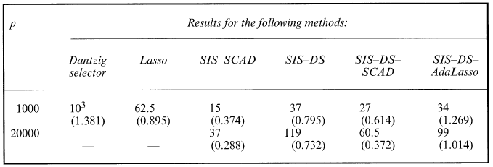
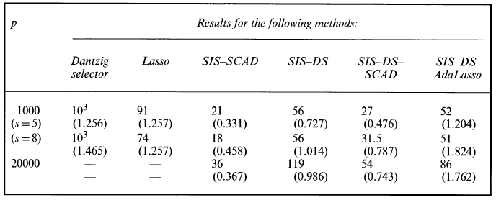
Numerical studies
Simulation I: Independent Features
Simulation II: Dependent Features
Notes:
Simulation I
For the first simulation, we used the linear model (1) with IID standard Gaussian predictors and Gaussian noise with standard deviation = 1.5.
two such models with (n, p) = (200,1000) and (n, p) = (800,20000).
sizes s of the true models, i.e. the numbers of non-zero coefficients, were chosen to be 8 and 18
For the SIS-SCAD and SIS DS methods, we chose d = [n/log(n)] and, for the last two methods, we chose d = n - 1 and d' = [n/log(n)] and in the middle step the Dantzig selector was used to reduce the model size further from d to d’ by choosing variables with the d’ largest componentwise magnitudes of the estimated d-vector
each of the above six methods, we report in Table 1 the median of the selected model sizes and the median of the estimation errors
Simulation II
predictors are now correlated with each other. We considered three models with in,p,s) = (200,1000,5), (200, 1000, 8) and (800, 20000, 14), where s denotes the size of the true model,

Slide 8
ISIS
Extension of Sure Independence Screening
Potential issues with SIS
Some unimportant predictors highly correlated with important predictors
Important predictor that us marginally uncorrelated but jointly correlated with response cannot be picked
Collinearity of predictors
Notes:
Three potential issues, however, might arise with this SIS.
First, some unimportant predictors that are highly correlated with the important predictors can have higher priority for being selected by SIS than other important predictors that are relatively weakly related to the response.
Second, an important predictor that is marginally uncorrelated but jointly correlated with the response cannot be picked by SIS and thus will not enter the estimated model.
Third, the issue of collinearity between predictors adds difficulty to the problem of variable selection
when the model assumptions are satisfied, which excludes basically the three aforementioned problems, SIS can accurately reduce the dimensionality from ultrahigh to a moderate scale, say, below the sample size. But, when those assumptions fail, it could happen that SIS would miss some important predictors. To overcome this problem, we propose below ISIS to enhance the methodological power. It is an iterative application of the SIS approach to variable selection. The essence is to apply iteratively a large-scale variable screening followed by a moderate-scale careful variable selection.

Slide 9

Methodology
Start with following the SIS methodology and following it with a low-dimensional method to a select a subset of $k_{1}$ variables $A_{1}=\{X_{i1}, …, X_{ik_{1}}\}$
Now you have a n-vector of residuals, we’ll call it $ε_{k_{1}}$, from regressing Y over $A_{1}$
Now we use the residuals, $ε_{k_{1}}$, as the new response, Y, and redo model selection using SIS and the low-dimensional method we selected earlier on the remaining $p−k_{1}$ variables to get a subset of $k_{2}$ variables $A_{2}=\{X_{i1}, …, X_{ik_{2}}\}$
We can iterate this until we obtain $l$ disjoint subsets $A_{1},…, A_{l}$, then $A= \bigcup_{i−1}^{l}{A_{i}}$ has a size $d<n$.
From the selected features in $A$ we can use a lower-dimensional method to find the final model.
Notes:
We remark that fitting the residuals from the previous step on {X1,..., Xp}\A1 can significantly weaken the priority of those unimportant variables that are highly correlated with the response through their associations with Xi1,..., Xik, since the residuals are uncorrelated with those selected variables in A1. This helps to solve the first issue. It also makes those important predictors that are missed in the previous step possible to survive, which addresses the second issue above. In fact, after variables in A1 enter the model, those that are marginally weakly correlated with Y purely due to the presence of variables in A1 should now be correlated with the residuals.
For the problem of ultrahigh dimensional variable selection, we now have ISIS-based model selection methods which are extensions of SIS-based model selection methods. Applying a moderate dimensional method such as SCAD, the Dantzig selector, lasso or adaptive lasso to A will produce a model that is very close to the true sparse model M*. The idea of ISIS is somewhat related to the boosting algorithm (Freund and Schapire, 1997). In particular, if SIS is used to select only one variable at each iteration, i.e. |Ai| = 1, ISIS is equivalent to a form of matching pursuit or a greedy algorithm for variable selection (Barron et al, 2008).

Slide 10
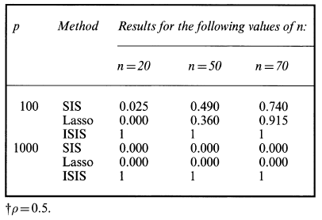
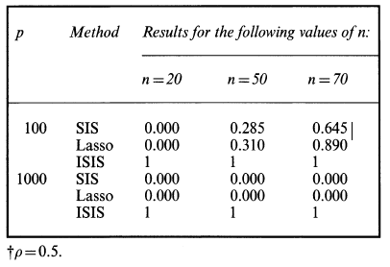
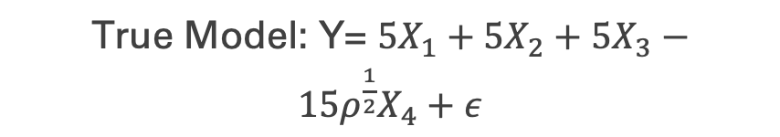
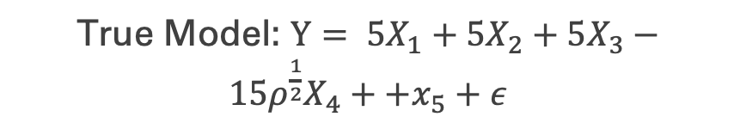
Numerical Studies
True Model: Y= $5X_{1}+5X_{2}+5X_{3}−15ρ^{\frac{1}{2}}X_{4}+ε$
True Model: $Y= 5X_{1}+5X_{2}+5X_{3}−15ρ^{\frac{1}{2}}X_{4}++x_{5}+ε$
Notes:
* Look at pages 867 and 868 of paper for explanation

Slide 11
Thank you!

