Slide 1
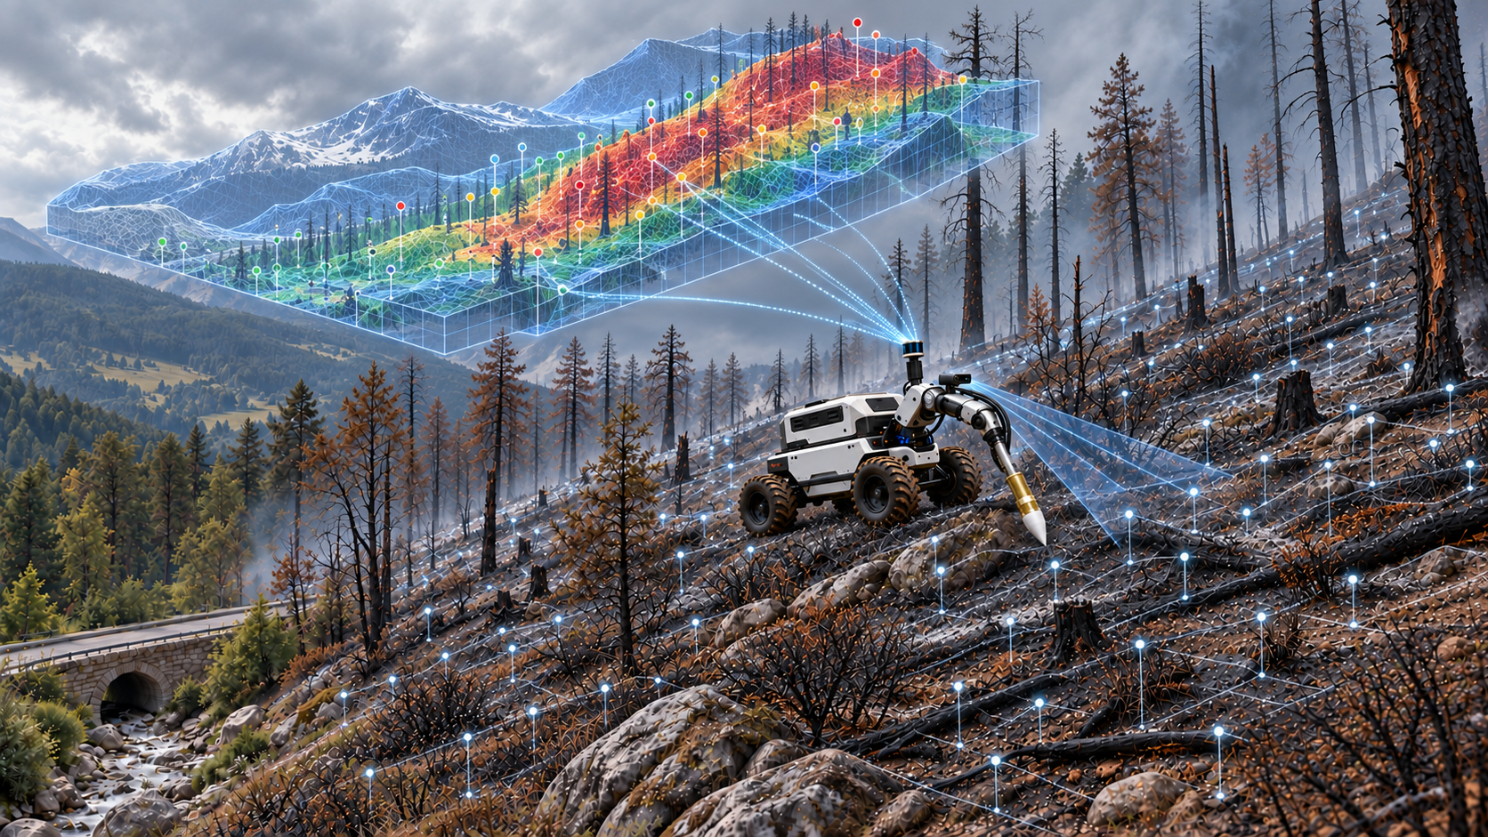



SMART-MOLE
Soil-monitoring Mobile Autonomous Robot for Targeted Management Of post-fire Landslides and Ecosystem restoration
European Talent Academy 2026 – Proposal pitch
Notes:
Concept video: https://drive.google.com/file/d/1yzD1IRJpNW2sFg2-kVtldFW8rYUzm_k4/view

Slide 2
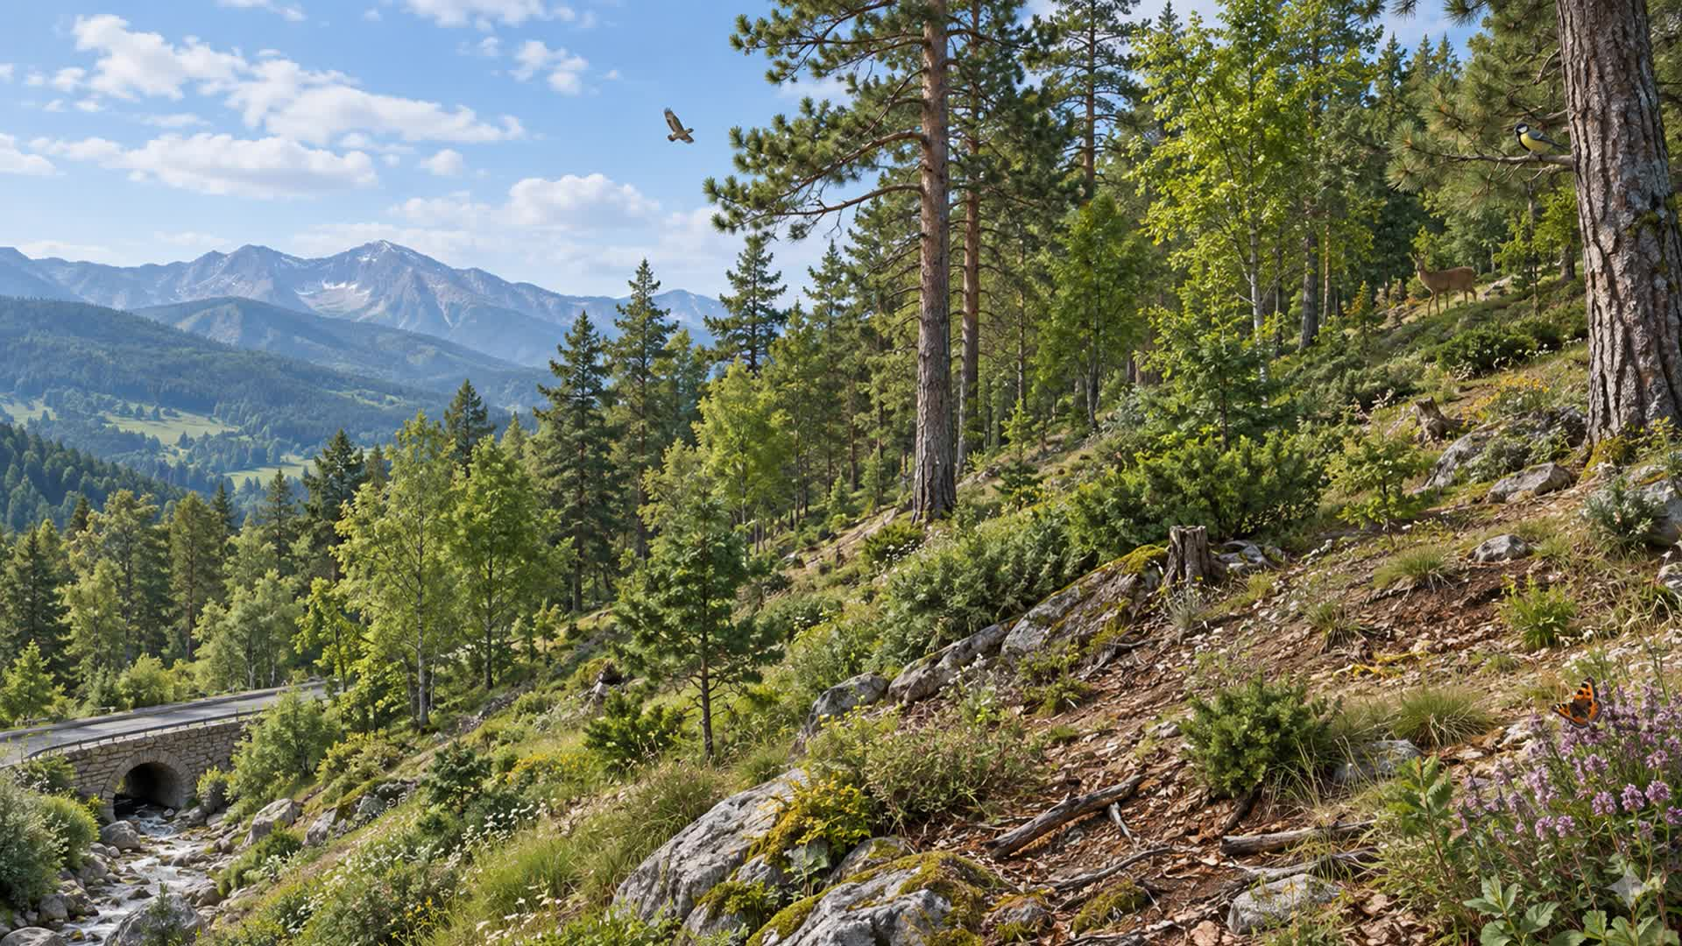
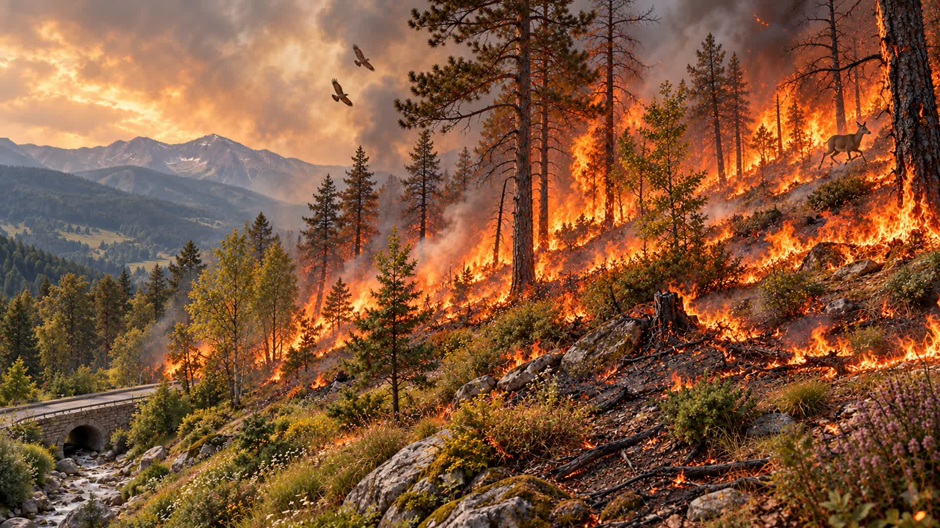

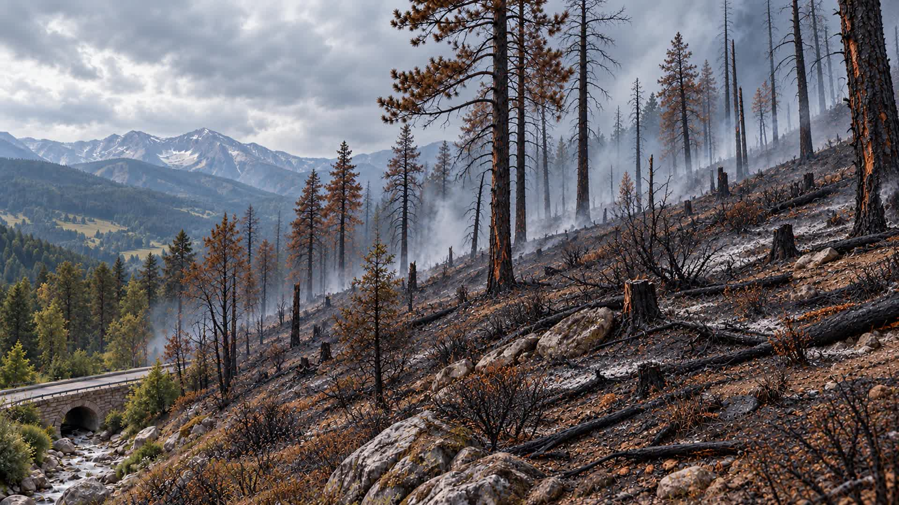


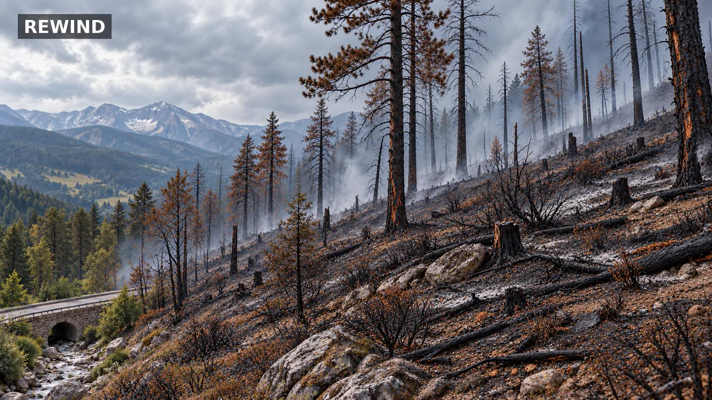
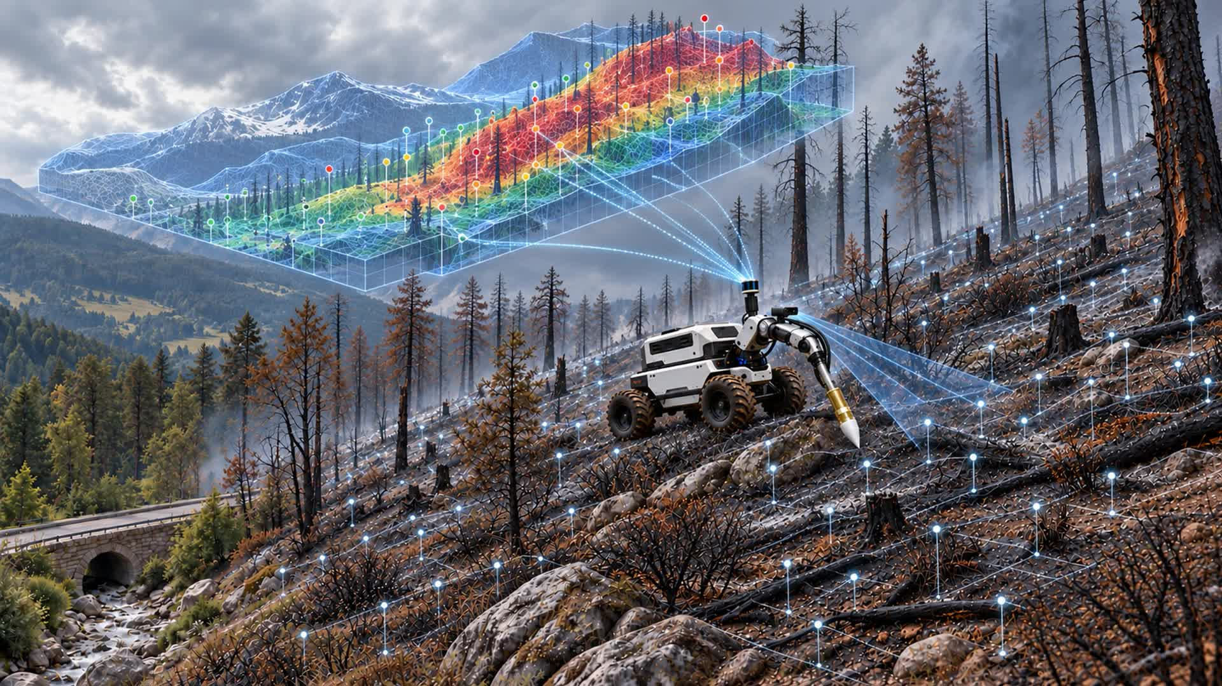


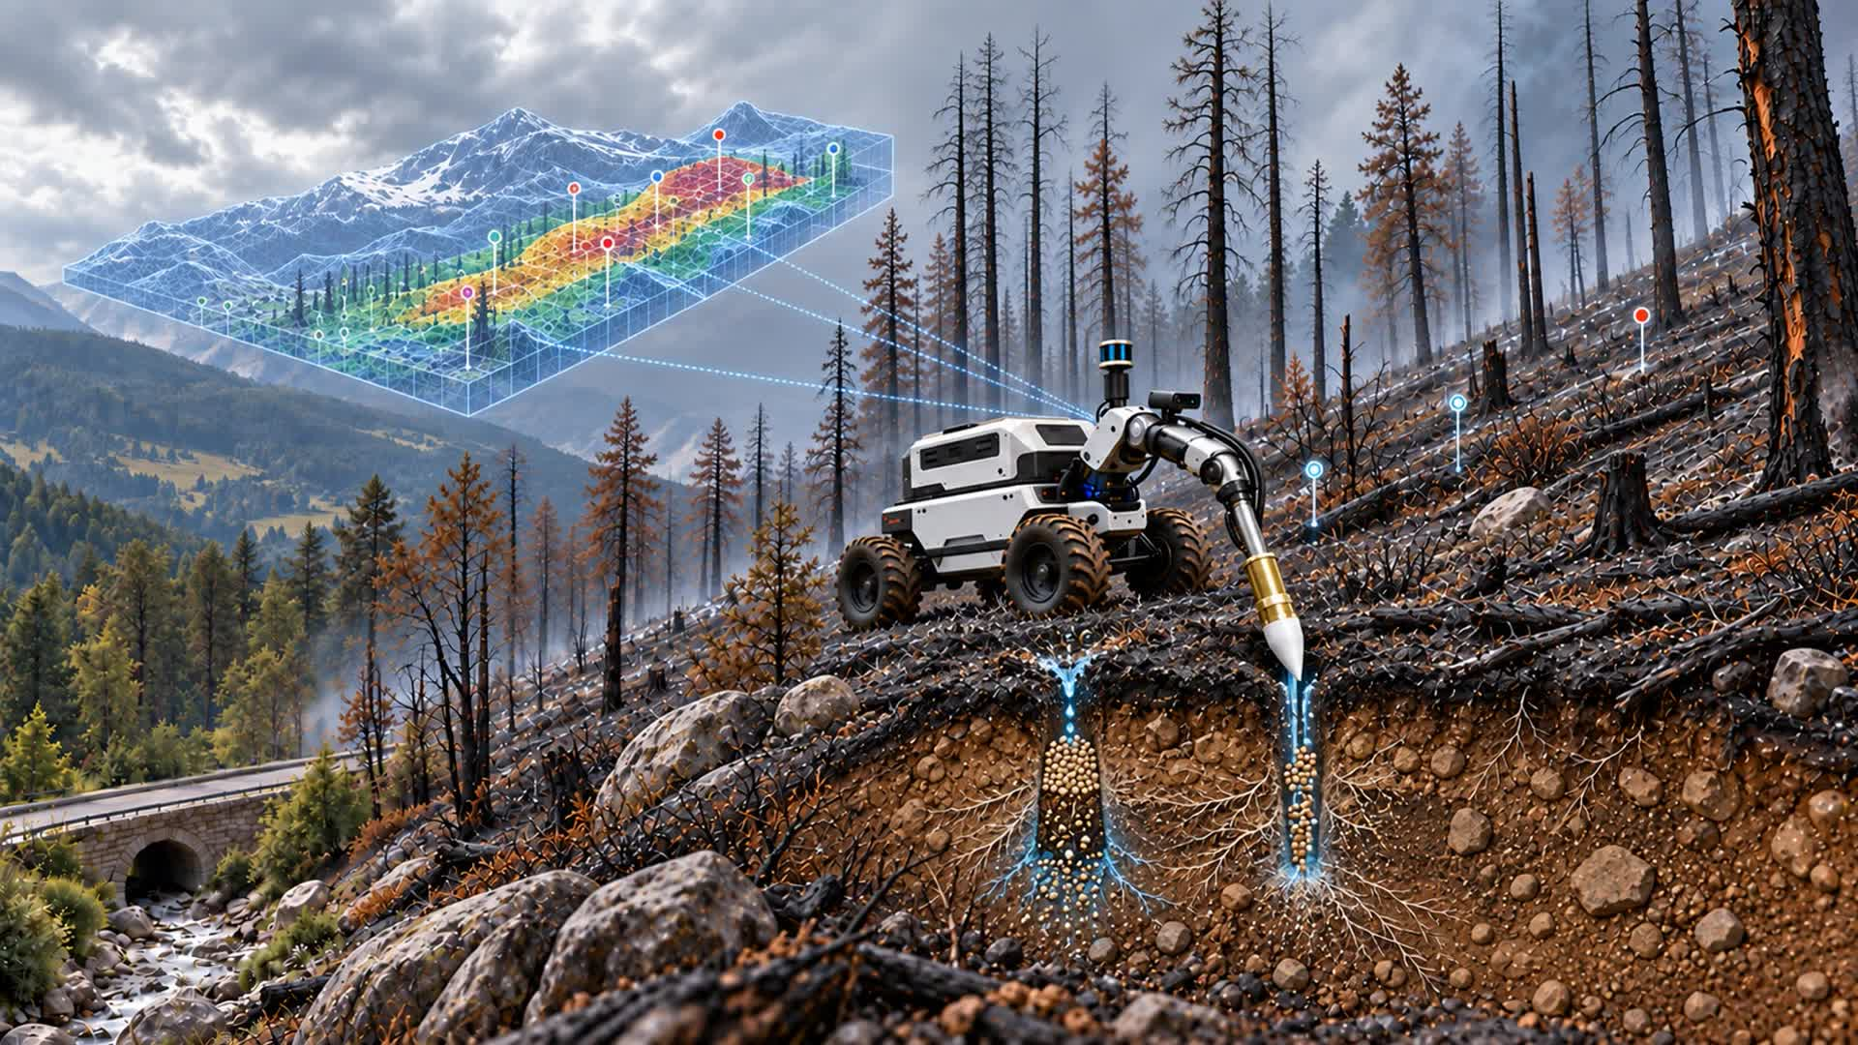
MAPPING
REVEGETATION
TARGETED INFILTRATIONS
Notes:
Concept video: https://drive.google.com/file/d/1yzD1IRJpNW2sFg2-kVtldFW8rYUzm_k4/view

Slide 3
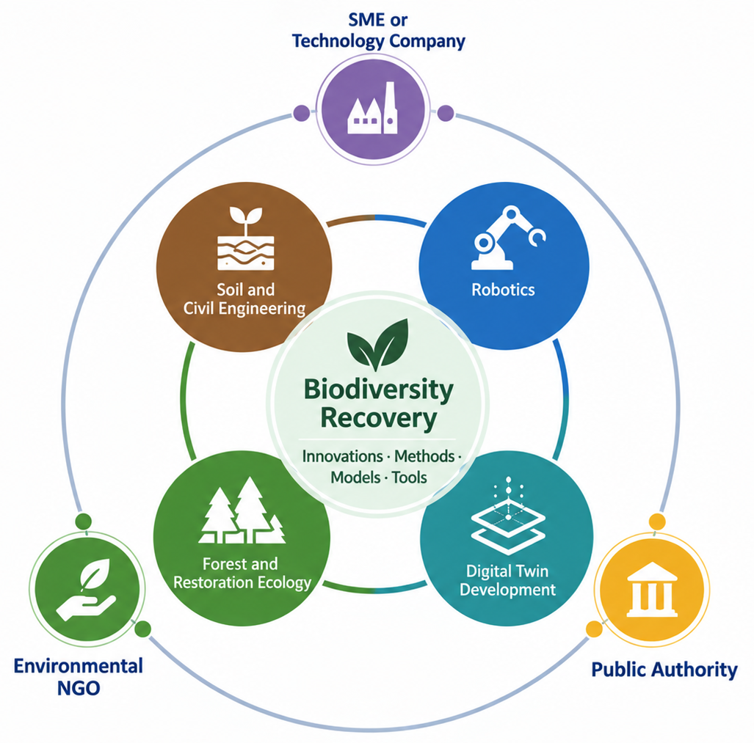
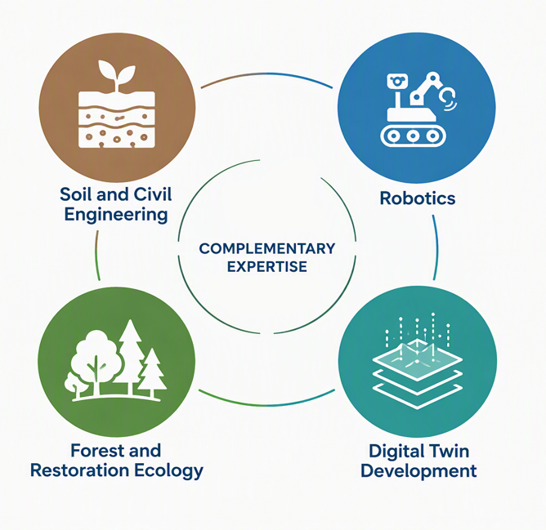
Towards Horizon Europe
HORIZON-CL6-2027-01-BIODIV-03 • Technical innovation to protect ecosystems and to scale up their restoration
FIELD-READY HORIZON CONSORTIUM
SCIENTIFIC CORE
SCIENTIFIC CORE
IMPERIAL
Technology Company
IMPERIAL
IMPERIAL
POLIMI/IMPERIAL
POLIMI/IMPERIAL/IIT
Casarella, Tsiampousi
PAL Robotics
Casarella · soil mechanics
Casarella · soil mechanics
Tsiampousi · slope stability
Mentasti · autonomy & sensing
Bhattacharya · vision & ML
Mentasti · autonomy & sensing
Bhattacharya · vision & ML
Mazzolai · root-inspired burrowing robot
POLIMI/IMPERIAL/IIT
Mentasti, Bhattacharya, Mazzolai
HORIZON EUROPE CONNECT FUND
POLIMI
Public Authority
TUM
TUM
POLIMI
POLIMI
Botteghi
???
Rojas-Botero · restoration
Rojas-Botero · restoration
Seidl · forest resilience
Botteghi · digital twin & control
Botteghi · digital twin & control
TUM
Environmental NGO
Rojas-Botero, Seidl
???
SMART-MOLE

Slide 4
Timeline
FEB 2027
Imperial–IIT experimental test
Co-supervised MEng thesis starts
MAY 2027
Writing kick-off meeting
(online)
AUG 2027
Co-supervised MSc student starts
30 OCT 2026
HECF submitted
ETA
M1
M2
M3
M4
M5
M6
M7
M8
AUG/SEP 2026
Visits at Imperial and Polimi
Idea formalisation
DEC 2026
Research visit at TUM
APR 2027
Workshop at Imperial
Consortium finalisation
JUL 2027
ECoR paper submission
on preliminary results
2 SEP 2027
SMART-MOLE proposal submitted
HORIZON-CL6-2027-01-
BIODIV-03
SMART-MOLE

