Slide 1
CUSTOMER SUPPORT
TICKET API
End-to-end DevOps project: CI/CD on Kubernetes
Python / Flask • Git & GitHub • Docker • Jenkins • Kubernetes (Minikube)
SOURCE
BUILD
DEPLOY
VERIFY
Rahul Bhatt | BCA Student | Aspiring Cloud Engineer

Slide 2
Project Overview & Architecture
2
One small app, taken through a real DevOps delivery workflow
Developer
Code change
GitHub
main branch
Jenkins
Pipeline
Docker
Image + container
Kubernetes
Deployment
App
Ticket API
▶
▶
▶
▶
▶
Application
Delivery
Deployment
Customer Support Ticket API built with Python + Flask, exposed on port 5000.
GitHub holds the source. Jenkins checks out, builds the Docker image and deploys.
Kubernetes (Minikube) runs the container; the rollout is verified with kubectl.

Slide 3
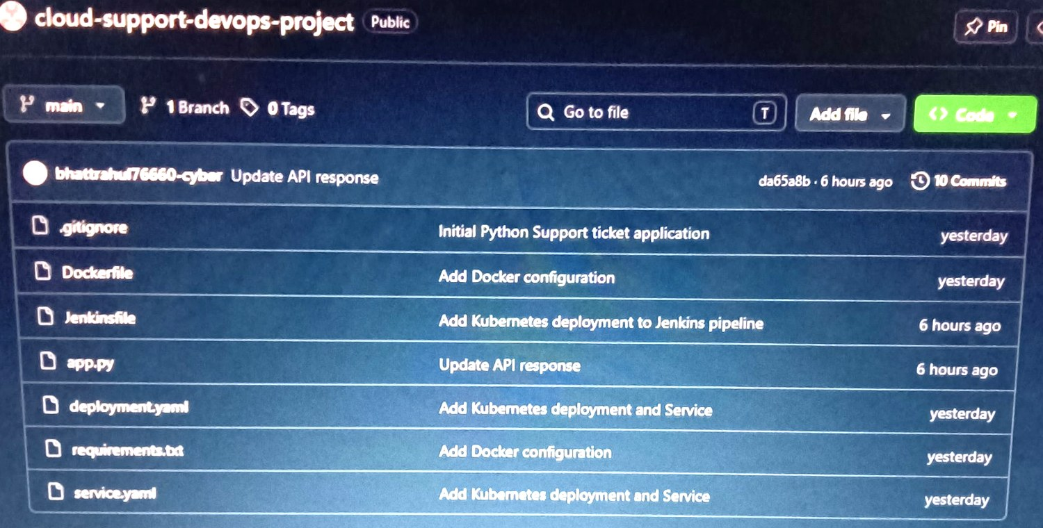
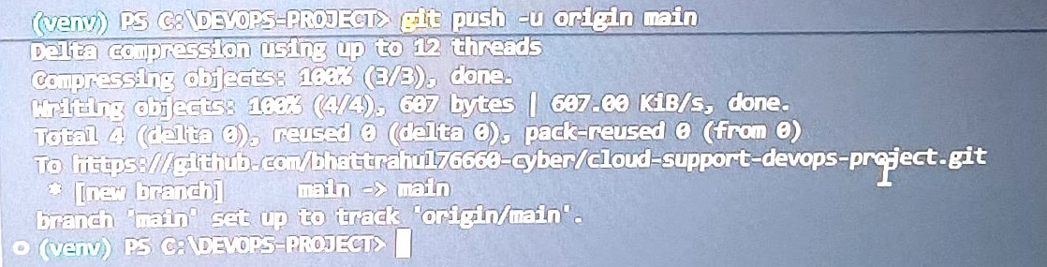
Source Control: GitHub
3
GitHub is the source of truth for the pipeline
Repository
cloud-support-devops-project (public)
Branch: main • 10 commits
app.py, Dockerfile, Jenkinsfile, deployment.yaml, service.yaml
Flow: add → commit → push → Jenkins
GitHub repo: files + commit history
Jenkins pulls the code from this repo; there is no local copy involved in the pipeline.
git push -u origin main from VS Code terminal

Slide 4
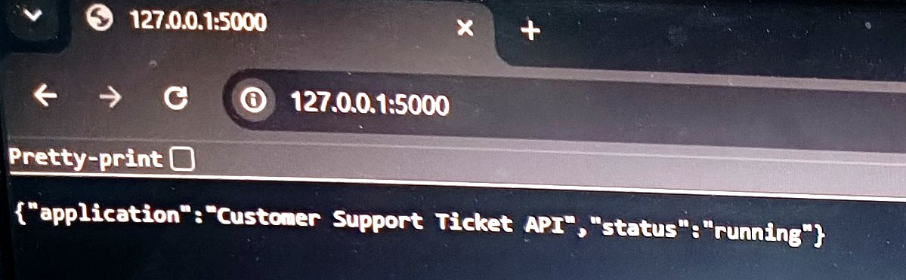
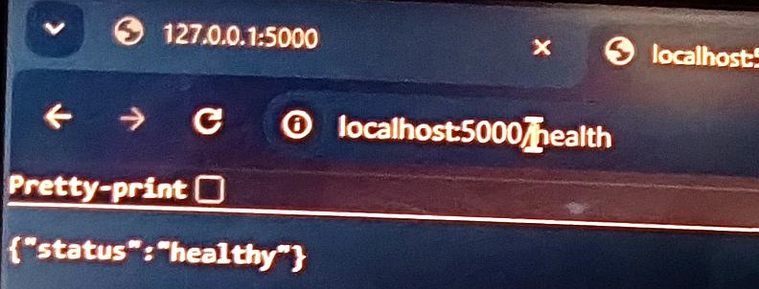
Application Layer
4
A simple Flask API, so the focus stays on DevOps
app.py
from flask import Flask, jsonify
app = Flask(__name__)
@app.route("/")
def home():
return jsonify({
"application": "Customer Support Ticket API is running",
"status": "running"
})
@app.route("/health")
def health():
return jsonify({"status": "healthy"})
GET / → application status
GET /health → {"status":"healthy"}

Slide 5
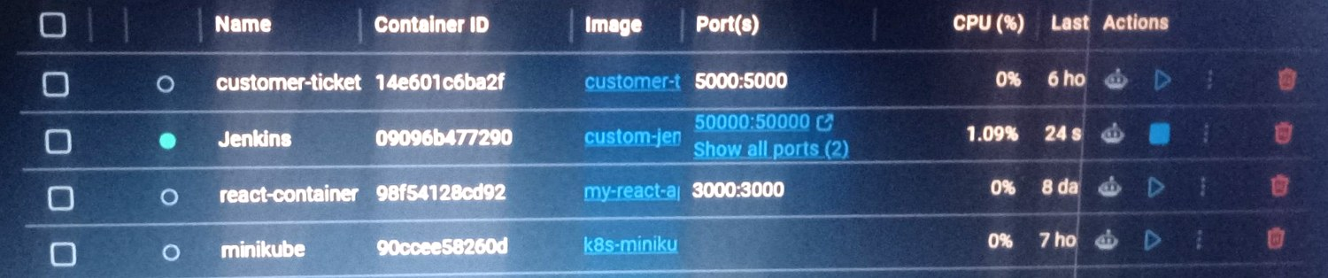
Containerization: Docker
5
Package the app once, run it the same way everywhere
Build
Dockerfile + source code
Image
customer-ticket-api:latest
Run
Container on port 5000
Deploy
Same image → Kubernetes
▶
▶
▶
KEY COMMANDS
docker build -t
customer-ticket-api:latest .
docker run -p 5000:5000
customer-ticket-api:latest
Docker Desktop: customer-ticket-api (5000:5000), Jenkins and minikube containers
Repeatable runtime; the image is the artifact Jenkins hands to Kubernetes.

Slide 6
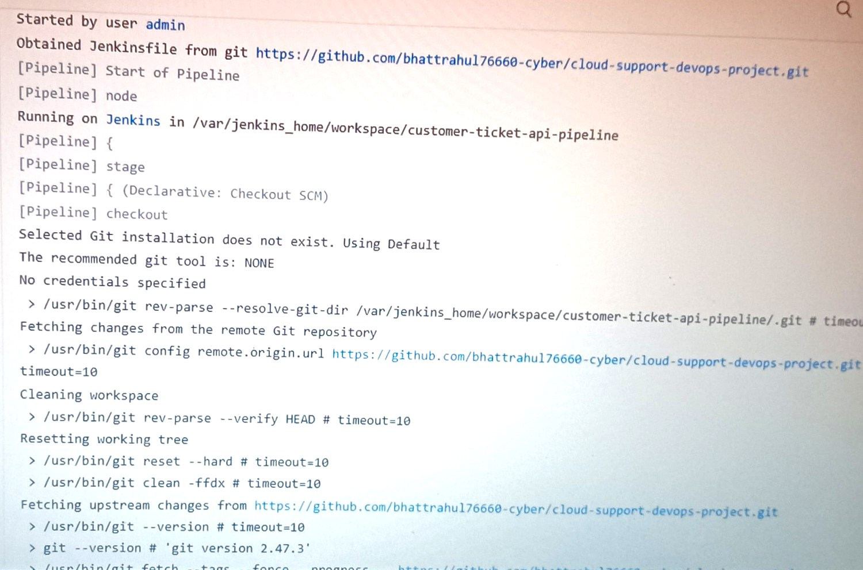
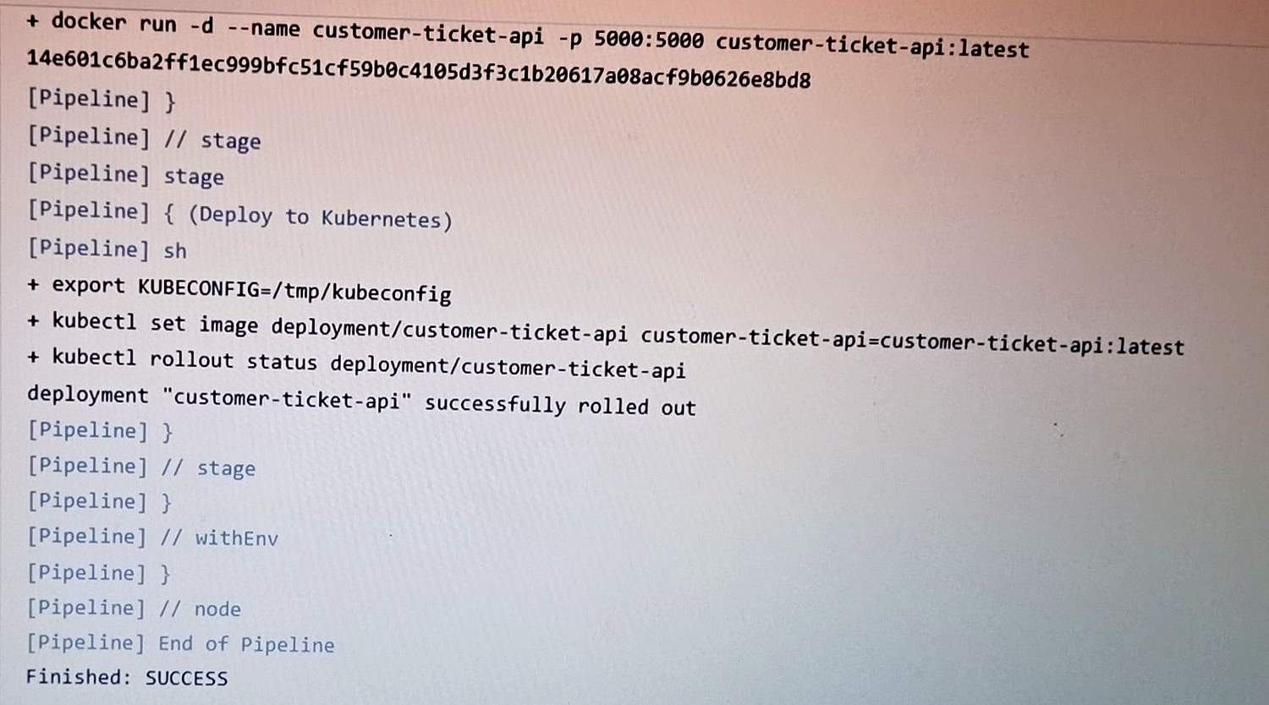
CI/CD: Jenkins Pipeline
6
Declarative pipeline from the Jenkinsfile in GitHub
1 Checkout
Fetch from GitHub
2 Build
Docker image
3 Run
Start container
4 Deploy
Update deployment
5 Rollout
Verify status
▶
▶
▶
▶
Console: Jenkinsfile obtained from GitHub, checkout SCM
Console: kubectl rollout → "successfully rolled out", Finished: SUCCESS

Slide 7
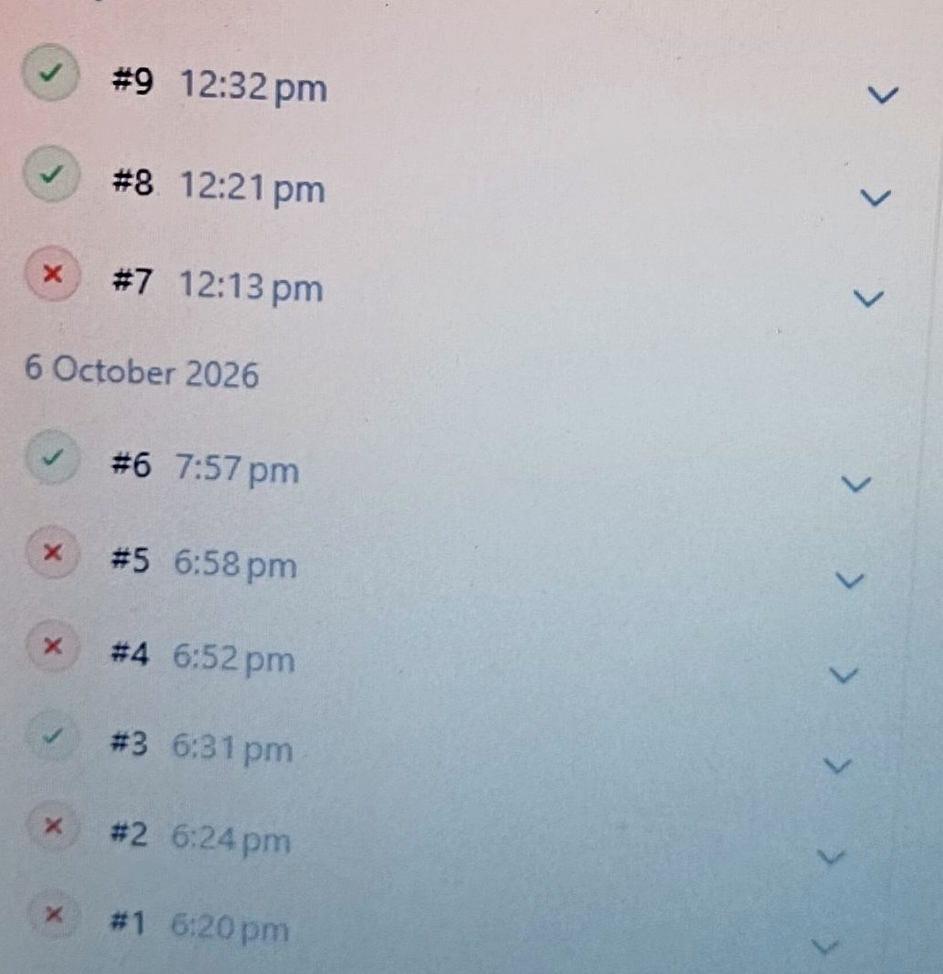
Jenkins Build History: Fail → Fix → Success
7
9 builds, 5 failed, 4 successful — each failure was debugged
5 failed
Builds #1, #2, #4, #5, #7 failed during Git tool, checkout and pipeline-syntax setup.
4 successful
Builds #3, #6, #8, #9 passed; #9 ran Checkout → Build → Run → Deploy → Rollout.
What it shows
Real debugging: read console logs, fix config, rebuild until the pipeline is green.

Slide 8
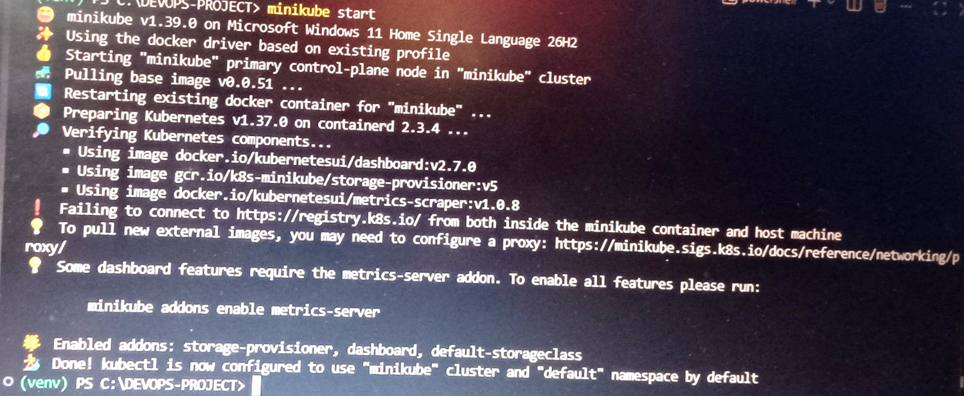
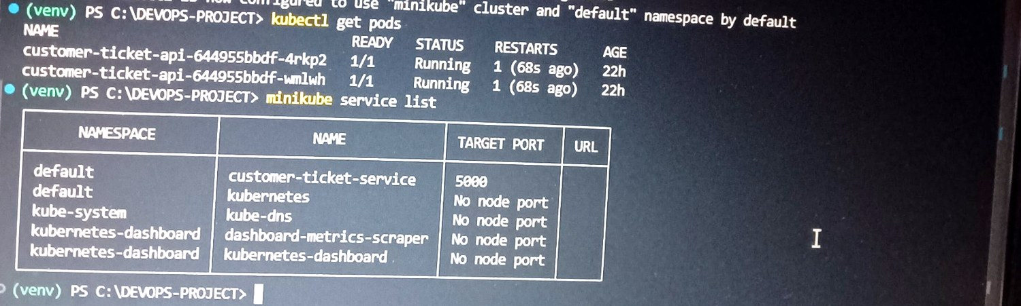
Orchestration: Kubernetes (Minikube)
8
Real cluster output
kubectl get pods → 2/2 Running; minikube service list
minikube start → kubectl configured to use "minikube"
Deployment
Key concept
customer-ticket-api (2 replicas). Jenkins updates the image with kubectl set image, then checks the rollout.
Jenkins automates the change; Kubernetes runs and manages the containers.

Slide 9
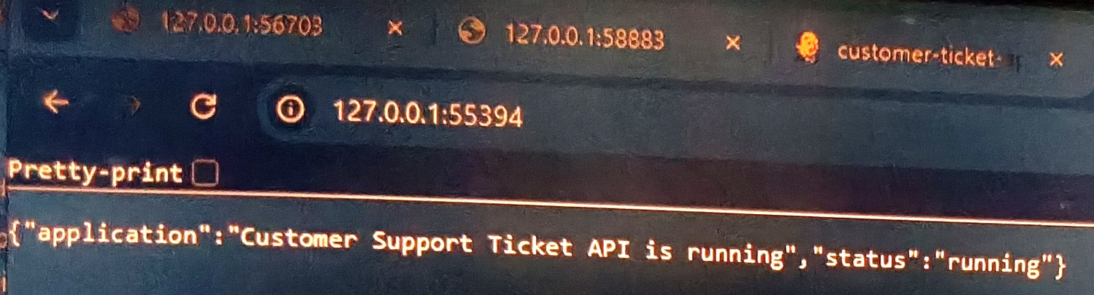
End-to-End Result
9
A code change reached the running cluster
Developer
Changes app.py
GitHub
Pushes to main
Jenkins
Checks out + builds
Docker
Creates latest image
Kubernetes
Updates deployment
User
Gets updated app
▶
▶
▶
▶
▶
Result
The developer only changes code; the pipeline handles repeatable delivery; Kubernetes runs the workload.
Updated response served from the cluster via a minikube service URL

Slide 10
Troubleshooting: Jenkins & Git
10
Setup errors that were diagnosed and fixed
Area | Observed issue | Fix / learning
Jenkins | Selected Git installation does not exist | Fix Git/tool configuration, use the available installation
Jenkins → GitHub | Fetching remote repo / max checkout retry | Check repo URL + credentials, retry checkout
Repository | Empty Git repo at first setup | Add files, commit, push to main
Jenkinsfile | Pipeline syntax / shell formatting issue | Valid Declarative syntax; shell commands in sh steps
Pipeline runs | 5 of first 9 builds failed | Read console logs, fix, rebuild until #9 green

Slide 11
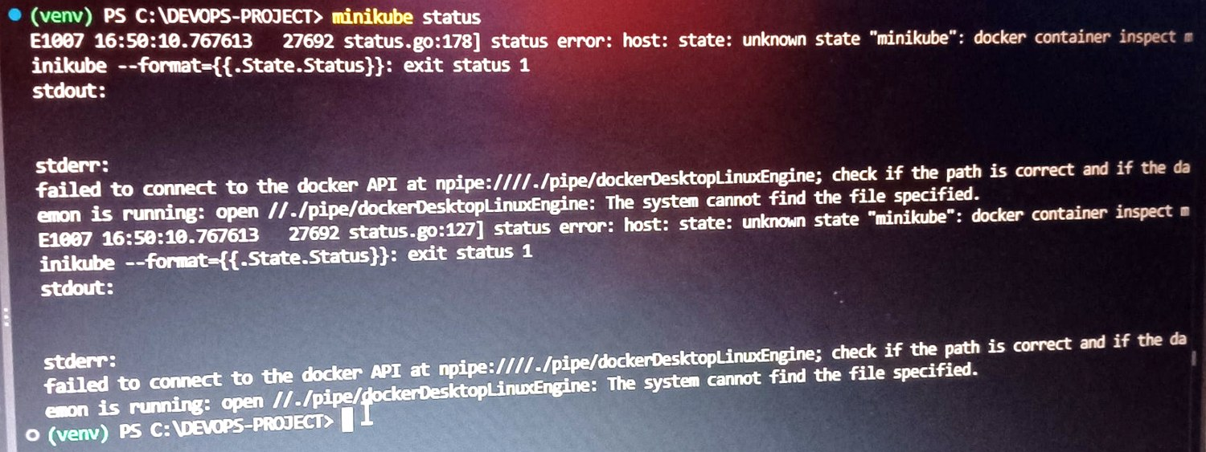
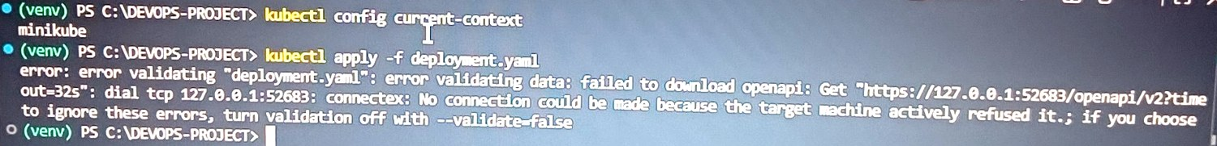
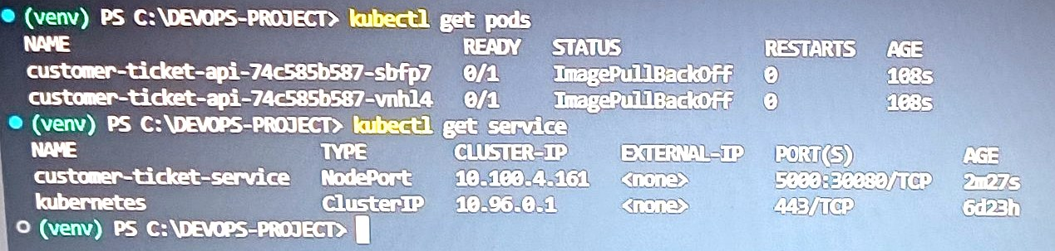
Troubleshooting: Docker & Kubernetes
11
Real errors from this project, with the fix
kubectl apply: connection refused to API server
minikube status: Docker API not reachable
kubectl get pods: ImagePullBackOff
Docker not running
API refused
ImagePullBackOff
Start Docker Desktop, wait for "Engine running", then minikube start.
Cluster was down. Start minikube first, then kubectl apply.
Image not available to the cluster: load/build it inside Minikube; check image name and pull policy.

Slide 12
Key Takeaways
SOURCE
Git + GitHub
CI/CD
Jenkins
CONTAINER
Docker
ORCHESTRATION
Kubernetes
Connected four tools around one real application, from code push to deployed workload
Debugged Git, Jenkins, Docker and Kubernetes failures instead of only showing the happy path
Verified every stage: checkout, build, rollout and the live endpoint
github.com/bhattrahul76660-cyber/cloud-support-devops-project

