Slide 1




Computer Vision
Team 6/6
IMAGE COLOURING
Aritra Banerjee
2018102006
Jayati Narang
2018101066
Sahil Bhatt
2018111002
Srivathsan baskaran
2018101049

Slide 2
OVERVIEW
We plan to implement the paper “Let there be Color!: Joint End-to-end Learning of Global and Local Image Priors for Automatic Image Colorization with Simultaneous Classification”.
Paper link : Let there be Color!
The main objective of our project is develop a model capable of automatically colorizing black and white images.

Slide 3
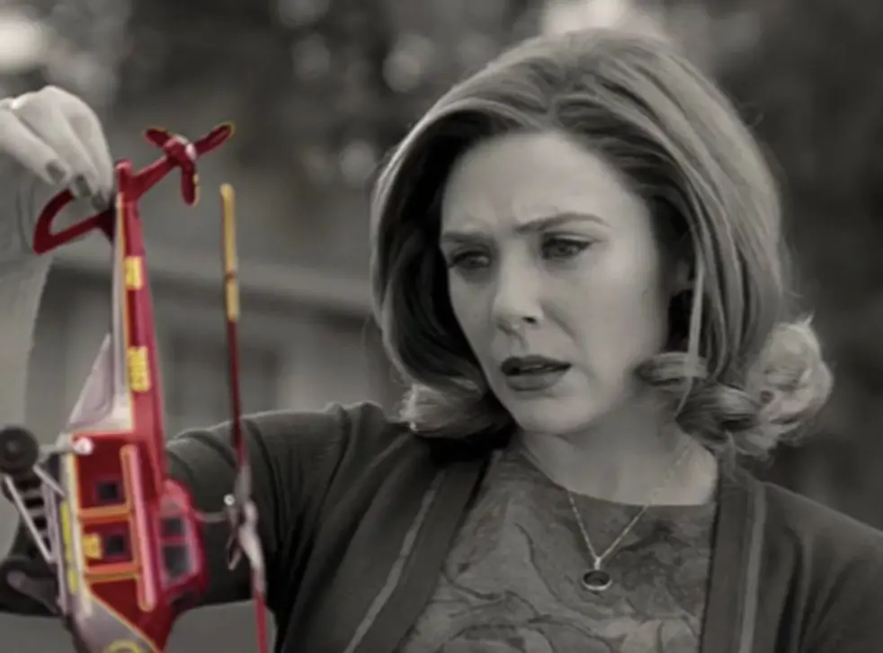
Bringing color to black and white images.
Image source: Link

Slide 4
OBJECTIVES
Traditional colorization requires significant user interaction.
This paper uses a fully automated data-driven approach for colorization of grayscale images.
In this, we use a combination of global image priors, which are extracted from the entire image, and local image features, which are computed from small image patches, to colorize an image automatically.
Global priors provide information at an image level such as whether or not the image was taken indoors or outdoors, whether it is day or night, etc.

Slide 5
OBJECTIVES
Local features represent the local texture or object at a given location.
The approach is to use CNN. The global and local features are extracted jointly and then fuse together to perform the final colorization.
This method requires neither pre-processing nor post-processing.
To predict the chrominance, CIE L*a*b colorspace is used.

Slide 6
RELATED WORK
There has been a lot of work done a priori in this area. Some notable ones are:
Chrominance blending based on geodesic distances
Texture similarity based coloring (by Luan) which is used in the coloring of cartoons
Graph-cut based optimization techniques for coloring styles
Example based colorization robust to illumination differences (by Liu). Here, user does not need to give the images, (available from web search)
An automatic approach (Cheng, 2015) in which multiple features are extracted and patches colorized with the help of neural networks. But the networks require a high-performance segmentation model to work

Slide 7
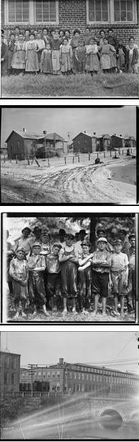
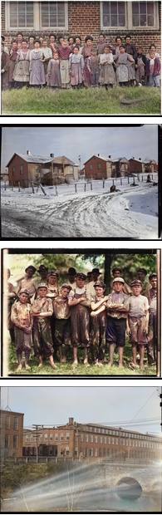
Results
To the right, we can see a few results obtained using the image coloring network proposed by the authors on a set of black and white images.
(Images taken from the reference paper)
Black and White images
Colorized images generated by the model

Slide 8
METHODS
Our model consists of four main components:
A Low-level features network
A Mid-level features network
A Global features network
A Colorization network
The components are all tightly coupled and trained in an end-to-end fashion. The output of our model is the chrominance of the image which is fused with the luminance to form the output image.

Slide 9
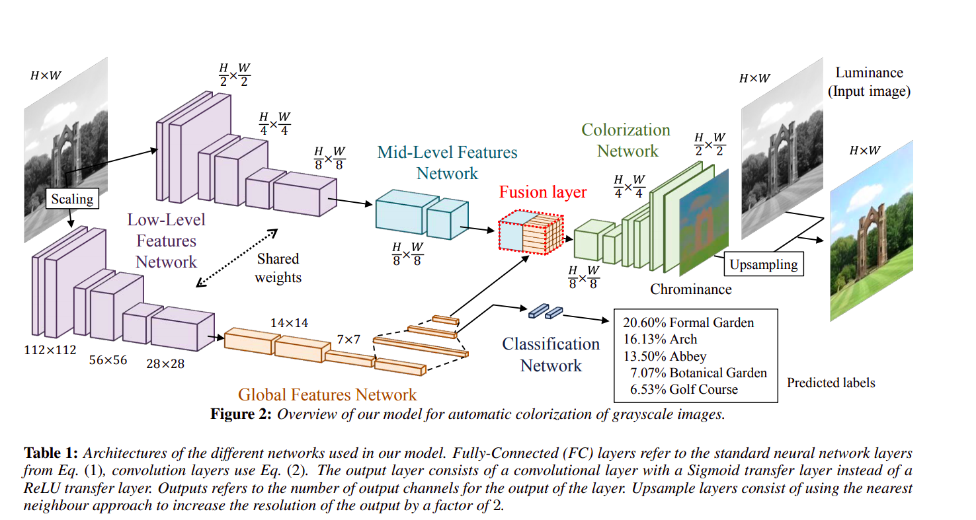
Image taken from the reference paper

Slide 10
Low-Level Features:
We use a 6-layer Convolutional Neural Network to obtain low-level features directly from the input image. The convolution filter is shared between the global features network and the mid-level features network.We use 33 convolution kernels exclusively and a padding of 1 1
Global Image Features:
The global image features are obtained by further processing the low-level features with four convolutional layers followed by three fully-connected layers resulting in a 256-dimensional vector

Slide 11
Mid-Level Features:
The mid-level features are obtained by processing the low-level features further with two convolutional layers.The output is 256-channel mid-level features.
The mid-level features networks are fully convolutional networks, such that the output is a scaled version of the input.
Fusion Layer:
This layer combines the global image features, with the (mid-level) local image features,to produce a H/8 x W/8 x 256-dimensional volume, we introduce a fusion layer. The resulting features are independent of any resolution constraints that the global image features might have.

Slide 12
Colorization Network:
We process the fused features using a convolution layer and an upsampling layer by alternating them.The output layer consists of a convolutional layer with a Sigmoid transfer function that outputs the chrominance of the input grayscale image. We compute the MSE between the output and target output which is then back-propagated through all the networks to update all the parameters of the model.
Colorization with Classification:
We optimize the training for colorization by also doing classification with labels. These labels correspond to a global image tag and can be used to guide the training of the global image features. The color loss affects the entire network, while the classification loss only affects the classification, global, and the shared low-level features network

Slide 13
TIMELINE AND GOALS
Date | Deliverables
March | Mid-evaluation: We plan on implementing the Global priors, Lower and Mid-level feature networks (CNN architecture), as described in the paper and previous slides.
April | Final-evaluation: Complete implementation of the reference paper (fusion of global and local features, colorization network), with results that can be demonstrated.

Slide 14
Thank you

