Slide 1
Credit Card Fraud Detection (Capstone Project)
Made and Presented by:
Shubham Bhatt

Slide 2
Table of Content
What is credit card fraud ?
Problem statement
Useful insights from root cause analysis
IMP Features TO BE FOCUSED ON
Cost benefit analysis
Appendix: Data Attributes
Appendix: Data Methodology
Files attached

Slide 3
What is credit card fraud ?
credit card fraud is an inclusive term for fraud that is committed using a payment card, such as a credit card or a debit card, by stealing the card information through skimmers.

Slide 4
Problem statement
Finex is a leading financial service provider based out of Florida, US. It offers a wide range of products and business services ranging from in-person banking and ATMs to online banking. Over the last few years, Finex has observed, Many customers have been complaining about unauthorised transactions being made through their credit/debit cards. Fraudsters are indulge in ATM skimming at various POS terminals such as gas stations, shopping malls, and ATMs .
In most cases, customers get to know of such unauthorised transactions happening through their cards quite late as they are unaware of such ongoing credit card frauds. This has led to late complaint registration with Finex and by the time the case is flagged fraudulent, the bank incurs heavy losses and ends up paying the lost amount to the cardholders.
Now, Finex is also not really equipped with the latest financial technologies, and it is becoming difficult for the bank to track these data breaches on time to prevent further losses. The Branch Manager is worried about the ongoing situation and wants to identify the possible root causes and action areas to come up with a long-term solution that would help the bank generate high revenue with minimal losses.

Slide 5
Useful insights from root cause analysis
Why frauds are rising?
Merchants do not follow strict data sanctity checks.
Inability to identify or take actions on time over fraudulent transactions by banks.
Other aspects:
Such fraudulent activities have been reported to happen during non-peak and odd hours of the day leaving no room for suspicion.
Fraudsters use stolen/lost cards and hack private systems to access the personal and sensitive data of many cardholders thus appears to be a genuine transaction.
ATMs/POS terminals do not have OTP systems available
Late reporting by customers, lead to heavy losses incur by finex

Slide 6
IMP Features TO BE FOCUSED ON
 | Varname | Imp
0 | amount | 0.581354
1 | transaction_hour | 0.134038
5 | category_grocery_pos | 0.059144
3 | category_gas_transport | 0.024102
20 | age_group_60+ | 0.019561
15 | gender_M | 0.019026
19 | age_group_51-60 | 0.016013
9 | category_misc_net | 0.014455
10 | category_misc_pos | 0.014376
12 | category_shopping_net | 0.012556
13 | category_shopping_pos | 0.009325
17 | age_group_31-40 | 0.009239

Slide 7
Cost benefit analysis

Slide 8
CURRENT Losses Incurred
Average number of transactions per month : 79,388
Average number of fraudulent transaction per month : 306
Average amount per fraud transaction : $528.35
Cost incurred per month before the model was deployed : $161,175.1

Slide 9
After ml model development
Av. number of transactions per month detected as fraudulent: 8,237
Cost of providing customer executive support per fraudulent transaction : $1.5
Total cost of providing customer support per month for fraudulent transactions : $12,355.5
Average number of transactions per month that are fraudulent but not detected : 77
Cost incurred due to fraudulent transactions left undetected : $40,682.95
Cost incurred per month after the model is built and deployed : $53,038.45
Final savings : $108,636.65

Slide 10
SUMMARY
Questions | Answers
Average number of transactions per month | 79,388
Average number of fraudulent transaction per month | 306
Average amount per fraud transaction | $528.35
Cost incurred per month before the model was deployed | $161,175.1
Average number of transactions per month detected as fraudulent by the model (TF) | 8,237
Cost of providing customer executive support per fraudulent transaction detected by the model | $1.5
Total cost of providing customer support per month for fraudulent transactions detected by the model | $12,355.5
Average number of transactions per month that are fraudulent but not detected by the model | 77
Cost incurred due to fraudulent transactions left undetected by the model | $40,682.95
Cost incurred per month after the model is built and deployed | $53,038.45
Final savings | $108,636.65

Slide 11
Total estimated savings if model is deployed could be whopping
$108,636.65

Slide 12
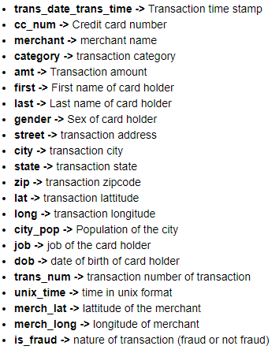
Appendix: Data Attributes

Slide 13
Appendix: Data Methodology
15 models were developed and amongst them the model which satisfy our need was chosen, with prime focus on recall metric
A logistic regression classifier built on top dataset and Class imbalance adjusted using synthetic minority oversampling technique (SMOTE) sampling method

Slide 14
Files attached
Structured Problem Solving (excel file)
Root Cause Analysis (pdf file)
Cost Benefit Analysis (excel file)
PPT
Video Presentation
python coding file

Slide 15
Thank you

