Slide 1
Intuit Craft Demo
Data-Pipeline for Customer Graph

Slide 2
Introduction
Why Computer Science?
Journey so far...
What next?

Slide 3
Projects Proud of...
Imagery Stack for Walmart.com
  Scale
  Latency
  Lessons
https://medium.com/walmartlabs/building-object-store-storing-images-in-cassandra-walmart-scale-a6b9c02af593
Product Matching
  Similarity based on title, price, images...
  Impact
  Lessons

Slide 4
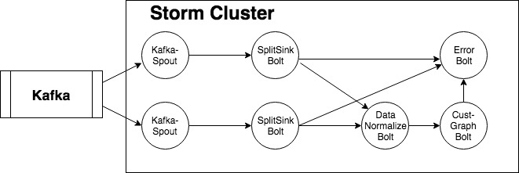
Data-Pipeline for Customer Graph
Design + Demo

Slide 5
Data-Pipeline for Customer Graph
Productionalizing Requirements
Batch /Real-time - Connecting to Multiple Sources
Scalable/Reliable/Fault Tolerant
Dealing with errors
  System
  Data
Extensible & Maintainable
  Static vs Dynamic
Tech Stack
  Java vs Kotlin + FP
  Neo4J vs OrientDB
  Storm vs Flink
  Micro-services
  Monitoring with ELK Stack

