Slide 1
Unit-1: Introduction to DBMS

Slide 2
(1)What is Data? Differentiate between data and information.
Data → Raw, unorganized facts such as numbers, names, or readings.
Information → Processed and meaningful form of data.
Basis | Data | Information
Meaning | Raw facts, figures | Processed, meaningful data
Nature | Often lacks immediate meaning or context on its own. | Provides meaningful and relevant insights to users.
Purpose | Input for processing | Output of data processing
Structure | Unorganized | Organized
DBMS Role | A DBMS converts this raw data into useful information by organizing and structuring it. | The end product that is valuable for users.
Example | 25, “John”, “HR” | “John works in HR and earns 25K/month”

Slide 3
(2) Differentiate between File Management System and Database Management System.
Feature | File System | DBMS
Data Storage | In separate files | In structured tables
Data Redundancy | High | Controlled
Security | Basic file-level | Advanced user-level
Concurrency | Difficult | Managed by DBMS
Backup & Recovery | Manual | Built-in
Querying | Limited | Powerful (SQL)

Slide 4
(3)Define DBMS. Give examples of Database Management Systems.
A Database Management System (DBMS) is software that manages the creation, storage, retrieval, and manipulation of data in databases.
Examples: MySQL, Oracle, MS SQL Server, PostgreSQL.

Slide 5
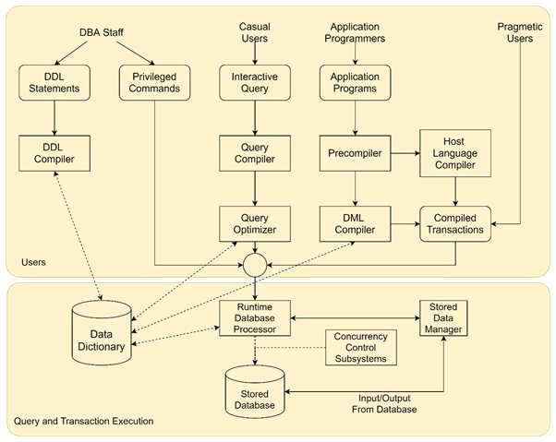
(4) Draw and explain Database System environment.
Components:
Database – Stores data.
DBMS Software – Manages database operations.
Database Administrator (DBA) – Controls access and maintenance.
End Users / Applications – Interact via SQL or interfaces.
Hardware & OS – Underlying infrastructure.

Slide 6
(5)What is Data Dictionary? Explain types of Data Dictionary.
A Data Dictionary stores metadata — information about database structure, tables, attributes, users, and constraints.
Types:
Active Data Dictionary – Automatically updated by DBMS (real-time).
An active data dictionary is integrated with a database and updated automatically by the DBMS as changes occur, ensuring real-time accuracy and consistency.
Passive Data Dictionary – Updated manually by users, may be outdated.
A passive data dictionary is a separate, standalone document that requires manual updates, making it prone to inconsistencies and outdated information, but it offers greater flexibility for custom use.

Slide 7
Active Data Dictionary
Integration: Part of the database system and managed automatically by the DBMS.
Updates: Self-updating, meaning it reflects changes to the database schema
or structure in real-time.
Accuracy: Highly accurate and consistent because it is always synchronized
with the database.
Example:
The system catalog within a Relational Database Management System
(RDBMS) is an example of an active data dictionary.

Slide 8
Passive Data Dictionary-
Integration: A separate, standalone entity that requires a separate database
for storage.
Updates: Requires manual updates by users whenever changes are made to the database.
Accuracy: Can become inconsistent and outdated because it's not automatically synchronized with the database.
Use: Offers flexibility for users to manage and customize it independently
from the specific RDBMS.

Slide 9
(6) How many types of database users are there?
Explain the roles / characteristics of any three types of users.
1. Database Administrator (DBA)
Role/Characteristics: The DBA has central control over the entire database system.
Responsibilities:
  Authorizing access to the database.
  Coordinating and monitoring the database's use.
  Managing resources (software and hardware) needed for the database.
  Implementing security and backup procedures.

Slide 10
2. Database Designers
Role/Characteristics: These users are responsible for defining the structure (schema) of the database.
Responsibilities:
  Identifying the data requirements of the users.
  Choosing the appropriate database structure (tables, relationships, constraints) to store the data.
  Ensuring the design meets all business requirements and performs efficiently.
3. End Users
Role/Characteristics: These are the people who interact with the database either directly or indirectly to perform their work.
Sub-categories (Examples):
  Naive/Parametric End Users: Use pre-written, specialized application programs (e.g., bank tellers, airline reservation clerks).
  Sophisticated End Users: Interact directly with the DBMS using query languages (like SQL) or analysis tools (e.g., business analysts, scientists).
  Casual End Users: Access the database occasionally but need different information each time (e.g., high-level managers).

Slide 11
Other Database Users
Application Programmers: Developers who write the programs that access the database and present data to end users.
System Administrators: Manage the overall computer system and network on which the DBMS resides.
Security Officers: Responsible for establishing and enforcing data security policies and training users on security.

Slide 12
(7)Explain different types of database architectures with its advantage and limitation.
1. Centralized Architecture (Single-Tier)
  In a centralized architecture, the entire DBMS, application programs, and the database are all located on a single computer system or server.
Feature | Advantage | Limitation
Simplicity | Easy to set up, maintain, and manage security, as everything is in one place. | Lack of Scalability: Difficult to handle a growing number of users or transactions, leading to performance bottlenecks.
Cost | Less expensive for small organizations due to minimal networking and hardware requirements. | Dependence: Total system failure if the single host computer fails.
Security | Easier to implement and manage physical access and software security. | Only suitable for applications with small data volume and few users (e.g., a simple personal database).

Slide 13
2. Client-Server Architecture
(A)(Two-Tier Architecture (2-Tier))
This architecture divides the workload between two separate entities: the Client (user interface/application) and the Server (database processing and data storage).
Feature | Advantage | Limitation
Workload Distribution | The application logic and user interface reside on the client, while the data logic and storage reside on the server, improving performance over centralized systems. | Fat Client: The client machine handles both the presentation logic and the application logic, making it difficult to update and maintain the application software.
Security | Improved security since direct access is required only to the database server. | High Traffic: High network traffic because many requests (even simple ones) need direct interaction with the database server.

Slide 14
(B)Three-Tier Architecture (3-Tier)
This architecture introduces an intermediate layer, the Application Server, between the client and the database server. This is the most common model for modern web applications.
Layer | Component | Function
1. Presentation Tier (Client) | User Interface (Web browser, desktop app) | Handles all user interaction and presentation logic.
2. Application Tier (Middle Tier) | Application Server/Web Server | Contains the Business Logic (the rules governing how data is handled, like calculations, validations).
3. Data Tier (Server) | DBMS (Database Server) | Stores, manages, and provides access to the data.

Slide 15
Feature | Advantage | Limitation
Scalability | Excellent Scalability and Performance as the Application Server handles connection pooling and complex logic, reducing the load on the database server. | Increased Complexity: More layers mean greater setup and maintenance complexity.
Maintenance | Thin Client: The client only handles presentation, making updates simpler, as only the middle-tier logic needs changing. | Higher Cost: Requires additional hardware and software for the dedicated Application Server layer.
Security | Enhanced Security because the client never connects directly to the database server; the middle tier acts as a security filter. | Slower response for extremely simple queries due to the extra network hop through the middle layer.

Slide 16
(8) Draw and explain the 3-tier ANSI-SPARC architecture in detail.
The ANSI/SPARC architecture, proposed by the American National Standards Institute's Standards Planning and Requirements Committee, defines three distinct levels of data abstraction to provide data independence and facilitate database design and management.
The ANSI-SPARC model, or three-level architecture, is a conceptual framework for database management systems (DBMS) proposing three distinct levels of data abstraction: External, Conceptual, and Internal.
It aims to provide data independence by separating how data is viewed by users (external) from the overall data structure (conceptual) and its physical storage (internal).
This architecture allows changes at one level, such as how data is stored physically, without impacting users at higher levels.

Slide 17
External level-
This is the highest level and closest to the user, where data is presented through customized "views" or user interfaces.
Each user interacts with a specific view of the database that is relevant to their needs, hiding irrelevant or sensitive information.
Example: Think of it as different department members in a company seeing only the information they need from a large central database.
Conceptual level-
This level describes the entire database globally, including data entities, relationships between them, and constraints.
It provides a common community view of the data and ensures data consistency and integrity across the entire database, acting as a bridge between the external and internal levels.
Changes to the physical storage or external views don't affect the conceptual level , and changes to the conceptual level can be made without altering user views.
Internal Level (Physical Level)-
This is the lowest level, describing how the data is physically stored on storage devices like hard disks.
It details the actual data structures, file organization, indexing, and access methods used by the DBMS.
Changes at this level, such as upgrading storage hardware, should not affect the higher conceptual and external levels.

Slide 18
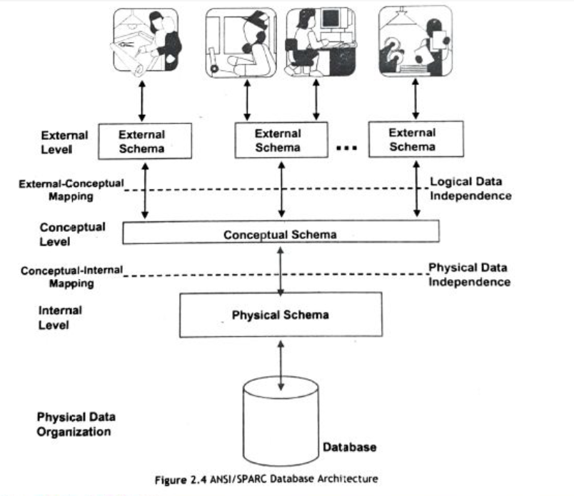
ANSI/SPARC Database Architecture

Slide 19
(9)Mention the advantages of using Three-Tier Architecture.
The Three-Tier Architecture (also known as the 3-Tier Client-Server Architecture) is the most preferred model for large-scale, modern web and enterprise applications.
Advantage :
Enhanced Scalability :
The middle-tier (Application Server) handles the business logic and manages connections to the database. This distribution of tasks reduces the load on the database server, allowing the system to handle a significantly larger number of users and transactions by adding more application servers.

Slide 20
Improved Security :
The client (Presentation Tier) never communicates directly with the database server (Data Tier). The Application Server acts as a middleman and security filter, preventing direct SQL injection or unauthorized access to the data.
Easier Maintainability and Updates :
The separation of application logic (Middle Tier) from the user interface (Presentation Tier) creates a "thin client." If business rules change, only the code on the Application Server needs to be updated, without requiring updates to be deployed on every user's machine.
Increased Flexibility :
Different clients (e.g., web browsers, mobile apps, desktop clients) can use the exact same business logic residing on the Middle Tier, promoting code reuse and making it easier to integrate new technologies.
Better Performance :
The Application Server can implement techniques like caching and connection pooling to optimize and reuse database connections, resulting in faster response times for users.

Slide 21
(10) What is data independence? Explain two kinds of data independence.
Logical Data Independence: The capacity to change the conceptual schema without having to change the external schemas and their application programs.
Physical Data Independence: The capacity to change the internal schema wit out having to change the conceptual schema.
1. Physical Data Independence :
Definition: It is the ability to change the physical level (internal schema) of the database without requiring changes to the conceptual level (logical schema) or the external view.
In Simple Terms: You can change how the data is actually stored on the disk (e.g., changing file organization, switching from one type of storage device to another, changing indexing methods) without having to rewrite or modify the application programs or the way the data is logically perceived.

Slide 22
Change at Physical Level | No Impact on Higher Level
Changing file organization (e.g., from sequential to indexed) | Application programs and logical structure remain unchanged.
Creating or dropping new indexes | User queries and the conceptual schema are unaffected.
Changing storage devices (e.g., hard disk to SSD) | The logical view of the data is preserved.
2. Logical Data Independence
Definition: It is the ability to change the conceptual level (logical schema) of the database without requiring changes to the external level (view schemas) or the application programs that access the data.
In Simple Terms: You can change what data is stored in the database (e.g., adding a new attribute to a table or combining two tables) without forcing the end-user applications to be modified.

Slide 23
Change at Logical Level | No Impact on Higher Level
Adding a new table (entity) or column (attribute) | User views accessing the existing data are not affected.
Modifying a constraint (e.g., changing a data type) | Applications accessing the unchanged parts of the schema continue to work.
Combining or splitting existing tables | Views can be redefined using the DBMS to appear as the original tables.
Importance: Logical data independence is more difficult to achieve but provides more benefits, as major changes in the logical structure often have widespread consequences for application programs.

Slide 24
(11) What is data abstraction? Explain 3 levels of data abstraction in brief.
Data abstraction in a Database Management System (DBMS) is the process of hiding the complex implementation details of how data is stored and managed, presenting users and applications with a simplified and conceptual view. This simplification is achieved through a multi-level architecture, typically comprising three levels of abstraction.
Physical Level
Logical Level
View level

Slide 25
Physical Level :
This is the lowest level of abstraction, describing how the data is actually stored on the physical storage devices (e.g., hard drives, SSDs).
It deals with details like file organization, indexing methods, data block allocation, and the physical location of data.
Users and applications are generally unaware of this level of detail.
Logical Level (Conceptual Level) :
This level describes what data is stored in the database and the relationships between these data elements.
It defines the database schema, including tables, attributes, data types, relationships, and constraints.
Database administrators and designers primarily work at this level to define the overall structure of the database. Users interact with the database using the logical schema, without needing to know the physical storage details.

Slide 26
View Level (External Level) :
This is the highest level of abstraction, presenting a customized and simplified view of the database to individual users or applications.
Users at this level only see the specific data that is relevant to their tasks, and irrelevant details or sensitive information are hidden.
Views can be created to provide different perspectives of the same data, enhancing security and simplifying data access for various user groups.

Slide 27
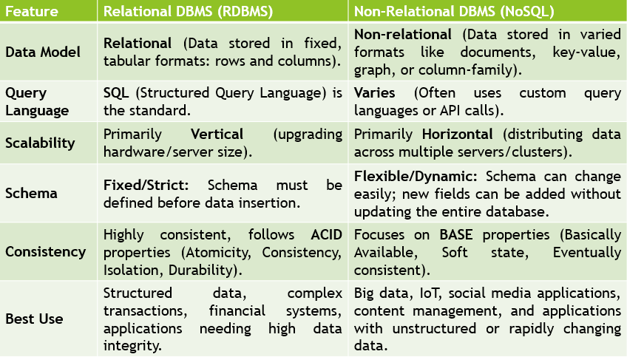
(12) What is data abstraction? Explain 3 levels of data abstraction in brief.

Slide 28
Benefits of RDBMS-
The benefits of a Relational Database Management System (RDBMS)include data integrity and consistency, data security and controlled access, scalability to handle growing data, a well-defined relational model for organized storage, efficient querying with SQL, improved data handling and reduced redundancy through normalization, and support for multi-user access.
Data Integrity and Consistency: RDBMS ensures data is accurate and consistent through the use of keys, indexes, and the ACID (Atomicity,Consistency, Isolation, Durability) properties for transactions.
Data Security: Features such as multi-level security and controlled access allow organizations to restrict data access to specific users, protecting sensitive information.
Scalability: RDBMS can be easily extended to incorporate more records and accommodate growing data, providing greater scalability for businesses.
Relational Model and Organization: Data is stored in tables, creating a clear, organized structure that simplifies data management, understanding, and access to related data points.

Slide 29
SQL Querying: The standardized structured query language (SQL) allows for powerful and flexible data querying, including complex queries that combine data from multiple tables.
Reduced Redundancy: Normalization principles, along with keys and indexes, help avoid data duplication, leading to cleaner and more consistent data.
Flexibility and Ease of Use: Data can be easily updated at a single point of access without affecting other files, and the structured format makes it easier to manage and use.
Multi-User Access: RDBMS supports client-server architecture, enabling multiple users to access and work with the database simultaneously.
Fault Tolerance: Features like database replication help ensure continuousaccess and enable the system to recover from disasters.

Slide 30
(13) Explain DBMS languages with examples.
In a Database Management System (DBMS), special languages are used to perform tasks such as defining the structure of data, manipulating data, and controlling user access. These are called DBMS languages and can be categorized into:
DDL – Data Definition Language
DML – Data Manipulation Language
DCL – Data Control Language

Slide 31
1. Data Definition Language (DDL)
DDL commands are used to define the internal and conceptual schema of the database. They deal with the structure or description of the database objects.
Command | Purpose | Example
CREATE | Used to create new database objects (tables, indexes, views, etc.). | CREATE TABLE Employee (EmpID INT PRIMARY KEY, Name VARCHAR(50));
ALTER | Used to modify the structure of an existing database object. | ALTER TABLE Employee ADD Salary DECIMAL(10, 2);
DROP | Used to permanently delete a database object from the schema. | DROP TABLE Employee;
TRUNCATE | Used to quickly remove all rows from a table, but the table structure remains. | TRUNCATE TABLE Employee;
RENAME | Used to rename an existing database object. | RENAME TABLE Employee TO Staff;

Slide 32
2. Data Manipulation Language (DML)
DML commands are used to manipulate the data stored within the database objects (tables). They perform CRUD operations (Create, Read, Update, Delete).
Command | Purpose | Example
INSERT | Used to add a new row of data into a table. | INSERT INTO Employee (EmpID, Name) VALUES (101, 'Rahul');
SELECT | Used to retrieve data from the database (the 'Read' operation). | SELECT Name, Salary FROM Employee WHERE EmpID = 101;
UPDATE | Used to modify existing data within a table. | UPDATE Employee SET Salary = 50000 WHERE EmpID = 101;
DELETE | Used to delete specific rows of data from a table. | DELETE FROM Employee WHERE Salary IS NULL;

Slide 33
3. Data Control Language (DCL)
DCL commands are used to control access permissions and manage rights and privileges of database users.
Command | Purpose | Example
GRANT | Used to give a user access privileges to a database object. | GRANT SELECT ON Employee TO User_A;
REVOKE | Used to remove access privileges from a user. | REVOKE INSERT ON Employee FROM User_A;

Slide 34
(14)What is No-SQL? Give types of No-SQL Databases with examples.
NoSQL = “Not only SQL” – a broad class of non-relational databases designed for:
High scalability
Flexible schema-less structure
Unstructured/semi-structured data
Key Characteristics:
Horizontal scalability (easier distributed architecture)
Schema flexibility (can change structure anytime)
High performance for specific workloads
For better performance and availability use BASE: Basically Available, Soft state, Eventually consistent (NOT ACID)

Slide 35
Types of NoSQL Databases:
Type | Description | Example
Document-based | Store data in JSON-like documents | MongoDB, CouchDB
Key-Value Stores | Simple key-value Pairs | Redis, DynamoDB
Column-based | Store data in columns for fast Retrieval | Cassandra, HBase
Graph-based | Store data as nodes and relationships | Neo4j, ArangoDB

Slide 36
1. Key-Value Stores
Model: Data is stored as a simple collection of keys (identifiers) and their associated values. This is the simplest NoSQL model, similar to a dictionary or hash map.
Best For: Caching, session management, and storing simple user profiles.
Example: Redis, Memcached, Amazon DynamoDB.
2. Document Databases
Model: Data is stored in documents, which are usually in JSON (JavaScript Object Notation), BSON, or XML format. Documents can contain nested data structures and do not need to follow a fixed schema.
Best For: Content management systems, e-commerce product catalogs, and flexible data that frequently changes structure.
Example: MongoDB, Couchbase.

Slide 37
(15)What are the components of DBMS?
Database Engine | The core service for accessing and processing data. It handles storage, query processing, and transaction management.
Data Definition Language (DDL) Compiler | Interprets and processes DDL statements like CREATE, ALTER, DROP to define schema and structure of the database.
Data Manipulation Language (DML) Compiler | Translates DML statements (INSERT, UPDATE, DELETE, SELECT) into low-level instructions the DBMS engine can execute.
Query Processor | Analyzes, parses, and optimizes SQL queries before execution. Converts high-level queries into efficient execution plans.
Transaction Manager | Ensures ACID properties (Atomicity, Consistency, Isolation, Durability) during transactions. Manages concurrency and crash recovery.

Slide 38
Storage Manager | Manages storage space on disk and memory. It handles data files, indexes, and data buffering for optimized access.
Buffer Manager | Controls data transfer between disk and main memory (RAM). Keeps frequently used data in memory for faster access.
Authorization and Integrity Manager | Enforces user access controls and data validation rules. Ensures only authorized users can access or modify the data.
Catalog/Metadata Manager | Maintains metadata — data about database structure like tables, columns, data types, indexes, constraints, etc.
User Interface or Query Interface | Allows users to interact with the DBMS. Interfaces may include command-line (e.g., SQL prompt) or graphical tools (e.g., MySQL Workbench).
Kothiya Bhaumik

