Slide 1
RECOMMENDATION SYSTEM
GROUP 5
Notes:
Introduce group members, What are recommendation Systems ,

Slide 2
BENEFITS OF RECOMMENDATION SYSTEM
Revenue
Customer Satisfaction
Personalization
Discovery
Provide Reports
Notes:
Why we use recommendation systems

Slide 3
Personalized Recommendation
Gives an insight about the customer’s behavior and preferences
Saves time for clients
Conversion rates increase
Algorithms Used
Deep Autoencoders
Matrix Factorization
Notes:
Why Personalized Recommendation , Say that for this type of recommendation we have these 2 algorithms

Slide 4
DATASET
Netflix Prize Dataset
Dataset contains over 100 million ratings by 480,189 users.
17,770 movies are rated from October 1998 to December 2005.
Movies were rated on a scale from 1 to 5.
Notes:
<talk about the dataset nd how are we using it(as in ful data we are using or what >

Slide 5
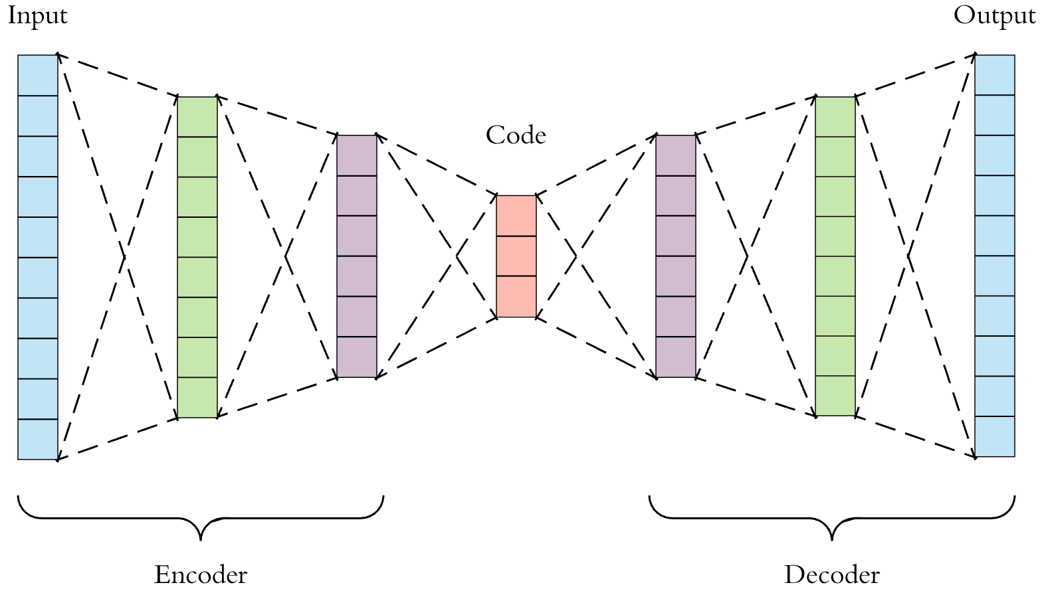
AUTOENCODERS
Autoencoders are feedforward neural network used to achieve dimensionality reduction.
They compress the input into a lower-dimensional code and then reconstruct the output from this representation
Autoencoders are trained to preserve as much information as possible.
Notes:
As our dataset is sparse we are using autoencoders as they are capable of information preservation and dimensionality reduction
With appropriate dimensionality and sparsity constraints, autoencoders can learn data projections that are more interesting than PCA or other basic techniques. Autoencoders are trained to preserve as much information as possible when an input is run through the encoder and then the decoder, but are also trained to make the new representation have various nice properties.

Slide 6
IMPLEMENTATION
6 Layer Deep Autoencoder trained end to end without any layer-wise pre training.
Training interval contains ratings which came in earlier than the ones from testing interval.
Testing interval is then randomly split into Test and Validation subsets so that each rating from testing interval has a 50% chance of appearing in either subset. Users and items that do not appear in the training set are removed from both test and validation subsets.
Notes:
Training interval -12/99-11/05, Testing interval - 12/05

Slide 7

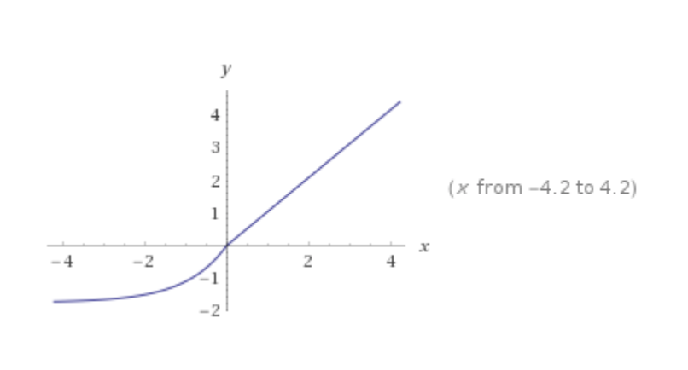
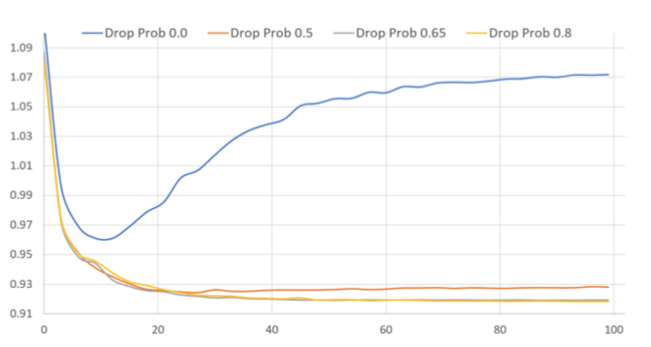
Activation Type
SELU is used on the middle 4 layers.
Sigmoid is used on the last layer.
Drop Out
We apply 80% drop out on the output of encoder.
Notes:
“scaled exponential linear units” Dropout during training.
There are three reasons why you should use SELUs instead of ReLUs from now on:
Similar to ReLUs, SELUs enable deep neural networks since there is no problem with vanishing gradients.
In contrast to ReLUs, SELUs cannot die.
SELUs on their own learn faster and better than other activation functions, even if they are combined with batch normalization

Slide 8
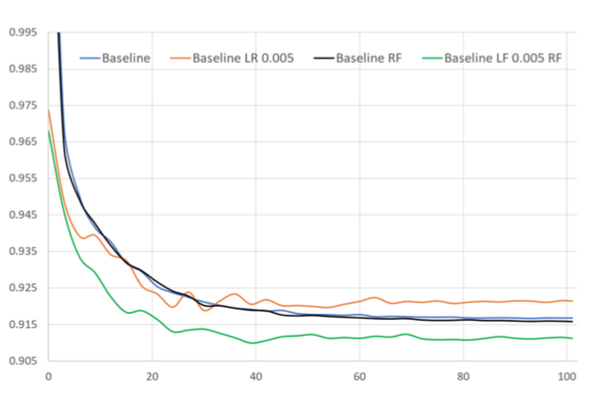
Dense Re-feeding
Iterative dense re-feeding provides additional improvement in evaluation accuracy for our 6-layer-model
We implemented dense re-feeding and increased the learning rate. This helped in improving the RMSE.

Slide 9
Dense Re-feeding Algorithm
Given sparse x, compute dense f (x) and loss using loss function (forward pass)
Compute gradients and perform weight update (backward pass)
Treat f (x) as a new example and compute f (f (x)). Now both f (x) and f (f (x)) are dense. (second forward pass)
Compute gradients and perform weight update (second backward pass)

Slide 10
MATRIX FACTORIZATION
Matrix factorization aims to provide a low-dimension representation of the user-item matrix.
Movie ratings are divided into two matrices such that their product represents the user-item interactions.
This helps us to encapsulate and model the user-item relationship in terms of latent factors, which we can then use to make predictions.

Slide 11
IMPLEMENTATION
We have used surprise library to implement Matrix factorization using SVD.
The user-based recommendation algorithm is trained on a subset of Netflix prize dataset.
We vary the number of hidden factors to determine the effect it has on the RMSE.
We recommend Top-k movies to a given user.

Slide 12
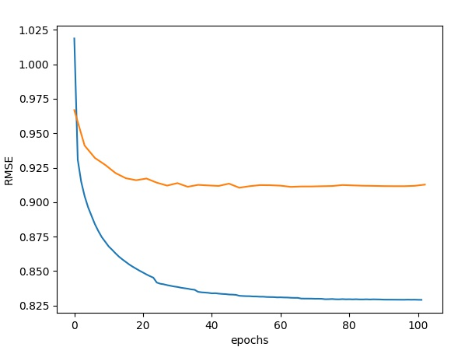
RESULTS - Autoencoder
Deep Autoencoder:
Test RMSE: 0.91

Slide 13
RESULTS - Matrix Factorization
Sr No. | Number of factors | RMSE | MAE
1 | 50 | 1.11 | 0.93
2 | 100 | 1.11 | 0.93
3 | 200 | 1.11 | 0.93
4 | 300 | 1.11 | 0.93

Slide 14
Project Repository
GitHub: https://github.com/bhaumik-choksi/CSE573-Group5-Spring19

