Slide 1
Lab-1
Symbolic Mathematics

Slide 2
“Symbolic” toolbox allows you to:
Enter expressions in symbolic form with symbolic data types.
Expand or simplify symbolic expressions.
Find symbolic roots, limits, minima, maxima, etc.
Differentiate and integrate symbolic functions.
Generate Taylor series of functions (among other tools).
Solve algebraic and differential equations symbolically.
Solve simultaneous equations (even some nonlinear).
Do variable precision arithmetic.
Create graphical representations of symbolic functions.

Slide 3
Creating Symbolic Variables
In order to use the symbolic toolbox, you must create symbolic variables.
To create one symbolic variable, type:
You can also use the syms command:

Slide 4
Creating Multiple Variables
To create several symbolic variables use the syms command as follows:
This creates the symbolic variables K, T, and P0; execute the command whos to check that this is indeed the case.

Slide 5
Creating a symbolic expression with symbolic variables
To create an expression using existing symbolic variables, type:
This creates a symbolic expression that includes the exponential function. It could represent the exponential growth of a population.

Slide 6
Creating an expression with sym()
You can also create symbolic expressions with the sym() command:

Slide 7
Symbolic equations
It is possible to write equations with the symbolic toolbox. Type the following:
This equation is the ideal gas law.

Slide 8
Manipulating symbolic expressions
numden()
expand()
factor()
collect()
simplify()
simple()
poly2sym()

Slide 9
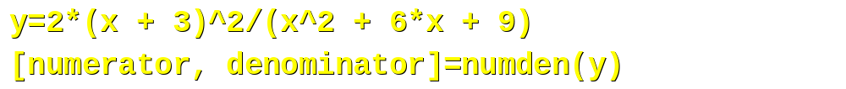
numden()
The numden() command is used to separate the numerator and denominator of a quotient.
Use numden() on the following expression:
numerator=
2*(x + 3)^2
denominator=
(x^2 + 6*x + 9)

Slide 10
expand()
expand() is used to expand an expression by expanding the products of factors in an expression.
Expand the numerator of y:
ans=
2*x^2 + 12*x + 18

Slide 11
factor()
The factor() command is used to factor an expression into a product of terms.
Example: Factor the expression for the denominator.
ans=
(x + 3)^2

Slide 12
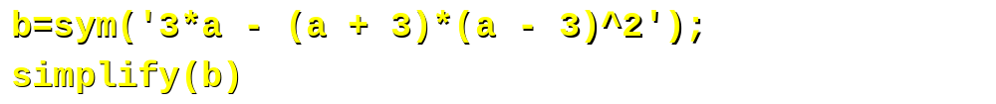
simplify()
The simplify() command uses the Maple simplification algorithm to simplify each part of an expression.
Enter the expression:
ans=
12*a - a^3 + 3*a^2 - 27

Slide 13
simple()
The simple() command executes many techniques to simplify an expression; its ans is the simplest expression.
ans =
3*a - (a + 3)*(a - 3)^2
Note: The simple() command displays the results of all simplification methods; only the final result, i.e., the answer (ans) is shown here.

Slide 14
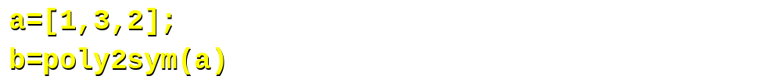
poly2sym()
The poly2sym() function uses an array of coefficients to create a polynomial:
b=
x^2 + 3*x + 2
The function sym2poly() is the inverse of poly2sym().

Slide 15
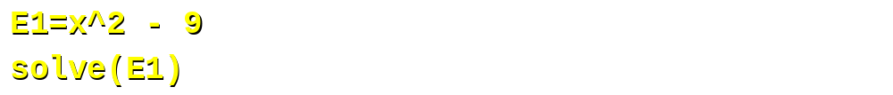
solve()
The solve() function sets an expression equal to zero, then solves the equation for its roots.
ans=
3
-3

Slide 16
Hands on
ans =
1/2/a*( -b + (b^2 - 4*a*c)^(1/2))
1/2/a*( -b - (b^2 - 4*a*c)^(1/2))
Note: The expression is in single quotes; if the symbolic variables in the expression have not been defined previously, then the single quotes are necessary.

Slide 17
Hands on
ans =
-(b*x + c)/x^2
Note that this solves the expression for “a”.

Slide 18
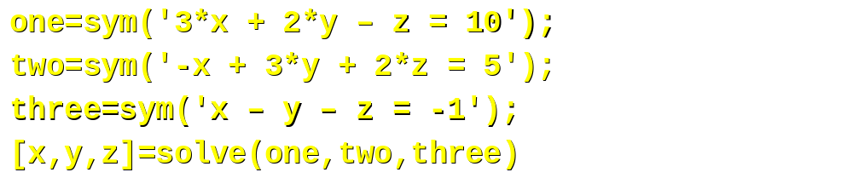
Systems of equations
You can use solve() to find the solution of a system of equations.
x=
-2
y=
5
z=
-6
Note that the solve function produces symbolic output. You can change the output to numerical values with the double() command.

Slide 19
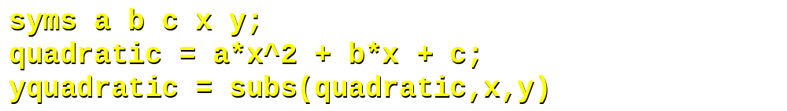
Substitution with subs()
The subs() command allows you to substitute a symbol with another symbol or assign a number to a variable.
yquadratic =
a*y^2 + b*y + c

Slide 20
Multiple substitutions
You can use the subs() command to do multiple substitutions in one command. This is done by grouping the variables and their substitutes (other variables or numerical values) in braces.
subs(symbolic_function, {substitutant}, {substitute})
ans =
27

Slide 21
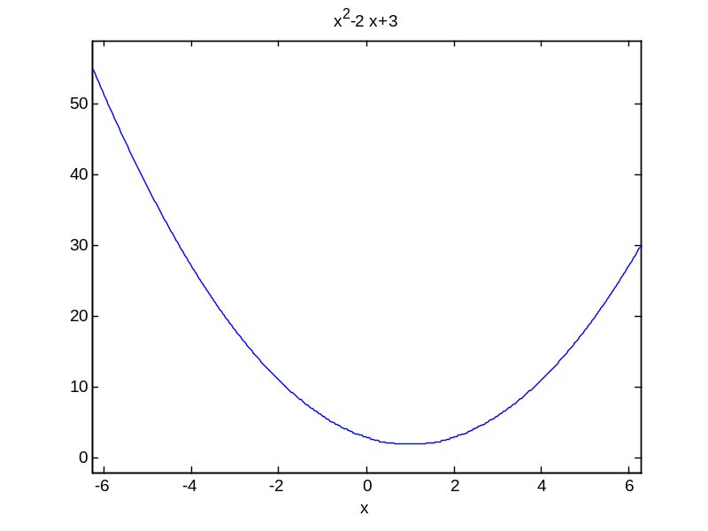
Plotting symbolical functions
Plotting symbolic functions in MATLAB is done with the ezplot() set of commands.
The syntax of ezplot() when y is a function of x is:
ezplot(y)

Slide 22
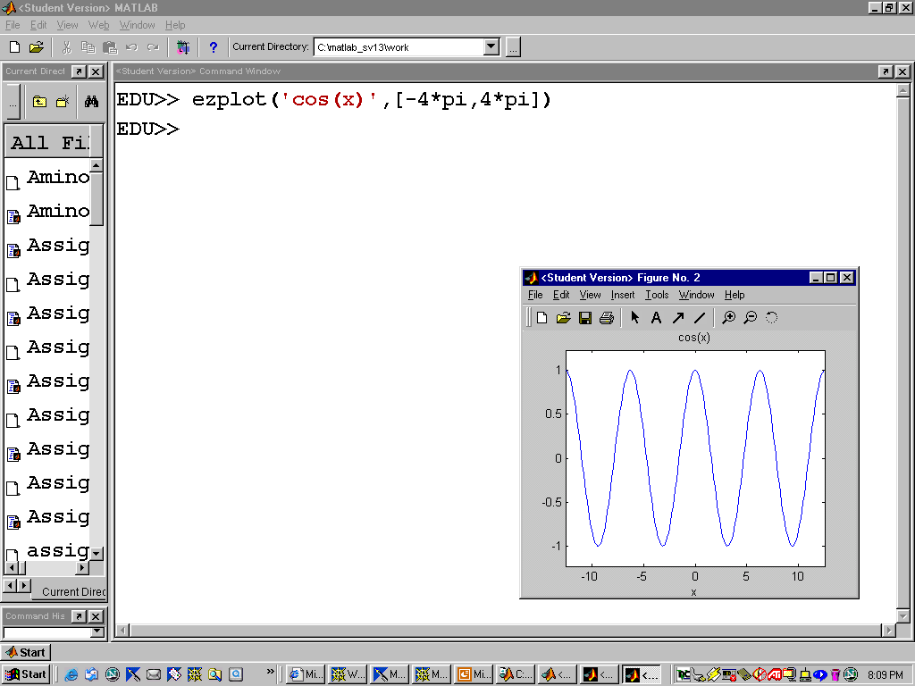

Slide 23
Symbolic Plot Types
ezplot | Function plotter | if z is a function of x ezplot(z)
ezmesh | Mesh plotter | if z is a function of x and y ezmesh(z)
ezmeshc | Combined mesh and contour plotter | if z is a function of x and y ezmeshc(z)
ezsurf | Surface plotter | if z is a function of x and y ezsurf(z)
ezsurfc | Combined surface and contour plotter | if z is a function of x and y ezsurfc(z)
ezcontour | Contour plotter | if z is a function of x and y ezcontour(z)
ezcontourf | Filled contour plotter | if z is a function of x and y ezcontourf(z)
ezplot3 | 3-D parametric curve plotter | if x is a function of t if y is a function of t if z is a function of t ezplot3(x,y,z)
ezpolar | Polar Coordinate plotter | if r is a function of θ ezpolar(r)

Slide 24
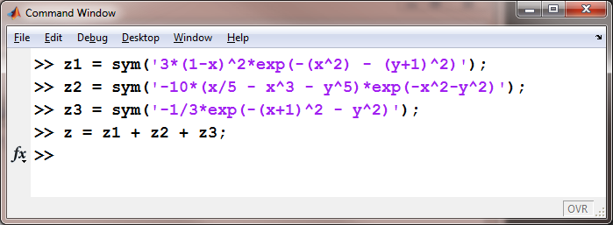
To demonstrate these plot types create a symbolic version of “peaks
We broke this function up into three parts to make it easier to enter into the computer. Notice that there are no “dot” operators used in these expressions, since they are all symbolic.

Slide 25
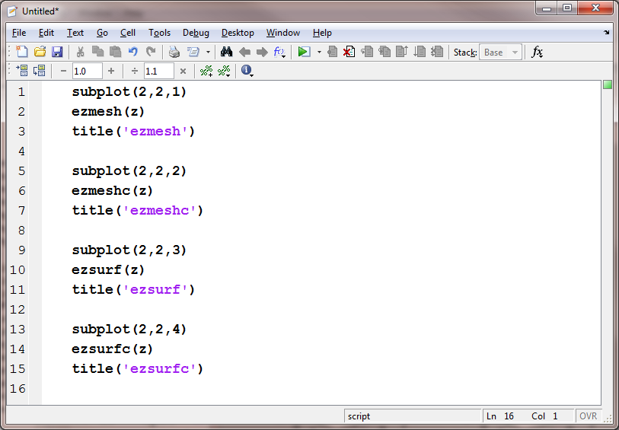

Slide 26
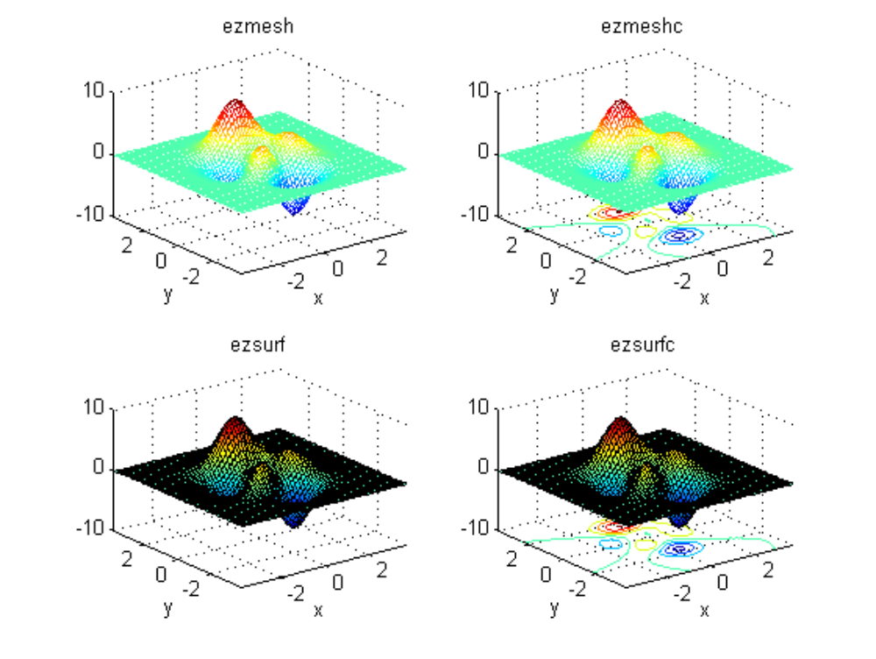

Slide 27
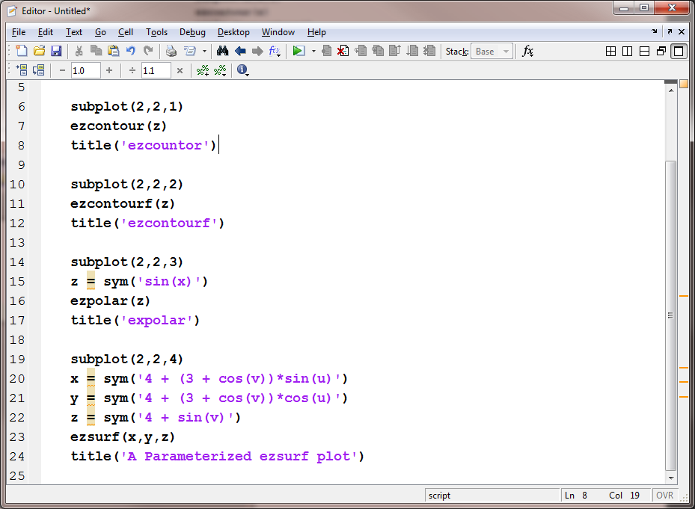

Slide 28
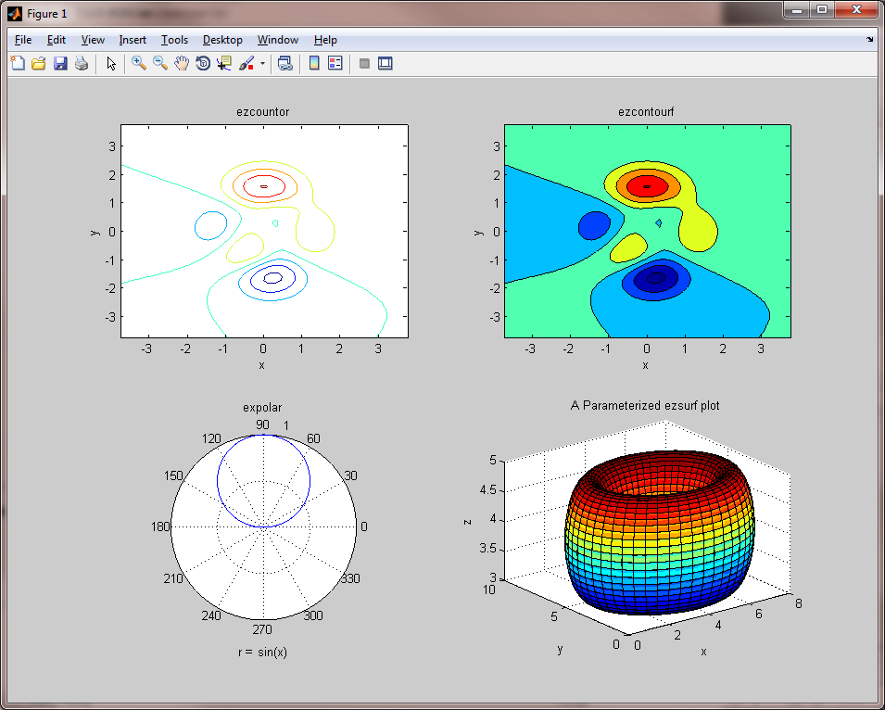

Slide 29
Differentiation
MATLAB allows you to differentiate symbolic functions with the diff() command.
The syntax of diff(), when f is a symbolic function of the variable x and n is the order of the derivative to be determined, is:
diff(f,'x' ,n)
ans =
2*x-2
Try a second derivative. Your result should be 2.

Slide 30
Integration
MATLAB allows you to integrate symbolic functions with the int() command. Either definite integrals, with assigned numeric or symbolic bounds, or indefinite integrals (note that when you compute indefinite integrals, the constant of integration does not appear explicitly).
int(y,'x',a,b)
ans =
1/3*x^3-x^2+3*x
Try a definite integral for 1<x<2. The result should be 7/3.

Slide 31
Integration constant
If you want to display the integration constant when applying the int() function, you can do the following:
  syms x y a
  y = 2*x;
  int(y,’a’,’x’)
  ans =
  x^2–a^2

Slide 32
Exercises
Use the symbolic toolbox to solve the following system of equations:
  x + 2y - z = 4
  3x + 8y + 7z = 20
  2x + 7y + 9z = 23
The velocity of a car is v = t^2 – 3t + 5. Find the displacement for 1<t<5 and the acceleration at t=1.5. Plot the equations for distance, velocity, and acceleration on one graph.

Slide 33
Summary
Creating Symbolic Expressions
  sym(‘x’), syms x, expressions i.e. e=sym(‘m*c^2’)
Manipulation
  numden, expand, factor, collect, simplify, simple, poly2sym
Solutions
  solve, subs
Plotting
  ezplot
Differentiation
  diff(y, ‘x’, n)
Integration
  int(y, ‘x’, a, b)

