Slide 1
Lab-8 Verify Divergence and stoke’s theorem in Matlab

Slide 2

Divergence theorem
Ans = 468

Slide 3

Divergence Theorem-2
Ans- 12

Slide 4
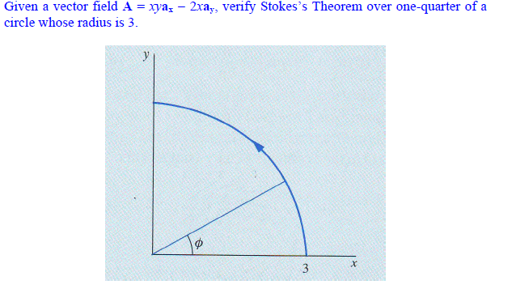
Stoke’s Theorem
ans = -23.1372

