Slide 1
Workshop: Python and OpenCV on Raspberry-Pi Day-2
Introduction to Image Processing in OpenCV
-Prof. Bhaumik Vaidya

Slide 2
Getting Started with Images
In this section, you will learn
how to read an image, how to display it and how to save it back
functions : cv2.imread(), cv2.imshow() , cv2.imwrite()
how to display images with Matplotlib

Slide 3
Read an image
Use the function cv2.imread() to read an image. The image should be in the working directory or a full path of image should be given.
Second argument is a flag which specifies the way image should be read.
cv2.IMREAD_COLOR : Loads a color image. Any transparency of image will be neglected. It is the default flag.
cv2.IMREAD_GRAYSCALE : Loads image in grayscale mode
cv2.IMREAD_UNCHANGED : Loads image as such including alpha channel
Note
Instead of these three flags, you can simply pass integers 1, 0 or -1 respectively.

Slide 4
Display an Image
Use the function cv2.imshow() to display an image in a window.
The window automatically fits to the image size.
First argument is a window name which is a string, second argument is our image.
You can create as many windows as you wish, but with different window names.

Slide 5
Write an image
Use the function cv2.imwrite() to save an image.
First argument is the file name, second argument is the image you want to save.
cv2.imwrite('messigray.png',img)
This will save the image in PNG format in the working directory.

Slide 6
Code
import numpy as np
import cv2
np.set_printoptions(threshold=np.inf)
#img = cv2.imread('C:/Users/vbhaumik/Pictures/Capture.jpg',0)
img = cv2.imread('images/messi5.jpg',0)
cv2.imshow('image',img)
print img
k = cv2.waitKey(0) & 0xFF
if k == 27: # wait for ESC key to exit
cv2.destroyAllWindows()
elif k == ord(‘e'): # wait for ‘e' key to save and exit
cv2.imwrite('C:/Users/vbhaumik/Pictures/Capture.png',img)
cv2.destroyAllWindows()

Slide 7
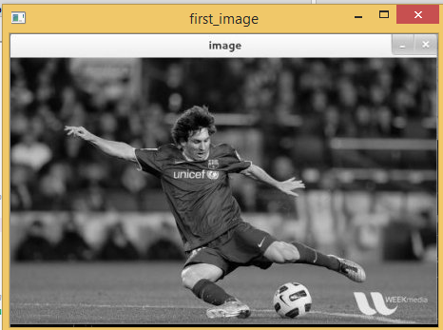

Slide 8
cv2.waitKey()
cv2.waitKey() is a keyboard binding function.
Its argument is the time in milliseconds.
The function waits for specified milliseconds for any keyboard event.
If you press any key in that time, the program continues.
If 0 is passed, it waits indefinitely for a key stroke.
It can also be set to detect specific key strokes like, in previous code if key e is pressed then image was saved and when Esc was pressed program exited.

Slide 9
Image Window Options
cv2.destroyAllWindows() simply destroys all the windows that are created.
If you want to destroy any specific window, use the function cv2.destroyWindow() where you pass the exact window name as the argument.
There is a special case where you can already create a window and load image to it later.
In that case, you can specify whether window is resizable or not.
It is done with the function cv2.namedWindow().
By default, the flag is cv2.WINDOW_AUTOSIZE. But if you specify flag to be cv2.WINDOW_NORMAL, you can resize window.
It will be helpful when image is too large in dimension and adding track bar to windows.

Slide 10
Display Image using Matplotlib
"""
Created on Sun Jan 01 11:51:19 2017
@author: vbhaumik
"""
import numpy as np
import cv2
from matplotlib import pyplot as plt
img = cv2.imread('C:/Users/vbhaumik/Pictures/Capture.jpg',0)
plt.imshow(img, cmap = 'gray')
plt.xticks([]), plt.yticks([]) # to hide tick values on X and Y axis
plt.show()
Warning
Color image loaded by OpenCV is in BGR mode. But Matplotlib displays in RGB mode. So color images will not be displayed correctly in Matplotlib if image is read with OpenCV. Please see the exercises for more details.

Slide 11
Capture Video from Camera
OpenCV provides a very simple interface to capture live stream with camera.
Let’s capture a video from the camera (I am using the in-built webcam of my laptop), convert it into grayscale video and display it..
To capture a video, you need to create a VideoCapture object.
Its argument can be either the device index or the name of a video file. Device index is just the number to specify which camera.
Normally one camera will be connected (as in my case). So I simply pass 0 (or -1). You can select the second camera by passing 1 and so on.
After that, you can capture frame-by-frame.
But at the end, don’t forget to release the capture.

Slide 12
"""
Created on Sun Jan 01 11:59:03 2017
@author: vbhaumik
"""
import numpy as np
import cv2
cap = cv2.VideoCapture(0)
while(True):
# Capture frame-by-frame
ret, frame = cap.read()
# Our operations on the frame come here
#gray = cv2.cvtColor(frame, cv2.COLOR_BGR2GRAY)
# Display the resulting frame
cv2.imshow('frame',gray)
if cv2.waitKey(1) & 0xFF == ord('q'):
break
# When everything done, release the capture
cap.release()
cv2.destroyAllWindows()

Slide 13
Note
cap.read() returns a bool (True/False). If frame is read correctly, it will be True. So you can check end of the video by checking this return value.
Sometimes, cap may not have initialized the capture. In that case, this code shows error. You can check whether it is initialized or not by the method cap.isOpened(). If it is True, OK. Otherwise open it using cap.open().
You can also access some of the features of this video using cap.get(propId) method where propId is a number from 0 to 18.
Each number denotes a property of the video (if it is applicable to that video) and full details can be seen here: Property Identifier. Some of these values can be modified using cap.set(propId, value). Value is the new value you want.
For example, I can check the frame width and height by cap.get(3) and cap.get(4). It gives me 640x480 by default. But I want to modify it to 320x240. Just use ret = cap.set(3,320) and ret = cap.set(4,240).

Slide 14
Playing Video from file
import numpy as np
import cv2
cap = cv2.VideoCapture('AAONA.avi')
while(cap.isOpened()):
ret, frame = cap.read()
gray = cv2.cvtColor(frame, cv2.COLOR_BGR2GRAY)
cv2.imshow('frame',gray)
if cv2.waitKey(25) & 0xFF == ord('q'):
break
cap.release()
cv2.destroyAllWindows()
Note:
It is same as capturing from Camera, just change camera index with video file name. Also while displaying the frame, use appropriate time for cv2.waitKey(). If it is too less, video will be very fast and if it is too high, video will be slow.

Slide 15
Saving the Video
Create a VideoWriter object.
We should specify the output file name (eg: output.avi). Then we should specify the FourCC code.
Then number of frames per second (fps) and frame size should be passed. And last one is isColor flag. If it is True, encoder expect color frame, otherwise it works with grayscale frame.
FourCC is a 4-byte code used to specify the video codec. The list of available codes can be found in fourcc.org. It is platform dependent. Following codecs works fine for me.
In Fedora: DIVX, XVID, MJPG, X264, WMV1, WMV2. (XVID is more preferable. MJPG results in high size video. X264 gives very small size video)
In Windows: DIVX (More to be tested and added)
In OSX : (I don’t have access to OSX. Can some one fill this?)
FourCC code is passed as cv2.VideoWriter_fourcc('M','J','P','G') or cv2.VideoWriter_fourcc(*'MJPG) for MJPG.

Slide 16
"""
Created on Sun Jan 01 13:03:25 2017
@author: vbhaumik
"""
import numpy as np
import cv2
cap = cv2.VideoCapture(0)
# Define the codec and create VideoWriter object
fourcc = cv2.VideoWriter_fourcc(*'XVID')
out = cv2.VideoWriter('output.avi',fourcc, 20.0, (640,480))
while(cap.isOpened()):
ret, frame = cap.read()
if ret==True:
frame = cv2.flip(frame,0)
# write the flipped frame
out.write(frame)
cv2.imshow('frame',frame)
if cv2.waitKey(1) & 0xFF == ord('q'):
break
else:
break
# Release everything if job is finished
cap.release()
out.release()
cv2.destroyAllWindows()

Slide 17
Drawing Line
To draw a line, you need to pass starting and ending coordinates of line. We will create a black image and draw a blue line on it from top-left to bottom-right corners.
# Create a black image
img = np.zeros((512,512,3), np.uint8)
# Draw a diagonal blue line with thickness of 5 px
img = cv2.line(img,(0,0),(511,511),(255,0,0),5)

Slide 18
Drawing Rectangle
To draw a rectangle, you need top-left corner and bottom-right corner of rectangle. This time we will draw a green rectangle at the top-right corner of image.
img = cv2.rectangle(img,(384,0),(510,128),(0,255,0),3)

Slide 19
Drawing Circle
To draw a circle, you need its center coordinates and radius. We will draw a circle inside the rectangle drawn above.
img = cv2.circle(img,(447,63), 63, (0,0,255), -1)

Slide 20
Drawing Polygon
To draw a polygon, first you need coordinates of vertices. Make those points into an array of shape ROWSx1x2 where ROWS are number of vertices and it should be of type int32. Here we draw a small polygon of with four vertices in yellow color.
pts = np.array([[10,5],[20,30],[70,20],[50,10]], np.int32)
pts = pts.reshape((-1,1,2))
img = cv2.polylines(img,[pts],True,(0,255,255))

Slide 21
Adding Text to Images
To put texts in images, you need specify following things.
Text data that you want to write
Position coordinates of where you want put it (i.e. bottom-left corner where data starts).
Font type (Check cv2.putText() docs for supported fonts)
Font Scale (specifies the size of font)
regular things like color, thickness, lineType etc. For better look, lineType = cv2.LINE_AA is recommended.
font = cv2.FONT_HERSHEY_SIMPLEX
cv2.putText(img,'OpenCV',(10,500), font, 4,(255,255,255),2,cv2.LINE_AA)

Slide 22
Mouse callback function
To list all available events available, run the following code in Python terminal:
>>> events = [i for i in dir(cv2) if 'EVENT' in i]
>>> print events
Creating mouse callback function has a specific format which is same everywhere. It differs only in what the function does. So our mouse callback function does one thing, it draws a circle where we double-click. So see the code below. Code is self-explanatory from comments :
import cv2
import numpy as np
# mouse callback function
def draw_circle(event,x,y,flags,param):
if event == cv2.EVENT_LBUTTONDBLCLK:
cv2.circle(img,(x,y),100,(255,0,0),-1)
# Create a black image, a window and bind the function to window
img = np.zeros((512,512,3), np.uint8)
cv2.namedWindow('image')
cv2.setMouseCallback('image',draw_circle)
while(1):
cv2.imshow('image',img)
if cv2.waitKey(20) & 0xFF == 27:
break
cv2.destroyAllWindows()

Slide 23
Accessing and Modifying pixel values
load a color image first.
You can access a pixel value by its row and column coordinates. For BGR image, it returns an array of Blue, Green, Red values. For grayscale image, just corresponding intensity is returned.
>>> px = img[100,100]
>>> print px
[157 166 200]
# accessing only blue pixel
>>> blue = img[100,100,0]
>>> print blue
157
You can modify the pixel values the same way.
>>> img[100,100] = [255,255,255]
>>> print img[100,100]
[255 255 255]

Slide 24
Same Operations using Numpy Library
Numpy is a optimized library for fast array calculations. So simply accessing each and every pixel values and modifying it will be very slow and it is discouraged.
Above mentioned method is normally used for selecting a region of array, say first 5 rows and last 3 columns like that. For individual pixel access, Numpy array methods, array.item() and array.itemset() is considered to be better. But it always returns a scalar. So if you want to access all B,G,R values, you need to call array.item() separately for all.
Better pixel accessing and editing method :
# accessing RED value
>>> img.item(10,10,2)
59
# modifying RED value
>>> img.itemset((10,10,2),100)
>>> img.item(10,10,2)
100

Slide 25
Accessing Image Properties
Image properties include number of rows, columns and channels, type of image data, number of pixels etc.
Shape of image is accessed by img.shape. It returns a tuple of number of rows, columns and channels (if image is color):
>>> print img.shape
(342, 548, 3)
If image is grayscale, tuple returned contains only number of rows and columns. So it is a good method to check if loaded image is grayscale or color image.
Total number of pixels is accessed by img.size:
>>> print img.size
562248
Image datatype is obtained by img.dtype:
>>> print img.dtype
uint8
img.dtype is very important while debugging because a large number of errors in OpenCV-Python code is caused by invalid datatype.

Slide 26
Image ROI
Sometimes, you will have to play with certain region of images. For eye detection in images, first perform face detection over the image until the face is found, then search within the face region for eyes.
This approach improves accuracy (because eyes are always on faces ) and performance (because we search for a small area).
ROI is again obtained using Numpy indexing. Here I am selecting the ball and copying it to another region in the image:
>>> ball = img[280:340, 330:390]
>>> img[273:333, 100:160] = ball

Slide 27
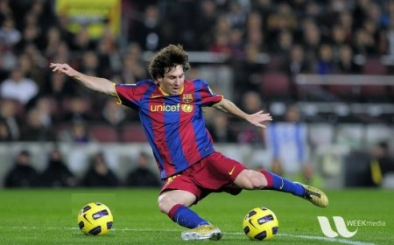
Result

Slide 28
Splitting and Merging Image Channels
The B,G,R channels of an image can be split into their individual planes when needed. Then, the individual channels can be merged back together to form a BGR image again. This can be performed by:
>>> b,g,r = cv2.split(img)
>>> img = cv2.merge((b,g,r))
Or
>>> b = img[:,:,0]
Suppose, you want to make all the red pixels to zero, you need not split like this and put it equal to zero. You can simply use Numpy indexing which is faster.
>>> img[:,:,2] = 0
cv2.split() is a costly operation (in terms of time), so only use it if necessary. Numpy indexing is much more efficient and should be used if possible.

Slide 29
Image Addition
You can add two images by OpenCV function, cv2.add() or simply by numpy operation, res = img1 + img2. Both images should be of same depth and type, or second image can just be a scalar value.
Note
There is a difference between OpenCV addition and Numpy addition. OpenCV addition is a saturated operation while Numpy addition is a modulo operation.
For example, consider below sample:
>>> x = np.uint8([250])
>>> y = np.uint8([10])
>>> print cv2.add(x,y) # 250+10 = 260 => 255
[[255]]
>>> print x+y # 250+10 = 260 % 256 = 4
[4]
It will be more visible when you add two images. OpenCV function will provide a better result. So always better stick to OpenCV functions.

Slide 30
Image Blending
his is also image addition, but different weights are given to images so that it gives a feeling of blending or transparency. Images are added as per the equation below:
g(x) = (1 – αf₀(x) + α f₁(x)
By varying α from 0 to 1, you can perform a cool transition between one image to another.
Here I took two images to blend them together. First image is given a weight of 0.7 and second image is given 0.3. cv2.addWeighted() applies following equation on the image.
dst = α*img1 + β* img2 +γ
Here γ is taken as zero.

Slide 31
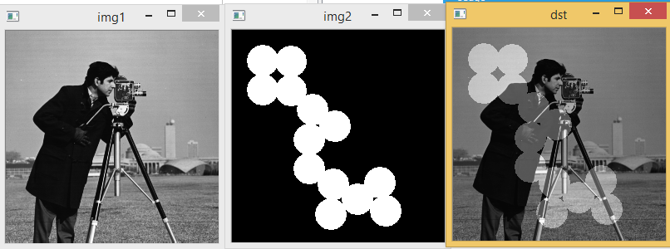
Code
img1 = cv2.imread('ml.png')
img2 = cv2.imread('opencv_logo.jpg')
dst = cv2.addWeighted(img1,0.7,img2,0.3,0)
cv2.imshow('dst',dst)
cv2.waitKey(0)
cv2.destroyAllWindows()

Slide 32
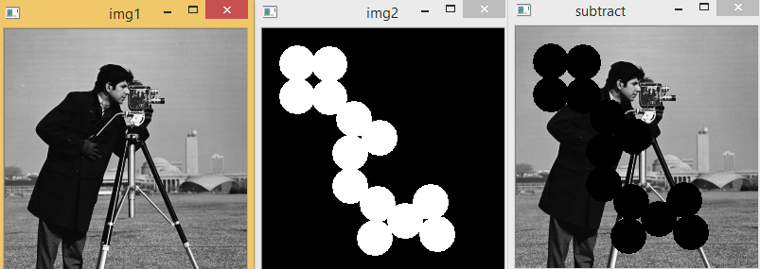
Image Subtraction
import cv2
img1 = cv2.imread('images/cameraman.tif')
cv2.imshow('img1',img1)
img2 = cv2.imread('images/circles.png')
cv2.imshow('img2',img2)
sub=cv2.subtract(img1,img2)
cv2.imshow('subtract',sub)
cv2.waitKey(0)
cv2.destroyAllWindows()

Slide 33
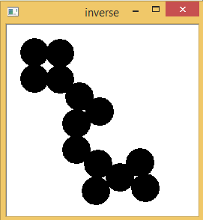
Image Inverse
import cv2
img2 = cv2.imread('images/circles.png')
inv= cv2.bitwise_not(img2)
cv2.imshow('inverse',inv)

Slide 34
Measuring Performance with OpenCV
cv2.getTickCount function returns the number of clock-cycles after a reference event (like the moment machine was switched ON) to the moment this function is called. So if you call it before and after the function execution, you get number of clock-cycles used to execute a function.
cv2.getTickFrequency function returns the frequency of clock-cycles, or the number of clock-cycles per second. So to find the time of execution in seconds, you can do following:
e1 = cv2.getTickCount()
# your code execution
e2 = cv2.getTickCount()
time = (e2 - e1)/ cv2.getTickFrequency()

Slide 35
Example
We will demonstrate with following example. Following example apply median filtering with a kernel of odd size ranging from 5 to 49.
img1 = cv2.imread('messi5.jpg')
e1 = cv2.getTickCount()
for i in xrange(5,49,2):
img1 = cv2.medianBlur(img1,i)
e2 = cv2.getTickCount()
t = (e2 - e1)/cv2.getTickFrequency()
print t
# Result I got is 0.000405415946497 seconds

Slide 36
Measuring Performance in IPython
Sometimes you may need to compare the performance of two similar operations. IPython gives you a magic command %timeit to perform this. It runs the code several times to get more accurate results. Once again, they are suitable to measure single line codes.
For example, do you know which of the following addition operation is more better, x = 5; y = x**2, x = 5; y = x*x, x = np.uint8([5]); y = x*x or y = np.square(x) ? We will find it with %timeit in IPython shell.
In [10]: x = 5
In [11]: %timeit y=x**2
10000000 loops, best of 3: 73 ns per loop
In [12]: %timeit y=x*x
10000000 loops, best of 3: 58.3 ns per loop
In [15]: z = np.uint8([5])
In [17]: %timeit y=z*z
1000000 loops, best of 3: 1.25 us per loop
In [19]: %timeit y=np.square(z)
1000000 loops, best of 3: 1.16 us per loop
You can see that, x = 5 ; y = x*x is fastest and it is around 20x faster compared to Numpy.
In [35]: %timeit z = cv2.countNonZero(img)
100000 loops, best of 3: 15.8 us per loop
In [36]: %timeit z = np.count_nonzero(img)
1000 loops, best of 3: 370 us per loop
See, OpenCV function is nearly 25x faster than Numpy function.

Slide 37
Changing Color-space
here are more than 150 color-space conversion methods available in OpenCV. But we will look into only two which are most widely used ones, BGR toGray and BGR to HSV.
For color conversion, we use the function cv2.cvtColor(input_image, flag) where flag determines the type of conversion.
For BGR to Gray conversion we use the flags cv2.COLOR_BGR2GRAY. Similarly for BGR to HSV, we use the flag cv2.COLOR_BGR2HSV. To get other flags, just run following commands in your Python terminal :
>>> import cv2
>>> flags = [i for i in dir(cv2) if i.startswith('COLOR_')]
>>> print flags
Note
For HSV, Hue range is [0,179], Saturation range is [0,255] and Value range is [0,255]. Different softwares use different scales. So if you are comparing OpenCV values with them, you need to normalize these ranges.

Slide 38
Object Tracking
Now we know how to convert BGR image to HSV, we can use this to extract a colored object. In HSV, it is more easier to represent a color than RGB color-space. In our application, we will try to extract a blue colored object. So here is the method:
Take each frame of the video
Convert from BGR to HSV color-space
We threshold the HSV image for a range of blue color
Now extract the blue object alone, we can do whatever on that image we want.

Slide 39
import cv2
import numpy as np
cap = cv2.VideoCapture(0)
while(1):
# Take each frame
_, frame = cap.read()
# Convert BGR to HSV
hsv = cv2.cvtColor(frame, cv2.COLOR_BGR2HSV)
# define range of blue color in HSV
lower_blue = np.array([110,50,50])
upper_blue = np.array([130,255,255])
# Threshold the HSV image to get only blue colors
mask = cv2.inRange(hsv, lower_blue, upper_blue)
# Bitwise-AND mask and original image
res = cv2.bitwise_and(frame,frame, mask= mask)
cv2.imshow('frame',frame)
cv2.imshow('mask',mask)
cv2.imshow('res',res)
k = cv2.waitKey(5) & 0xFF
if k == 27:
break
cv2.destroyAllWindows()

Slide 40
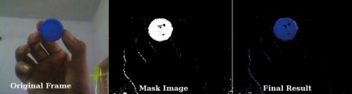
Result

Slide 41
Image Thresholding
Here, the matter is straight forward. If pixel value is greater than a threshold value, it is assigned one value (may be white), else it is assigned another value (may be black). The function used is cv2.threshold.
First argument is the source image, which should be a grayscale image. Second argument is the threshold value which is used to classify the pixel values. Third argument is the maxVal which represents the value to be given if pixel value is more than (sometimes less than) the threshold value. OpenCV provides different styles of thresholding and it is decided by the fourth parameter of the function. Different types are:
cv2.THRESH_BINARY
If intensity(x,y) > thresh, then set intensity(x,y) = maxVal; else set intensity(x,y) = 0.
cv2.THRESH_BINARY_INV
If intensity(x,y) > thresh, then set intensity(x,y) = 0; else set intensity(x,y) = maxVal
cv2.THRESH_TRUNC
If intensity(x,y) > thresh, then set intensity(x,y)=threshold; else leave intensity(x,y) as it is.
cv2.THRESH_TOZERO
If intensity(x,y)> thresh; then leave intensity(x,y) as it is; else set intensity(x,y) = 0.
cv2.THRESH_TOZERO_INV
If intensity(x,y) > thresh, then set intensity(x,y) = 0; else leave intensity(x,y) as it is.

Slide 42
import cv2
import numpy as np
from matplotlib import pyplot as plt
img = cv2.imread('gradient.png',0)
ret,thresh1 = cv2.threshold(img,127,255,cv2.THRESH_BINARY)
ret,thresh2 = cv2.threshold(img,127,255,cv2.THRESH_BINARY_INV)
ret,thresh3 = cv2.threshold(img,127,255,cv2.THRESH_TRUNC)
ret,thresh4 = cv2.threshold(img,127,255,cv2.THRESH_TOZERO)
ret,thresh5 = cv2.threshold(img,127,255,cv2.THRESH_TOZERO_INV)
titles = ['Original Image','BINARY','BINARY_INV','TRUNC','TOZERO','TOZERO_INV']
images = [img, thresh1, thresh2, thresh3, thresh4, thresh5]
for i in xrange(6):
plt.subplot(2,3,i+1),plt.imshow(images[i],'gray')
plt.title(titles[i])
plt.xticks([]),plt.yticks([])
plt.show()

Slide 43
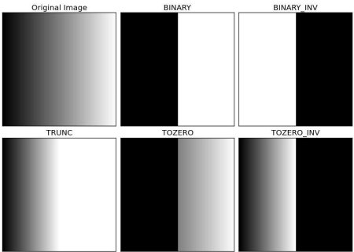

Slide 44
Image Scaling
Scaling is just resizing of the image. OpenCV comes with a function cv2.resize() for this purpose. The size of the image can be specified manually, or you can specify the scaling factor. Different interpolation methods are used. Preferable interpolation methods are cv2.INTER_AREA for shrinking and cv2.INTER_CUBIC (slow) & cv2.INTER_LINEAR for zooming. By default, interpolation method used is cv2.INTER_LINEAR for all resizing purposes.
import cv2
import numpy as np
img = cv2.imread('messi5.jpg')
res = cv2.resize(img,None,fx=2, fy=2, interpolation = cv2.INTER_CUBIC)
height, width = img.shape[:2]
res = cv2.resize(img,(2*width, 2*height), interpolation = cv2.INTER_CUBIC)

Slide 45

Image Translation
Translation is the shifting of object’s location. If you know the shift in (x,y) direction, let it be (t_x,t_y), you can create the transformation matrix as follows:
You can take make it into a Numpy array of type np.float32 and pass it into cv2.warpAffine() function. See below example for a shift of (100,50):
img = cv2.imread('messi5.jpg',0)
rows,cols = img.shape
M = np.float32([[1,0,100],[0,1,50]])
dst = cv2.warpAffine(img,M,(cols,rows))
cv2.imshow('img',dst)
cv2.waitKey(0)
cv2.destroyAllWindows()
Third argument of the cv2.warpAffine() function is the size of the output image, which should be in the form of (width, height). Remember width = number of columns, and height = number of rows.

Slide 46
Image Rotation
To find this transformation matrix, OpenCV provides a function, cv2.getRotationMatrix2D. Check below example which rotates the image by 90 degree with respect to center without any scaling.
img = cv2.imread('messi5.jpg',0)
rows,cols = img.shape
M = cv2.getRotationMatrix2D((cols/2,rows/2),90,1)
dst = cv2.warpAffine(img,M,(cols,rows))

Slide 47
Affine Transformation
In affine transformation, all parallel lines in the original image will still be parallel in the output image. To find the transformation matrix, we need three points from input image and their corresponding locations in output image. Then cv2.getAffineTransform will create a 2x3 matrix which is to be passed to cv2.warpAffine.
img = cv2.imread('drawing.png')
rows,cols,ch = img.shape
pts1 = np.float32([[50,50],[200,50],[50,200]])
pts2 = np.float32([[10,100],[200,50],[100,250]])
M = cv2.getAffineTransform(pts1,pts2)
dst = cv2.warpAffine(img,M,(cols,rows))
plt.subplot(121),plt.imshow(img),plt.title('Input')
plt.subplot(122),plt.imshow(dst),plt.title('Output')
plt.show()

Slide 48
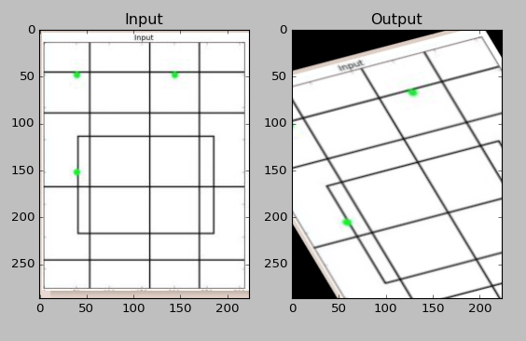

Slide 49
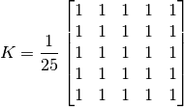
Image Filtering
As for one-dimensional signals, images also can be filtered with various low-pass filters (LPF), high-pass filters (HPF), etc. A LPF helps in removing noise, or blurring the image. A HPF filters helps in finding edges in an image.
OpenCV provides a function, cv2.filter2D(), to convolve a kernel with an image. As an example, we will try an averaging filter on an image. A 5x5 averaging filter kernel can be defined as follows:
Filtering with the above kernel results in the following being performed: for each pixel, a 5x5 window is centered on this pixel, all pixels falling within this window are summed up, and the result is then divided by 25. This equates to computing the average of the pixel values inside that window. This operation is performed for all the pixels in the image to produce the output filtered image.

Slide 50
Code
import cv2
import numpy as np
from matplotlib import pyplot as plt
img = cv2.imread('images/cameraman.tif')
kernel = np.ones((5,5),np.float32)/25
dst = cv2.filter2D(img,-1,kernel)
plt.subplot(121),plt.imshow(img),plt.title('Original')
plt.xticks([]), plt.yticks([])
plt.subplot(122),plt.imshow(dst),plt.title('Averaging')
plt.xticks([]), plt.yticks([])
plt.show()

Slide 51
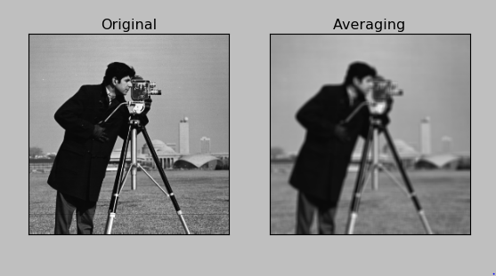

Slide 52
Image blurring
This is done by convolving the image with a normalized box filter. It simply takes the average of all the pixels under kernel area and replaces the central element with this average.
This is done by the function cv2.blur() or cv2.boxFilter(). We should specify the width and height of kernel. A 3x3 normalized box filter would look like this:
import cv2
import numpy as np
from matplotlib import pyplot as plt
img = cv2.imread('opencv_logo.png')
blur = cv2.blur(img,(5,5))
plt.subplot(121),plt.imshow(img),plt.title('Original')
plt.xticks([]), plt.yticks([])
plt.subplot(122),plt.imshow(blur),plt.title('Blurred')
plt.xticks([]), plt.yticks([])
plt.show()

Slide 53
Gaussian Filtering
n this approach, instead of a box filter consisting of equal filter coefficients, a Gaussian kernel is used.
It is done with the function, cv2.GaussianBlur(). We should specify the width and height of the kernel which should be positive and odd.
We also should specify the standard deviation in the X and Y directions, sigmaX and sigmaY respectively. If only sigmaX is specified, sigmaY is taken as equal to sigmaX.
If both are given as zeros, they are calculated from the kernel size. Gaussian filtering is highly effective in removing Gaussian noise from the image.
If you want, you can create a Gaussian kernel with the function, cv2.getGaussianKernel().
The above code can be modified for Gaussian blurring:
blur = cv2.GaussianBlur(img,(5,5),0)

Slide 54
Median Filtering
Here, the function cv2.medianBlur() computes the median of all the pixels under the kernel window and the central pixel is replaced with this median value. This is highly effective in removing salt-and-pepper noise. One interesting thing to note is that, in the Gaussian and box filters, the filtered value for the central element can be a value which may not exist in the original image. However this is not the case in median filtering, since the central element is always replaced by some pixel value in the image. This reduces the noise effectively. The kernel size must be a positive odd integer.
In this demo, we add a 50% noise to our original image and use a median filter. Check the result:
median = cv2.medianBlur(img,5)

Slide 55
Salt and Pepper Noise
import numpy as np
import cv2
import random
import matplotlib.pyplot as plt
img = cv2.imread('/home/pi/book/test_set/lena_color_512.tif',1)
input = cv2.cvtColor(img,cv2.COLOR_BGR2RGB)
output = np.zeros(input.shape,np.uint8)
p = 0.05 # probablity of noise
for i in range (input.shape[0]):
for j in range(input.shape[1]):
r = random.random()
if r < p/2:
output[i][j] = 0,0,0
elif r < p:
output[i][j] = 255,255,255
else:
output[i][j] = input[i][j]
plt.imshow(output), plt.title('Salt and Pepper Sprinkled')
plt.xticks([]),plt.yticks([])
plt.show()

Slide 56
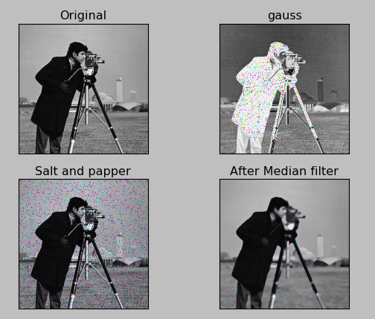

Slide 57
Bilateral Filtering
As we noted, the filters we presented earlier tend to blur edges. This is not the case for the bilateral filter, cv2.bilateralFilter(), which was defined for, and is highly effective at noise removal while preserving edges. But the operation is slower compared to other filters.
We already saw that a Gaussian filter takes the a neighborhood around the pixel and finds its Gaussian weighted average. This Gaussian filter is a function of space alone, that is, nearby pixels are considered while filtering. It does not consider whether pixels have almost the same intensity value and does not consider whether the pixel lies on an edge or not. The resulting effect is that Gaussian filters tend to blur edges, which is undesirable.
The bilateral filter also uses a Gaussian filter in the space domain, but it also uses one more (multiplicative) Gaussian filter component which is a function of pixel intensity differences. The Gaussian function of space makes sure that only pixels are ‘spatial neighbors’ are considered for filtering, while the Gaussian component applied in the intensity domain (a Gaussian function of intensity differences) ensures that only those pixels with intensities similar to that of the central pixel (‘intensity neighbors’) are included to compute the blurred intensity value. As a result, this method preserves edges, since for pixels lying near edges, neighboring pixels placed on the other side of the edge, and therefore exhibiting large intensity variations when compared to the central pixel, will not be included for blurring.
blur = cv2.bilateralFilter(img,9,75,75)

Slide 58
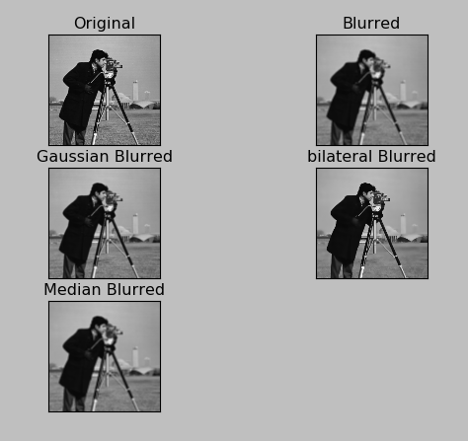

Slide 59

Morphological Transformations
Morphological transformations are some simple operations based on the image shape. It is normally performed on binary images. It needs two inputs, one is our original image, second one is called structuring element or kernel which decides the nature of operation. Two basic morphological operators are Erosion and Dilation. Then its variant forms like Opening, Closing, Gradient etc also comes into play. We will see them one-by-one with help of following image:

Slide 60
Erosion
The basic idea of erosion is just like soil erosion only, it erodes away the boundaries of foreground object (Always try to keep foreground in white). So what does it do? The kernel slides through the image (as in 2D convolution). A pixel in the original image (either 1 or 0) will be considered 1 only if all the pixels under the kernel is 1, otherwise it is eroded (made to zero).
So what happends is that, all the pixels near boundary will be discarded depending upon the size of kernel. So the thickness or size of the foreground object decreases or simply white region decreases in the image. It is useful for removing small white noises (as we have seen in colorspace chapter), detach two connected objects etc.

Slide 61
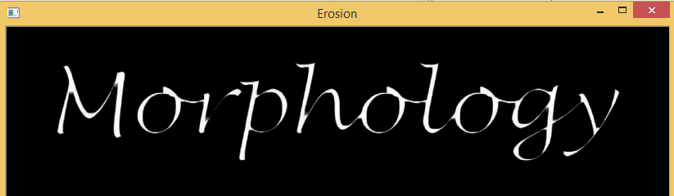
Code
import cv2
import numpy as np
img = cv2.imread(‘images/morph.jpg',0)
kernel = np.ones((5,5),np.uint8)
erosion = cv2.erode(img,kernel,iterations = 1)

Slide 62
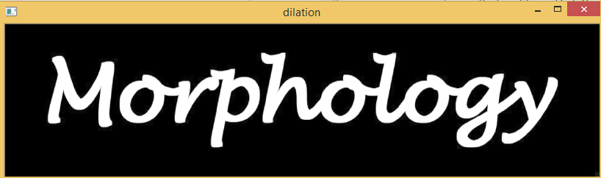
Dilation
It is just opposite of erosion. Here, a pixel element is ‘1’ if atleast one pixel under the kernel is ‘1’. So it increases the white region in the image or size of foreground object increases. Normally, in cases like noise removal, erosion is followed by dilation. Because, erosion removes white noises, but it also shrinks our object. So we dilate it. Since noise is gone, they won’t come back, but our object area increases. It is also useful in joining broken parts of an object.
dilation = cv2.dilate(img,kernel,iterations = 1)

Slide 63
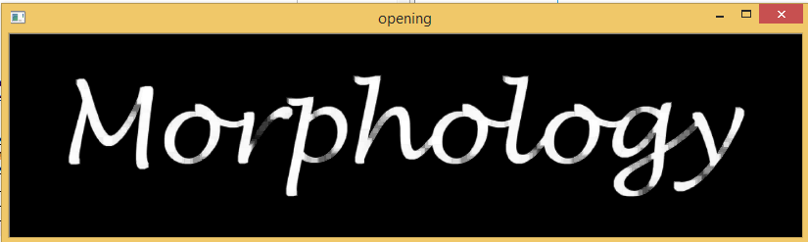
Opening
Opening is just another name of erosion followed by dilation. It is useful in removing noise, as we explained above. Here we use the function, cv2.morphologyEx()
opening = cv2.morphologyEx(img, cv2.MORPH_OPEN, kernel)

Slide 64
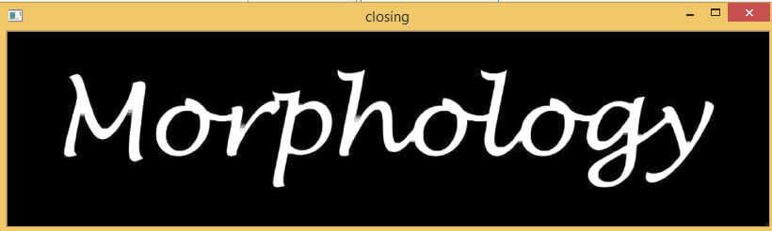
Closing
Closing is reverse of Opening, Dilation followed by Erosion. It is useful in closing small holes inside the foreground objects, or small black points on the object.
closing = cv2.morphologyEx(img, cv2.MORPH_CLOSE, kernel)

Slide 65
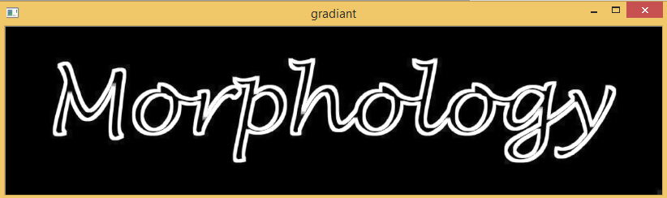
Morphological Gradient
It is the difference between dilation and erosion of an image. The result will look like the outline of the object.
gradient = cv2.morphologyEx(img, cv2.MORPH_GRADIENT, kernel)

Slide 66
Structuring Element
We manually created a structuring elements in the previous examples with help of Numpy. It is rectangular shape. But in some cases, you may need elliptical/circular shaped kernels. So for this purpose, OpenCV has a function, cv2.getStructuringElement(). You just pass the shape and size of the kernel, you get the desired kernel.
# Rectangular Kernel
>>> cv2.getStructuringElement(cv2.MORPH_RECT,(5,5))
array([[1, 1, 1, 1, 1],
[1, 1, 1, 1, 1],
[1, 1, 1, 1, 1],
[1, 1, 1, 1, 1],
[1, 1, 1, 1, 1]], dtype=uint8)
# Elliptical Kernel
>>> cv2.getStructuringElement(cv2.MORPH_ELLIPSE,(5,5))
# Cross-shaped Kernel
>>> cv2.getStructuringElement(cv2.MORPH_CROSS,(5,5))

Slide 67

Image Gradients
1. Sobel and Scharr Derivatives
Sobel operators is a joint Gausssian smoothing plus differentiation operation, so it is more resistant to noise. You can specify the direction of derivatives to be taken, vertical or horizontal (by the arguments, yorder and xorder respectively). You can also specify the size of kernel by the argument ksize. If ksize = -1, a 3x3 Scharr filter is used which gives better results than 3x3 Sobel filter. Please see the docs for kernels used.
2. Laplacian Derivatives
It calculates the Laplacian of the image given by the relation,
where each derivative is found using Sobel derivatives. If ksize = 1, then following kernel is used for filtering:

Slide 68
Code
import cv2
import numpy as np
from matplotlib import pyplot as plt
img = cv2.imread(‘images/blobs.png',0)
laplacian = cv2.Laplacian(img,cv2.CV_64F)
sobelx = cv2.Sobel(img,cv2.CV_64F,1,0,ksize=5)
sobely = cv2.Sobel(img,cv2.CV_64F,0,1,ksize=5)
plt.subplot(2,2,1),plt.imshow(img,cmap = 'gray')
plt.title('Original'), plt.xticks([]), plt.yticks([])
plt.subplot(2,2,2),plt.imshow(laplacian,cmap = 'gray')
plt.title('Laplacian'), plt.xticks([]), plt.yticks([])
plt.subplot(2,2,3),plt.imshow(sobelx,cmap = 'gray')
plt.title('Sobel X'), plt.xticks([]), plt.yticks([])
plt.subplot(2,2,4),plt.imshow(sobely,cmap = 'gray')
plt.title('Sobel Y'), plt.xticks([]), plt.yticks([])
plt.show()

Slide 69
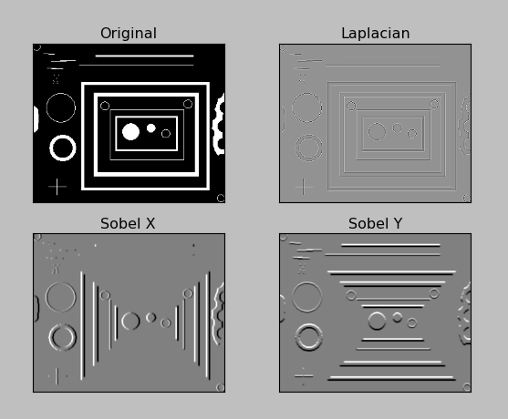

Slide 70
Canny Edge Detection
OpenCV puts all the above in single function, cv2.Canny().
First argument is our input image. Second and third arguments are our minVal and maxVal respectively. Third argument is aperture_size. It is the size of Sobel kernel used for find image gradients. By default it is 3.
Last argument is L2gradient which specifies the equation for finding gradient magnitude. If it is True, it uses the equation mentioned above which is more accurate, otherwise it uses this function: Edge Gradient ; (G) = |G_x| + |G_y|. By default, it is False.

Slide 71
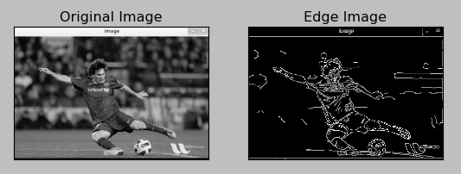
Code
import cv2
import numpy as np
from matplotlib import pyplot as plt
img = cv2.imread(‘images/messi5.jpg',0)
edges = cv2.Canny(img,100,200)
plt.subplot(121),plt.imshow(img,cmap = 'gray')
plt.title('Original Image'), plt.xticks([]), plt.yticks([])
plt.subplot(122),plt.imshow(edges,cmap = 'gray')
plt.title('Edge Image'), plt.xticks([]), plt.yticks([])
plt.show()

Slide 72
Histograam Calculation in OpenCV
So now we use cv2.calcHist() function to find the histogram. Let’s familiarize with the function and its parameters :
cv2.calcHist(images, channels, mask, histSize, ranges[, hist[, accumulate]])
images : it is the source image of type uint8 or float32. it should be given in square brackets, ie, “[img]”.
channels : it is also given in square brackets. It the index of channel for which we calculate histogram. For example, if input is grayscale image, its value is [0]. For color image, you can pass [0],[1] or [2] to calculate histogram of blue,green or red channel respectively.
mask : mask image. To find histogram of full image, it is given as “None”. But if you want to find histogram of particular region of image, you have to create a mask image for that and give it as mask. (I will show an example later.)
histSize : this represents our BIN count. Need to be given in square brackets. For full scale, we pass [256].
ranges : this is our RANGE. Normally, it is [0,256].

Slide 73
So let’s start with a sample image. Simply load an image in grayscale mode and find its full histogram.
img = cv2.imread('home.jpg',0)
hist = cv2.calcHist([img],[0],None,[256],[0,256])
hist is a 256x1 array, each value corresponds to number of pixels in that image with its corresponding pixel value.

Slide 74
Histogram Calculation in Numpy
Numpy also provides you a function, np.histogram(). So instead of calcHist() function, you can try below line :
hist,bins = np.histogram(img.ravel(),256,[0,256])
hist is same as we calculated before. But bins will have 257 elements, because Numpy calculates bins as 0-0.99, 1-1.99, 2-2.99 etc. So final range would be 255-255.99. To represent that, they also add 256 at end of bins. But we don’t need that 256. Upto 255 is sufficient.
Numpy has another function, np.bincount() which is much faster than (around 10X) np.histogram(). So for one-dimensional histograms, you can better try that. Don’t forget to set minlength = 256 in np.bincount. For example, hist = np.bincount(img.ravel(),minlength=256)
Note
OpenCV function is more faster than (around 40X) than np.histogram(). So stick with OpenCV function.

Slide 75
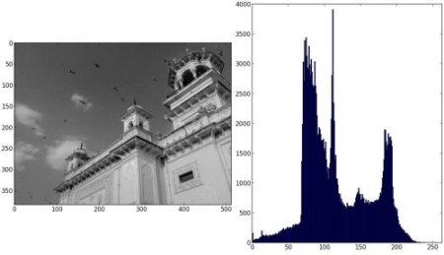
Plotting Histograms
Matplotlib comes with a histogram plotting function : matplotlib.pyplot.hist()
It directly finds the histogram and plot it. You need not use calcHist() or np.histogram() function to find the histogram. See the code below:
import cv2
import numpy as np
from matplotlib import pyplot as plt
img = cv2.imread('home.jpg',0)
plt.hist(img.ravel(),256,[0,256]); plt.show()

Slide 76
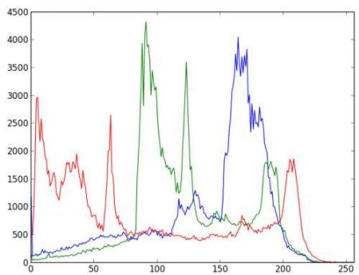
For Color Images
import cv2
import numpy as np
from matplotlib import pyplot as plt
img = cv2.imread('home.jpg')
color = ('b','g','r')
for i,col in enumerate(color):
histr = cv2.calcHist([img],[i],None,[256],[0,256])
plt.plot(histr,color = col)
plt.xlim([0,256])
plt.show()

Slide 77
Application of Mask
img = cv2.imread('images/autumn.tif',0)
# create a mask
mask = np.zeros(img.shape[:2], np.uint8)
mask[100:300, 100:400] = 255
masked_img = cv2.bitwise_and(img,img,mask = mask)
# Calculate histogram with mask and without mask
# Check third argument for mask
hist_full = cv2.calcHist([img],[0],None,[256],[0,256])
hist_mask = cv2.calcHist([img],[0],mask,[256],[0,256])
plt.subplot(221), plt.imshow(img, 'gray')
plt.subplot(222), plt.imshow(mask,'gray')
plt.subplot(223), plt.imshow(masked_img, 'gray')
plt.subplot(224), plt.plot(hist_full), plt.plot(hist_mask)
plt.xlim([0,256])
plt.show()

Slide 78
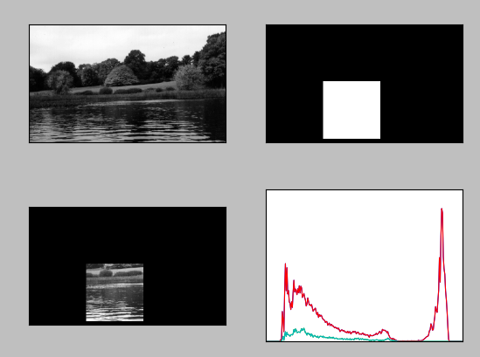

Slide 79
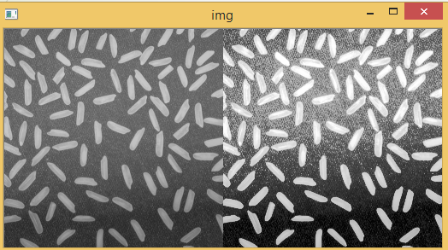
Histograms Equalization in OpenCV
OpenCV has a function to do this, cv2.equalizeHist(). Its input is just grayscale image and output is our histogram equalized image.
Below is a simple code snippet showing its usage for same image we used :
img = cv2.imread('images/rice.png',0)
equ = cv2.equalizeHist(img)
res = np.hstack((img,equ)) #stacking images side-by-side
cv2.imshow("img",res)

Slide 80
2D Histogram in OpenCV
It is quite simple and calculated using the same function, cv2.calcHist(). For color histograms, we need to convert the image from BGR to HSV. (Remember, for 1D histogram, we converted from BGR to Grayscale). For 2D histograms, its parameters will be modified as follows:
channels = [0,1] because we need to process both H and S plane.
bins = [180,256] 180 for H plane and 256 for S plane.
range = [0,180,0,256] Hue value lies between 0 and 180 & Saturation lies between 0 and 256.
Now check the code below:
import cv2
import numpy as np
img = cv2.imread('home.jpg')
hsv = cv2.cvtColor(img,cv2.COLOR_BGR2HSV)
hist = cv2.calcHist([hsv], [0, 1], None, [180, 256], [0, 180, 0, 256])

Slide 81
Plotting 2D Histograms
We can use matplotlib.pyplot.imshow() function to plot 2D histogram with different color maps. It gives us much more better idea about the different pixel density. But this also, doesn’t gives us idea what color is there on a first look, unless you know the Hue values of different colors. Still I prefer this method. It is simple and better.
While using this function, remember, interpolation flag should be nearest for better results.
import cv2
import numpy as np
from matplotlib import pyplot as plt
img = cv2.imread('images/autumn.tif')
hsv = cv2.cvtColor(img,cv2.COLOR_BGR2HSV)
hist = cv2.calcHist( [hsv], [0, 1], None, [180, 256], [0, 180, 0, 256] )
plt.subplot(1,2,1),plt.imshow(img), plt.xticks([]), plt.yticks([])
plt.subplot(1,2,2),plt.imshow(hist,interpolation = 'nearest'), plt.xticks([]), plt.yticks([])
plt.show()

Slide 82
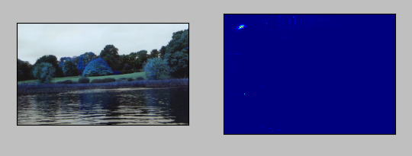
Below is the input image and its color histogram plot. X axis shows S values and Y axis shows Hue.
In histogram, you can see some high values near H = 100 and S = 200. It corresponds to blue of sky. Similarly another peak can be seen near H = 25 and S = 100. It corresponds to yellow of the palace. You can verify it with any image editing tools like GIMP.

Slide 83
Fourier Transform
Fourier Transform is used to analyze the frequency characteristics of various filters. For images, 2D Discrete Fourier Transform (DFT) is used to find the frequency domain.
A fast algorithm called Fast Fourier Transform (FFT) is used for calculation of DFT.
For a sinusoidal signal, x(t) = A*sin(2*pi*f*t), we can say f is the frequency of signal, and if its frequency domain is taken, we can see a spike at f.
If signal is sampled to form a discrete signal, we get the same frequency domain, but is periodic in the range [- pi, pi] or [0,2*pi] (or [0,N] for N-point DFT).
You can consider an image as a signal which is sampled in two directions. So taking fourier transform in both X and Y directions gives you the frequency representation of image.
More intuitively, for the sinusoidal signal, if the amplitude varies so fast in short time, you can say it is a high frequency signal. If it varies slowly, it is a low frequency signal. You can extend the same idea to images. Where does the amplitude varies drastically in images ? At the edge points, or noises. So we can say, edges and noises are high frequency contents in an image. If there is no much changes in amplitude, it is a low frequency component.

Slide 84
Fourier Transform in Numpy
First we will see how to find Fourier Transform using Numpy.
Numpy has an FFT package to do this. np.fft.fft2() provides us the frequency transform which will be a complex array. Its first argument is the input image, which is grayscale.
Second argument is optional which decides the size of output array. If it is greater than size of input image, input image is padded with zeros before calculation of FFT. If it is less than input image, input image will be cropped. If no arguments passed, Output array size will be same as input.
Now once you got the result, zero frequency component (DC component) will be at top left corner.
If you want to bring it to center, you need to shift the result by N/2 in both the directions. This is simply done by the function, np.fft.fftshift(). (It is more easier to analyze). Once you found the frequency transform, you can find the magnitude spectrum.

Slide 85
Code
import cv2
import numpy as np
from matplotlib import pyplot as plt
img = cv2.imread('messi5.jpg',0)
f = np.fft.fft2(img)
fshift = np.fft.fftshift(f)
magnitude_spectrum = 20*np.log(np.abs(fshift))
plt.subplot(121),plt.imshow(img, cmap = 'gray')
plt.title('Input Image'), plt.xticks([]), plt.yticks([])
plt.subplot(122),plt.imshow(magnitude_spectrum, cmap = 'gray')
plt.title('Magnitude Spectrum'), plt.xticks([]), plt.yticks([])
plt.show()

Slide 86
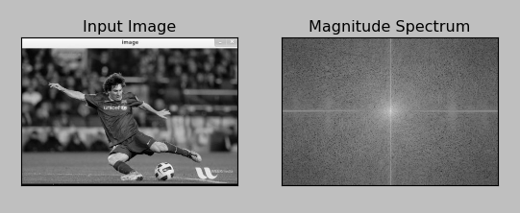

Slide 87
Fourier Transform in OpenCV
OpenCV provides the functions cv2.dft() and cv2.idft() for this. It returns the same result as previous, but with two channels. First channel will have the real part of the result and second channel will have the imaginary part of the result. The input image should be converted to np.float32 first. We will see how to do it.
import numpy as np
import cv2
from matplotlib import pyplot as plt
img = cv2.imread('messi5.jpg',0)
dft = cv2.dft(np.float32(img),flags = cv2.DFT_COMPLEX_OUTPUT)
dft_shift = np.fft.fftshift(dft)
magnitude_spectrum = 20*np.log(cv2.magnitude(dft_shift[:,:,0],dft_shift[:,:,1]))
plt.subplot(121),plt.imshow(img, cmap = 'gray')
plt.title('Input Image'), plt.xticks([]), plt.yticks([])
plt.subplot(122),plt.imshow(magnitude_spectrum, cmap = 'gray')
plt.title('Magnitude Spectrum'), plt.xticks([]), plt.yticks([])
plt.show()

Slide 88
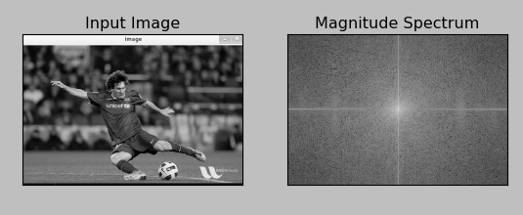

Slide 89
So, now we have to do inverse DFT. In previous session, we created a HPF, this time we will see how to remove high frequency contents in the image, ie we apply LPF to image. It actually blurs the image. For this, we create a mask first with high value (1) at low frequencies, ie we pass the LF content, and 0 at HF region.
rows, cols = img.shape
crow,ccol = rows/2 , cols/2
# create a mask first, center square is 1, remaining all zeros
mask = np.zeros((rows,cols,2),np.uint8)
mask[crow-30:crow+30, ccol-30:ccol+30] = 1
# apply mask and inverse DFT
fshift = dft_shift*mask
f_ishift = np.fft.ifftshift(fshift)
img_back = cv2.idft(f_ishift)
img_back = cv2.magnitude(img_back[:,:,0],img_back[:,:,1])
plt.subplot(121),plt.imshow(img, cmap = 'gray')
plt.title('Input Image'), plt.xticks([]), plt.yticks([])
plt.subplot(122),plt.imshow(img_back, cmap = 'gray')
plt.title(‘image_back'), plt.xticks([]), plt.yticks([])
plt.show()

Slide 90
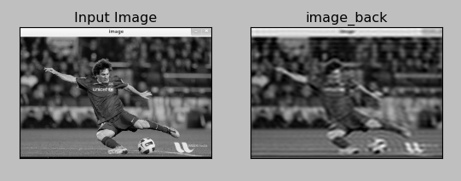

Slide 91
Filtering in Frequency Domain
import cv2
import numpy as np
from matplotlib import pyplot as plt
# simple averaging filter without scaling parameter
mean_filter = np.ones((3,3))
# creating a guassian filter
x = cv2.getGaussianKernel(5,10)
gaussian = x*x.T
# different edge detecting filters
# scharr in x-direction
scharr = np.array([[-3, 0, 3],
[-10,0,10],
[-3, 0, 3]])
# sobel in x direction
sobel_x= np.array([[-1, 0, 1],
[-2, 0, 2],
[-1, 0, 1]])
# sobel in y direction
sobel_y= np.array([[-1,-2,-1],
[0, 0, 0],
[1, 2, 1]])
# laplacian
laplacian=np.array([[0, 1, 0],
[1,-4, 1],
[0, 1, 0]])
filters = [mean_filter, gaussian, laplacian, sobel_x, sobel_y, scharr]
filter_name = ['mean_filter', 'gaussian','laplacian', 'sobel_x', \
'sobel_y', 'scharr_x']
fft_filters = [np.fft.fft2(x) for x in filters]
fft_shift = [np.fft.fftshift(y) for y in fft_filters]
mag_spectrum = [np.log(np.abs(z)+1) for z in fft_shift]
for i in xrange(6):
plt.subplot(2,3,i+1),plt.imshow(mag_spectrum[i],cmap = 'gray')
plt.title(filter_name[i]), plt.xticks([]), plt.yticks([])
plt.show()

Slide 92
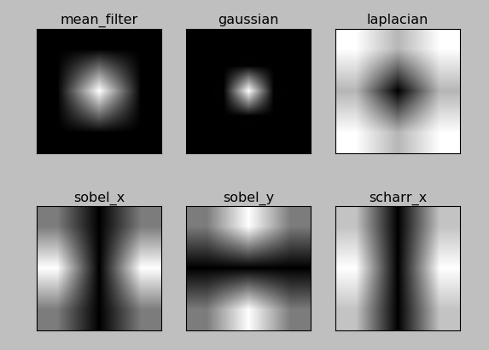

Slide 93
Detecting and tracking faces
import cv2
import numpy as np
face_cascade=cv2.CascadeClassifier('C:/opencv/build/etc/haarcascades/haarcascade_frontalface_alt.xml')
cap = cv2.VideoCapture(0)
scaling_factor = 0.5
while True:
ret, frame = cap.read()
frame = cv2.resize(frame, None, fx=scaling_factor, fy=scaling_factor,interpolation=cv2.INTER_AREA)
gray = cv2.cvtColor(frame, cv2.COLOR_BGR2GRAY)
face_rects = face_cascade.detectMultiScale(gray, 1.3, 5)
for (x,y,w,h) in face_rects:
cv2.rectangle(frame, (x,y), (x+w,y+h), (0,255,0), 3)
cv2.imshow('Face Detector', frame)
c = cv2.waitKey(1)
if c == 27:
break
cap.release()
cv2.destroyAllWindows()

Slide 94
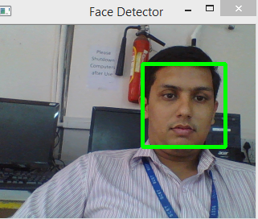
Result

Slide 95
Understanding it better
We need a classifier model that can be used to detect the faces in an image. OpenCV provides an xml file that can be used for this purpose.
We use the function CascadeClassifier to load the xml file.
Once we start capturing the input frames from the webcam, we convert it to grayscale and use the function detectMultiScale to get the bounding boxes for all the faces in the current image.
The second argument in this function specifies the jump in the scaling factor.
As in, if we don’t find an image in the current scale, the next size to check will be, in our case, 1.3 times bigger than the current size.
The last parameter is a threshold that specifies the number of adjacent rectangles needed to keep the current rectangle. It can be used to increase the robustness of the face detector.

Slide 96
Thank You -Any Questions ?
If any Queries Contact me: Vaidya.bhaumik@gmail.com or bhaumik.Vaidya@scet.ac.in
Mobile: 9925572670

