Slide 1
Workshop: Python and OpenCV on Raspberry-Pi Day-1
Introduction To Python And OpenCV
-Prof. Bhaumik Vaidya

Slide 2
Introduction to OpenCV
OpenCV is released under a BSD license and hence it’s free for both academic and commercial use.
It has C++, C, Python and Java interfaces and supports Windows, Linux, Mac OS, iOS and Android.
OpenCV was designed for computational efficiency and with a strong focus on real-time applications.
Written in optimized C/C++, the library can take advantage of multi-core processing.
Enabled with OpenCL, it can take advantage of the hardware acceleration of the underlying heterogeneous compute platform.
Adopted all around the world, OpenCV has more than 47 thousand people of user community and estimated number of downloads exceeding 9 million.
Usage ranges from interactive art, to mines inspection, stitching maps on the web or through advanced robotics.
OpenCV-Python is the Python API of OpenCV. It combines the best qualities of OpenCV C++ API and Python language.

Slide 3
MATLAB also can do Image Processing, then why OpenCV?
Speed: programs written in OpenCV run much faster than similar programs written in Matlab.
Resources needed: Due to the high level nature of Matlab, it uses a lot of your systems resources. And I mean A LOT! Matlab code requires over a gig of RAM to run through video. In comparison, typical OpenCV programs only require ~70mb of RAM to run in real-time.
Cost: List price for the base (no toolboxes) MATLAB (commercial, single user License) is around USD 2150. OpenCV (BSD license) is free! Now, how do you beat that? Huh? huh? huh?
Portability: MATLAB and OpenCV run equally well on Windows, Linux and MacOS. However, when it comes to OpenCV, any device that can run C, can, in all probability, run OpenCV.

Slide 4
OpenCV does lose out over MATLAB on some points:
Ease of use: Matlab is a relatively easy language to get to grips with.
Memory Management: OpenCV is based on C. As such, every time you allocate a chunk of memory you will have to release it again. If you have a loop in your code where you allocate a chunk of memory in that loop and forget release it afterwards, you will get what is called a “leak”. This is where the program will use a growing amount of memory until it crashes from no remaining memory. Due to the high-level nature of Matlab, it is “smart” enough to automatically allocate and release memory in the background.
Development Environment: Matlab comes with its own development environment. For OpenCV, there is no particular IDE that you have to use.

Slide 5
Introduction to Python
Python is one of those rare languages which can claim to be both simple and powerful.
You will find yourself pleasantly surprised to see how easy it is to concentrate on the solution to the problem rather than the syntax and structure of the language you are programming in.
Guido van Rossum, the creator of the Python language, named the language after the BBC show "Monty Python's Flying Circus". He doesn't particularly like snakes that kill animals for food by winding their long bodies around them and crushing them.

Slide 6
Features of Python
Simple
Easy to Learn
Free and Open Source
High-level Language
Portable
Interpreted
Object Oriented
Extensible
Embeddable
Extensive Libraries

Slide 7
Python and OpanCV
Compared to other languages like C/C++, Python is slower. But another important feature of Python is that it can be easily extended with C/C++.
This feature helps us to write computationally intensive codes in C/C++ and create a Python wrapper for it so that we can use these wrappers as Python modules.
This gives us two advantages: first, our code is as fast as original C/C++ code (since it is the actual C++ code working in background) and second, it is very easy to code in Python.
This is how OpenCV-Python works, it is a Python wrapper around original C++ implementation.
And the support of Numpy makes the task more easier.
Numpy is a highly optimized library for numerical operations. It gives a MATLAB-style syntax.
All the OpenCV array structures are converted to-and-from Numpy arrays. So whatever operations you can do in Numpy, you can combine it with OpenCV, which increases number of weapons in your arsenal.
Besides that, several other libraries like SciPy, Matplotlib which supports Numpy can be used with this.
So OpenCV-Python is an appropriate tool for fast prototyping of computer vision problems.

Slide 8
Basic Python Language

Slide 9
ASPECTS OF LANGUAGES
primitive constructs
English: words
programming language: numbers, strings, simple operators

Slide 10
ASPECTS OF LANGUAGE
Syntax
English: "cat dog boy" → not syntactically valid
"cat hugs boy“→ syntactically valid
programming language: "hi"5 → not syntactically valid
3.2*5 → syntactically valid
Static semantics is which syntactically valid strings have meaning
English: "I are hungry“ → syntactically valid but static semantic error
programming language: 3.2*5 → syntactically valid
3+"hi“→ static semantic error
Semantics is the meaning associated with a syntactically correct string of symbols with no static semantic errors
English: One statement can have many meanings
programming languages: have only one meaning but may not be what programmer intended

Slide 11
WHERE THINGS GO WRONG
Syntactic errors
common and easily caught
Static semantic errors
some languages check for these before running program
can cause unpredictable behavior
no semantic errors but different meaning than what programmer intended
program crashes, stops running
program runs forever
program gives an answer but different than expected

Slide 12
IDE’s
painful to just type things into a shell
better to have a text editor –integrated development environment (IDE)
IDLE or Anaconda are examples
comes with
Text editor –use to enter, edit and save your programs
Shell –place in which to interact with and run your programs; standard methods to evaluate your programs from the editor or from stored files
Integrated debugger

Slide 13
PYTHON PROGRAMS
A program is a sequence of definitions and commands
definitions evaluated
commands executed by Python interpreter in a shell
commands(statements) instruct interpreter to do something
can be typed directly in a shell or stored in a file that is read into the shell and evaluated

Slide 14
Objects
programs manipulate data objects
objects have a type that defines the kinds of things programs can do to them
objects are
scalar (cannot be subdivided)
non-scalar (have internal structure that can be accessed)

Slide 15
SCALAR OBJECTS
int–represent integers, ex. 5
float –represent real numbers, ex. 3.27
bool –represent Boolean values Trueand False
NoneType–special and has one value, None
can use type() to see the type of an object
In [1]: type(5)
Out[1]: int
In [2]: type(3.0)
Out[2]: float

Slide 16
TYPE CONVERSIONS (CAST)
can convert object of one type to another
float(3) converts integer 3 to float 3.0
int(3.9)truncates float 3.9 to integer 3

Slide 17
PRINTING TO CONSOLE
To show output from code to a user, use print command
In [11]: 3+2
Out[11]: 5
In [12]: print(3+2)
5
x = 1
print(x)
x_str= str(x)
print("my fav num is", x, ".", "x =", x)
print("my fav num is "+ x_str+ ". "+ "x = "+ x_str)

Slide 18
INPUT: input("")
prints whatever is within the quotes
user types in something and hits enter
returns entered sequence
can bind that value to a variable so can reference
text = input("Type anything... ")
print(5*text)
Input returns a string so must cast if working with numbers
num= int(input("Type a number... "))
print(5*num)

Slide 19
EXPRESSIONS
combine objects and operators to form expressions
an expression has a value, which has a type
syntax for a simple expression
<object> <operator> <object>

Slide 20
OPERATORS ON ints and floats
i+j the sum
i-j the difference
i*j the product
i/j division
i//j int division
i%j the remainder when I is divided by j
i**j I to the power of j

Slide 21
SIMPLE OPERATIONS
parentheses used to tell Python to do these operations first
3*5+1 evaluates to 16
3*(5+1) evaluates to 18
operator precedence without parentheses
**
*
/
+ and –executed left to right, as appear in expression

Slide 22
BINDING VARIABLES AND VALUES
equal sign is an assignment of a value to a variable name
pi = 3.14159
pi_approx= 22/7
value stored in computer memory
an assignment binds name to value
retrieve value associated with name or variable by invoking the name, by typing pi

Slide 23
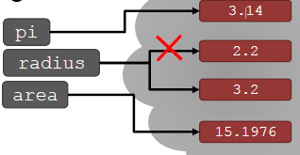
CHANGING BINDINGS
can re-bind variable names using new assignment statements
previous value may still stored in memory but lost the handle for it
value for area does not change until you tell the computer to do the calculation again
pi = 3.14
radius = 2.2
area = pi*(radius**2)
radius = radius+1

Slide 24
Comments
Comments are any text to the right of the # symbol and is mainly useful as notes for the reader of the program.
For example:
print('hello world') # Note that print is a function
or:
# Note that print is a function
print('hello world')
Use as many useful comments as you can in your program to:
explain assumptions
explain important decisions
explain important details
explain problems you're trying to solve
explain problems you're trying to overcome in your program, etc.

Slide 25
Strings
A string is a sequence of characters. Strings are basically just a bunch of words.
You will be using strings in almost every Python program that you write, so pay attention to the following part.
Single Quote
You can specify strings using single quotes such as 'Quote me on this'.
All white space i.e. spaces and tabs, within the quotes, are preserved as-is.
Double Quotes
Strings in double quotes work exactly the same way as strings in single quotes. An example is "What's your name?".
Triple Quotes
You can specify multi-line strings using triple quotes - (""" or '''). You can use single quotes and double quotes freely within the triple quotes.

Slide 26
Strings Are Immutable
This means that once you have created a string, you cannot change it. Although this might seem like a bad thing, it really isn't. We will see why this is not a limitation in the various programs that we see later on.
Note for C/C++ Programmers
There is no separate char data type in Python. There is no real need for it and I am sure you won't miss it.

Slide 27
OPERATIONS ON STRINGS
‘ab’+ ‘cd’ → concatenation
3* ‘eric’ → successive concatenation
len(‘eric’) → the length
‘eric’[1] → indexing
‘eric’[1:3] → slicing

Slide 28
Indentation
Whitespace is important in Python. Actually, whitespace at the beginning of the line is important. This is called indentation.
Leading whitespace (spaces and tabs) at the beginning of the logical line is used to determine the indentation level of the logical line, which in turn is used to determine the grouping of statements.
This means that statements which go together must have the same indentation. Each such set of statements is called a block. We will see examples of how blocks are important in later chapters.
One thing you should remember is that wrong indentation can give rise to errors. For example:
i = 5
# Error below! Notice a single space at the start of the line
print('Value is', i)
print('I repeat, the value is', i)

Slide 29
COMPARISON OPERATORS ON intand float
I and j are any variable names
I > j
I >= j
I < j
I <= j
I == j equality test, True if I equals j
I != j Inequality test, True if I not equal to j

Slide 30
LOGIC OPERATORS ON bools
A and b are any variable names
not a →True if a is False
False if a is True
a and b → True if both are True
a or b → True if either or both are True

Slide 31
BRANCHING PROGRAMS
The simplest branching statement is a conditional
A test (expression that evaluates to True or False)
A block of code to execute if the test is True
An optional block of code to execute if the test is False

Slide 32
A SIMPLE EXAMPLE
x= int(input('Enter an integer: '))
If x%2 == 0:
print(‘’)
print('Even')
else:
print(‘’)
print('Odd')
print(’Done with conditional')

Slide 33
SOME OBSERVATIONS
The expression x%2 == 0 evaluates to True when the remainder of x divided by 2 is 0
Note that == is used for comparison, since = is reserved for assignment
The indentation is important –each indented set of expressions denotes a block of instructions
For example, if the last statement were indented, it would be executed as part of the else block of code
Note how this indentation provides a visual structure that reflects the semantic structure of the program

Slide 34
NESTED CONDITIONALS
If x%2 == 0:
if x%3 == 0:
print('Divisible by 2 and 3’)
else:
print('Divisible by 2 and not by 3’)
elif x%3 == 0:
print('Divisible by 3 and not by 2’)

Slide 35
COMPOUND BOOLEANS
If x< y and x< z:
print('x is least’)
elif y< z:
print('y is least’)
else:
print('z is least’)

Slide 36
WHAT HAVE WE ADDED?
Branching programs allow us to make choices and do different things
But still the case that at most, each statement gets executed once.
So maximum time to run the program depends only on the length of the program
These programs run in constant time

Slide 37
CONTROL FLOW: while LOOPS
while <condition>:
<expression>
<expression>
...
<condition> evaluates to a Boolean
if <condition> is True, do all the steps inside the while code block
check <condition> again
repeat until <condition> is False

Slide 38
CONTROL FLOW: while and for LOOPS
# more complicated with while loop
n = 0
While n < 5:
print(n)
n = n+1
# shortcut with for loop
For n in range(5):
print(n)

Slide 39
CONTROL FLOW: for LOOPS
for<variable> in range(<some_num>):
<expression>
<expression>
...
each time through the loop, <variable> takes a value
first time, <variable> starts at the smallest value
next time, <variable> gets the prevvalue + 1

Slide 40
range(start,stop,step)
default values are start = 0 and step = 1 and is optional
loop until value is stop -1
mysum= 0
for i in range(7, 10):
mysum+= i
print(mysum)
mysum= 0
for i in range(5, 11, 2):
mysum+= i
print(mysum)

Slide 41
break STATEMENT
immediately exits whatever loop it is in
skips remaining expressions in code block
exits only innermost loop
while<condition_1>:
while<condition_2>:
<expression_a>
break
<expression_b>
<expression_c>

Slide 42
break STATEMENT
mysum= 0
for i in range(5, 11, 2):
mysum+= i
if mysum== 5:
break
print(mysum)
what happens in this program?

Slide 43
for VS while LOOPS
For Loop
While loop
know number of iterations
can end early via break
uses a counter
can rewrite a for loop using a while loop
unbounded number of iterations
can end early via break
can use a counter but must initialize before loop and increment it inside loop
may not be able to rewrite a while loop using a for loop

Slide 44
Functions
Functions are reusable pieces of programs.
They allow you to give a name to a block of statements, allowing you to run that block using the specified name anywhere in your program and any number of times. This is known as calling the function.
We have already used many built-in functions such as len and range.
The function concept is probably the most important building block of any non-trivial software (in any programming language),

Slide 45
Functions in Python
Functions are defined using the def keyword.
After this keyword comes an identifier name for the function, followed by a pair of parentheses which may enclose some names of variables, and by the final colon that ends the line.
Next follows the block of statements that are part of this function. An example will show that this is actually very simple:
def say_hello():
# block belonging to the function
print('hello world')
# End of function
say_hello() # call the function
say_hello() # call the function again
Output:
$ python function1.py
hello world
hello world

Slide 46
Function Parameters
A function can take parameters, which are values you supply to the function so that the function can do something utilizing those values.
These parameters are just like variables except that the values of these variables are defined when we call the function and are already assigned values when the function runs.
Parameters are specified within the pair of parentheses in the function definition, separated by commas.
When we call the function, we supply the values in the same way.
Note the terminology used - the names given in the function definition are called parameters whereas the values you supply in the function call are called arguments.

Slide 47
Example
def print_max(a, b):
if a > b:
print(a, 'is maximum')
elif a == b:
print(a, 'is equal to', b)
else:
print(b, 'is maximum')
# directly pass literal values
print_max(3, 4)
x = 5
y = 7
# pass variables as arguments
print_max(x, y)
Output:
$ python function_param.py
4 is maximum
7 is maximum

Slide 48
The global statement
If you want to assign a value to a name defined at the top level of the program (i.e. not inside any kind of scope such as functions or classes), then you have to tell Python that the name is not local, but it is global. We do this using the global statement. It is impossible to assign a value to a variable defined outside a function without the global statement
x = 50
def func():
global x
print('x is', x)
x = 2
print('Changed global x to', x)
func()
print('Value of x is', x)
Output:
$ python function_global.py
x is 50
Changed global x to 2
Value of x is 2

Slide 49
Default Argument Values
For some functions, you may want to make some parameters optional and use default values in case the user does not want to provide values for them. This is done with the help of default argument values. You can specify default argument values for parameters by appending to the parameter name in the function definition the assignment operator (=) followed by the default value.
Note that the default argument value should be a constant.
def say(message, times=1):
print(message * times)
say('Hello')
say('World', 5)
Output:
$ python function_default.py
Hello
WorldWorldWorldWorldWorld

Slide 50
Keyword Arguments
If you have some functions with many parameters and you want to specify only some of them, then you can give values for such parameters by naming them - this is called keyword arguments - we use the name (keyword) instead of the position (which we have been using all along) to specify the arguments to the function.
def func(a, b=5, c=10):
print('a is', a, 'and b is', b, 'and c is', c)
func(3, 7)
func(25, c=24)
func(c=50, a=100)
Output:
$ python function_keyword.py
a is 3 and b is 7 and c is 10
a is 25 and b is 5 and c is 24
a is 100 and b is 5 and c is 50

Slide 51
The return statement
The return statement is used to return from a function i.e. break out of the function. We can optionally return a value from the function as well.
def maximum(x, y):
if x > y:
return x
elif x == y:
return 'The numbers are equal'
else:
return y
print(maximum(2, 3))
Output:
$ python function_return.py
3

Slide 52
DocStrings
Python has a nifty feature called documentation strings, usually referred to by its shorter name docstrings.
DocStrings are an important tool that you should make use of since it helps to document the program better and makes it easier to understand.
Amazingly, we can even get the docstring back from, say a function, when the program is actually running!

Slide 53
def print_max(x, y):
'''Prints the maximum of two numbers.
The two values must be integers.'''
# convert to integers, if possible
x = int(x)
y = int(y)
if x > y:
print(x, 'is maximum')
else:
print(y, 'is maximum')
print_max(3, 5)
print(print_max.__doc__)
Output:
$ python function_docstring.py
5 is maximum
Prints the maximum of two numbers.
The two values must be integers.

Slide 54
Modules
You have seen how you can reuse code in your program by defining functions once. What if you wanted to reuse a number of functions in other programs that you write? As you might have guessed, the answer is modules.
There are various methods of writing modules, but the simplest way is to create a file with a .py extension that contains functions and variables.
A module can be imported by another program to make use of its functionality. This is how we can use the Python standard library as well. First, we will see how to use the standard library modules.
Example (save as module_using_sys.py):
import sys
print('The command line arguments are:')
for i in sys.argv:
print(i)
print('\n\nThe PYTHONPATH is', sys.path, '\n')

Slide 55
Output:
$ python module_using_sys.py we are arguments
The command line arguments are:
module_using_sys.py
we
are
arguments
The PYTHONPATH is ['/tmp/py',
# many entries here, not shown here
'/Library/Python/2.7/site-packages',
'/usr/local/lib/python2.7/site-packages']

Slide 56
The from..import statement
If you want to directly import the argv variable into your program (to avoid typing the sys. everytime for it), then you can use the from sys import argv statement.
WARNING: In general, avoid using the from..import statement, use the import statement instead. This is because your program will avoid name clashes and will be more readable.
Example:
from math import sqrt
print("Square root of 16 is", sqrt(16))

Slide 57
The dir function
Built-in dir() function returns list of names defined by an object. If the object is a module, this list includes functions, classes and variables, defined inside that module.
This function can accept arguments. If the argument is the name of the module, function returns list of names from that specified module. If there is no argument, function returns list of names from the current module.
Example:
>>> import sys
# get names of attributes in sys module
>>> dir(sys)
['__displayhook__', '__doc__',argv', 'builtin_module_names','version', 'version_info']
# only few entries shown here
# get names of attributes for current module
>>> dir()
['__builtins__', '__doc__','__name__', '__package__']
# create a new variable 'a'
>>> a = 5
>>> dir()
['__builtins__', '__doc__', '__name__', '__package__', 'a']

Slide 58
Data Structures
Data structures are basically just that - they are structures which can hold some data together. In other words, they are used to store a collection of related data.
There are four built-in data structures in Python
list
tuple
dictionary
set

Slide 59
List
A list is a data structure that holds an ordered collection of items i.e. you can store a sequence of items in a list.
This is easy to imagine if you can think of a shopping list where you have a list of items to buy, except that you probably have each item on a separate line in your shopping list whereas in Python you put commas in between them.
The list of items should be enclosed in square brackets so that Python understands that you are specifying a list.
Once you have created a list, you can add, remove or search for items in the list.
Since we can add and remove items, we say that a list is a mutable data type i.e. this type can be altered.

Slide 60
# This is my shopping list
shoplist = ['apple', 'mango', 'carrot', 'banana']
print('I have', len(shoplist), 'items to purchase.')
print('These items are:'),
for item in shoplist:
print(item)
print('\nI also have to buy rice.')
shoplist.append('rice')
print('My shopping list is now', shoplist)
print('I will sort my list now')
shoplist.sort()
print('Sorted shopping list is', shoplist)
print('The first item I will buy is', shoplist[0])
olditem = shoplist[0]
del shoplist[0]
print('I bought the', olditem)
print('My shopping list is now', shoplist)

Slide 61
Output:
$ python ds_using_list.py
I have 4 items to purchase.
These items are: apple mango carrot banana
I also have to buy rice.
My shopping list is now ['apple', 'mango', 'carrot', 'banana', 'rice']
I will sort my list now
Sorted shopping list is ['apple', 'banana', 'carrot', 'mango', 'rice']
The first item I will buy is apple
I bought the apple
My shopping list is now ['banana', 'carrot', 'mango', 'rice']

Slide 62
Tuple
Tuples are used to hold together multiple objects.
Think of them as similar to lists, but without the extensive functionality that the list class gives you.
One major feature of tuples is that they are immutable like strings i.e. you cannot modify tuples.
Tuples are defined by specifying items separated by commas within an optional pair of parentheses.
Tuples are usually used in cases where a statement or a user-defined function can safely assume that the collection of values i.e. the tuple of values used will not change.

Slide 63
# I would recommend always using parentheses
# to indicate start and end of tuple
# even though parentheses are optional.
# Explicit is better than implicit.
zoo = ('python', 'elephant', 'penguin')
print('Number of animals in the zoo is', len(zoo))
new_zoo = 'monkey', 'camel', zoo
print('Number of cages in the new zoo is', len(new_zoo))
print('All animals in new zoo are', new_zoo)
print('Animals brought from old zoo are', new_zoo[2])
print('Last animal brought from old zoo is', new_zoo[2][2])
print('Number of animals in the new zoo is', len(new_zoo)-1+len(new_zoo[2]))

Slide 64
Output:
$ python ds_using_tuple.py
Number of animals in the zoo is 3
Number of cages in the new zoo is 3
All animals in new zoo are ('monkey', 'camel', ('python', 'elephant', 'penguin'))
Animals brought from old zoo are ('python', 'elephant', 'penguin')
Last animal brought from old zoo is penguin
Number of animals in the new zoo is 5

Slide 65
Dictionary
A dictionary is like an address-book where you can find the address or contact details of a person by knowing only his/her name i.e. we associate keys (name) with values (details).
Note that the key must be unique just like you cannot find out the correct information if you have two persons with the exact same name.
Note that you can use only immutable objects (like strings) for the keys of a dictionary but you can use either immutable or mutable objects for the values of the dictionary. This basically translates to say that you should use only simple objects for keys.
Pairs of keys and values are specified in a dictionary by using the notation d = {key1 : value1, key2 : value2 }. Notice that the key-value pairs are separated by a colon and the pairs are separated themselves by commas and all this is enclosed in a pair of curly braces.
Remember that key-value pairs in a dictionary are not ordered in any manner. If you want a particular order, then you will have to sort them yourself before using it.

Slide 66
Example (save as ds_using_dict.py):1
# 'ab' is short for 'a'ddress'b'ook
ab = { 'Swaroop': 'swaroop@swaroopch.com', 'Larry': 'larry@wall.org', 'Matsumoto': 'matz@ruby-lang.org', 'Spammer': 'spammer@hotmail.com'}
print("Swaroop's address is", ab['Swaroop'])
# Deleting a key-value pair
del ab['Spammer']
print('\nThere are {} contacts in the address-book\n'.format(len(ab)))
for name, address in ab.items():
print('Contact {} at {}'.format(name, address))
# Adding a key-value pair
ab['Guido'] = 'guido@python.org'
if 'Guido' in ab:
print("\nGuido's address is", ab['Guido'])

Slide 67
Output:
$ python ds_using_dict.py
Swaroop's address is swaroop@swaroopch.com
There are 3 contacts in the address-book
Contact Swaroop at swaroop@swaroopch.com
Contact Matsumoto at matz@ruby-lang.org
Contact Larry at larry@wall.org
Guido's address is guido@python.org

Slide 68
Slicing on List
shoplist = ['apple', 'mango', 'carrot', 'banana']
name = 'swaroop'
# Slicing on a list #
print('Item 1 to 3 is', shoplist[1:3])
print('Item 2 to end is', shoplist[2:])
print('Item 1 to -1 is', shoplist[1:-1])
print('Item start to end is', shoplist[:])
# Slicing on a string #
print('characters 1 to 3 is', name[1:3])
print('characters 2 to end is', name[2:])
print('characters 1 to -1 is', name[1:-1])
print('characters start to end is', name[:])

Slide 69
Output:
Item 1 to 3 is ['mango', 'carrot']
Item 2 to end is ['carrot', 'banana']
Item 1 to -1 is ['mango', 'carrot']
Item start to end is ['apple', 'mango', 'carrot', 'banana']
characters 1 to 3 is wa
characters 2 to end is aroop
characters 1 to -1 is waroo
characters start to end is swaroop

Slide 70
Slicing Step Size
You can also provide a third argument for the slice, which is the step for the slicing (by default, the step size is 1):
>>> shoplist = ['apple', 'mango', 'carrot', 'banana']
>>> shoplist[::1]
['apple', 'mango', 'carrot', 'banana']
>>> shoplist[::2]
['apple', 'carrot']
>>> shoplist[::3]
['apple', 'banana']
>>> shoplist[::-1]
['banana', 'carrot', 'mango', 'apple']

Slide 71
File
You can open and use files for reading or writing by creating an object of the file class and using its read, readline or write methods appropriately to read from or write to the file.
The ability to read or write to the file depends on the mode you have specified for the file opening.
Then finally, when you are finished with the file, you call the close method to tell Python that we are done using the file.

Slide 72
Lambda Operator
The lambda operator or lambda function is a way to create small anonymous functions, i.e. functions without a name.
These functions are throw-away functions, i.e. they are just needed where they have been created.
Lambda functions are mainly used in combination with the functions filter(), map() and reduce(). The lambda feature was added to Python due to the demand from Lisp programmers.
The general syntax of a lambda function is quite simple:
lambda argument_list: expression
The argument list consists of a comma separated list of arguments and the expression is an arithmetic expression using these arguments. You can assign the function to a variable to give it a name.
The following example of a lambda function returns the sum of its two arguments:
>>> f = lambda x, y : x + y
>>> f(1,1)
2

Slide 73
The map() Function
map() is a function with two arguments:
r = map(func, seq)
The first argument func is the name of a function and the second a sequence (e.g. a list) seq. map() applies the function func to all the elements of the sequence seq. It returns a new list with the elements changed by func
>>> Celsius = [39.2, 36.5, 37.3, 37.8]
>>> Fahrenheit = map(lambda x: (float(9)/5)*x + 32, Celsius)
>>> print Fahrenheit
[102.56, 97.700000000000003, 99.140000000000001, 100.03999999999999]
>>> C = map(lambda x: (float(5)/9)*(x-32), Fahrenheit)
>>> print C
[39.200000000000003, 36.5, 37.300000000000004, 37.799999999999997]

Slide 74
Filtering
The function filter(function, list) offers an elegant way to filter out all the elements of a list, for which the function function returns True.
The function filter(f,l) needs a function f as its first argument. f returns a Boolean value, i.e. either True or False. This function will be applied to every element of the list l. Only if f returns True will the element of the list be included in the result list.
>>> fib = [0,1,1,2,3,5,8,13,21,34,55]
>>> result = filter(lambda x: x % 2, fib)
>>> print result
[1, 1, 3, 5, 13, 21, 55]
>>> result = filter(lambda x: x % 2 == 0, fib)
>>> print result
[0, 2, 8, 34]

Slide 75
Reducing a List
The function reduce(func, seq) continually applies the function func() to the sequence seq. It returns a single value.
If seq = [ s1, s2, s3, ... , sn ], calling reduce(func, seq) works like this:
At first the first two elements of seq will be applied to func, i.e. func(s1,s2) The list on which reduce() works looks now like this: [ func(s1, s2), s3, ... , sn ]
In the next step func will be applied on the previous result and the third element of the list, i.e. func(func(s1, s2),s3)
The list looks like this now: [ func(func(s1, s2),s3), ... , sn ]
Continue like this until just one element is left and return this element as the result of reduce()
We illustrate this process in the following example:
>>> reduce(lambda x,y: x+y, [47,11,42,13])
113

Slide 76
Examples of reduce()
Determining the maximum of a list of numerical values by using reduce:
>>> f = lambda a,b: a if (a > b) else b
>>> reduce(f, [47,11,42,102,13])
102
Calculating the sum of the numbers from 1 to 100:
>>> reduce(lambda x, y: x+y, range(1,101))
5050

Slide 77
Example (save as io_using_file.py):
poem = '''\Programming is fun When the work is done if you wanna make your work also fun: use Python! '''
# Open for 'w'riting
f = open('poem.txt', 'w')
# Write text to file
f.write(poem)
# Close the file
f.close()
# If no mode is specified, Read mode is assumed by default
f = open('poem.txt')
while True:
line = f.readline()
# Zero length indicates EOF
if len(line) == 0:
break
# The `line` already has a newline at the end of each line since it is reading from a file.
print(line, end='')
# close the file
f.close()

Slide 78
Numpy
Fundamental package for scientific computing with Python
N-dimensional array object
Linear algebra, Fourier transform, random number capabilities
Building block for other packages (e.g. Scipy)
Open source

Slide 79
Arrays – Numerical Python (Numpy)
Lists ok for storing small amounts of one-dimensional data
But, can’t use directly with arithmetical operators (+, -, *, /, …)
Need efﬁcient arrays with arithmetic and better multidimensional tools
Numpy
Similar to lists, but much more capable, except ﬁxed size
>>> a = [1,3,5,7,9]
>>> print(a[2:4])
[5, 7]
>>> b = [[1, 3, 5, 7, 9], [2, 4, 6, 8, 10]]
>>> print(b[0])
[1, 3, 5, 7, 9]
>>> print(b[1][2:4])
[6, 8]
>>> a = [1,3,5,7,9]
>>> b = [3,5,6,7,9]
>>> c = a + b
>>> print c
[1, 3, 5, 7, 9, 3, 5, 6, 7, 9]
>>> import numpy

Slide 80
Numpy – N-dimensional Array manipulation
The fundamental library needed for scientific computing with Python is called NumPy. This Open Source library contains:
a powerful N-dimensional array object
advanced array slicing methods (to select array elements)
convenient array reshaping methods
and it even contains 3 libraries with numerical routines:
basic linear algebra functions
basic Fourier transforms
sophisticated random number capabilities
NumPy can be extended with C-code for functions where performance is highly time critical. In addition, tools are provided for integrating existing Fortran code. NumPy is a hybrid of the older NumArray and Numeric packages, and is meant to replace them both.

Slide 81
Numpy – Creating arrays
There are a number of ways to initialize new numpy arrays, for example from
a Python list or tuples
using functions that are dedicated to generating numpy arrays, such as arange, linspace, etc.
reading data from files

Slide 82
Numpy – Creating vectors
From lists
numpy.array
# as vectors from lists
>>> a = numpy.array([1,3,5,7,9])
>>> b = numpy.array([3,5,6,7,9])
>>> c = a + b
>>> print c
[4, 8, 11, 14, 18]
>>> type(c)
(<type 'numpy.ndarray'>)
>>> c.shape
(5,)

Slide 83
Numpy – Creating matrices
>>> l = [[1, 2, 3], [3, 6, 9], [2, 4, 6]] # create a list
>>> a = numpy.array(l) # convert a list to an array
>>>print(a)
[[1 2 3]
[3 6 9]
[2 4 6]]
>>> a.shape
(3, 3)
>>> print(a.dtype) # get type of an array
int64
# or directly as matrix
>>> M = array([[1, 2], [3, 4]])
>>> M.shape
(2,2)
>>> M.dtype
dtype('int64')
>>> M = numpy.array([[1, 2], [3, 4]], dtype=complex)
>>> M
array([[ 1.+0.j, 2.+0.j],
[ 3.+0.j, 4.+0.j]])

Slide 84
Numpy – Matrices use
>>> print(a)
[[1 2 3]
[3 6 9]
[2 4 6]]
>>> print(a[0]) # this is just like a list of lists
[1 2 3]
>>> print(a[1, 2]) # arrays can be given comma separated indices
9
>>> print(a[1, 1:3]) # and slices
[6 9]
>>> print(a[:,1])
[2 6 4]
>>> a[1, 2] = 7
>>> print(a)
[[1 2 3]
[3 6 7]
[2 4 6]]
>>> a[:, 0] = [0, 9, 8]
>>> print(a)
[[0 2 3]
[9 6 7]
[8 4 6]]

Slide 85
Numpy – Creating arrays
Generation functions
>>> x = arange(0, 10, 1) # arguments: start, stop, step
>>> x
array([0, 1, 2, 3, 4, 5, 6, 7, 8, 9])
>>> numpy.linspace(0, 10, 25)
array([ 0. , 0.41666667, 0.83333333, 1.25 ,
1.66666667, 2.08333333, 2.5 , 2.91666667,
3.33333333, 3.75 , 4.16666667, 4.58333333,
5. , 5.41666667, 5.83333333, 6.25 ,
6.66666667, 7.08333333, 7.5 , 7.91666667,
8.33333333, 8.75 , 9.16666667, 9.58333333, 10. ])
>>> numpy.logspace(0, 10, 10, base=numpy.e)
array([ 1.00000000e+00, 3.03773178e+00, 9.22781435e+00,
2.80316249e+01, 8.51525577e+01, 2.58670631e+02,
7.85771994e+02, 2.38696456e+03, 7.25095809e+03,
2.20264658e+04])

Slide 86
Numpy – Creating arrays
# a diagonal matrix
>>> numpy.diag([1,2,3])
array([[1, 0, 0],
[0, 2, 0],
[0, 0, 3]])
>>> b = numpy.zeros(5)
>>> print(b)
[ 0. 0. 0. 0. 0.]
>>> b.dtype
dtype(‘float64’)
>>> n = 1000
>>> my_int_array = numpy.zeros(n, dtype=numpy.int)
>>> my_int_array.dtype
dtype(‘int32’)
>>> c = numpy.ones((3,3))
>>> c
array([[ 1., 1., 1.],
[ 1., 1., 1.],
[ 1., 1., 1.]])

Slide 87
Numpy – array creation and use
>>> d = numpy.arange(5) # just like range()
>>> print(d)
[0 1 2 3 4]
>>> d[1] = 9.7
>>> print(d) # arrays keep their type even if elements changed
[0 9 2 3 4]
>>> print(d*0.4) # operations create a new array, with new type
[ 0. 3.6 0.8 1.2 1.6]
>>> d = numpy.arange(5, dtype=numpy.float)
>>> print(d)
[ 0. 1. 2. 3. 4.]
>>> numpy.arange(3, 7, 0.5) # arbitrary start, stop and step
array([ 3. , 3.5, 4. , 4.5, 5. , 5.5, 6. , 6.5])

Slide 88
Numpy – array creation and use
>>> x, y = numpy.mgrid[0:5, 0:5] # similar to meshgrid in MATLAB
>>> x
array([[0, 0, 0, 0, 0],
[1, 1, 1, 1, 1],
[2, 2, 2, 2, 2],
[3, 3, 3, 3, 3],
[4, 4, 4, 4, 4]])
# random data
>>> numpy.random.rand(5,5)
array([[ 0.51531133, 0.74085206, 0.99570623, 0.97064334, 0.5819413 ],
[ 0.2105685 , 0.86289893, 0.13404438, 0.77967281, 0.78480563],
[ 0.62687607, 0.51112285, 0.18374991, 0.2582663 , 0.58475672],
[ 0.72768256, 0.08885194, 0.69519174, 0.16049876, 0.34557215],
[ 0.93724333, 0.17407127, 0.1237831 , 0.96840203, 0.52790012]])

Slide 89
Numpy - ndarray
NumPy's main object is the homogeneous multidimensional array called ndarray.
This is a table of elements (usually numbers), all of the same type, indexed by a tuple of positive integers. Typical examples of multidimensional arrays include vectors, matrices, images and spreadsheets.
Dimensions usually called axes, number of axes is the rank
[7, 5, -1] An array of rank 1 i.e. It has 1 axis of length 3
[ [ 1.5, 0.2, -3.7] , An array of rank 2 i.e. It has 2 axes, the first
[ 0.1, 1.7, 2.9] ] length 3, the second of length 3 (a matrix
with 2 rows and 3 columns

Slide 90
Numpy – ndarray attributes
ndarray.ndim
the number of axes (dimensions) of the array i.e. the rank.
ndarray.shape
the dimensions of the array. This is a tuple of integers indicating the size of the array in each dimension. For a matrix with n rows and m columns, shape will be (n,m). The length of the shape tuple is therefore the rank, or number of dimensions, ndim.
ndarray.size
the total number of elements of the array, equal to the product of the elements of shape.
ndarray.dtype
an object describing the type of the elements in the array. One can create or specify dtype's using standard Python types. NumPy provides many, for example bool_, character, int_, int8, int16, int32, int64, float_, float8, float16, float32, float64, complex_, complex64, object_.
ndarray.itemsize
the size in bytes of each element of the array. E.g. for elements of type float64, itemsize is 8 (=64/8), while complex32 has itemsize 4 (=32/8) (equivalent to ndarray.dtype.itemsize).

Slide 91
Numpy – array creation and use
Two ndarrays are mutable and may be views to the same memory:
>>> x = np.array([1,2,3,4])
>>> y = x
>>> x is y
True
>>> id(x), id(y)
(139814289111920, 139814289111920)
>>> x[0] = 9
>>> y
array([9, 2, 3, 4])
>>> x[0] = 1
>>> z = x[:]
>>> x is z
False
>>> id(x), id(z)
(139814289111920, 139814289112080)
>>> x[0] = 8
>>> z
array([8, 2, 3, 4])
>>> x = np.array([1,2,3,4])
>>> y = x.copy()
>>> x is y
False
>>> id(x), id(y)
(139814289111920, 139814289111840)
>>> x[0] = 9
>>> x
array([9, 2, 3, 4])
>>> y
array([1, 2, 3, 4])
>>>a = np.arange(10).reshape((2,5))
>>>a.ndim # 2 dimension
>>>a.shape # (2, 5) shape of array
>>>a.size # 10 # of elements
>>>a.T # transpose
>>>a.dtype # data type

Slide 92
Numpy – array creation and use
>>> a = numpy.arange(4.0)
>>> b = a * 23.4
>>> c = b/(a+1)
>>> c += 10
>>> print c
[ 10. 21.7 25.6 27.55]
>>> arr = numpy.arange(100, 200)
>>> select = [5, 25, 50, 75, -5]
>>> print(arr[select]) # can use integer lists as indices
[105, 125, 150, 175, 195]
>>> arr = numpy.arange(10, 20 )
>>> div_by_3 = arr%3 == 0 # comparison produces boolean array
>>> print(div_by_3)
[ False False True False False True False False True False]
>>> print(arr[div_by_3]) # can use boolean lists as indices
[12 15 18]
>>> arr = numpy.arange(10, 20) . reshape((2,5))
[[10 11 12 13 14]
[15 16 17 18 19]]

Slide 93
Numpy – array methods
>>> arr.sum()
145
>>> arr.mean()
14.5
>>> arr.std()
2.8722813232690143
>>> arr.max()
19
>>> arr.min()
10
>>> div_by_3.all()
False
>>> div_by_3.any()
True
>>> div_by_3.sum()
3
>>> div_by_3.nonzero()
(array([2, 5, 8]),)

Slide 94
Numpy – array methods - sorting
>>> arr = numpy.array([4.5, 2.3, 6.7, 1.2, 1.8, 5.5])
>>> arr.sort() # acts on array itself
>>> print(arr)
[ 1.2 1.8 2.3 4.5 5.5 6.7]
>>> x = numpy.array([4.5, 2.3, 6.7, 1.2, 1.8, 5.5])
>>> numpy.sort(x)
array([ 1.2, 1.8, 2.3, 4.5, 5.5, 6.7])
>>> print(x)
[ 4.5 2.3 6.7 1.2 1.8 5.5]
>>> s = x.argsort()
>>> s
array([3, 4, 1, 0, 5, 2])
>>> x[s]
array([ 1.2, 1.8, 2.3, 4.5, 5.5, 6.7])

Slide 95
Matplotlib
Plotting library for Python
Works well with Numpy
Syntax similar to Matlab

Slide 96
Simple 2D Plot
import numpy as np
import matplotlib . pyplot as plt
x = np. linspace (0 , 10, 1000)
y = np.power(x , 2)
plt . plot (x , y)
plt .show()

Slide 97
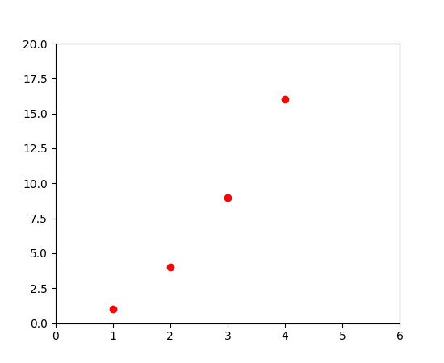
Example:
For every x, y pair of arguments, there is an optional third argument which is the format string that indicates the color and line type of the plot. The letters and symbols of the format string are from MATLAB, and you concatenate a color string with a line style string. The default format string is ‘b-‘, which is a solid blue line. For example, to plot the above with red circles, you would issue
import matplotlib.pyplot as plt plt.plot([1,2,3,4], [1,4,9,16], 'ro') plt.axis([0, 6, 0, 20]) plt.show()
See the plot() documentation for a complete list of line styles and format strings. The axis() command in the example above takes a list of [xmin, xmax, ymin, ymax] and specifies the viewport of the axes.

Slide 98
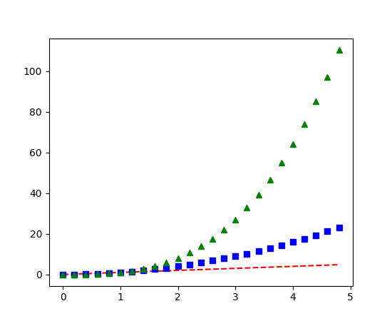
Example:
import numpy as np import matplotlib.pyplot as plt # evenly sampled time at 200ms intervals t = np.arange(0., 5., 0.2) # red dashes, blue squares and green triangles plt.plot(t, t, 'r--', t, t**2, 'bs', t, t**3, 'g^') plt.show()

Slide 99
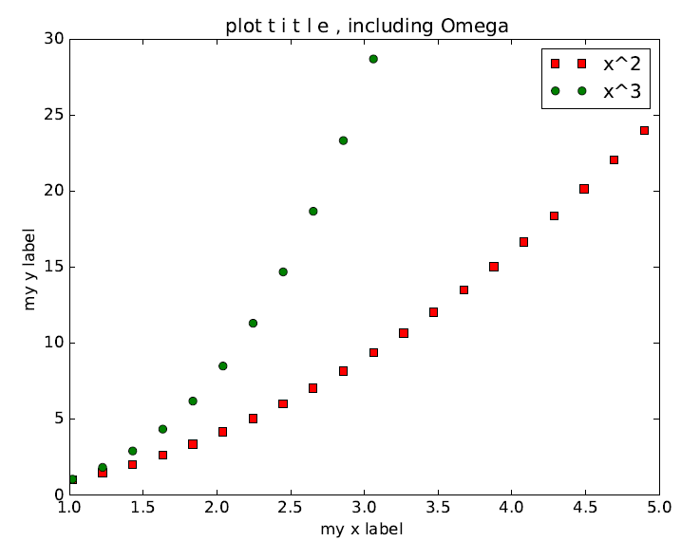
Adding multiple lines and a legend
x = np. linspace (0 , 10, 50)
y1 = np.power(x , 2)
y2 = np.power(x , 3)
plt . plot (x , y1 , ’rs’ , label=’$x^2$ ’ )
plt . plot (x , y2 , ’go ’ , label=’$x^3$ ’ )
plt . xlim((1 , 5))
plt . ylim((0 , 30))
plt . xlabel ( ’my x label ’ )
plt . ylabel ( ’my y label ’ )
plt . t i t l e ( ’ plot t i t l e , including $\Omega$’ )
plt . legend()
plt . savefig ( ’ line_plot_plus2 . pdf ’ )

Slide 100
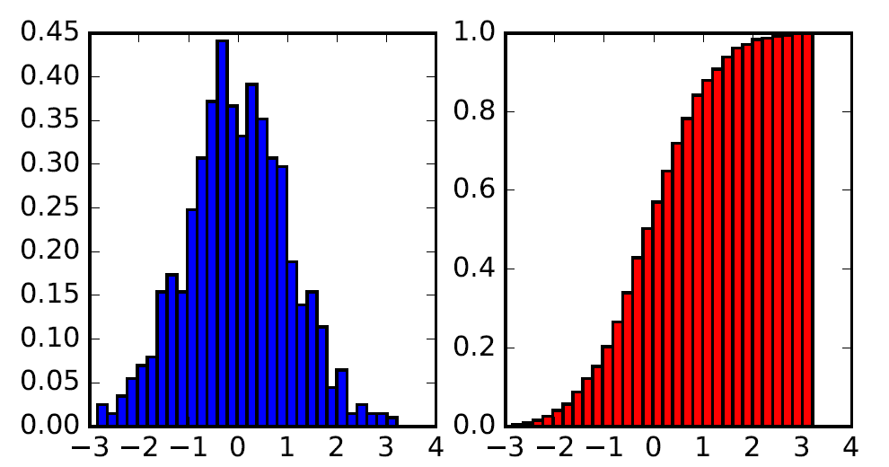
Histogram
data = np.random. randn(1000)
f , (ax1 , ax2) = plt . subplots (1 , 2, f igsi z e=(6,3))
# histogram (pdf)
ax1 . hist (data , bins=30, normed=True, color=’b ’ )
# empirical cdf
ax2 . hist (data , bins=30, normed=True, color=’ r ’ ,
cumulative=True)
plt . savefig ( ’histogram. pdf ’ )

Slide 101
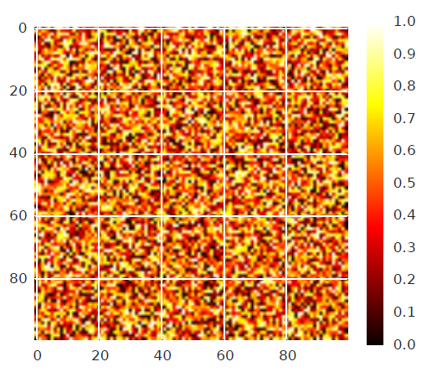
Image Plot
A = np.random.random((100, 100))
plt.imshow(A)
plt.hot()
plt.colorbar()
plt.savefig(’imageplot.pdf’)

Slide 102
Thank You -Any Questions ?
If any Queries Contact me: Vaidya.bhaumik@gmail.com or bhaumik.Vaidya@scet.ac.in
Mobile: 9925572670

