Slide 1
Presentation Candidate Screening Agent
Transforming Recruitment with AI-Powered Screening
Developed by Using Antigravity + KIMI Code

Slide 2
Process
HR Published The Requirement Through Different Portals,
Candidate Apply On That Requirement and Then Resume Come To The HR And HR Looking Into The Resume As Per The Job Description, If Resume Matched With Job Description, That Resume Forward To The Next Round Or Sort Listed As Per HR / Company Criteria.
HR Will Contact Within 2 To 3 Days to Candidate Via mail, What's App And Other platform.

Slide 3
Current Problems
Time Consuming
HR spends 20-30 minutes per resume review
Manual skill matching is tedious – HR Matching SKILLS Manually is Tedious
Inconsistent Screening
Different HRs evaluate differently - Different HR people evaluate the same candidate differently.
Poor Candidate Management
Resumes lost in email threads – Resumes get lost in email threads. There's no visibility of where each candidate stands in the pipeline.
Difficult to track interview feedback

Slide 4
Current Problems
Communication Gaps
Hard to share feedback with team - HR has to switch between multiple apps just to contact candidates. Information is scattered everywhere.

Slide 5
Example Scenario
In Morning:
HR receives 30+ resumes for a AI Agent Developer position. She opens the first PDF and starts reading manually. She tries to match skills with the job description. It takes her 15 minutes just to decide suitable or not?.'
In Afternoon:
She can't remember which resumes she already shortlisted. She emails a candidate for an interview - but uses the wrong email thread
Result:
Three candidates got lost in the process, The wrong candidate got shortlisted.
she wasted 4 hours on manual work.

Slide 6
Purpose of This System - Why Built This Solution?
To automate and make it easy recruitment process using AI, ensuring fair, fast, and trackable candidate Records.
Key Goals:
Save Time - We can evaluate a candidate in just 2 seconds, compared to 20 minutes manually.
Better Organization
We have a visual kanban board for pipeline management. All candidate information is in one place.
Easy Communication
One-click WhatsApp and Email. Simple.
Prevent Mistakes
We have duplicate detection, locked job descriptions, and delete confirmations.

Slide 7
The Solution - Benefits
Problem | Our Solution | Benefit
Slow screening | AI evaluation in 2 seconds | Save 90% time
Inconsistent decisions | Standardized scoring | Fair hiring
Lost resumes | Kanban board with all data | Organized data
No interview records | Interview tracking fields | Better feedback
Duplicate entries | Auto duplicate detection | Clean database
App switching | Built-in WhatsApp/Email | Faster communication
Changing JD by mistake | JD Lock feature | Accurate screening

Slide 8
App Live on Vercel
Site Link:
AI Recruitment Screening Agent
GitHub Presentation Link:
Recruitment-Screening-Agent/Presentation_Outline.md at main · bhaumikgohel/Recruitment-Screening-Agent

Slide 9
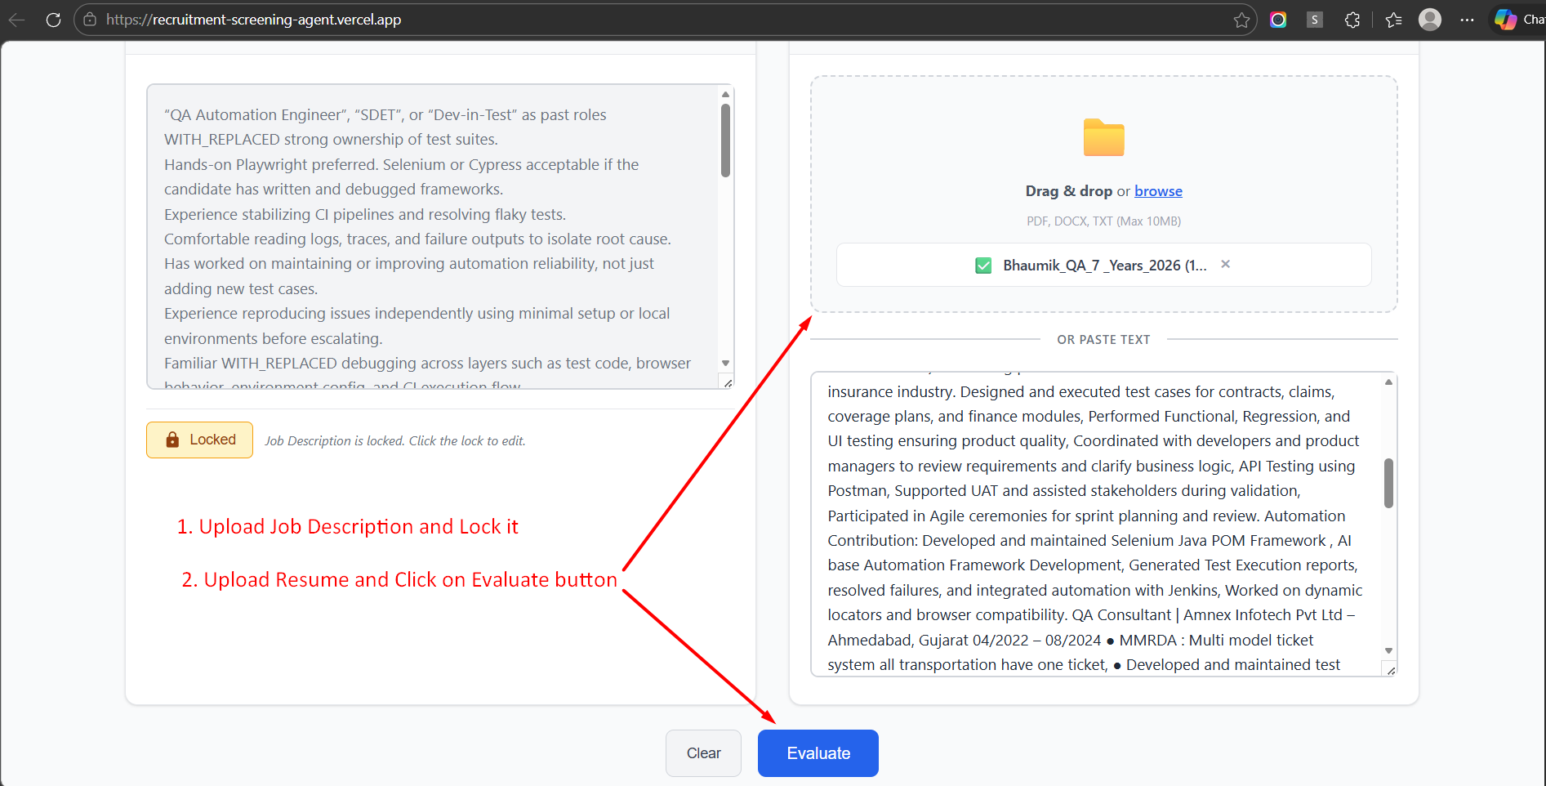
How It Works – Screening

Slide 10
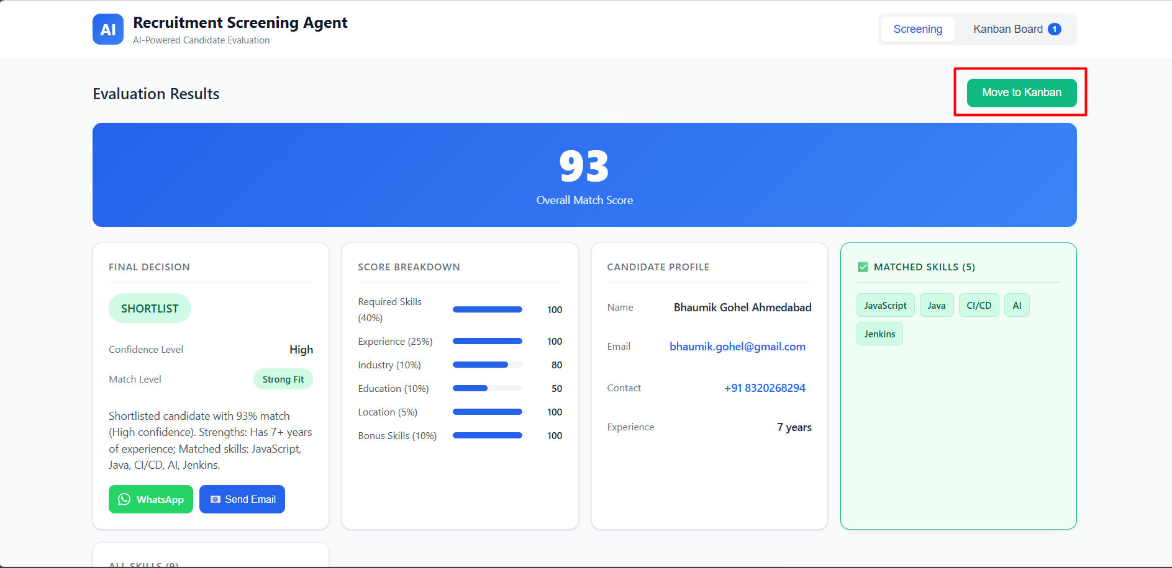
How It Works – Screening

Slide 11
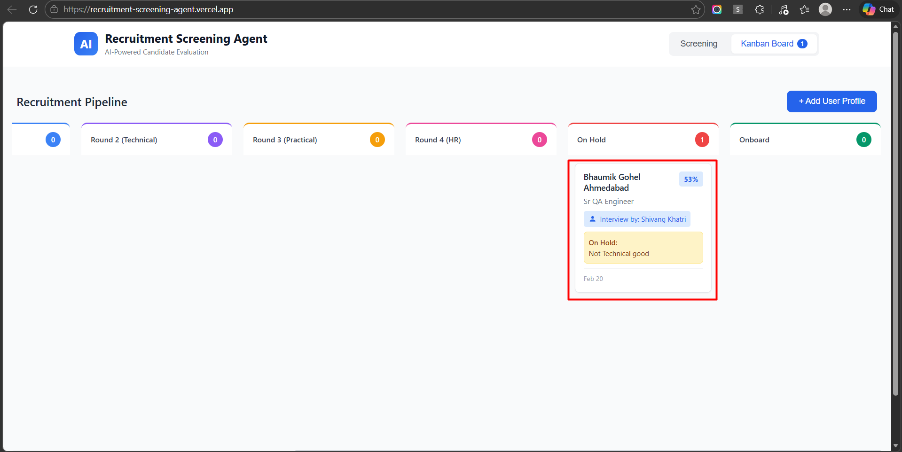
How It Works – Screening

Slide 12
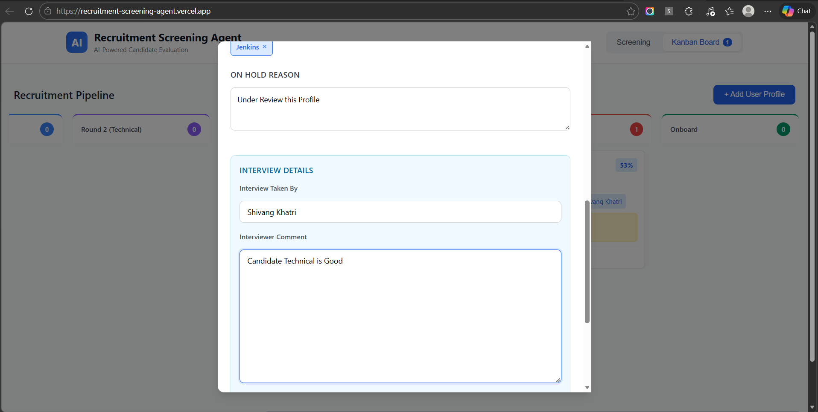
How It Works – Screening

Slide 13
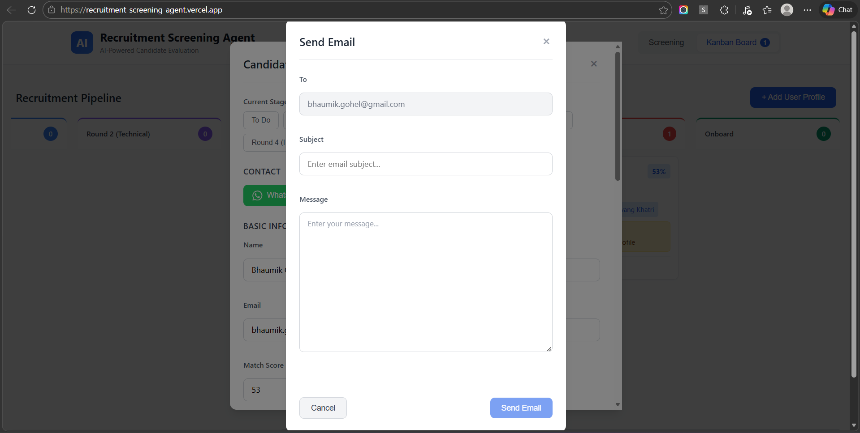
How It Works – Screening

Slide 14
Suggestion & Ideas
User and Role Management
Auto Mail Triggers while Move to Different Stage in Kanban
Auto Notification Send while anyone add the comment or Update the Status,
If Anyone Send the Mail / What's app message that will store in History Maintained
Interviewer Comment History Maintained as per Rounds,
AI Agent Cold Call - R & D
Missing Part
Config DB to store data.

Slide 15
Thank You

