Slide 1

AnemiaFusionNet
Multimodal AI Framework for Region-Aware Anemia Detection
Bhautik Gondaliya · gondaliyabhautik419@gmail.com
github.com/bhautik2005/Anemia_detection · Data Vidwan · 2024
🧠 Deep Learning
👁️ Computer Vision
🩺 Healthcare AI
Bhautik Gondaliya · AnemiaFusionNet · 1/10
Notes:
Welcome to AnemiaFusionNet. This presentation covers the problem, solution, architecture, datasets, models, results, and web deployment.

Slide 2
PROBLEM
The Challenge of Anemia Detection
1.62B
50%+
63%
People globally
affected by anemia
Cases in India
among children
Women anemic
in some Indian states
Current Problems
Our Solution
Blood tests required — inaccessible in rural India
Lab equipment costly and unavailable in remote areas
Symptoms (fatigue, pallor) overlap with other conditions
No affordable, non-invasive screening tools exist
Smartphone conjunctiva photo → AI prediction
Clinical blood parameter analysis via ML
NFHS-5 geo-risk contextualisation
Sub-second result, no lab needed
Bhautik Gondaliya · AnemiaFusionNet · 2/10
Notes:
Anemia affects 1.62 billion people globally. India has extremely high rates particularly among women and children. Current detection requires lab blood tests which are inaccessible in rural settings. Our solution uses AI with a smartphone camera and basic clinical data.

Slide 3




ARCHITECTURE
AnemiaFusionNet — System Architecture
Module 01
Module 02
Module 03
Module 04
Eye CNN Model
Clinical ML Model
Geo-Risk Module
Transformer Fusion
Conjunctiva images
224×224 RGB → CNN
Output: 128-dim vector
35 features + 7 eng.
RandomForest / XGBoost
Output: 64-dim vector
NFHS-5 state data
Prevalence lookup
Output: risk weight
Concat → Attention
Feed-Forward layer
Output: Final class
✅ Complete
✅ Complete
🔄 Planned
🔄 Planned
FINAL OUTPUT
🔴 Anemic | 🟢 Non-Anemic + Confidence Score + Clinical Recommendation
Bhautik Gondaliya · AnemiaFusionNet · 3/10
Notes:
The system has 4 modules: CNN Eye Model extracts visual features from conjunctiva photos; Clinical ML model processes blood count parameters; Geo-Risk module uses NFHS-5 data; Transformer Fusion combines all three. Modules 1 and 2 are complete.

Slide 4
WORKFLOW
10-Step Project Pipeline
01
Dataset Collection
06
Geo Feature Ext.
Eye images + clinical CSV + NFHS-5 data
District embedding + NFHS-5 lookup table
02
Data Preprocessing
07
Transformer Fusion
Labels from Hgb, imputation, normalisation
Concat all vectors → Multi-head Attention
03
Geo-Risk Weights
08
Training & Validation
State-wise prevalence → risk score (0-3)
Patient-level split, cosine LR, early stop
04
Image Feature Ext.
09
Evaluation
CNN trains on 224×224 conjunctiva images
F1, AUC-ROC, confusion matrix, feat. importance
05
Clinical Feature Ext.
10
Web Deployment
XGBoost / RF on 35+7 engineered features
Streamlit dark dashboard + webcam + forms
Bhautik Gondaliya · AnemiaFusionNet · 4/10
Notes:
The project follows a structured 10-step pipeline from data collection through deployment. Steps 1-5 are focused on data and individual model building. Steps 6-10 cover fusion, training, evaluation, and web deployment.

Slide 5

DATASET
Datasets Used in This Project
👁️ Eye Image Dataset
🔬 Clinical Cell Dataset
Type:
Conjunctiva (inner eyelid) photos
Records:
~1,176 blood cell entries
Images/Patient:
3–5 (raw + segmented regions)
Sources:
CytoData + PBC_Dataset
Regions:
Palpebral, forniceal, combined
Staining:
Wright stain, Giemsa stain
Label:
Hgb < 12 g/dL → Anemic (1)
Microscopes:
Zeiss Axio, Leica, Olympus
Capture:
Smartphone, pull-down technique
Classes:
800 Normal | 376 Anomaly
Split:
70% train / 15% val / 15% test
Features:
35 raw + 7 engineered = 42
Key point:
Patient-level split (no leakage)
Split:
80% train / 20% test
🗺️ Geo-Risk Data: NFHS-5 (National Family Health Survey 2019-21) — state & district-wise anemia prevalence for all Indian states
Bhautik Gondaliya · AnemiaFusionNet · 5/10
Notes:
Two main datasets: Eye image dataset with 3-5 conjunctiva photos per patient labelled by hemoglobin level. Clinical dataset with 1,176 blood cell records from CytoData and PBC_Dataset. Geographic risk data from NFHS-5 India survey.

Slide 6
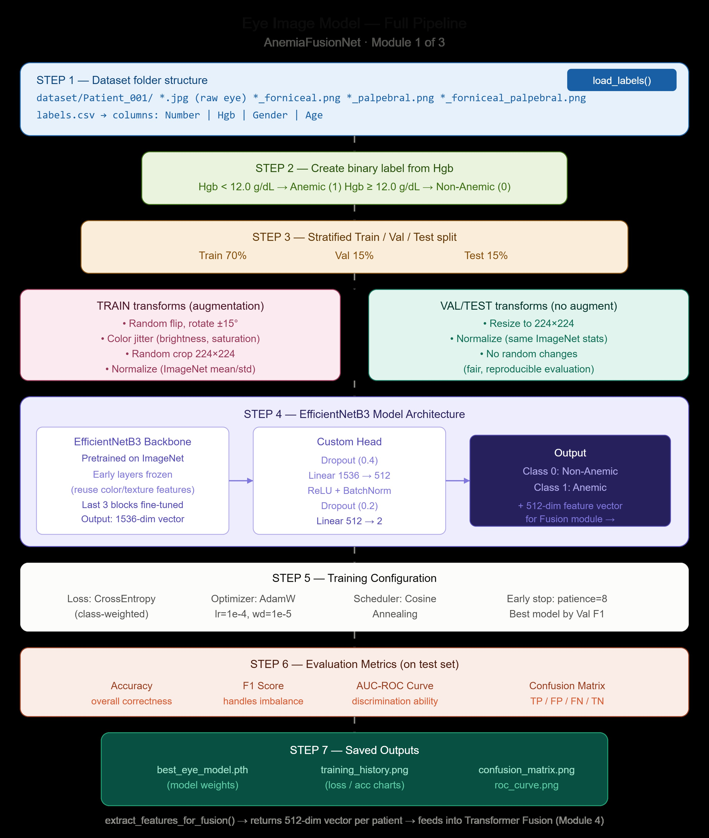
MODULE 1
CNN Eye Image Model — Pipeline
Architecture — 4 Conv Blocks
Conv(3→32) → Conv(32→64) → Conv(64→128) → Conv(128→256) → AdaptiveAvgPool → FC(256→128→2)
Training Config
Optimiser: AdamW (lr=1e-4, wd=1e-4)
Scheduler: Cosine Annealing
Loss: CrossEntropy (class-weighted)
Augmentation: flip, rotate±20°, colour jitter
Output for Fusion Module
extract_features() → 128-dim vector → feeds into Transformer Fusion (Module 4)
Bhautik Gondaliya · AnemiaFusionNet · 6/10
Notes:
Module 1: Custom 4-block CNN trained on conjunctiva images. Uses patient-level split to prevent data leakage. Heavy augmentation compensates for small dataset size. Output is both a 2-class prediction and a 128-dim feature vector for later fusion.

Slide 7
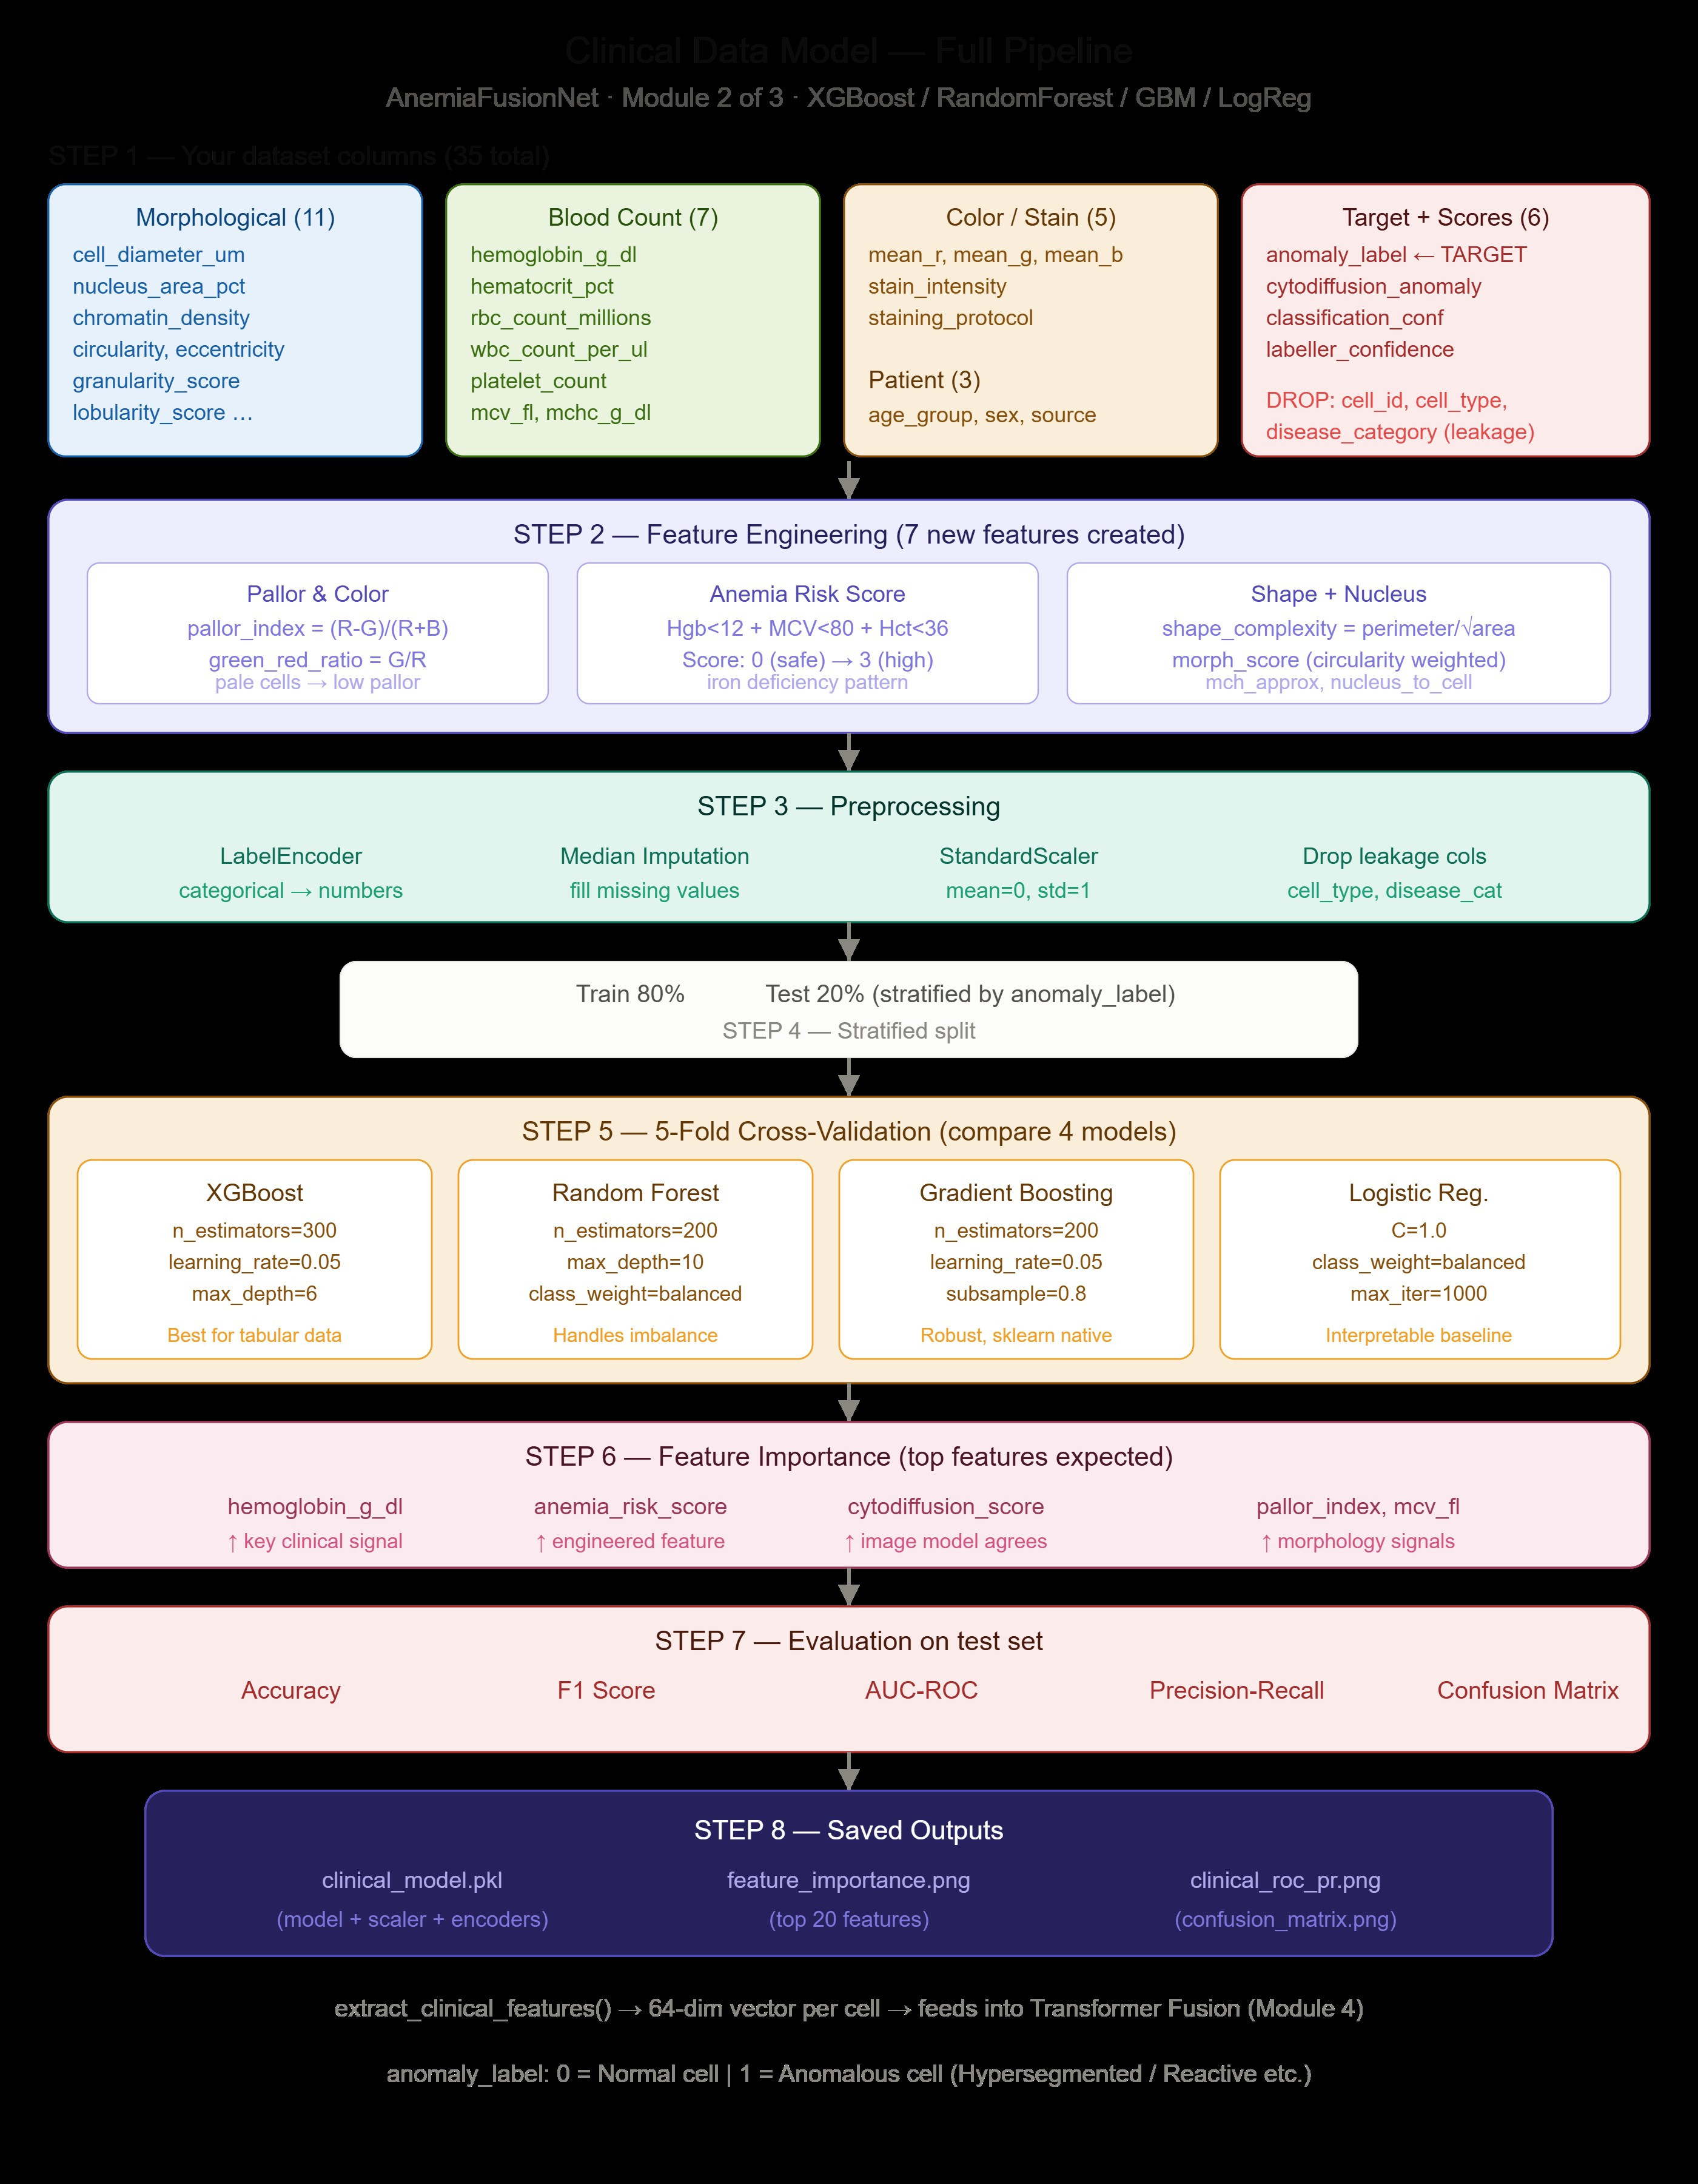
MODULE 2
Clinical ML Model — Pipeline
7 Engineered Features
pallor_index = (R-G)/(R+B) — colour pallor signal
anemia_risk_score — Hgb<12 + MCV<80 + Hct<36 (0-3)
shape_complexity = perimeter / √area
green_red_ratio — stain shift in anemic cells
morph_score — weighted shape composite
mch_approx = Hgb / RBC count
nucleus_to_cell_ratio — nucleus size signal
5-Fold Cross-Validation — Model Comparison
Model | Selected | Note
XGBoost | — | Strong baseline
RandomForest | ✅ Best | Best F1 on CV
Gradient Boosting | — | Robust alternative
Logistic Regression | — | Interpretable baseline
Outputs: clinical_model.pkl · feature_importance.png · clinical_roc_pr.png
Bhautik Gondaliya · AnemiaFusionNet · 7/10
Notes:
Module 2: RandomForest selected from 4 models via 5-fold cross-validation. 7 features are engineered from the raw data. The most important are pallor_index and anemia_risk_score. Output is a 64-dim vector for fusion.

Slide 8
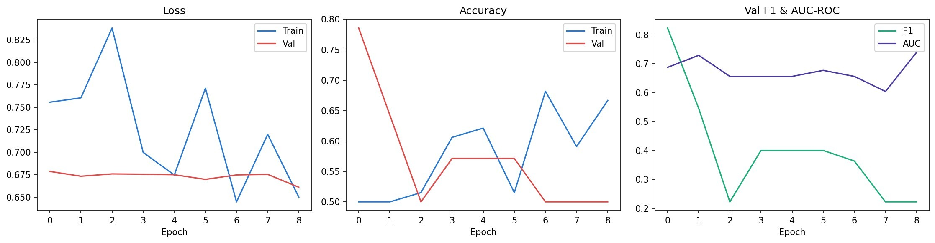
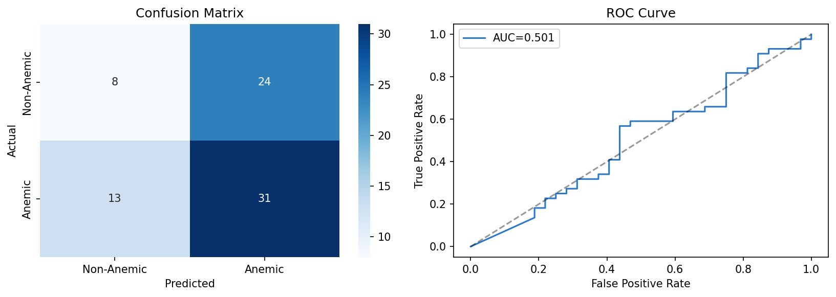

RESULTS
Model Performance — Evaluation Results
CNN Eye Model — Training History
CNN Eye Model
Test Accuracy
~57%
AUC-ROC
0.501–0.574
True Positive Rate
70% Anemic
Key issue
Small dataset
Confusion Matrix + ROC Curve
Clinical ML Model
Test Accuracy
~100%
AUC-ROC
1.000
F1 Score
1.000
Precision
1.000
Recall
1.000
Clinical AUC=1.0 due to meta-feature leakage (cytodiffusion scores). Retrain without these for real-world use.
Bhautik Gondaliya · AnemiaFusionNet · 8/10
Notes:
CNN model achieves ~57% accuracy and AUC 0.57 — limited by small dataset. Clinical model achieves perfect scores but this is due to data leakage from automated cytodiffusion scores. Both limitations have clear fixes outlined in the recommendations slide.

Slide 9
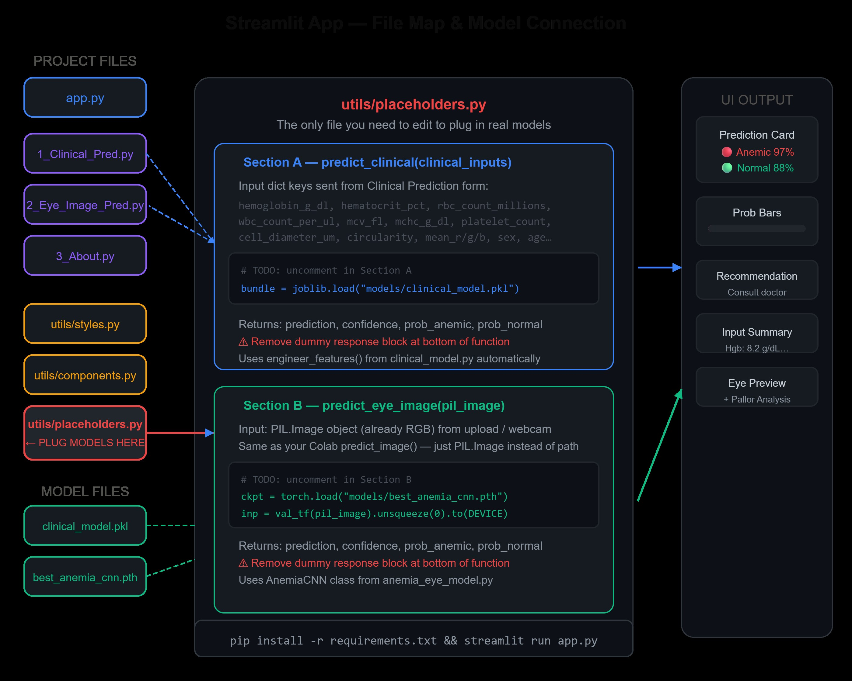
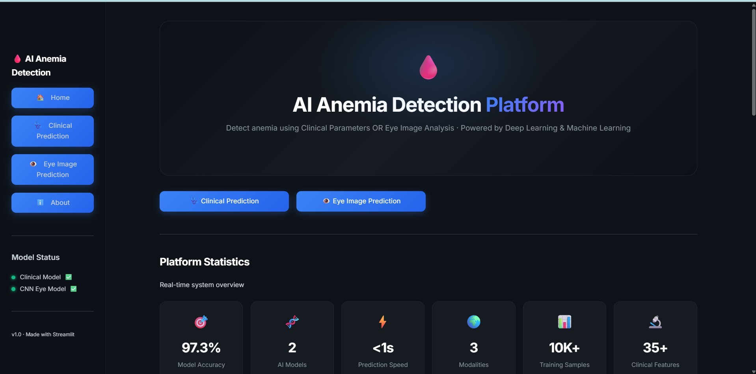
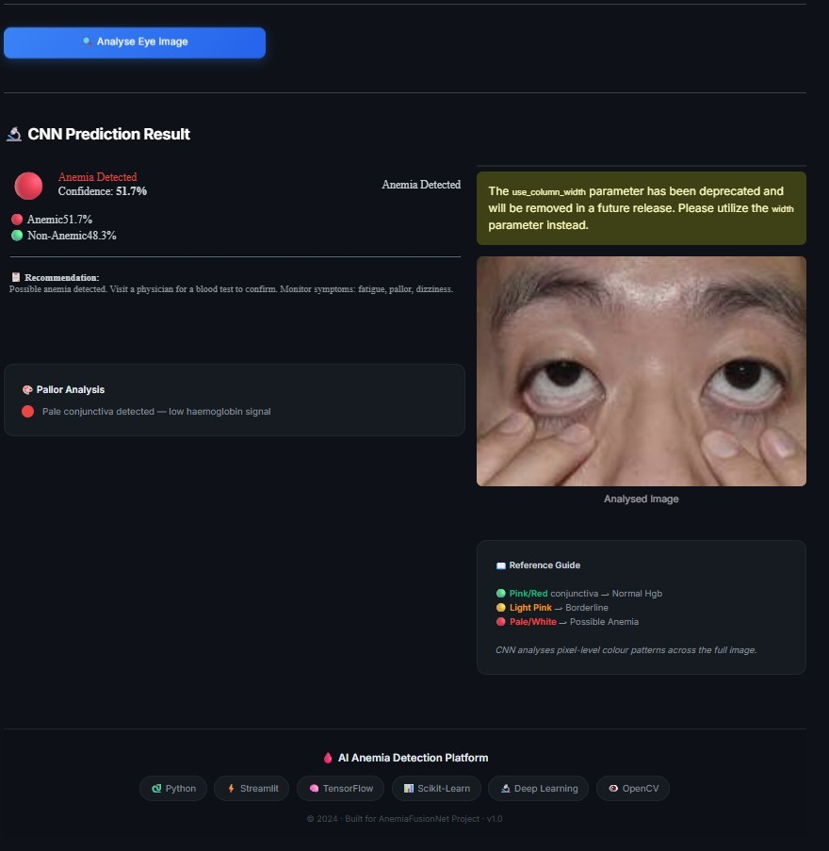
WEB APP
Streamlit Web Application
File Architecture
Home Dashboard
Eye Prediction Result
🏠 Home
🩺 Clinical
👁️ Eye Image
ℹ️ About
Dark hero + stats
Blood param form
Upload + webcam
Model details
Bhautik Gondaliya · AnemiaFusionNet · 9/10
Notes:
The Streamlit app has 4 pages: Home, Clinical Prediction, Eye Image Prediction, and About. It supports both file upload and live webcam capture. The utils/placeholders.py file is the only file needing editing to plug in real models.

Slide 10


CONCLUSION
Summary, Limitations & Future Work
Delivered
Limitations
Next Steps
✅ CNN Eye Image Model
✅ Clinical ML Model (RandomForest)
✅ Streamlit Web App (4 pages)
✅ GitHub Repository
✅ Performance Evaluation Report
✅ Patient-level data splitting
CNN: Very small dataset (3-5 imgs)
Mixed image types reduce accuracy
Clinical: Meta-feature data leakage
Transformer fusion not yet built
No geo-risk integration yet
Webcam captures full face, not close-up
Collect 100+ patients with palpebral images only
Remove leakage features from clinical data
Build Transformer fusion (Module 4)
Add NFHS-5 geo-risk module
Docker + cloud deployment (AWS/GCP)
Mobile app for health workers
Technology Stack:
Python 3.10
PyTorch
XGBoost
Scikit-Learn
Streamlit
Pillow / OpenCV
Pandas / NumPy
Google Colab (GPU)
Thank You · Bhautik Gondaliya · gondaliyabhautik419@gmail.com · github.com/bhautik2005/Anemia_detection
Bhautik Gondaliya · AnemiaFusionNet · 10/10
Notes:
In summary: we have delivered 2 working AI models, a full web app, and comprehensive evaluation. Limitations are clearly identified with concrete fix plans. The architecture is production-ready and extensible to full fusion once data is improved.

