Slide 1
SECOND HAND CAR TRADE USING BLOCKCHAIN
By:
Arun Pradeep 195002014
Bhavna Magendiran 195002021
Guided by:
Dr. S. Mohanavalli

Slide 2
OUTLINE
Introduction - Motivation
  Second Hand Car Trade
  Blockchain
Problem Statement
Technology Assessment
  Which Blockchain?
  Consensus Algorithm
Proposed Model
Implementation
Result
Literature Survey
Conclusion
  Challenges
  Future Scope
References

Slide 3
INTRODUCTION - MOTIVATION
SECOND HAND CAR TRADE
Why? (Scope)
  Primary motivation: Pre-owned car ownership cost is cheaper than new ones.
  Pandemic situation: People started preferring individual mobility.
  Trends in India: Growing middle class, young population and steady increase in disposable income.
Traditional method - Disadvantages
  Data asymmetry between buyer and seller
  Lack of trust
  Tedious paperwork
Notes:
B

Slide 4
INTRODUCTION - MOTIVATION
BLOCKCHAIN
Distributed ledger
Decentralised database - Data transparency and Traceability
Consensus algorithm
Data integrity and Reliability
Smart contracts
Automate business logic
Notes:
A

Slide 5
PROBLEM STATEMENT
One of the major concerns of traditional second hand car trade system is data asymmetry and lack of trust between buyers and sellers. To address this problem we use distributed ledger system to develop a second hand car trade system to track the car history.
Notes:
B

Slide 6
TECHNOLOGY ASSESSMENT
WHICH BLOCKCHAIN?
Public or Private or Hybrid Blockchain?
BLOCKCHAIN | PUBLIC | PRIVATE | HYBRID
ADVANTAGE | Decentralization and transparency | Enhanced privacy and security | Flexibility and customization
DISADVANTAGE | Scalability and transaction costs | Centralization and trust | Complexity and maintenance
Chosen blockchain type: Public - Ethereum
Notes:
A

Slide 7
TECHNOLOGY ASSESSMENT
CONSENSUS ALGORITHM:
Chosen Consensus algorithm: PoW
Consensus Algorithm | Advantage | Disadvantage
Proof of Work (PoW) | Well-established, secure, difficult for attackers to manipulate | Energy-intensive, large amount of computing power to solve cryptographic puzzles
Proof of Stake (PoS) | Energy-efficient, lower electricity consumption and a lower environmental impact | Vulnerable to centralization, most stake in the network may have more influence over decision-making
Notes:
B

Slide 8
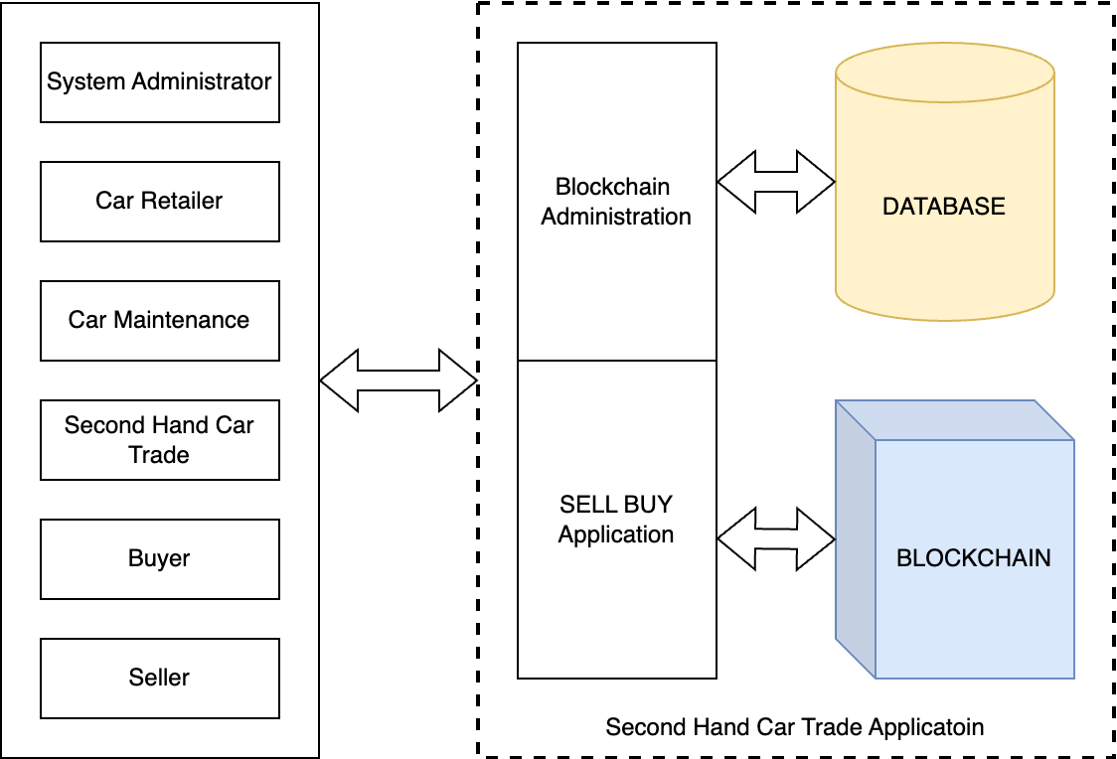
PROPOSED MODEL
USE CASE DIAGRAMS
Simple use case diagram
Notes:
A

Slide 9
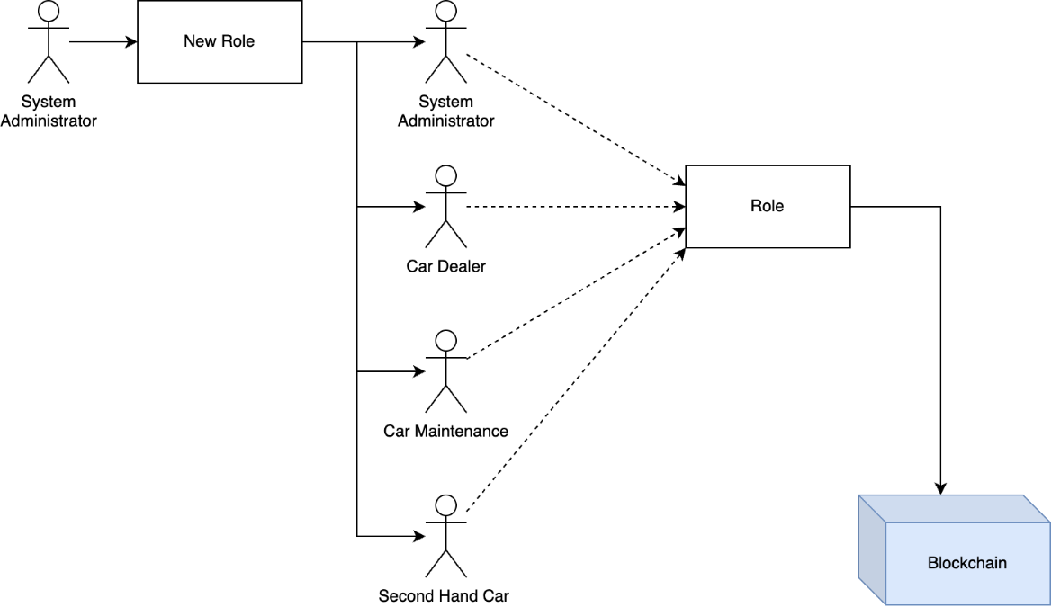
PROPOSED MODEL
USE CASE DIAGRAMS
System administrator responsibilities
Notes:
B

Slide 10
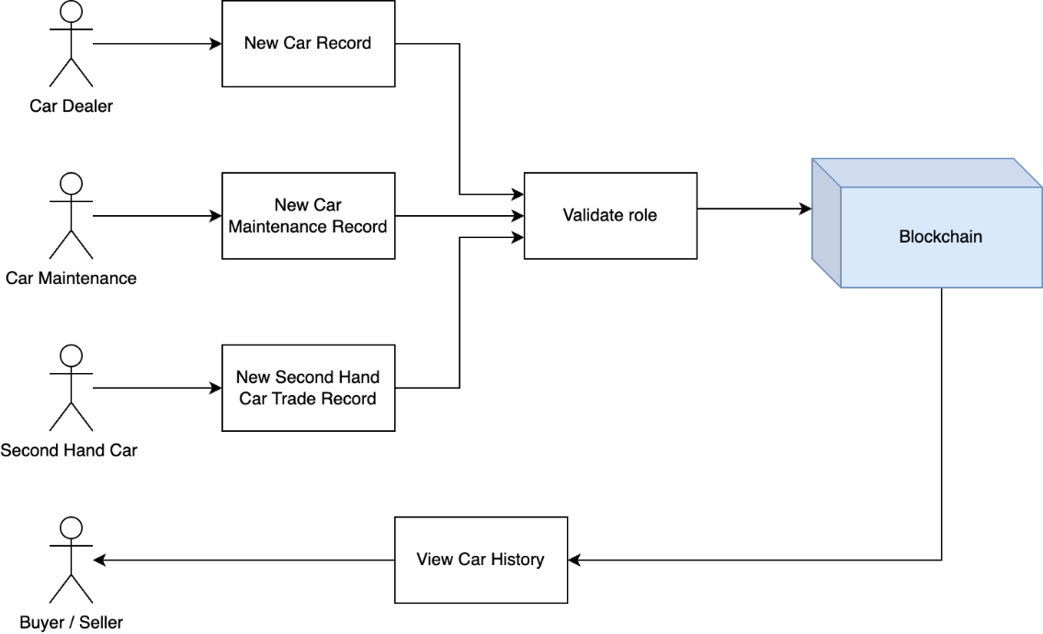
PROPOSED MODEL
USE CASE DIAGRAMS
Blockchain transactions
Notes:
B

Slide 11
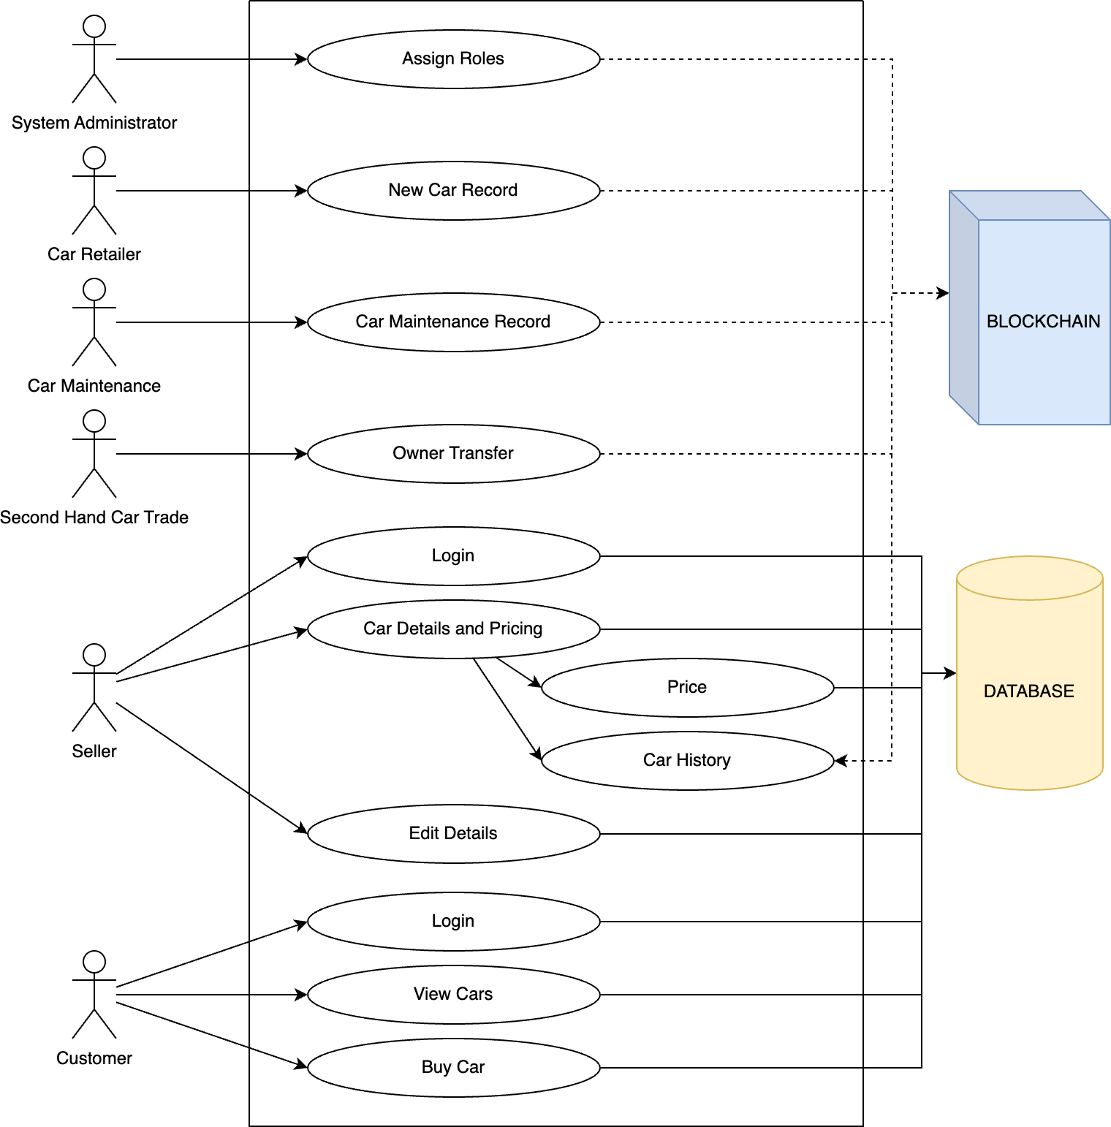
PROPOSED MODEL
USE CASE DIAGRAMS
Blockchain administration - Roles and responsibilities
Notes:
A

Slide 12
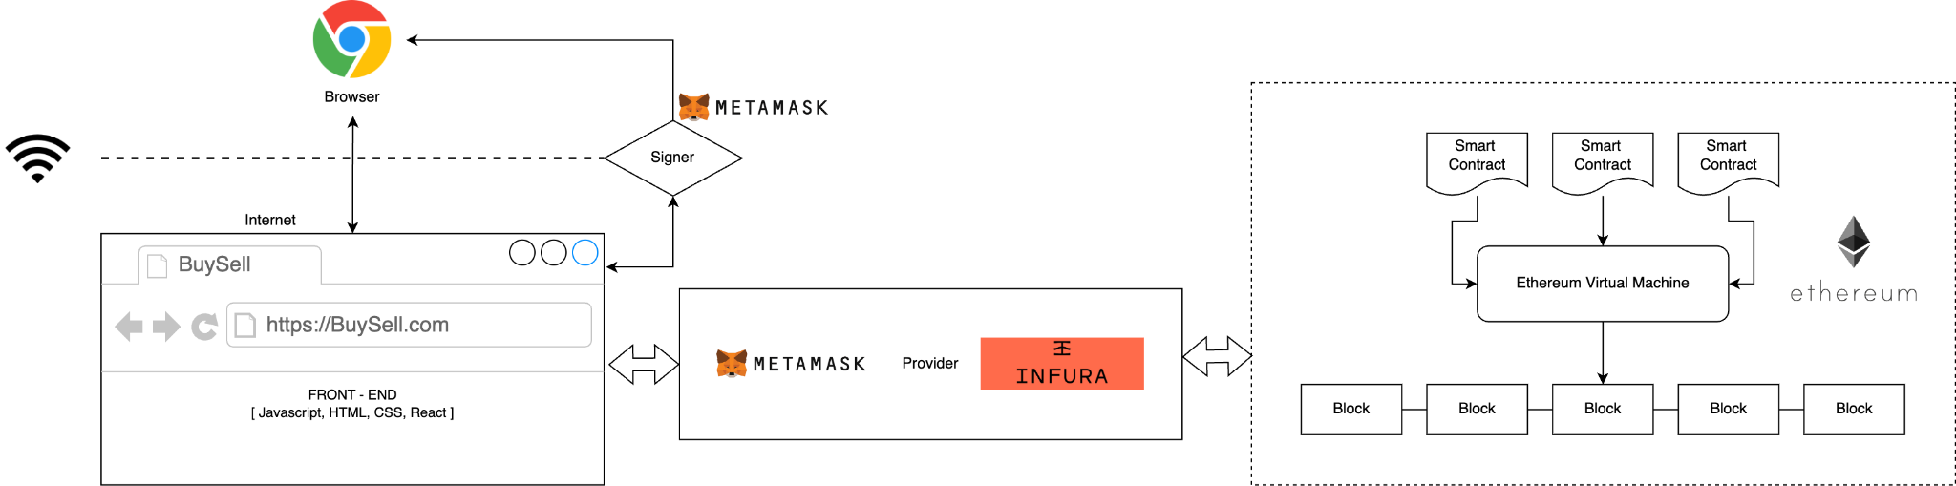
PROPOSED MODEL
SYSTEM DESIGN
Web3 application architecture
Notes:
B

Slide 13
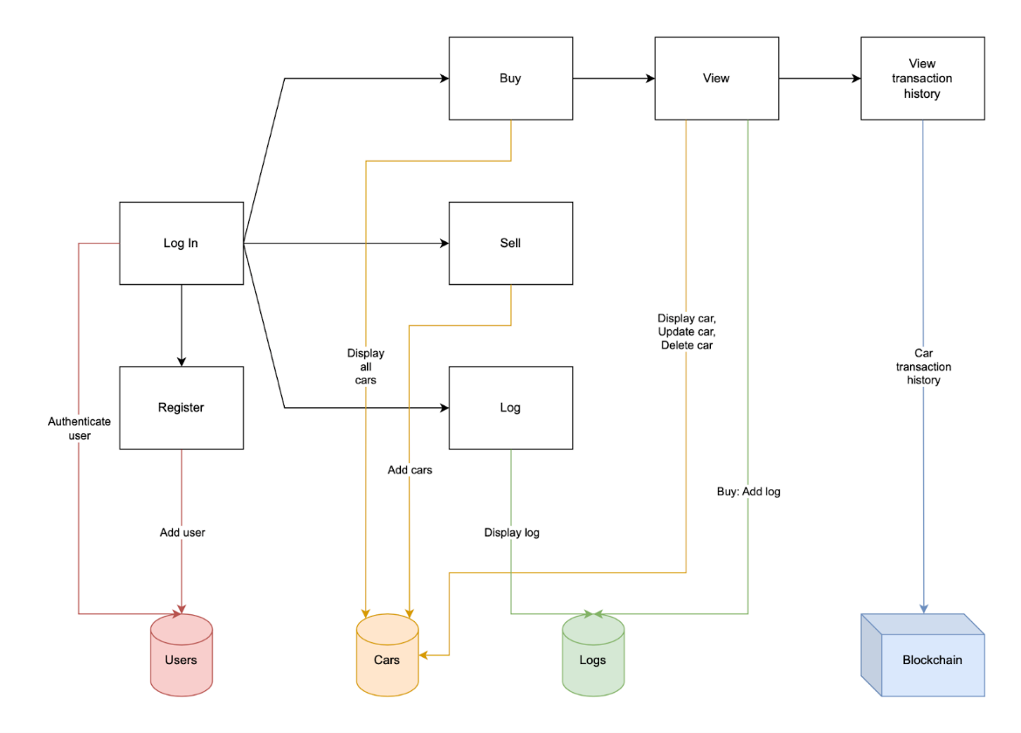
PROPOSED MODEL
SYSTEM DESIGN
Customer side application - workflow
Notes:
A

Slide 14
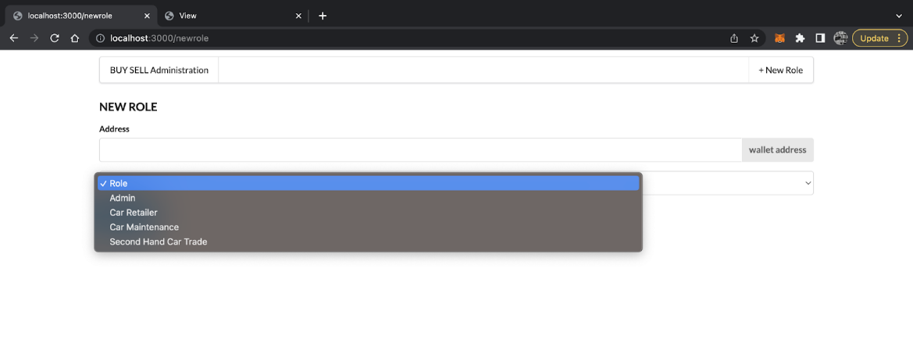
IMPLEMENTATION
Four roles
Notes:
B

Slide 15
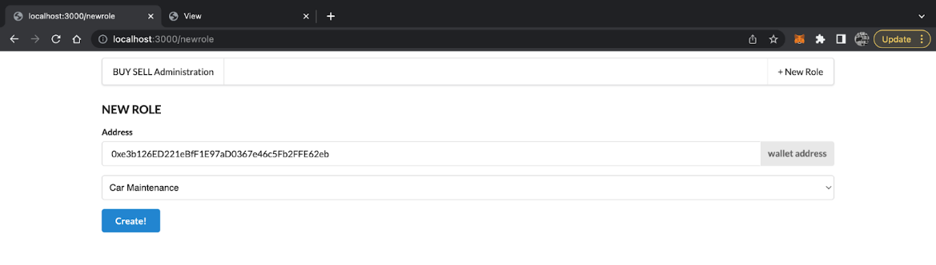
IMPLEMENTATION
Adding new role
Notes:
B

Slide 16
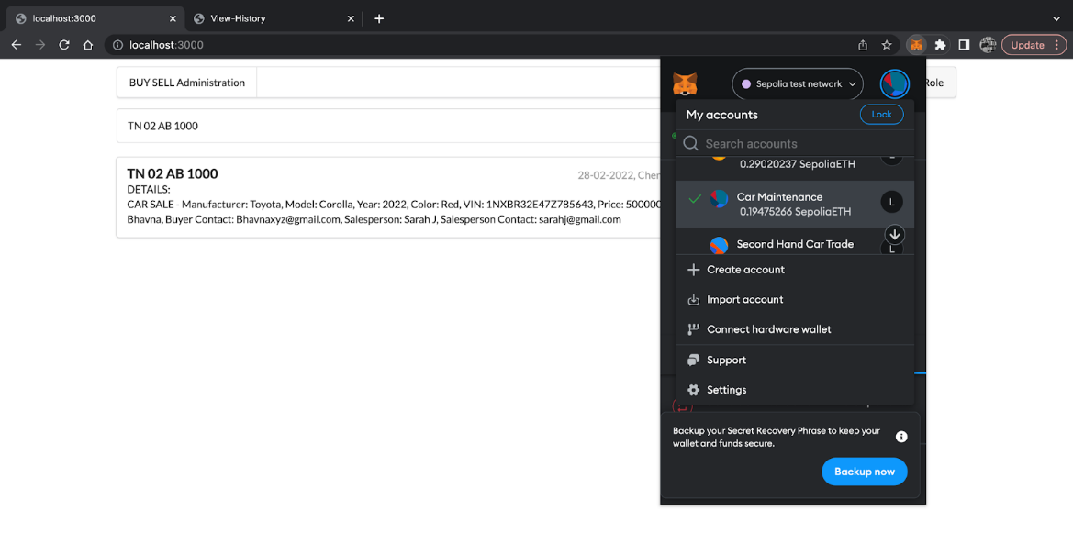
IMPLEMENTATION
Roles - Authorisation
Notes:
B

Slide 17
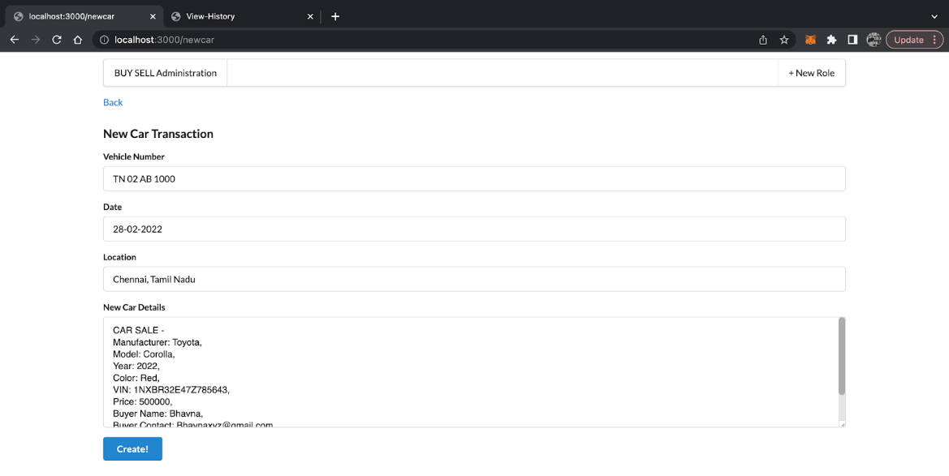
IMPLEMENTATION
Adding new car transaction
Notes:
B

Slide 18
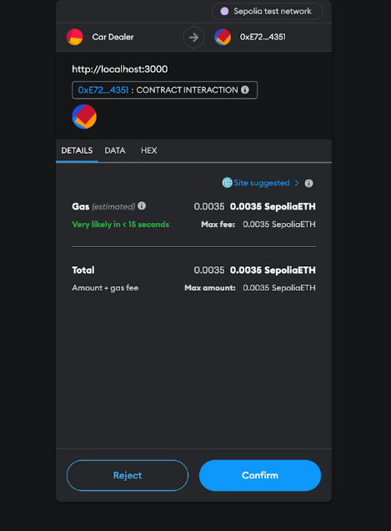
IMPLEMENTATION
Gas fee - for completing transaction
Notes:
B

Slide 19
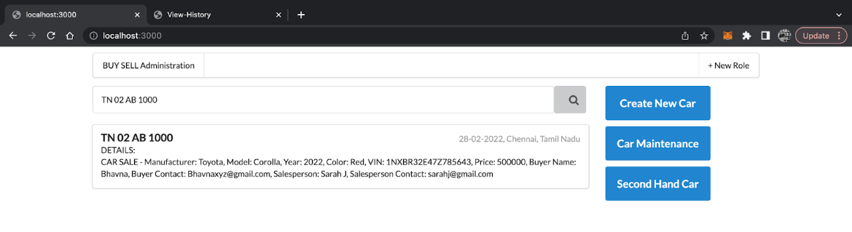
IMPLEMENTATION
Showing successful transaction
Notes:
B

Slide 20
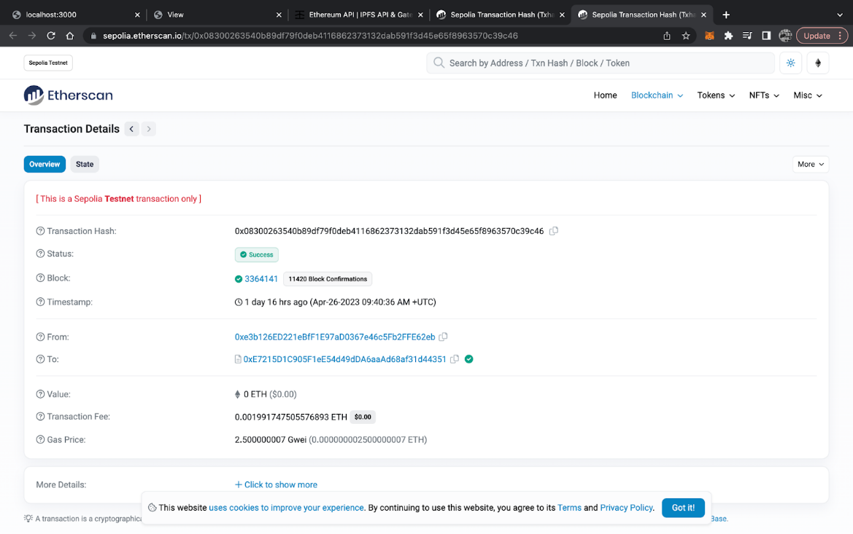
IMPLEMENTATION
Etherscan - Transaction details
Notes:
B

Slide 21
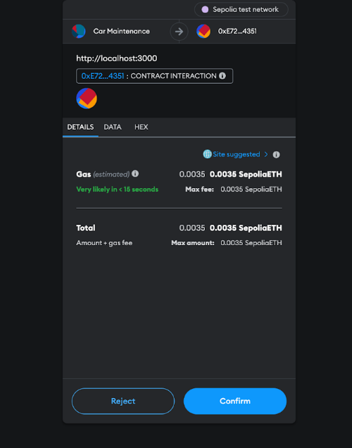
IMPLEMENTATION
Gas fee - for completing automobile maintenance transaction
Notes:
B

Slide 22
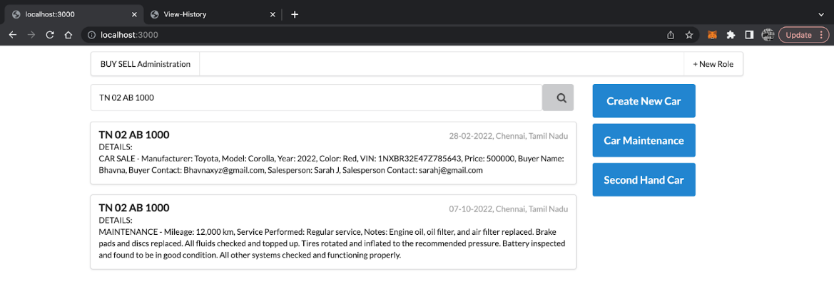
IMPLEMENTATION
Showing automobile maintenance transaction
Notes:
B

Slide 23
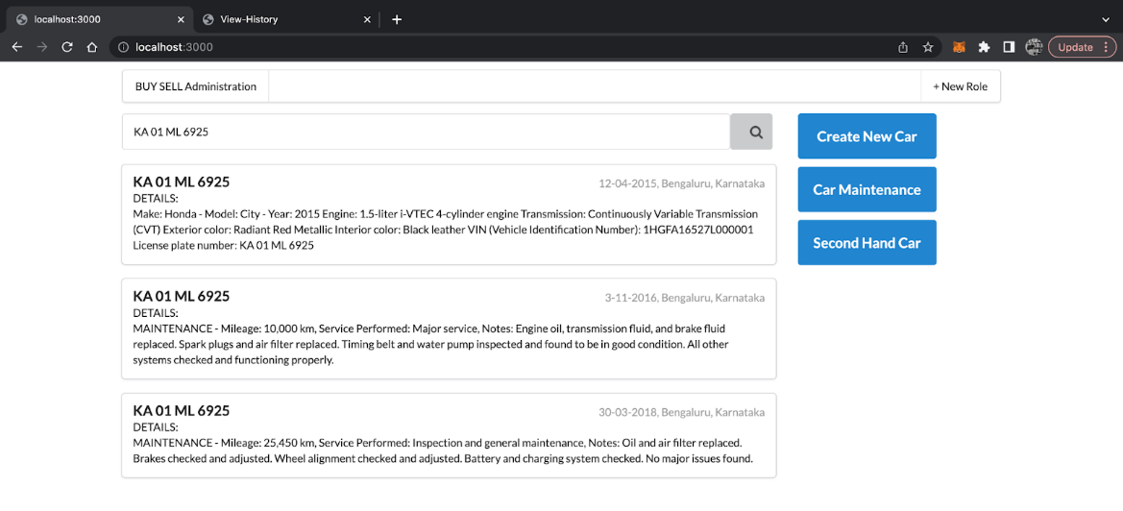
IMPLEMENTATION
Example of various completed transactions for a car
Notes:
B

Slide 24
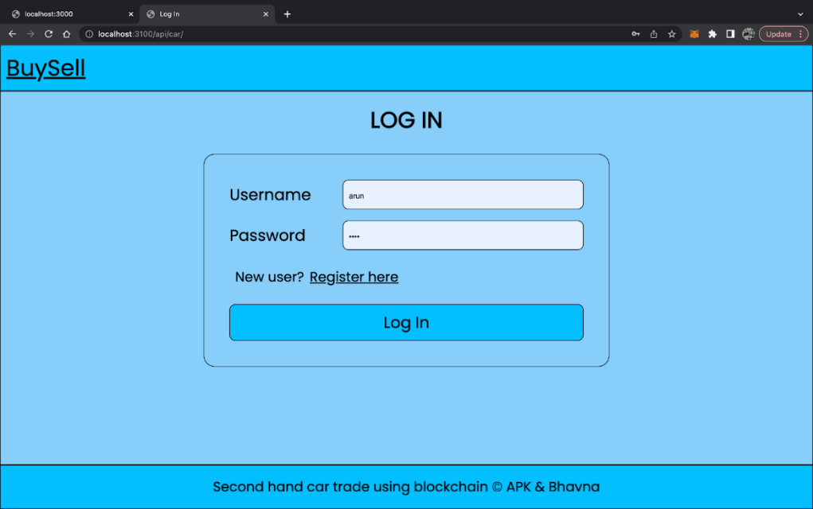
IMPLEMENTATION
Login page
Notes:
A

Slide 25
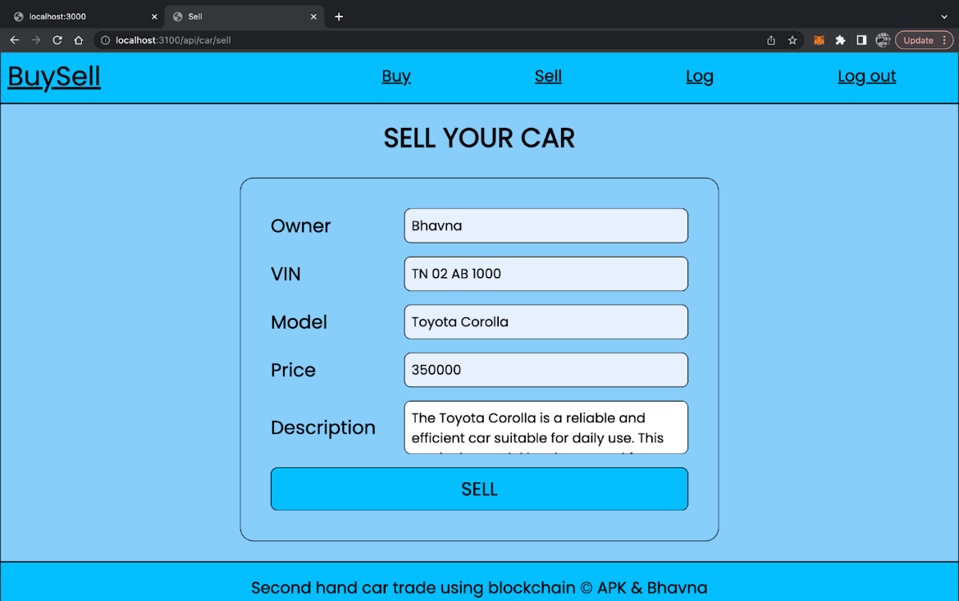
IMPLEMENTATION
Sell page
Notes:
A

Slide 26
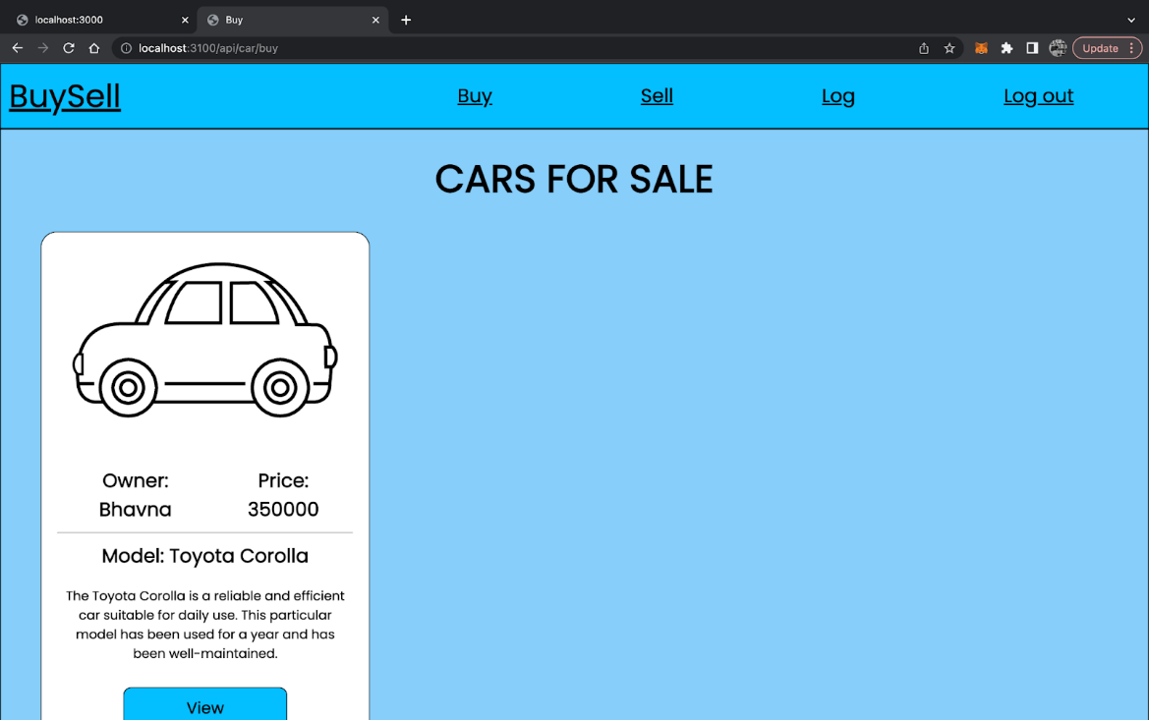
IMPLEMENTATION
Buy page
Notes:
A

Slide 27
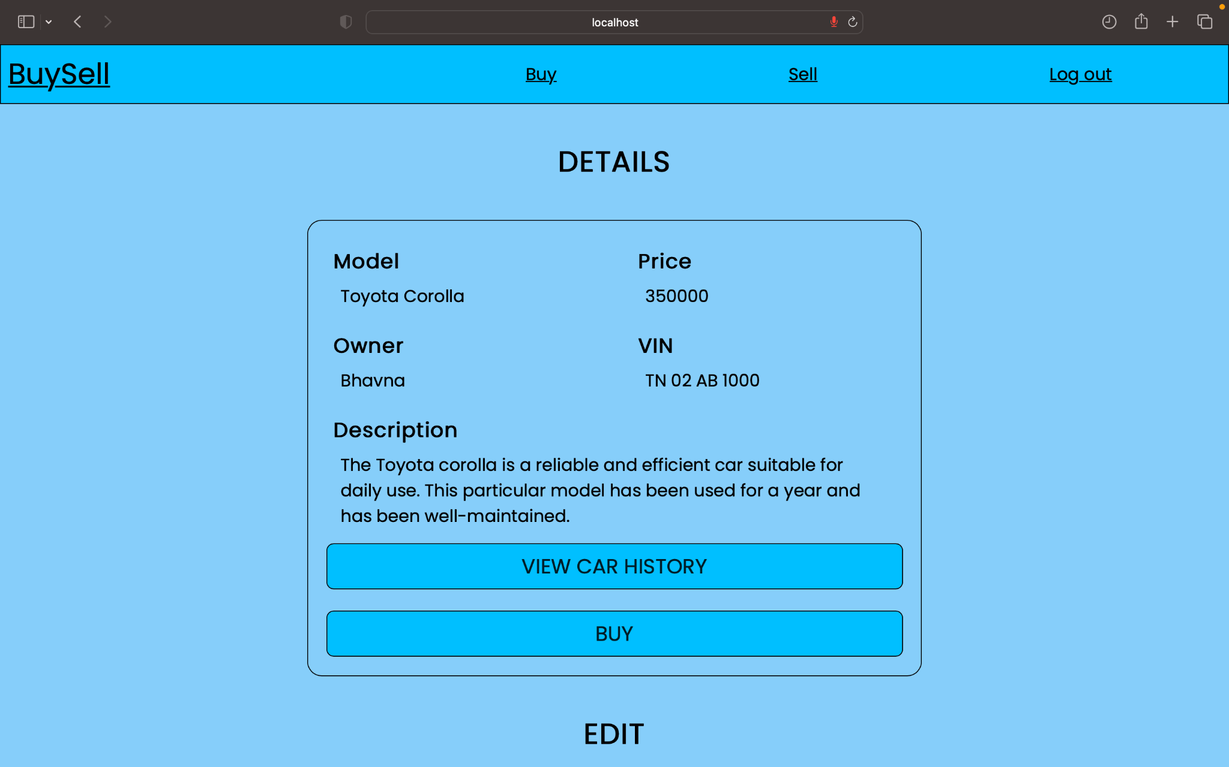
IMPLEMENTATION
View page
Notes:
A

Slide 28
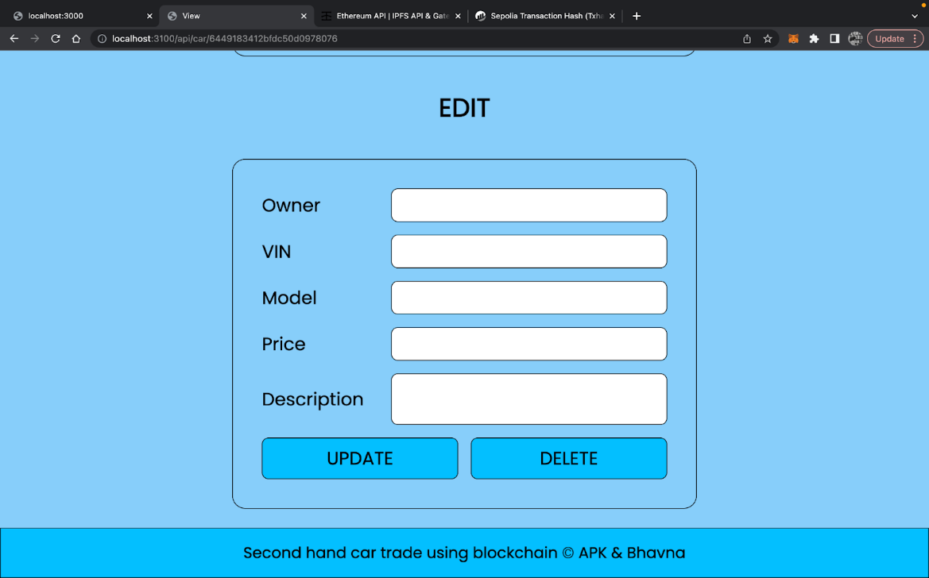
IMPLEMENTATION
View page - update and delete
Notes:
A

Slide 29
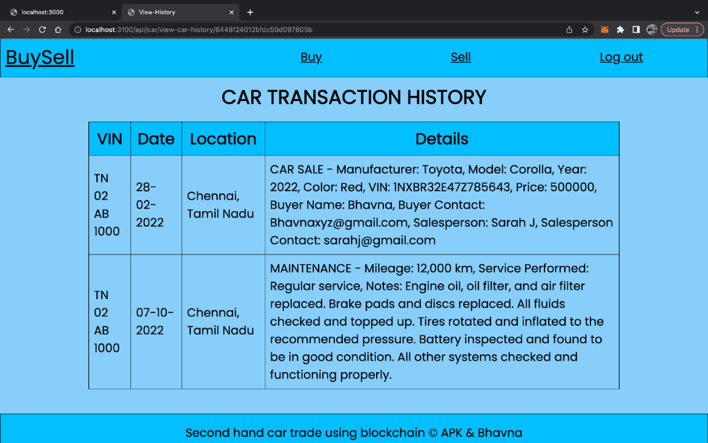
IMPLEMENTATION
View transaction history page
Notes:
A

Slide 30
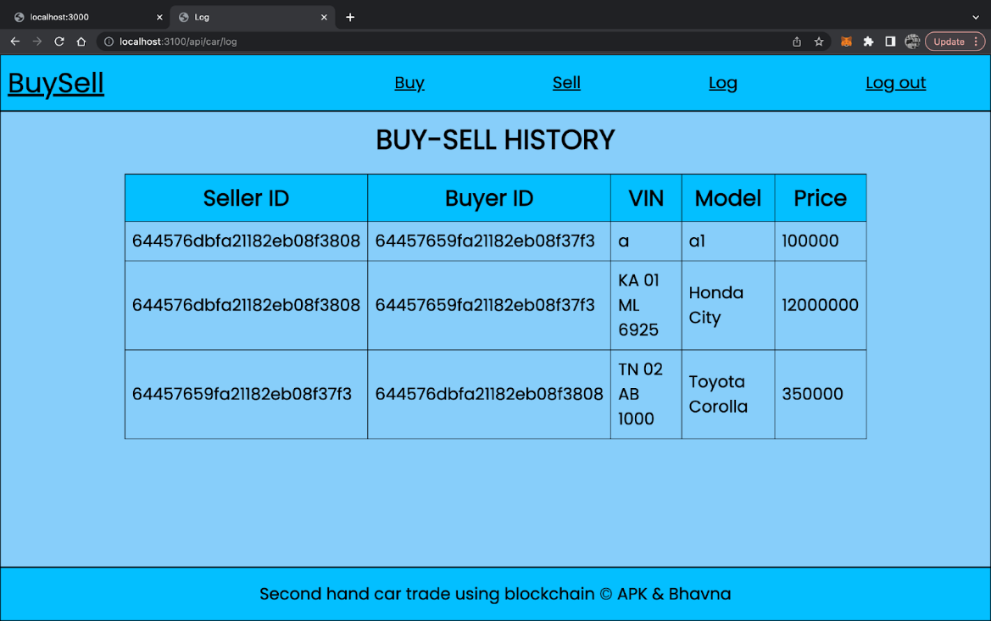
IMPLEMENTATION
Log page
Notes:
A

Slide 31
RESULT
We are able to achieve a second hand car trade system using blockchain technology to tackle data asymmetry problem.
Lower Transaction Fee: A transaction fee of 0.0001991747505576893 ETH is cheaper compared to the average transaction fee of 0.00485866809534777 ETH, which means it's about 4.1% of the average transaction fee on the network.
Notes:
A

Slide 32
LITERATURE SURVEY
TITLE | SUMMARY | INFERENCES | AUTHORS
Blockchain Adoption in the Vehicle Leasing Business to Increase the Transparency of Transactions | To build a blockchain architectural model (DSS - Design Support System) to increase transaction transparency in the car rental business. Here smart contracts are used by renters and automobile owners to conduct transactions with mutually agreed terms. Various subscription services are involved such as automobile insurance, parking rental, toll road payments, vehicle inspection can be automated with smart contracts, payments can be done with cryptocurrency, saving time and money. | ADVANTAGES: No third party is required No central authority Accessible to anyone No transaction cost No infrastructure fees | Djajasinga ND, Mutaufiq A, Hasan MR. 2022
Notes:
B

Slide 33
LITERATURE SURVEY
TITLE | SUMMARY | INFERENCES | AUTHORS
A study for efficiency improvement of used car trading based on a public blockchain | Used car transaction management system used to solve the problem of asymmetry of information between the seller and the buyer and provides a reliable transaction environment through smart contracts based on the public blockchain Ethereum. | The system uses IPFS (InterPlanetary File System) to store data using the Mongo database based on the Node.js server and returns the hash function stored in the smart contract. The server uses Web3.JS to interact with the functions of the smart contract and Tx to invoke the smart contract. The blockchain transactions are then sent to the Ethereum blockchain via Geth. User and commands: Personal user - User used car listing, Vehicle information inquiry, Used car list inquiry, Contract writing, Contract lookup, Messenger Manufacturer, Insurance Company & Auto Body Shop - My vehicle status, Vehicle status update, Vehicle information inquiry | Seung Gyun Yoo, Byeongtae Ahn 2021
Notes:
A

Slide 34
LITERATURE SURVEY
TITLE | SUMMARY | INFERENCES | AUTHORS
Blockchain-based vehicle condition Recording System for Second-Hand Vehicle Market | Proposes a use of blockchain architecture provided by Ethereum to record the information of vehicle condition.Here smart contracts are used to create decentralized applications which will be used to construct the vehicle condition recording system. | Smart contracts in Ethereum are written using solidity which is then compiled to Ethereum bytecode and run the code in EVM (Ethereum Virtual Machine). The system is built on Go Ethereum (private network), uses Clique PoA consensus algorithm and smart contracts are used for access control. Limitations of the system: Relies on an existing system and hence the overall performance is finally determined by it. | Jiang YT, Sun HM. A 2021
Notes:
B

Slide 35
LITERATURE SURVEY
TITLE | SUMMARY | INFERENCES | AUTHORS
Second-Hand car Trading Framework based on Blockchain in Cloud Service Environment | To use blockchain technology as an auxiliary means to solve the long-standing problems in the used car market. The blockchain based transaction framework is built in the cloud service environment. | Second hand car trade problems: Selling cars as new ones Mileage fraud Tampering with VIN - Vehicle Identification Number Concealing accident vehicle Testing standards are not unified Appraisal standard nit unified Hard to fulfill service promise Consumers lack of professional identification ability Opaque circulation information Limitations: If a car manufacturer did not obey the law and forged documents in the very beginning in order to make profits. It cannot reach 100% accuracy for the mileage usage. Must improve the work efficiency between nodes and make sure the normal operation of the framework. | Yu Y, Yao C, Zhang Y, Jiang R. 2021
Notes:
A

Slide 36
LITERATURE SURVEY
TITLE | SUMMARY | INFERENCES | AUTHORS
A Blockchain-Based System for Recording Vehicle Conditions for the Used Car Market | Proposes a blockchain-based system for recording the condition of second-hand vehicles in order to create a more transparent and trustworthy market for used vehicles, by providing an immutable record of the vehicle's condition that cannot be altered or deleted. | System users: Vehicle manufacturer, Maintenance plant, Government branch, Customer, Second-hand vehicle dealer, Authority node. System operations: Log-in process Operation of customer: authenticate to query vehicle information Operation of vehicle manufacturer: input the initial information of the vehicle and deploy the contract Operation of maintenance plant: record maintenance history and mileage of vehicles Operation of government branch: maintain ownership history System evaluation: Gas Limit and Transaction Throughput | You-Ting Jiang, Hung-Min Sun 2020
Notes:
B

Slide 37
CONCLUSION - Challenges
Limited adoption due to new and foreign technology
Lack of regulatory framework leading to legal ambiguities
Integration with existing systems, such as car registration and insurance databases, may be difficult
Scalability and performance issues despite resource-intensive nature
User education and adoption efforts required to ensure acceptance
Notes:
A

Slide 38
CONCLUSION - Future Scope
Integration with other blockchains: Investigating the possibility of integrating with other blockchains like Polkadot and Binance Smart Chain to enhance usability.
Integration with IoT devices: Improving functionality by integrating with IoT devices, like car sensors, to provide real-time information on vehicle performance.
Use of smart contracts: Automating transactions with smart contracts to simplify the purchasing and selling process and reduce the need for middlemen.
Notes:
A

Slide 39
REFERENCE
Djajasinga ND, Mutaufiq A and Hasan MR (2022), Blockchain Adoption in the Vehicle Leasing Business to Increase the Transparency of Transactions
Seung Gyun Yoo and Byeongtae Ahn (2021), A study for efficiency improvement of used car trading based on a public blockchain
Jiang YT and Sun HM. A (2021), Blockchain-based vehicle condition Recording System for Second-Hand Vehicle Market
Yu Y, Yao C, Zhang Y and Jiang R (2021), Second-Hand car Trading Framework based on Blockchain in Cloud Service Environment
You-Ting Jiang and Hung-Min Sun (2020), A Blockchain-Based Vehicle Condition Recording System for Second-Hand Vehicle Market

Slide 40
THANK YOU

