Slide 1


HINDUSTHAN INSTITUTE OF TECHNOLOGY, COIMBATORE – 641 032 (An Autonomous Institution)
(Approved by AICTE,New Delhi,Affiliated To Anna University,Chennai)
Vally Campus, Pollachi Main Road , Coimbatore – 642 032
DEPARTMENT OF COMPUTER SCIENCE AND ENGINEERING
IOT BASED AIR QUALITY MONITORING DEVICE
TEAM MEMBERS
GUIDED BY
Mr.K.MURUGAN, M.E.,(Ph.D)
Assistant Professor/CSE
BHAVADHARANI R | 720823103030
ALAGUMALAI M | 720823103014
ARUN KUMAR B | 720823103022
HARISH J | 720823103055

Slide 2
ABSTRACT
Air pollution is a serious environmental issue that affects human health and daily life. This project presents an IoT-based smart air quality monitoring system that provides real-time information about pollution levels. The system uses the MQ-135 Gas Sensor to detect harmful gases such as carbon dioxide, ammonia, and smoke. It also uses the DHT11 Temperature and Humidity Sensor to measure temperature and humidity in the environment.
The collected data is processed using a microcontroller like Arduino or ESP8266 and is transmitted to a web dashboard for easy monitoring. The system also includes an alert mechanism using LEDs or a buzzer to warn users when pollution levels exceed safe limits. This helps users take necessary precautions.
The proposed system is low-cost, easy to implement, and suitable for use in homes, schools, and offices, making it an effective solution for air quality monitoring.

Slide 3
INTRODUCTION
Air pollution is a major environmental problem that affects human health and the quality of life.
There is a growing need for real-time air quality monitoring systems in homes, schools, and workplaces.
This project uses sensors like the MQ-135 Gas Sensor to detect harmful gases in the air.
Environmental parameters such as temperature and humidity are measured using the DHT11 Temperature and Humidity Sensor.
The system provides real-time data and alerts, helping users monitor air quality and take preventive actions.

Slide 4
EXISTING SYSTEM
Traditional air quality monitoring systems are large and expensive.
They are mainly used by government organizations.
Monitoring is limited to specific locations only.
They do not provide real-time data for common users.
They lack portable and user-friendly features.

Slide 5
PROPOSED SYSTEM
The system is a low-cost IoT-based air quality monitoring system.
It detects pollution levels using the MQ-135 Gas Sensor.
It measures temperature and humidity using the DHT11 Temperature and Humidity Sensor.
The data is processed by a microcontroller and displayed on a web dashboard.
It provides real-time monitoring of air quality.
An alert system (LED/Buzzer) notifies users when pollution levels exceed safe limits.

Slide 6
LITERATURE REVIEW
Author(s) & Year | Title | Description | Limitations
IEEE Access (2024) | IoT-Based Smart Air Quality Monitoring System Using ESP8266 | Developed a real-time monitoring system using ESP8266 and gas sensors | Limited accuracy due to low-cost sensors
Elsevier (2024) | Real-Time Air Quality Monitoring Using Low-Cost Sensors and IoT | Focuses on affordable sensors for continuous air monitoring | Calibration issues and environmental impact on readings
Springer (2024) | Air Pollution Monitoring System Using IoT and Cloud | Uses cloud for data storage and visualization | Requires stable internet and increases complexity
IEEE Sensors Journal (2025) | Wireless Sensor Network-Based Air Quality Monitoring | Uses multiple sensors and wireless communication | High power consumption and maintenance cost
Elsevier (2024) | Indoor Air Quality Monitoring Using IoT | Monitors indoor pollution levels using IoT devices | Limited to indoor environments only
IEEE IoT Journal (2025) | IoT and AI-Based Air Quality Prediction System | Combines IoT with AI for prediction of pollution trends | Complex implementation and higher cost
Springer (2025) | Smart Environmental Monitoring Using IoT | Integrates multiple environmental parameters | Requires large data handling and processing
IJITEE (2024) | IoT-Based Air Quality Monitoring Using Arduino | Simple system using Arduino and sensors | No remote access and limited scalability
Elsevier (2024) | Multi-Gas Monitoring System Using IoT | Detects multiple gases for environmental safety | Sensor cross-sensitivity affects accuracy
IEEE Access (2025) | Cloud-Based Air Quality Monitoring System | Provides remote monitoring through cloud platforms | Dependency on internet and security concerns

Slide 7
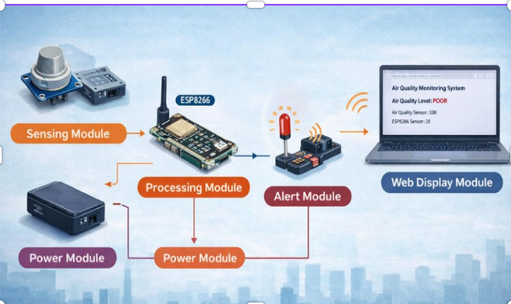
ARCHITECTURE

Slide 8
MODULES DESCRIPTION
Sensing Module This module includes sensors like the MQ-135 Gas Sensor and DHT11 Temperature and Humidity Sensor. It is responsible for detecting air pollution levels, temperature, and humidity from the environment.
Processing Module This module uses a microcontroller (ESP8266) to read sensor data and process it into meaningful values such as air quality level.
Communication Module The WiFi module (ESP8266) is used to transmit the processed data to a web server for remote monitoring.
Display Module This module shows the air quality data on a web dashboard or mobile/laptop screen for user understanding.
Alert Module This module includes LED and buzzer to alert users when the pollution level exceeds the safe limit.

Slide 9
SUSTAINABLE DEVELOPMENT GOALS ADHERED AND JUSTIFICATION
Good Health and Well-being (SDG 3) The system helps in monitoring air pollution using the MQ-135 Gas Sensor, which enables people to avoid exposure to harmful gases and improves overall health.
Sustainable Cities and Communities (SDG 11) By providing real-time air quality data, the system supports the development of cleaner and safer living environments in urban areas.
Climate Action (SDG 13) The project helps in identifying pollution levels and raises awareness about environmental conditions, encouraging actions to reduce air pollution.

Slide 10
METHODOLOGY
Data Collection The system uses the MQ-135 Gas Sensor to detect harmful gases and measure air quality levels from the surrounding environment.
Data Processing The microcontroller (ESP8266) reads the sensor values and converts them into meaningful air quality data.
Data Transmission The processed data is transmitted through a WiFi module to a web server for remote access.
Data Display The air quality level is displayed on a wearable watch display as well as on a web page in a laptop for real-time monitoring.
Alert Mechanism If the pollution level exceeds the predefined safe limit, an alert (LED/buzzer or warning message) is triggered to notify the user.

Slide 11
UNIQUIENESS
The project uses a low-cost setup with ESP8266 and the MQ-135 Gas Sensor, making it affordable and easy to implement.
It provides real-time air quality monitoring through a web page using IP address, which can be accessed on both mobile and laptop.
The system includes an instant alert mechanism using a buzzer when pollution levels become unsafe.
It supports a portable and wearable concept (watch display) for personal air quality monitoring anywhere.
The project is simple, user-friendly, and does not require complex cloud setup, making it efficient for real-time usage.

Slide 12
SCALABILITY
The system can be expanded by adding more sensors along with the MQ-135 Gas Sensor to monitor additional environmental parameters.
Multiple devices can be installed in different locations to create a wide air quality monitoring network.
The system can be upgraded from a simple IP-based webpage to cloud-based monitoring for accessing data from anywhere.
More users can access the system simultaneously by hosting the web dashboard on a server.
The project can be enhanced with data storage and analysis features to support large-scale environmental monitoring.

Slide 13
FLEXIBILITY
The system can be easily modified by adding or removing components like the MQ-135 Gas Sensor or buzzer based on requirements.
It can be used in different environments such as homes, classrooms, offices, or outdoor areas.
The web page can be customized to display different formats like graphs, colors, or messages.
The system supports multiple display options, including wearable (watch) and laptop/mobile web dashboard.
The project can be upgraded anytime with new features like mobile app, cloud storage, or additional sensors.

Slide 14
FEASIBILITY
Technical Feasibility The project is easy to implement using ESP8266, MQ-135 Gas Sensor, and a buzzer. It does not require complex hardware or advanced programming.
Economic Feasibility The system is low-cost, as all components are affordable and easily available, making it suitable for student projects.
Operational Feasibility The system is simple to use, with real-time data displayed on a web page and alerts through a buzzer, requiring minimal user effort.
Practical Feasibility The project can be used in real-life environments like homes, classrooms, and offices for monitoring air quality.
Time Feasibility The project can be developed and completed within a short duration, making it suitable for academic purposes.

Slide 15
SYSTEM REQUIREMENTS
Hardware Requirements
ESP8266 Microcontroller
MQ-135 Gas Sensor
Buzzer (for alert)
Breadboard
Jumper Wires
Power Supply (USB / Adapter)
Software Requirements
Arduino IDE (for programming ESP8266)
Arduino Programming Language
Web Browser (Chrome ) for viewing dashboard

Slide 16

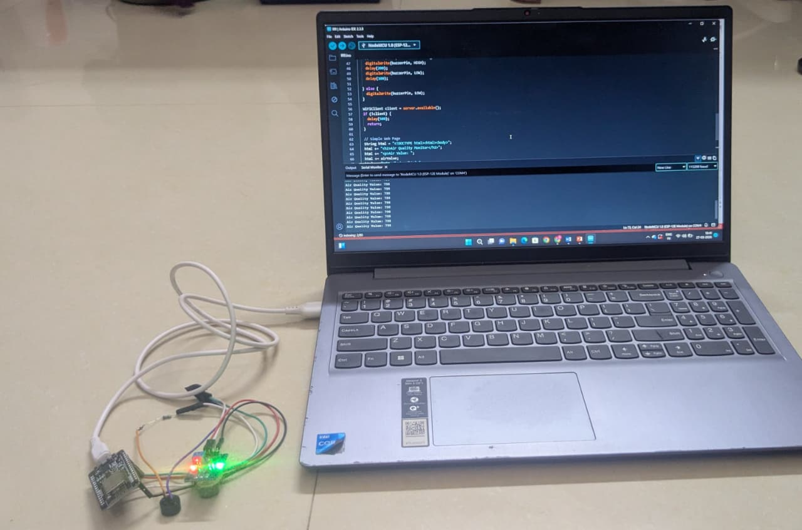
RESULT & DISCUSSION

Slide 17
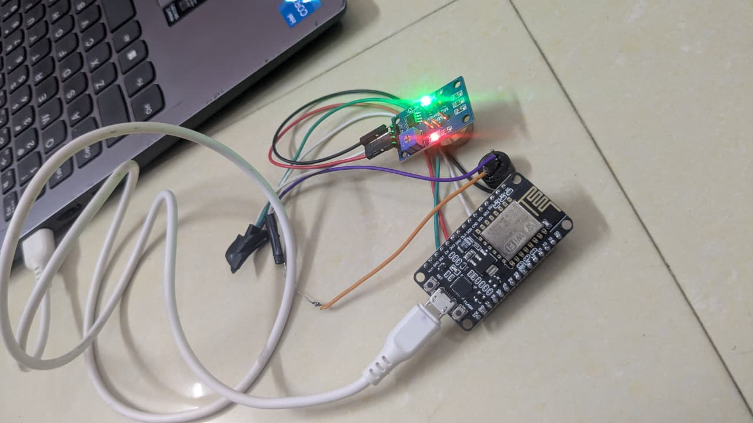
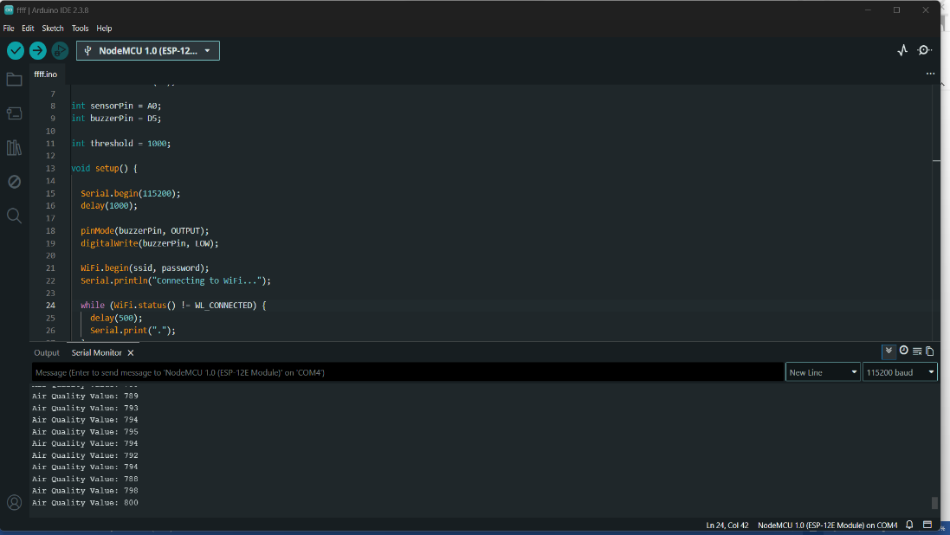
RESULT & DISCUSSION

Slide 18
CONCLUSION AND FUTURE ENHANCEMENT
CONCLUSION:
Successfully developed a real-time air quality monitoring system using ESP8266 and MQ-135 sensor
The system effectively detects pollution levels and displays data on a web page
Provides immediate alert using buzzer when air quality exceeds safe limits
Cost-effective, portable, and easy to use for daily applications
Helps in increasing awareness about air pollution and health safety
FUTURE ENHANCEMENT:
Integration with mobile app for real-time notifications and remote access
Addition of multiple sensors for detecting different gases with higher accuracy
Cloud integration for data storage and long-term analysis
GPS module for location-based air quality tracking
Implementation of AI/ML for predicting air quality trends

Slide 19
REFERENCES
“Smart Air Pollution Monitoring System with Real-Time Data Using IoT” – Elsevier Measurement Journal, 2024
“IoT-Enabled Air Quality Monitoring and Alert System Using ESP8266” – IEEE Xplore, 2024
“IoT-Based Indoor Air Quality Monitoring System Using Gas Sensors” – Elsevier Sustainable Computing, 2024
“Development of Smart Air Quality Monitoring System Using Arduino and IoT” – International Journal of Innovative Technology and Exploring Engineering (IJITEE), 2024
“IoT-Based Multi-Gas Monitoring System for Environmental Safety” – Elsevier Microprocessors and Microsystems, 2024
“Low-Cost IoT-Based Environmental Monitoring System for Smart Cities” – Springer Environmental Monitoring and Assessment, 2025
“Cloud-Based Air Quality Monitoring and Analysis Using IoT Sensors” – Springer Smart Cities Journal, 2025
“Real-Time Air Pollution Detection Using IoT and Edge Computing” – IEEE Internet of Things Journal, 2025
“Design of Wireless IoT-Based Air Quality Monitoring Using Cloud Platform” – IEEE Access, 2025
“Intelligent Air Quality Monitoring and Forecasting Using IoT and Machine Learning” – IEEE Sensors Journal, 2025

Slide 20
THANK YOU !

