Slide 1
PORTFOLIO
STUDENT PORTFOLIO

Slide 2
MY SELF
NAME: R.BHAVADHARANI.
NMID:6E82388B74410E3A5DB497C870B5523A
COLLEGE: VALLIAMMAI WOMEN’S College.
DEPARTMENT: BCA.
UNIVERSITY: ANNAMALAI UNIVERCITY.

Slide 3
TABLE OF CONTENT
CONTENTS:
1.Problem statement.
2. Project overview.
3. End user.
4.Tools and technologies.
5. Portfolio design and layout.
6.Features and functionality.
7.Result and screenshot.
8. Conclusion.
9. Github link .

Slide 4
PROBLEM STATEMENT
A problem statement is a concise description of an issue or challenge that needs to be addressed.
To craft or effective problem statement consider the following.
Focus on the impact: Describe the consequences of not addressing the problem.

Slide 5
Project overview:
To provide a helpful project overview is need more information about your project .
1.project tittle or topic .
2.Objective or goal.
3. Any specific requirements or constraints.

Slide 6
END USER :
The end user are the individual or group who will ultimately user or benefits from the project, service or solution being developer .
Customers.
Employees.
Patients.
Students.
Cusomers.

Slide 7
TOOLS AND TECHNOLOGIES
Tools and technologies refer to the software, hardware and platform are used to develop implement and maintain a project or solutions.
Software: programming language (e.g., Python,Java, Javascript ).
Hardware: servers and infrastructure.
Platforms: cloud platform (e.g.,AVS,AZURE, Google Cloud).

Slide 8
PORTFOLIO DESIGN AND LAYOUT
Portfolio design and layout refer to the visual arrangement and organization of content in a portfolio.
Which showcases an individual or company work skills and accomplishments.
1.Visual hierarchy: organizing content to draw attention to key pieces.
2.Tyography: choosing fronts that reflects the brand and enhance readability.
3.Navigation: creating an intuitive and user friendly and user friendly interface.

Slide 9
FRACTURES AND FUNCTIONALITY
In various context fractures and functionality can be related in different ways.
1.Medical: Fractures bone break can impact functionality affecting mobile or overall health.
2.Design: understanding fractures and material properties can inform design decisions to ensure functionality and durability.

Slide 10
CONCLUSION
A conclusion typically summarises the main point and key takeaways from a discussion project or analysis.
1.Recap the key findings or result.
2. Emphasizes the important or impact.
3.provide recommendation or next step.
Leave a lasting impression or final thoughts.

Slide 11
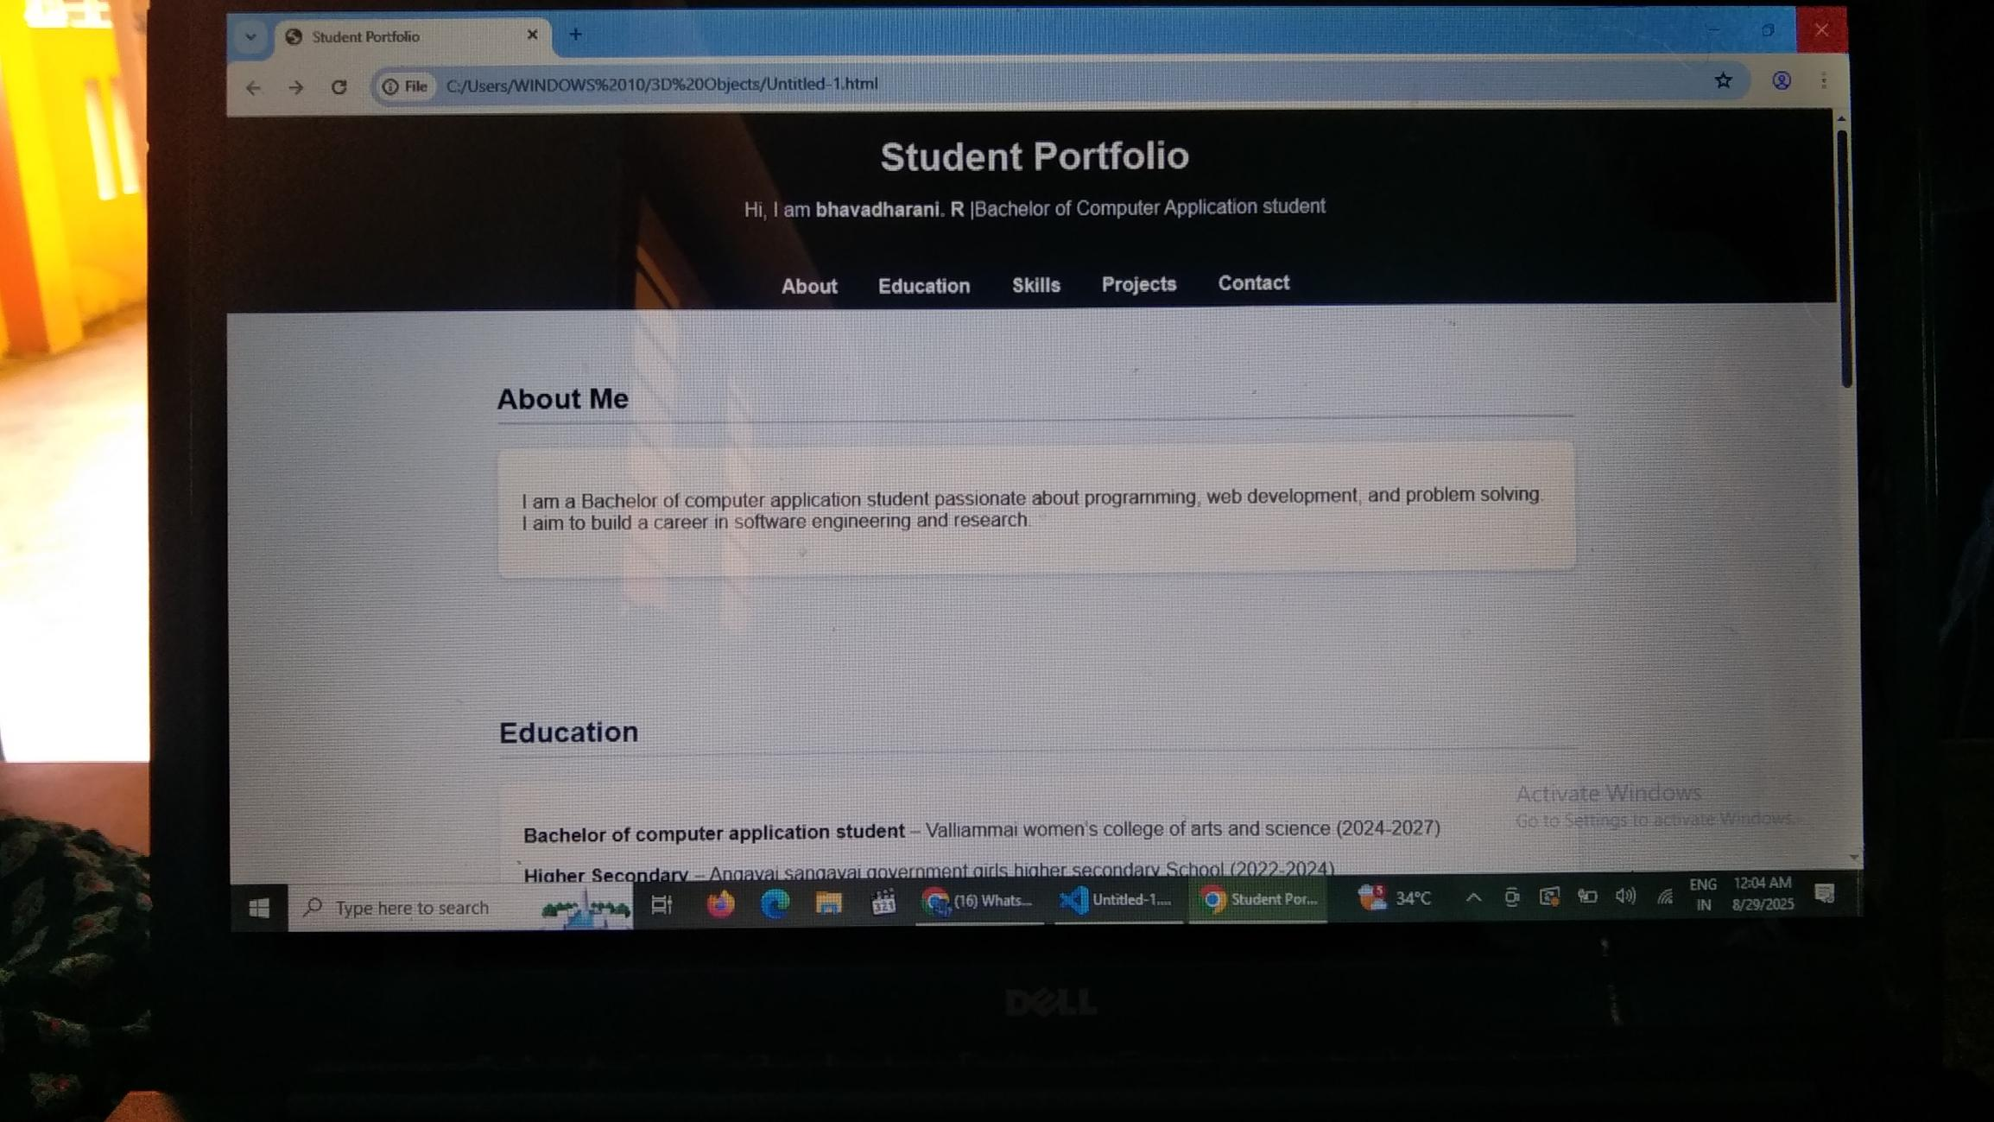

Slide 12
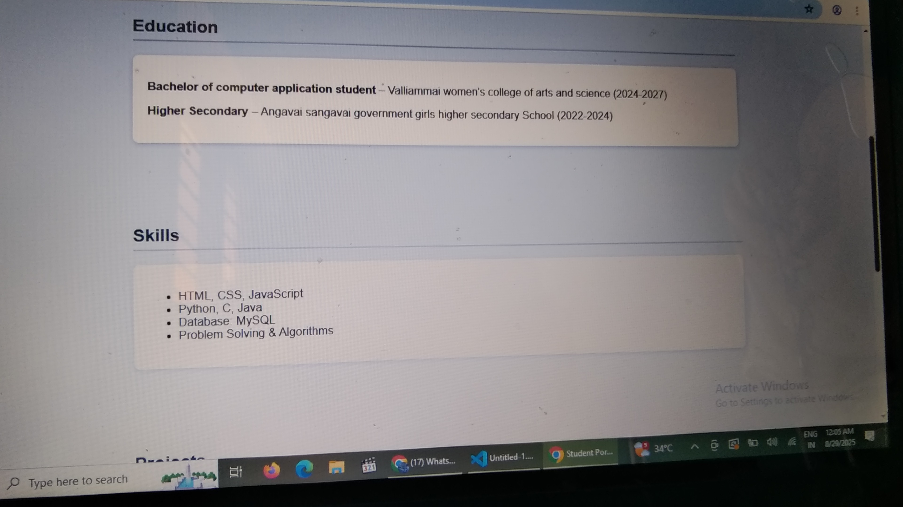

Slide 13
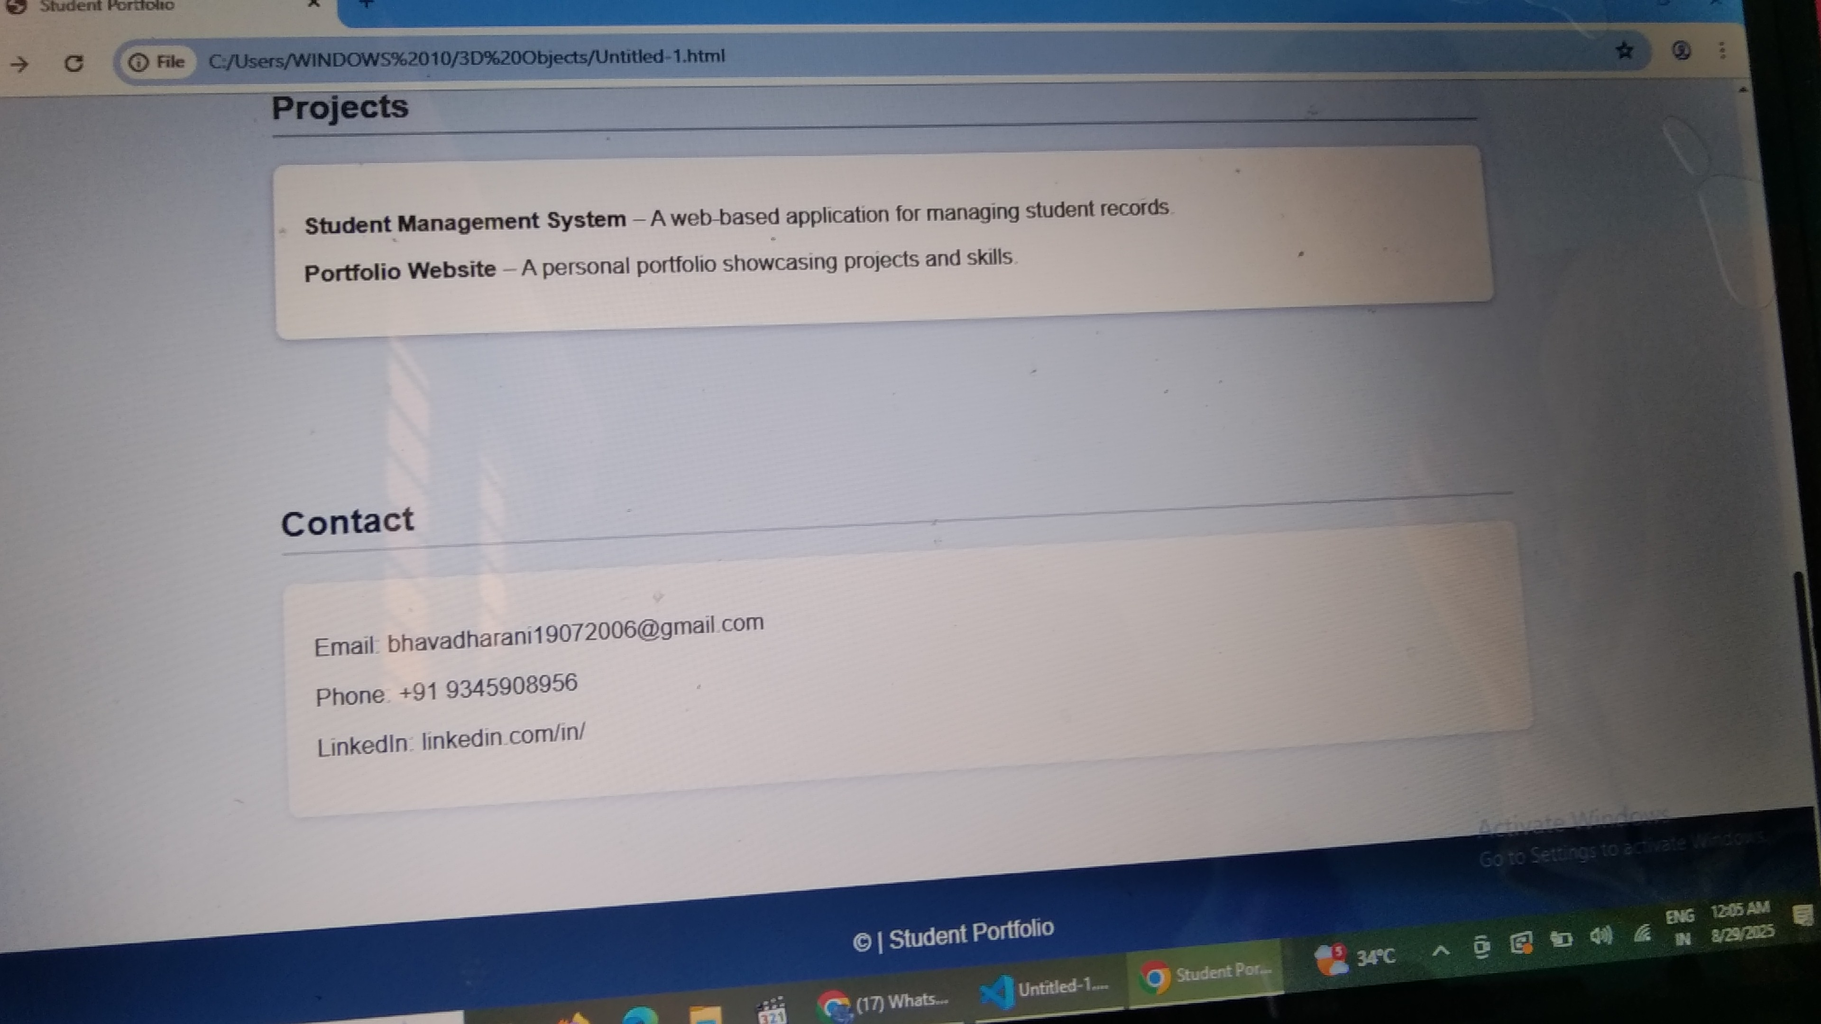

Slide 14
GitHub link
https://github.com/bhavadharani2006

