Slide 1
Chat Client
using sockets
Targerian Android App Manual

Slide 2
About App
App runs on the android interface (Client-Service model) using the TCP/IP sockets.The Application is the client-based model .One can use it by connecting to the server whose IP
should be provided to get the app working.Move on !!
On launch one would get the option for login or signup.

Slide 3
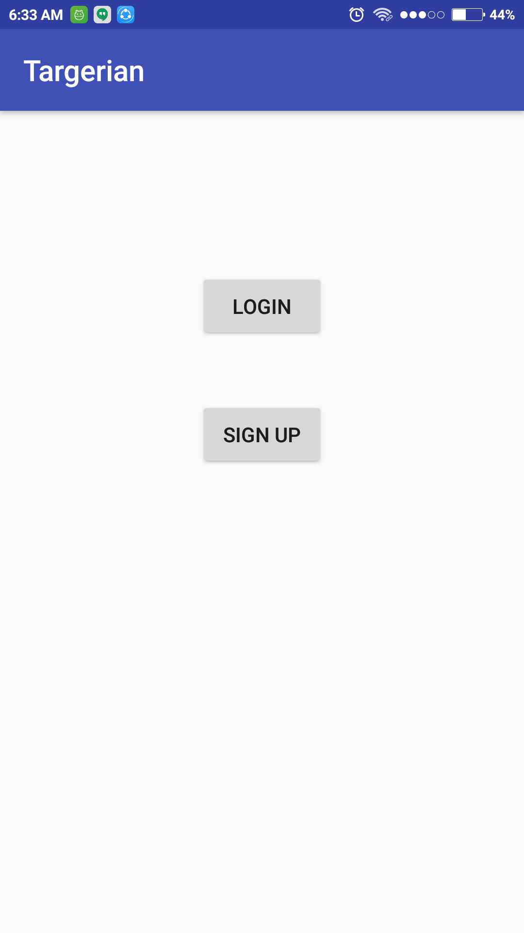
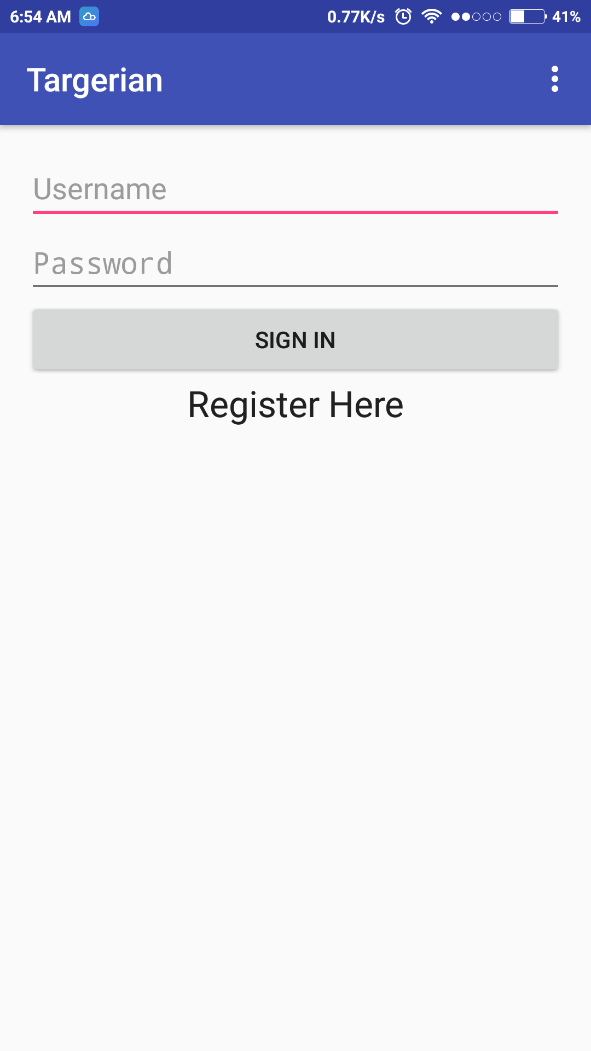
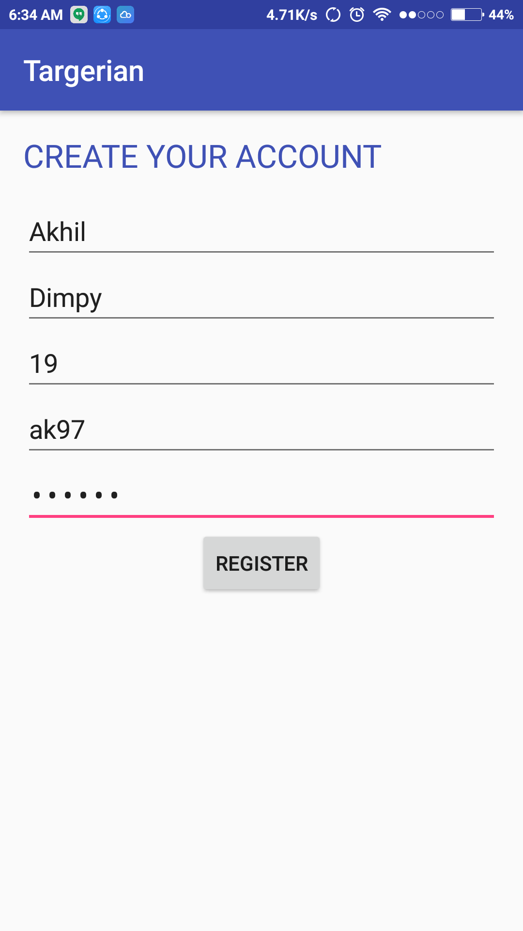
Start Login SignUp Screen

Slide 4
On Start one can navigate to sign up or login on checking the corresponding boxes,

Slide 5
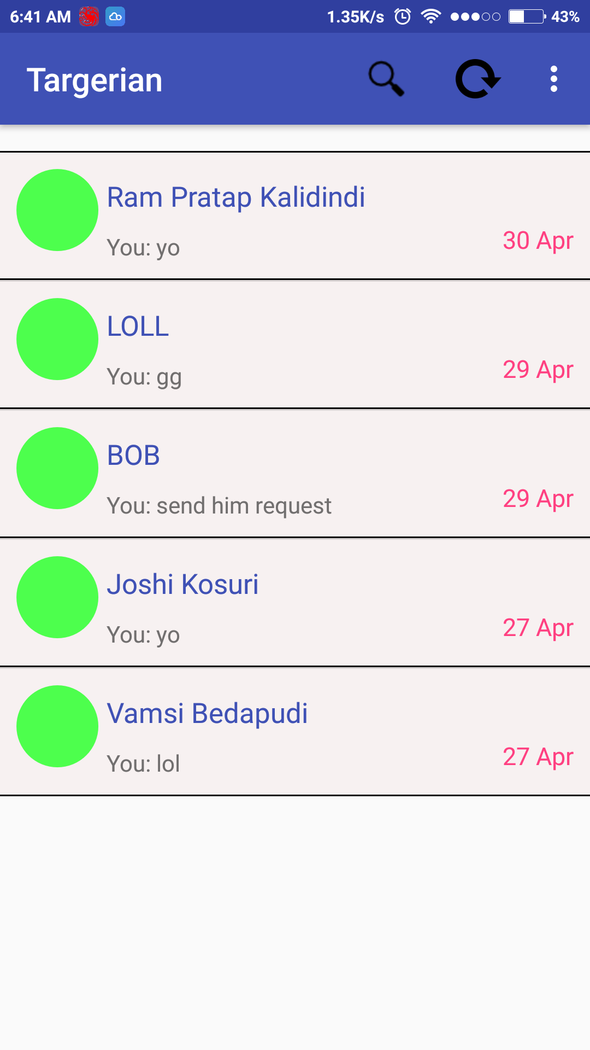
On Login It lands up you here enabling to check the old Chat Messages.
Here You can observe both individual chats with Normal Name and Groups too(LOLL).
Search box
Chat Boxes

Slide 6
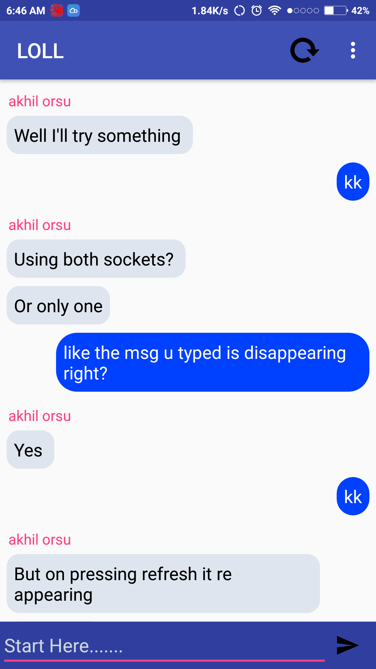
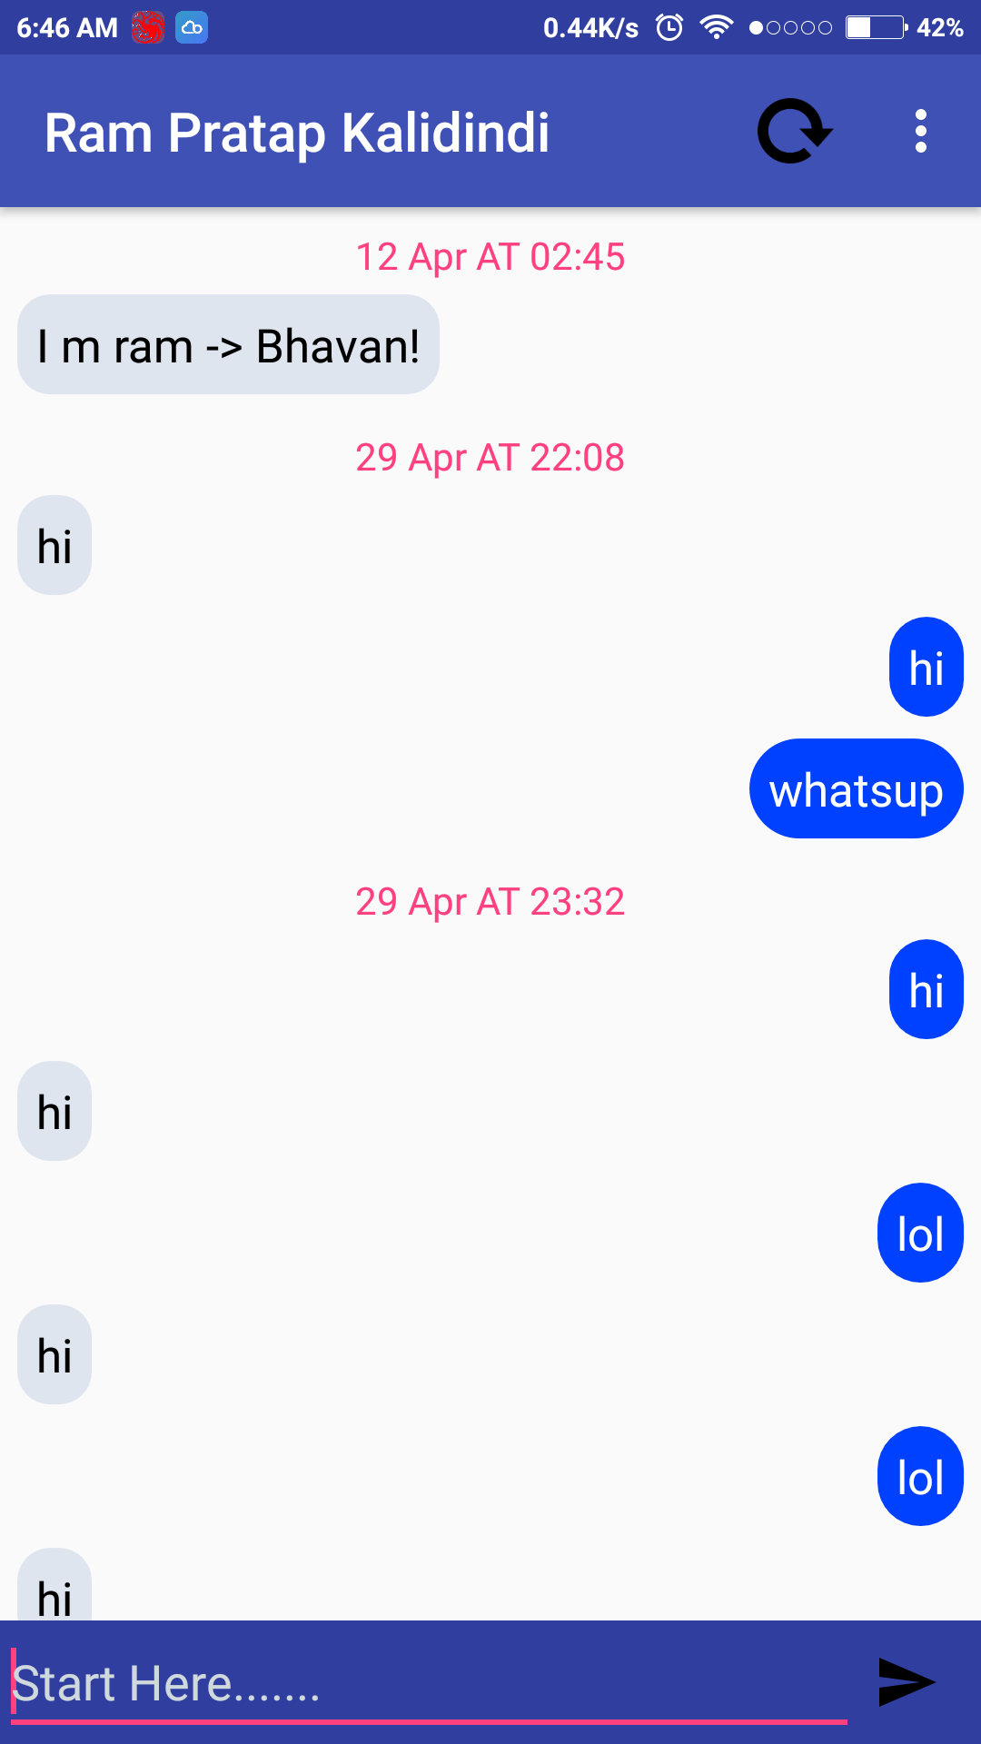
ON Clicking the individual chats they appear.
Likewise here Ram Pratap Is the chat of individual .
And Group chat LOLL.
One can Observe the time Stamps and these get generated on chat of atleast 10 min interval.
In Group chat Sender Name is being displayed .
With a Log Out Button at the top corner and Refresh Button.

Slide 7
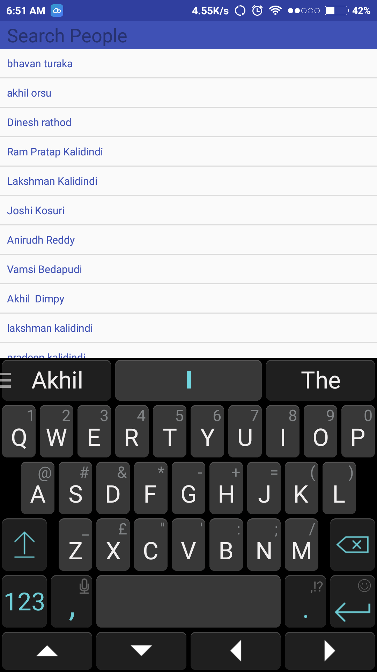
ON Pressing Search In previous menu , Lands up here .
Here you can search for all persons that are availabe for chat.
ON Clicking the Individual Person lands you in Chat List if you’re friends else you can add up as buddy’s
Next Slide

Slide 8
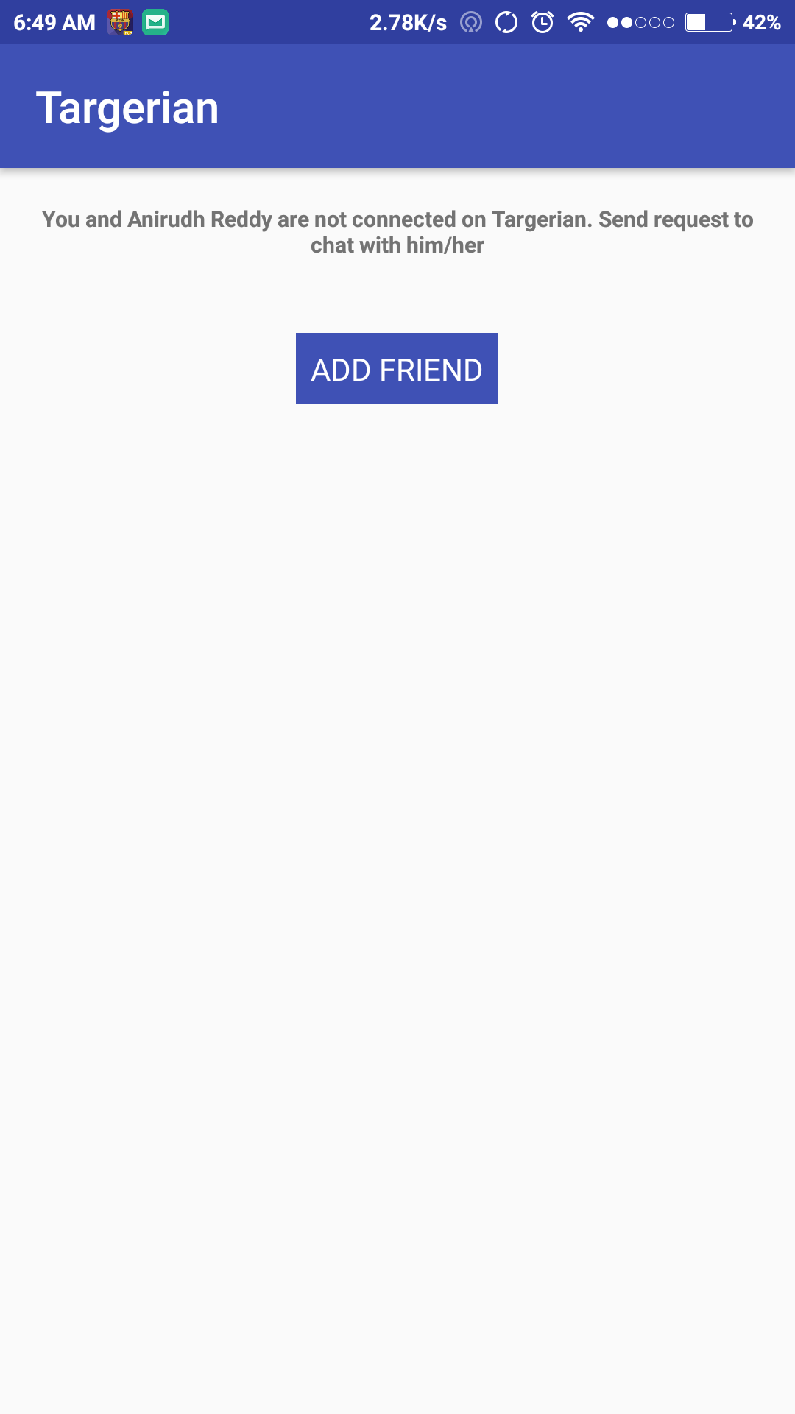
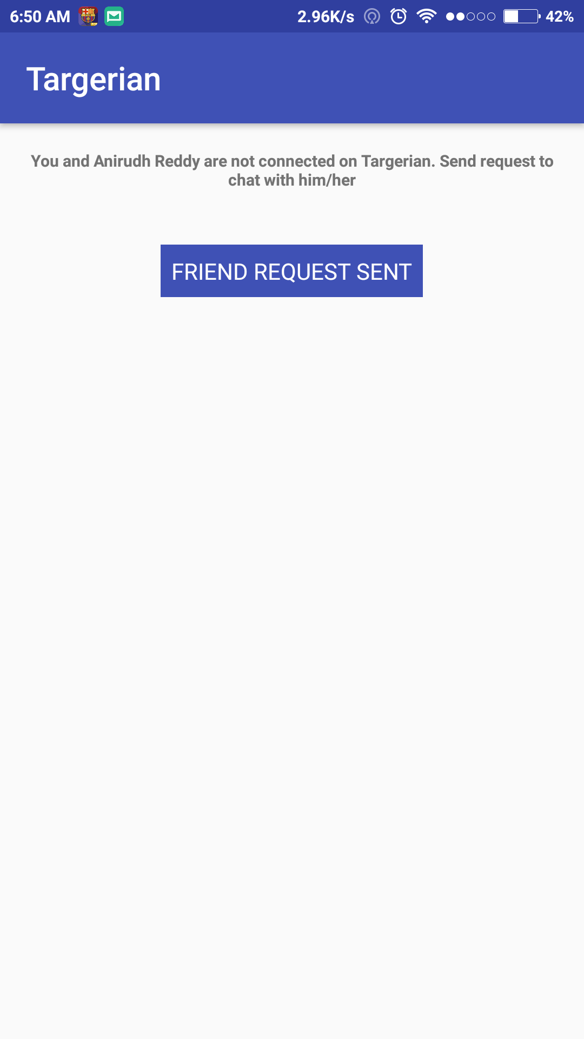
As mentioned if you’’re not buddy’s you can add ‘em here.
Which On Add Friend You wait for the approval.

Slide 9
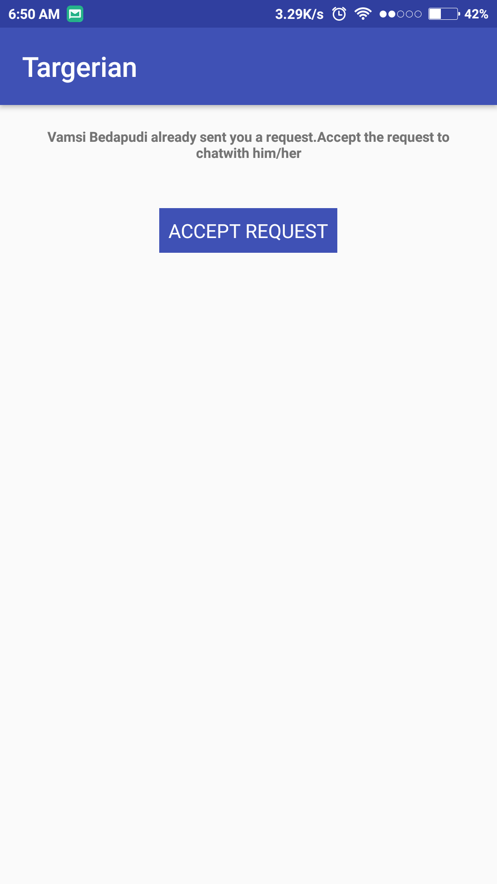
On Accept Req.
OLaa!! You’re buddy’s now.
Chat now!!.

Slide 10

MEMBERS
BHAVAN -
RAM -
LAKSHMAN-
AKHIL-

