Slide 1
Module 6 Final Project Data Analysis
By
Bhavana Deshetty

Slide 2
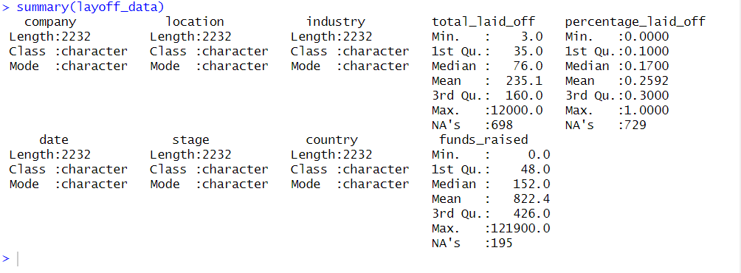
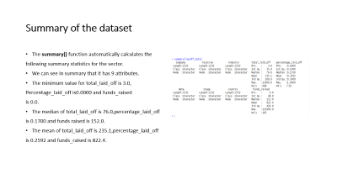

Summary of the dataset
The summary() function automatically calculates the
following summary statistics for the vector.
We can see in summary that it has 9 attributes.
The minimum value for total_laid_off is 3.0,
Percentage_laid_off is0.0000 and funds_raised
is 0.0.
The median of total_laid_off is 76.0,percentage_laid_off
is 0.1700 and funds raised is 152.0.
The mean of total_laid_off is 235.1,percentage_laid_off
is 0.2592 and funds_raised is 822.4.

Slide 3
About Dataset
My dataset it is all about layoff dataset.
Obtained from Kaggle.com
The dataset consists of 2233 records and 9 attributes. The data availability is from when COVID-19 was declared as a pandemic i.e. 11 March 2020 to present (14 February 2023).
Information about the features:
Company: name of the corporation
Location: City where layoff took place
Industry: Under what industry the company is operating
total_laid_off: Number of people laid off
Percentage: Percentage of total employee that has been laid off
Date: Date of layoffs
Fund Raised: How much funding has been secured from investors, banks etc
Stage: Stage of funding
Country: Country where layoffs took place

Slide 4
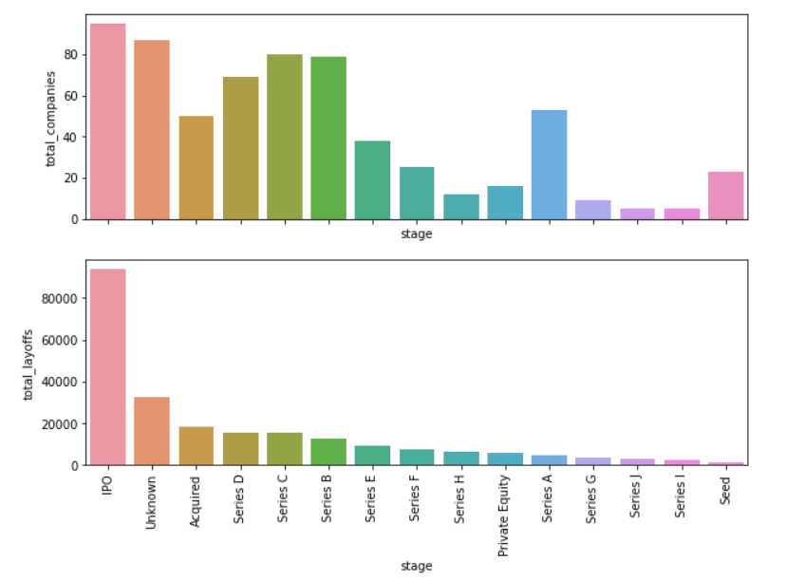
Observations on Graphs
Tech firms around the globe are fighting the economic slowdown. The slow consumer spending, higher interest rates by central banks and strong dollars overseas are hinting towards possible recession and tech firms have started laying employees off .This economic slowdown has made Meta recently fire 13% of its workforce, which amounts to more than 11,000 employees.
Observation: Most number of IPO stage companies has undertook the layoffs and most employees are fired from IPO stage companies.

Slide 5
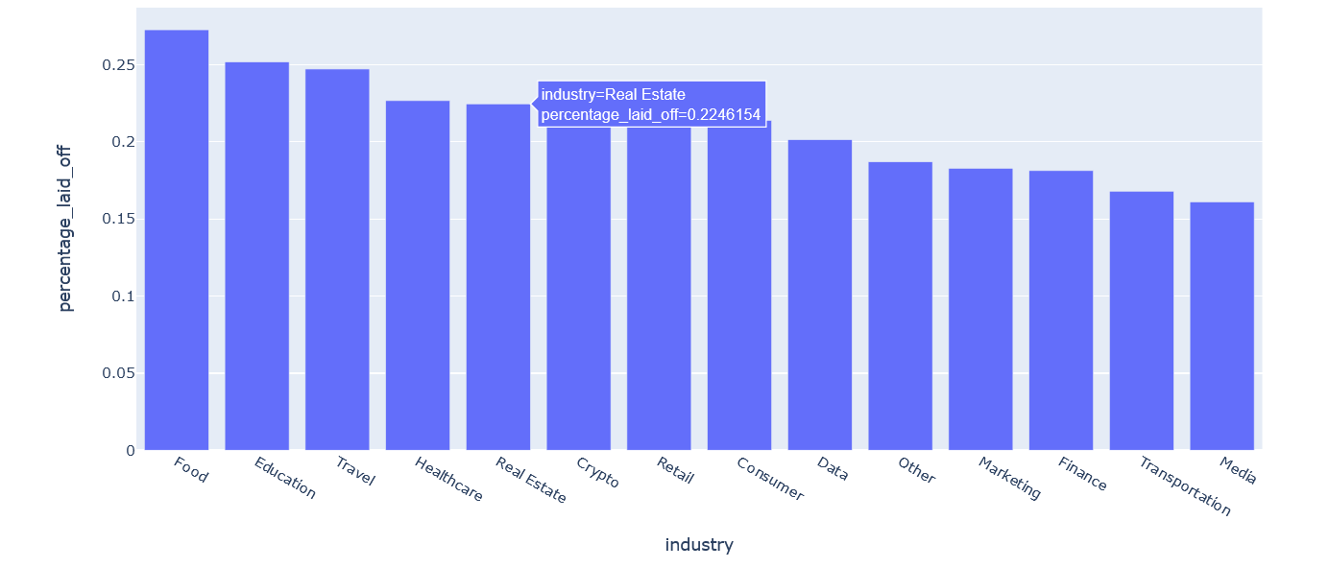
Observations: On average 26% of total workforce was laid off from food industry company followed Education, travel, real_estate and Healthcare.

Slide 6
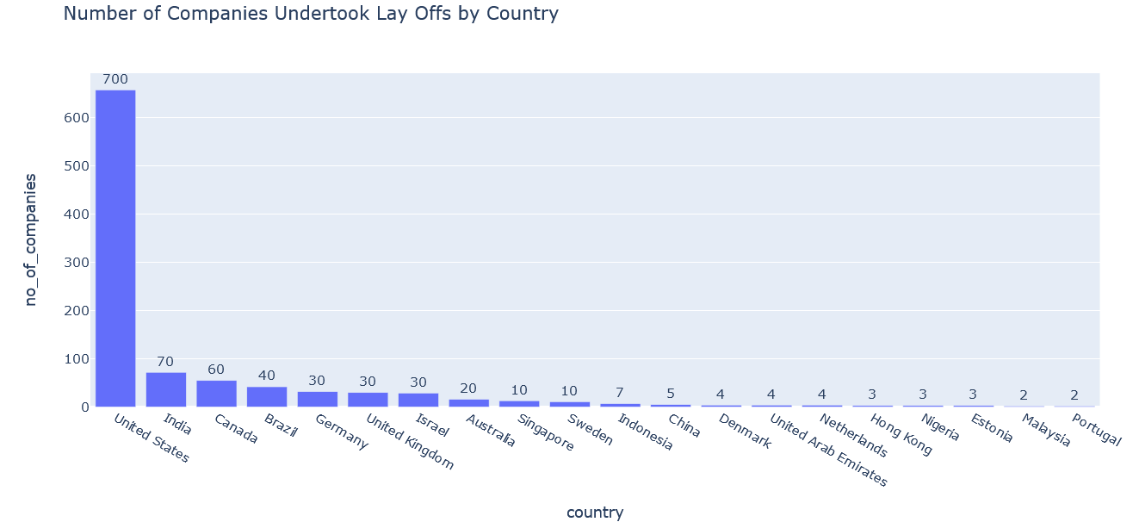
observations:We can see in the below graph that united states has highest layoff’s followed by india, Canada and brazil.

Slide 7
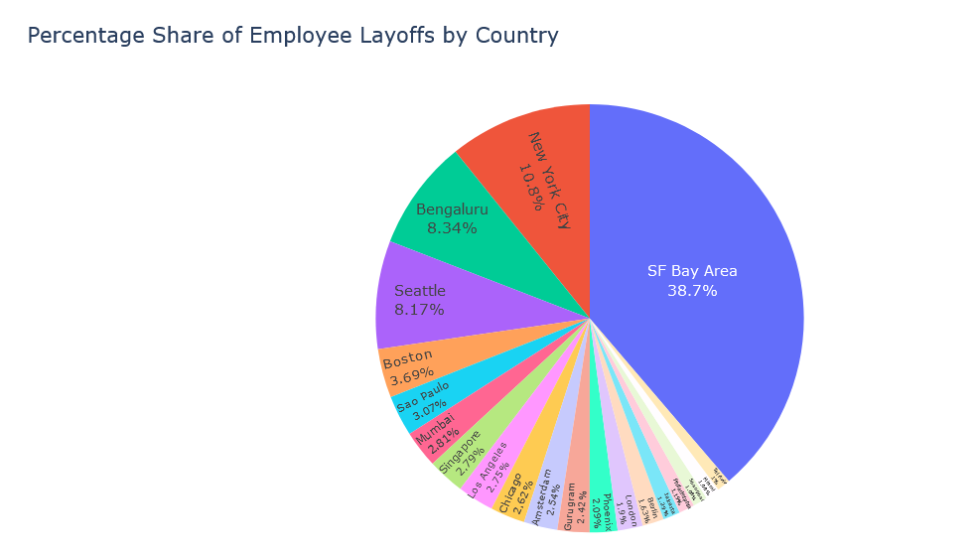
Observation: SF bay area (Silicon Valley), NYC & Bangalore are all the big tech cities which have witness high scale of layoffs.

Slide 8
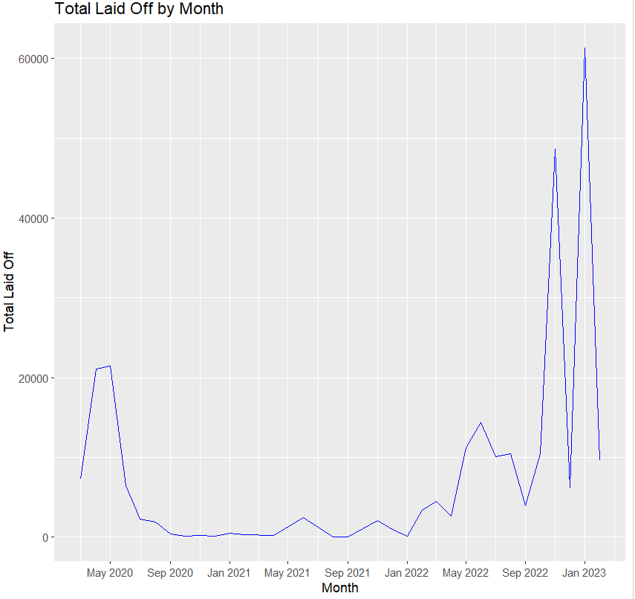
According to the above graph Month vs Total laid off,Layoffs were generally higher in 2020, then they dropped in 2021 and greatly increased in 2022.Yearly layoff trend for the whole world (minus USA data) matches somewhat with that of yearly trend in USA in the sense that layoffs were higher in 2020, then they dropped in 2021 and are generally higher in 2022.

Slide 9
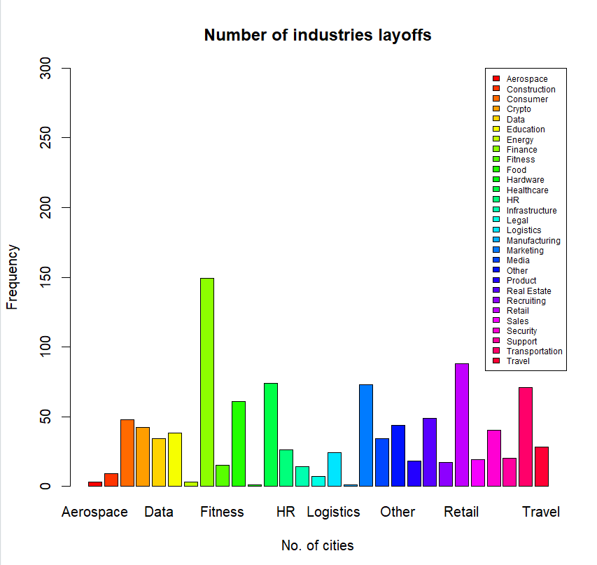
Initially, the travel business was the most affected, as evidenced by layoffs in 2020, but they have recovered extremely well since then. Unexpectedly, the education and retail industries experienced a significant increase in layoffs in 2022 compared to 2020. When compared to 2020, the travel and finance industries performed strongly in 2022.

Slide 10
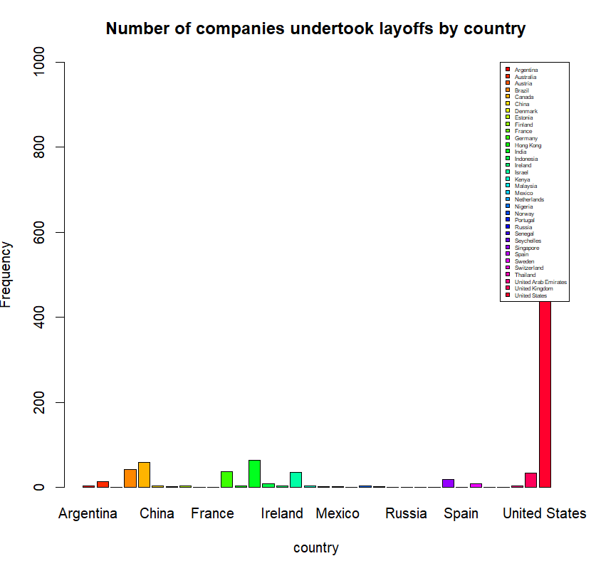
The global yearly layoff trend corresponds to the global yearly layoff trend in the sense that layoffs were higher in 2020, then declined in 2021, then exploded in 2022. This shows that United States is unproportionally affected by layoffs, compared to the rest of the world. This could be because most of the data in the dataset is about the United States.

Slide 11
Difficulties faced using dataset
There were lots of record missing in the dataset and records from 1,300 companies is not enough to give us a proper idea about lay offs.
If we can get at least data with a size 10K would be great to understand the impact, but then i have used mean computation method which is a useful statistic as it summarizes the central tendency of the data. However, it can be sensitive to extreme values or outliers in the data. In some cases, other measures of central tendency, such as the median or mode, may be more appropriate.

Slide 12
Key considerations
The global yearly layoff trend corresponds to the global yearly layoff trend in the sense that layoffs were higher in 2020, then declined in 2021, then exploded in 2022. This shows that United States is unproportionally affected by layoffs, compared to the rest of the world.
This could be because most of the data in the dataset is about the United States.
Initially, the travel business was the most affected, as evidenced by layoffs in 2020, but they have recovered extremely well since then. Unexpectedly, the education and retail industries experienced a significant increase in layoffs in 2022 compared to 2020.
When compared to 2020, the travel and finance industries performed strongly in 2022.
United States suffered most layoffs followed by India, compared to the rest of the world. More than 75% of the employees laid off since 2020 belong to USA.
Consumer industry in USA is hit hardest with layoffs in 2022 while Food industry is affected most outside USA in 2022.
Transportation and Food industries are affected by layoffs globally.
Travel industry faced considerably less layoffs globally in 2022 compared to 2022.

Slide 13
Biblography
S. (2022b, November 21). Lay offs Data Analysis. Kaggle. https://www.kaggle.com/code/shivsharma123/lay-offs-data-analysis/notebook
F. (2022b, November 17). Layoffs 2022 dataset - EDA. Kaggle. https://www.kaggle.com/code/fnmalik2002/layoffs-2022-dataset-eda
Quick-R: Scatterplots. (n.d.). https://www.statmethods.net/graphs/scatterplot.htm
R - Line Graphs. (n.d.). https://www.tutorialspoint.com/r/r_line_graphs.htm
Layoffs.fyi. (2020, December 29). Analysis. https://layoffs.fyi/category/analysis/

Slide 14
THANK YOU

