Slide 1
ASSIGNMENT 1 | CO1
Campus Smart-Parking System
Programming in Java: object-oriented design, implementation and validation
Name: Bhaavana B Register No: 192521153
GitHub: CSA09-192521153-Assignment1

Slide 2
Task 1 · Problem and Objects
4 Marks
Objects, I/O and rules
Input: reg no, vehicle type, pass status, entry/exit time. Output: slot, ticket no, fee.
Nouns become classes: Vehicle (+ types), ParkingSlot, ParkingFloor, ParkingFacility, ParkingTicket. Verbs become methods: allocate(), release(), calculateFee().
Facility owns floors; ticket links vehicle, slot and time; Vehicle knows its own rate.
Rules: one vehicle per slot; ticket no never reused; valid pass = free; visitor pays full.
Assumptions: slots numbered from 0; time in whole minutes; a started hour is billed in full; EV charging billed separately.
Alternative: parallel String arrays
regNo[], type[], entryTime[]: row i is one vehicle, linked only by index.
Search by reg no: O(n) scan in both designs (O(1) average if objects are in a HashMap).
New attribute: object = add one field; arrays = new array plus edits in every method.
Space per vehicle: O(1) in both; objects add a header (~16 B) but arrays can drift out of sync when one is updated and another is not.
Verdict: objects keep data and behaviour together, so they are safer and easier to extend.

Slide 3
Task 2 · Data Representation
3 Marks
Data types and casting
slot, floor: int. vehicleNo: String. entryTime: LocalTime (or long minutes). duration: int minutes. fee: double (BigDecimal for real money).
Floors and slots: jagged String[][] because floors can differ in size.
Input: Scanner for interactive entry; args[] only for fixed settings.
Casting risk: minutes / 60 * rate is integer division. 130 / 60 = 2, so Rs 60 instead of Rs 90.
Fix: hours = (minutes + 59) / 60 (integer ceiling) gives 3 x 30 = Rs 90; cast to double only for the final multiply.
Alternative layouts
1-D array, index = f x S + s: works only if every floor has S slots.
Uneven floors need an offset array: index = offset[f] + s.
ArrayList<String[]>: one array per floor, floors can be added dynamically.
Locate a slot: O(1) in all three. Space: O(F x S) in all three.
Jagged adds F row references; 1-D is most compact but least flexible.

Slide 4
Task 3 · Control Logic
4 Marks
Pseudocode and completed code
ALGORITHM Allocate(vehicleNo)
FOR f <- 0 TO F-1
FOR s <- 0 TO len(f)-1
IF slot[f][s] = null THEN
slot[f][s] <- vehicleNo; RETURN {f,s}
RETURN null // facility full
ALGORITHM Fee(minutes, rate)
IF minutes <= 0 THEN RETURN 0
hrs <- (minutes + 59) DIV 60
RETURN MIN(hrs * rate, dailyMax)
// TODO 1 allocate
for (int f=0; f<slots.length; f++)
for (int s=0; s<slots[f].length; s++)
if (slots[f][s]==null) {
slots[f][s]=vehicleNo; return new int[]{f,s}; }
return null;
// TODO 2 release
if (floor<0||floor>=slots.length) return false;
if (slot<0||slot>=slots[floor].length) return false;
if (slots[floor][slot]==null) return false;
slots[floor][slot]=null; return true;
Output and alternative
Expected output: [0, 0] [0, 1] [1, 0] null / true false false / [0, 1]
return exits at the first free slot, so no extra scanning; no free slot returns null.
Alternative: freeCount[f] plus a stack of free slot numbers per floor.
allocate: skip floors with freeCount = 0, pop a slot: O(F). Scan version: O(F x S) worst case.
release: push the slot back: O(1) (scan version: O(1) too).
Extra space: stacks need O(F x S); the scan needs O(1). Faster allocation costs memory.

Slide 5
Task 4 · Classes and Constructors
4 Marks
ParkingTicket design
Fields: ticketNo, regNo, floor, slot, entryTime. Methods: getters, duration(), toString().
No default constructor: a ticket without a vehicle would be invalid.
Parameterised constructor sets all fields; overloaded one omits entryTime and chains with this().
ParkingTicket(String r,int f,int s,long t){
ticketNo = nextNo++; regNo=r; floor=f; slot=s; entry=t; }
ParkingTicket(String r,int f,int s){
this(r, f, s, now()); }
ParkingTicket(ParkingTicket o){ ... } // duplicate
Copy constructor re-issues a duplicate ticket with the same ticketNo.
Memory: reference variable on the stack, object on the heap.
Alternative: setters or factories
Default constructor + setters: object can exist half-built (invalid state); validation scattered.
Static factory, e.g. ParkingTicket.issue(...): named, validates once, can reuse or cache.
Constructors guarantee a valid object at creation; setters only if called in the right order.
Time to create n tickets: O(n) in all; setters add k extra calls per object.
Space: O(n) objects in all approaches; same fields, so no real difference.

Slide 6
Task 5 · static and Object Life Cycle
3 Marks
static members and garbage collection
static int ticketCounter and totalOccupancy belong to the class. An instance variable would restart at 1 for every object and repeat ticket numbers.
static method nextTicketNo() needs no object; static block initialises rates once at class load.
After exit the ticket reference is removed from the active store. With no reference left it is eligible for garbage collection.
Objects are passed by value of the reference: a method can change the object's fields but cannot re-point the caller's variable.
Methods return the ticket reference so the caller can use it.
Alternative: counter per facility
Instance counter in ParkingFacility: north and south gates both issue ticket 1, 2, 3, so numbers repeat campus-wide.
Fix A: keep the static counter (one global sequence).
Fix B: instance counter plus a facility prefix: N-1, S-1.
Space for the counter: static = O(1) in total; instance = O(k) for k facilities.
Tickets themselves stay O(n) either way.

Slide 7
Task 6 · Inheritance Hierarchy
4 Marks
UML hierarchy
super, constructor trace, alternative
super(regNo) in each constructor passes data up; super.method() reuses parent code.
new ElectricCar('TN03C3') runs: 1 ElectricCar() starts, 2 Car(), 3 Vehicle() sets regNo, 4 Car body, 5 ElectricCar body.
Composition alternative: Vehicle has-a VehicleType (holds the rate).
New type = one new VehicleType object, no new class. Fee time O(1) in both.
Space: composition adds one reference per vehicle; inheritance adds none.
Vehicle (abstract)
TwoWheeler
Car
ElectricCar
Hierarchical + multilevel. Inherited: regNo, getRegNo(), calculateFee(). Added in ElectricCar: chargingFee() from Chargeable.

Slide 8
Task 7 · Overriding
4 Marks
Override and specialise
ratePerHour() is abstract in Vehicle and overridden in TwoWheeler (10), Car (30) because each type has its own rate.
@Override makes the compiler check the signature. Rules: same signature, same or covariant return type, access not weaker.
final: regNo (never changes), calculateFee() if billing rules are fixed, final class for ParkingTicket.
equals() and hashCode() use regNo only, so equal reg numbers mean equal vehicles; toString() prints type and number.
Alternative: one method with switch
calculateFee() with switch(type): O(1) with a switch, O(k) with an if-else chain over k types.
Adding a type means editing Vehicle and its switch: 1 existing class changes and old tests must run again.
Overriding: add 1 new subclass, 0 existing classes change (open for extension, closed for modification).
A forgotten switch case silently gives a wrong fee; a missing override fails at compile time.

Slide 9
Task 8 · Polymorphism
4 Marks
Overloading, dispatch, FeeDemo code
Overloading (compile time): calculateFee(int minutes) vs calculateFee(LocalTime in, LocalTime out); the compiler picks by argument types.
Upcasting: Vehicle[] parked holds TwoWheeler, Car, ElectricCar.
Dispatch trace: v.calculateFee(130), declared type Vehicle, actual ElectricCar; JVM runs Vehicle.calculateFee, which calls Car.ratePerHour() = 30.
// TODO 1 int h=(minutes+59)/60; return h*ratePerHour();
// TODO 2 Car(String r){super(r);}
protected double ratePerHour(){return 30;}
// TODO 3 public double chargingFee(int kWh){return kWh*12;}
Output, last line, alternative
TwoWheeler TN01A1 -> Rs 30.0 | Car TN02B2 -> Rs 90.0 | ElectricCar TN03C3 -> Rs 210.0 | true
Last line is true: equals() compares only regNo and both objects are Vehicles. Correct here, since one registration number is one physical vehicle.
Alternative: instanceof checks plus casts for each type.
Dispatch is O(1); instanceof chain is up to k checks, O(k).
Code grows with every new type, every chain must be edited, and a wrong cast can throw ClassCastException.

Slide 10
Task 9 · Abstraction
4 Marks
Abstract class vs interface
Vehicle is abstract: it has state (regNo), a constructor and shared calculateFee(); ratePerHour() is abstract.
Chargeable is an interface: a can-do ability (chargingFee) that is not part of the Vehicle family.
Abstract class = shared state in an is-a family; interface = contract any class can add.
ElectricCar extends Car implements Chargeable, Payable: multiple behaviours via interfaces.
default method: shared helper such as gst(fee); static method: utility such as isValidRate().
Alternative: swap the two
Vehicle as interface + default methods: no constructor, no instance fields; regNo must be repeated in every class.
Chargeable as abstract class: ElectricCar already extends Car, so it cannot extend a second class.
Method call time: O(1) in both (interface dispatch is marginally slower).
Space per object: abstract class state lives in each object; interfaces add none.

Slide 11
Task 10 · Packages and Encapsulation
3 Marks
Structure, access, validation
parking.model: Vehicle, TwoWheeler, Car, ElectricCar, ParkingTicket. parking.service: ParkingFacility, FeeCalculator. parking.app: Main.
Fields private; getters public; ratePerHour() protected (for subclasses); helpers package-private.
setDuration(int m): if (m < 0) throw new IllegalArgumentException(); slot checked against floor size.
Wrappers: Integer in collections via autoboxing. Risk: Integer a == b compares references (cached only for -128 to 127); use equals(). Unboxing null throws NullPointerException.
Alternative: public fields
Callers can set duration = -5 or slot = 999 directly; object state is no longer protected.
The same check must be repeated at every place that updates the field: m call sites instead of 1 setter.
Validation cost is O(1) per update in both, but forgotten checks cause bugs and are hard to find.
Changing a rule later means editing m places instead of one.

Slide 12
Task 11 · Test and Defend
5 Marks
Test table (expected by hand)
Evaluation and alternative
Hand total for day: TwoWheeler 130 min Rs 45 + Car 130 min Rs 135 + EV 130 min and 10 kWh Rs 255 = Rs 435. Compare with program output.
Design: encapsulation (private fields), inheritance (reuse), polymorphism (no type if-chains), abstraction (Vehicle, Chargeable).
Limitation: allocate() scans O(F x S); pricing is spread over subclasses.
Active tickets in ArrayList: find on exit O(n). HashMap<String,ParkingTicket>: O(1) average. Space O(n) in both, HashMap uses more per entry. Measure with System.nanoTime() for n = 10,000.
Type | Input | Expected | Actual
Normal | Car, 130 min | Rs 90
Normal | TwoWheeler, 60 min | Rs 10
Boundary | Last free slot | Allocated, then null
Boundary | 0 minutes | Rs 0
Boundary | Car, 120 min | Rs 60
Boundary | Car, 121 min | Rs 90
Invalid | Type Bus | Rejected
Invalid | Duplicate reg no | Rejected
Invalid | release(5, 0) | false

Slide 13
Task 12 · A and B: Impact and Evaluation
4 Marks
A. Impact analysis
New: e-bike (flat fee), delivery van (double car rate 9 AM to 5 PM), visitor one-day pass, 5 floors with different slot counts.
Affected: fee logic (time of day, pass), ParkingFacility checkout (pass check), user types.
Uneven floors: a fixed 2-D array or 1-D index fails, but the jagged String[][] already handles it, so it is retained.
Modified not extended: only the checkout/fee service that has no idea of passes or time of day.
B. Evaluation of original design
New vehicle types: just new subclasses of Vehicle, with no change to Car, TwoWheeler or ElectricCar.
Weakness: calculateFee(int minutes) has no clock time, so the van's 9 to 5 rule needs the in/out overload.
Pricing is spread over subclasses and passes are not modelled yet.
Tested classes (Vehicle, Car, ParkingFacility.allocate/release) can stay unchanged.

Slide 14
Task 12 · C and D: Redesign and Defence
4 Marks
C. Decision: MODIFY, not redesign
Keep jagged array, Vehicle hierarchy and tests; add what is new.
interface Pass { boolean covers(LocalDate d); }
class OneDayPass implements Pass { ... }
class EBike extends Vehicle {
protected double ratePerHour(){return 0;}
@Override public double calculateFee(int m)
{ return 20; } } // flat fee
class DeliveryVan extends Car {
// peak 9-17: 2 x car rate, via in/out overload }
Optional PricingRule interface later, to centralise pricing.
D. Evidence-based defence
Existing classes changed: 1 (checkout service). Unchanged: Vehicle, TwoWheeler, Car, ElectricCar.
New classes: EBike, DeliveryVan, Pass, OneDayPass (4).
Next vehicle type: 1 new class, 0 edits.
Tests (expected): e-bike 30 min = Rs 20; van 10:00 to 12:00 = 2 x 60 = Rs 120; van 18:00 to 19:00 = Rs 30; visitor with one-day pass = Rs 0.
Trade-off: more classes and pricing still spread out, but far less risk than a full redesign.

Slide 15
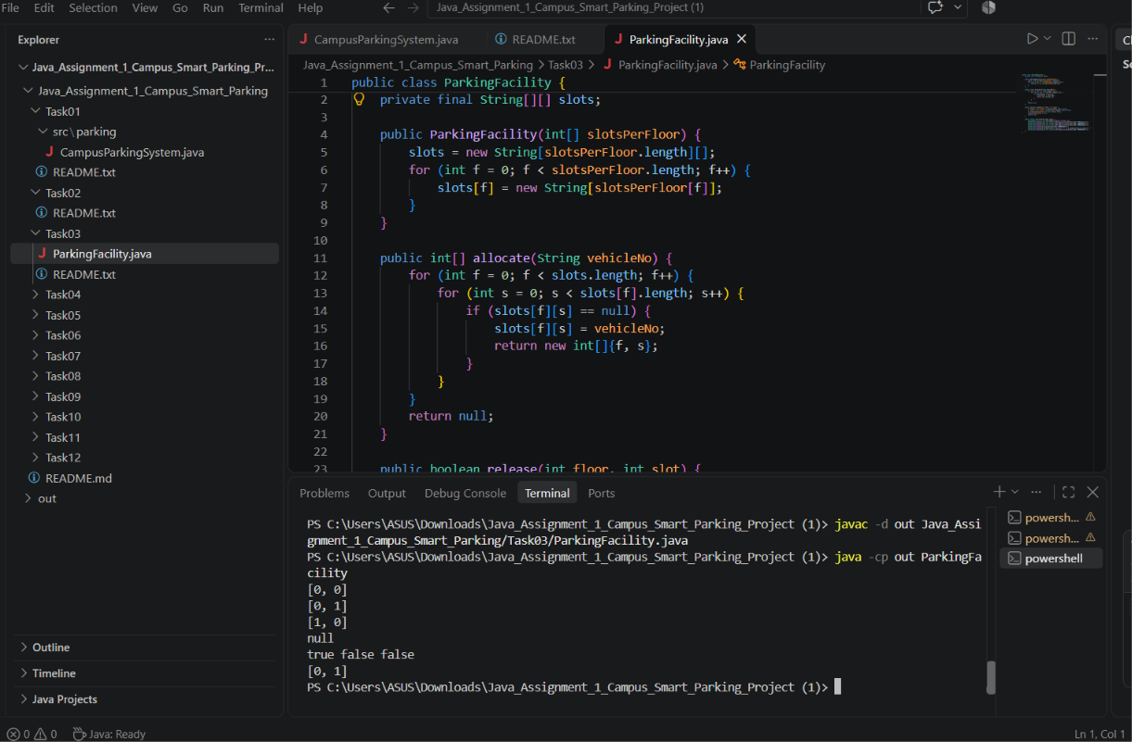
Task 3 – Parking Slot Allocation and Release (Execution Evidence)
VS Code output: slot allocation, full-capacity handling, release and re-allocation.

Slide 16
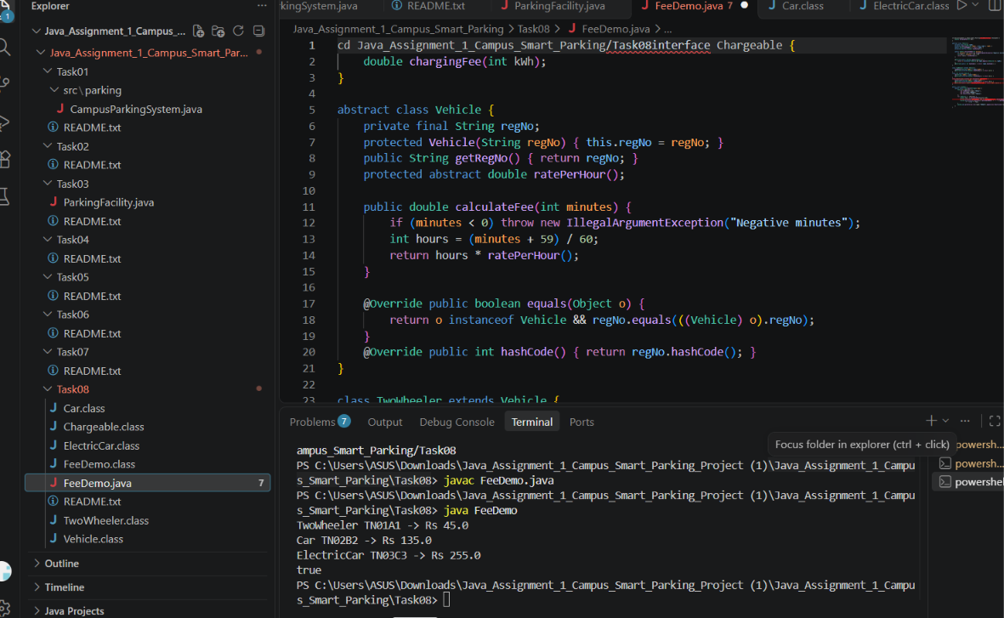
Task 8 – Polymorphism and Fee Calculation (Execution Evidence)
VS Code output: TwoWheeler, Car and ElectricCar fee calculations.

