Slide 1
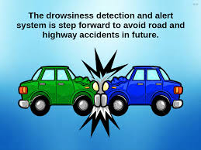
SOFTWARE TECH. LAB
-Antara karankar
-Bhavana komanduri
-Maithreyi Pagar
-Muskan Chourasia
-Nidhi Sharma

Slide 2
Introduction
• Vehicle accidents are most common if the driving is inadequate.
• These happen on most factors if the driver is drowsy or if he is alcoholic. Driver drowsiness is recognized as an important factor in the vehicle accidents.
• It was demonstrated that driving performance deteriorates with increased drowsiness with resulting crashes constituting more than 20% of all vehicle accidents. But the life lost once cannot be re-winded.
• Reasons leading to falling asleep behind the wheel as follows,
Fatigue.
Alcohol intoxication.
Monotonous road.
Riding at an inopportune time, at night.
Taking medication.

Slide 3
AIM AND OBJECTIVE
To develop a system that able to detect drowsiness of a driver based on eyelid detection in digital image.
To make analysis of the eyelid by using Euclidian distance between eyes.

Slide 4
Tools Used: 1. Python3 Interpreter. 2. OpenCV and Dlib libraries.
Application:
Using this we can detect symptoms of driver fatigue early to avoid accidents.
System can be developed at low cost.
Sensors are sensitive enough to detect minor movements.
Area required for installation is less, can be fitted to small places in car.
No manual attention is needed.
Automatically controlled and easy to use.

Slide 5
KNN Algorithm
K-nearest neighbors (KNN) algorithm is a type of supervised ML algorithm which can be used for both classification as well as regression predictive problems. However, it is mainly used for classification predictive problems in industry. The following two properties would define KNN well −
Lazy learning algorithm − KNN is a lazy learning algorithm because it does not have a specialized training phase and uses all the data for training while classification.
Non-parametric learning algorithm − KNN is also a non-parametric learning algorithm because it doesn’t assume anything about the underlying data.

Slide 6
Supervised Learning Algorithm
Supervised learning as the name indicates the presence of a supervisor as a teacher. Basically supervised learning is a learning in which we teach or train the machine using data which is well labeled that means some data is already tagged with the correct answer. After that, the machine is provided with a new set of examples(data) so that supervised learning algorithm analyses the training data(set of training examples) and produces a correct outcome from labeled data.

Slide 7
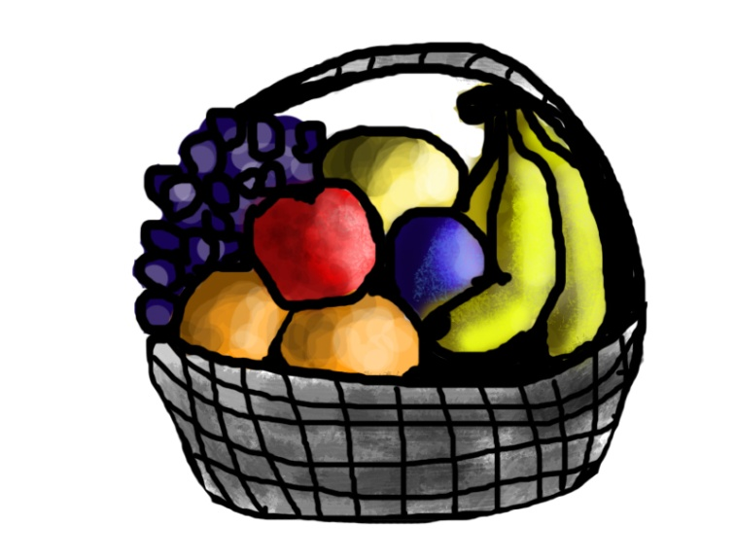
For instance, suppose you are given a basket filled with different kinds of fruits. Now the first step is to train the machine with all different fruits one by one like this:
If shape of object is rounded and depression at top having color Red then it will be labelled as –Apple.
If shape of object is long curving cylinder having color Green-Yellow then it will be labelled as –Banana.

Slide 8
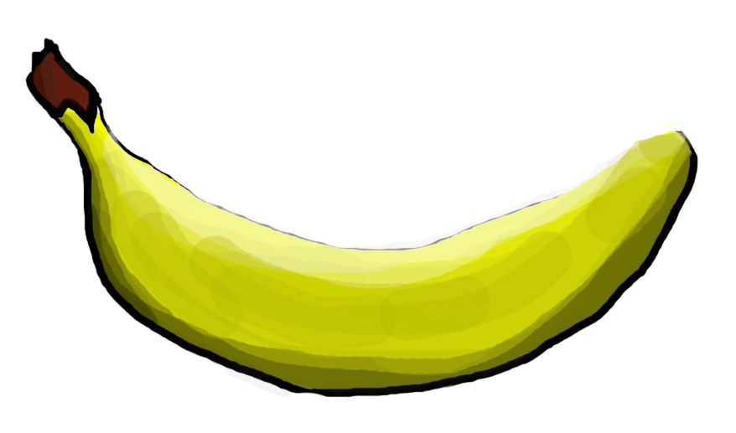
Now suppose after training the data, you have given a new separate fruit say Banana from basket and asked to identify it.
Since the machine has already learned the things from previous data and this time have to use it wisely. It will first classify the fruit with its shape and color and would confirm the fruit name as BANANA and put it in Banana category.
Thus the machine learns the things from training data(basket containing fruits) and then apply the knowledge to test data(new fruit).
Supervised learning classified into two categories of algorithms:
Classification: A classification problem is when the output variable is a category, such as “Red” or “blue” or “disease” and “no disease”.
Regression: A regression problem is when the output variable is a real value, such as “dollars” or “weight”.

Slide 9
A classification problem has a discrete value as its output. For example, “likes pineapple on pizza” and “does not like pineapple on pizza” are discrete. There is no middle ground. The analogy above of teaching a child to identify a pig is another example of a classification problem.
A regression problem has a real number (a number with a decimal point) as its output. For example, we could use the data in the table below to estimate someone’s weight given their height.

Slide 10
Working of KNN Algorithm
K-nearest neighbors (KNN) algorithm uses ‘feature similarity’ to predict the values of new datapoints which further means that the new data point will be assigned a value based on how closely it matches the points in the training set. We can understand its working with the help of following steps −
Step 1 − For implementing any algorithm, we need dataset. So during the first step of KNN, we must load the training as well as test data.
Step 2 − Next, we need to choose the value of K i.e. the nearest data points. K can be any integer.

Slide 11
Step 3 − For each point in the test data do the following −
3.1 − Calculate the distance between test data and each row of training data with the help of any of the method namely: Euclidean, Manhattan or Hamming distance. The most commonly used method to calculate distance is Euclidean.
3.2 − Now, based on the distance value, sort them in ascending order.
3.3 − Next, it will choose the top K rows from the sorted array.
3.4 − Now, it will assign a class to the test point based on most frequent class of these rows.
Step 4 − End

Slide 12
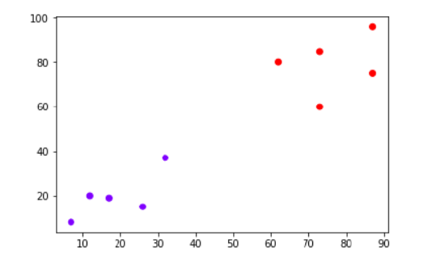
Example
The following is an example to understand the concept of K and working of KNN algorithm −
Suppose we have a dataset which can be plotted as follows −

Slide 13
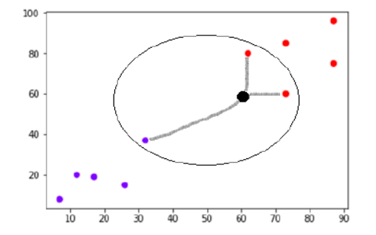
Now, we need to classify new data point with black dot (at point 60,60) into blue or red class. We are assuming K = 3 i.e. it would find three nearest data points. It is shown in the next diagram −
We can see in the above diagram the three nearest neighbors of the data point with black dot. Among those three, two of them lies in Red class hence the black dot will also be assigned in red class.

Slide 14
Pros and Cons of KNN
Pros
It is very simple algorithm to understand and interpret.
It is very useful for nonlinear data because there is no assumption about data in this algorithm.
It is a versatile algorithm as we can use it for classification as well as regression.
It has relatively high accuracy but there are much better supervised learning models than KNN.
Cons
It is computationally a bit expensive algorithm because it stores all the training data.
High memory storage required as compared to other supervised learning algorithms.
Prediction is slow in case of big N.
It is very sensitive to the scale of data as well as irrelevant features.

Slide 15
Methodology
The proposed method is built in four stages and it is applied to the coloured images with any background: -
1. Localization of Face
2. Localization of the Eyes
3. Tracking the eyes in the subsequent frames
4. Detection of Drowsiness

Slide 16
How to detect drowsiness?
A method using an infrared camera to monitor pupil of the eye is the most popular method. Other research uses EEG to monitor driver fatigue. It is expensive to be commercialized and needs complex noise processing.
Drowsiness in drivers can be generally divided into the following categories:-
1) sensing of physiological characteristics
2)sensing of driver operation.
3)sensing of vehicle response.
4)monitoring the response of driver.
The first one is accurate because is implemented in two ways: measuring changes in physiological signals, such as brain waves, heart rate, and eye blinking; and measuring physical changes such as sagging posture, leaning of the driver’s head and the open/closed states of the eyes.

Slide 17
As the driver becomes more fatigued, he/she is expected the eye-blinks to last longer.This lead to generation of consecutive frames which depict that the eyes are closed. ○ These frames are counted in order to decide the condition of the driver.

Slide 18
Advantages and limitations of various measures.
 | Measures | Parameters | Advantages | Limitations
 | Subjective measures | Questionnaire | Subjective | Not possible in real time
 | Vehicle based measures | Deviation from the lane position Loss of control over the steering wheel movements | Nonintrusive | Unreliable
 | Behavioural Measures | Yawning Eye closure Eye blink Head pose | Non-intrusive; Ease of use | Lighting condition Background
 | Physiological measures | Statistical & energy features derived from ECG EoG EEG | Reliable; Accurate | Intrusive

Slide 19
Future scope:
1. This project can be implemented in the form of mobile application to reduce the cost of hardware.
2. This project can be integrated with car, so that automatic speed control can be imparted if the driver is found sleeping.

Slide 20
Features Provided:-
• Detection of drowsiness • Detection of distraction • Audio feedback system • Different feedback based on type of distraction. • Works in low light conditions

Slide 21
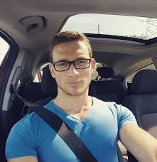
Limitations
Use of spectacles
In case the user uses spectacle then it is difficult to detect the state of the eye. As it hugely depends on light hence reflection of spectacles may give the output for a closed eye as opened eye. Hence for this purpose the closeness of eye to the camera is required to avoid light.

Slide 22
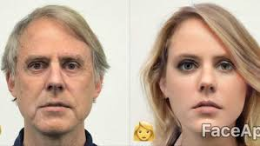
Multiple face problem
If multiple face arises in the window then the camera may detect more number of faces undesired output may appear. Because of different condition of different faces. So, we need to make sure that only the driver face come within the range of the camera. Also, the speed of detection reduces because of operation on multiple faces.

Slide 23
Libraries used:-
Scipy
Imutils
matplotlib
time
dlib
OpenCV

Slide 24
Scipy
SciPy is an Open Source Python-based library, which is used in mathematics, scientific computing, Engineering, and technical computing.
Sub-packages of Scipy-
File input/output - scipy.io
Special Function - scipy.special
Linear Algebra Operation - scipy.linalg
Interpolation - scipy.interpolate
Optimization and fit - scipy.optimize
Statistics and random numbers - scipy.stats
Numerical Integration - scipy.integrate
Fast Fourier transforms - scipy.fftpack
Signal Processing - scipy.signal
Image manipulation - scipy.ndimage

Slide 25
SciPy contains varieties of sub packages which help to solve the most common issue related to Scientific Computation.
SciPy is the most used Scientific library only second to GNU Scientific Library for C/C++ or Matlab's.
Easy to use and understand as well as fast computational power.
It can operate on an array of NumPy library.

Slide 26
Scipy vs Numpy
Numpy:
Numpy is written in C and use for mathematical or numeric calculation.
It is faster than other Python Libraries
Numpy is the most useful library for Data Science to perform basic calculations.
Numpy contains nothing but array data type which performs the most basic operation like sorting, shaping, indexing, etc.
SciPy:
SciPy is built in top of the NumPy
SciPy is a fully-featured version of Linear Algebra while Numpy contains only a few features.
Most new Data Science features are available in Scipy rather than Numpy.

Slide 27
Imutils
A series of convenience functions to make basic image processing functions such as translation, rotation, resizing, skeletonization, displaying Matplotlib images, sorting contours, detecting edges, and much more easier with OpenCV and both Python 2.7 and Python 3.

Slide 28
Matplotlib
Matplotlib is an amazing visualization library in Python for 2D plots of arrays. Matplotlib is a multi-platform data visualization library built on NumPy arrays and designed to work with the broader SciPy stack. It was introduced by John Hunter in the year 2002.
One of the greatest benefits of visualization is that it allows us visual access to huge amounts of data in easily digestible visuals. Matplotlib consists of several plots like line, bar, scatter, histogram etc.

Slide 29
Time
Python has defined a module, “time” which allows us to handle various operations regarding time, its conversions and representations, which find its use in various applications in life. The beginning of time is started measuring from 1 January, 12:00 am, 1970 and this very time is termed as “epoch” in Python.

Slide 30
Dlib
It‘s a landmark’s facial detector with pre-trained models, the dlib is used to estimate the location of 68 coordinates (x, y) that map the facial points on a person’s face.
These points are identified from the pre-trained model where the iBUG300-W dataset was used.

Slide 31
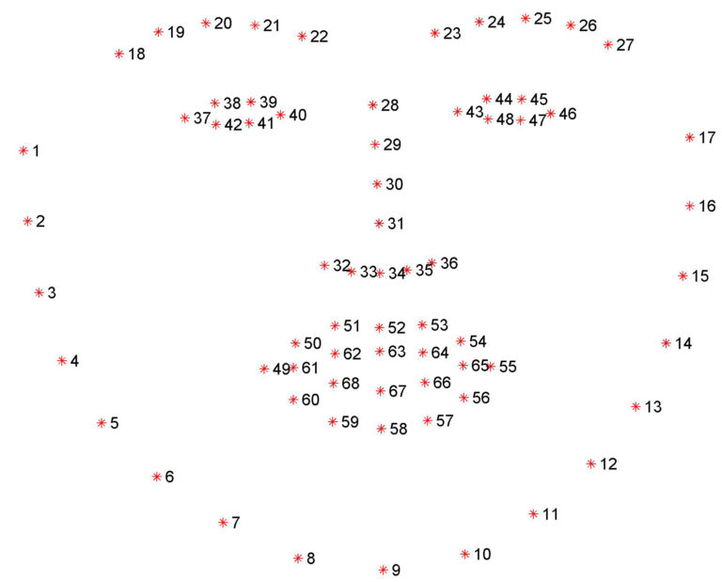
Dlib facial detection plot

Slide 32
OpenCV
OpenCV (Open source computer vision) is a library of programming functions mainly aimed at real-time computer vision. Originally developed by Intel, it was later supported by Willow Garage then Itseez (which was later acquired by Intel). The library is cross-platform and free for use under the open-source BSD license.
OpenCV supports the deep learning frameworks TensorFlow, Torch/PyTorch and Caffe.

Slide 33
Working
A program was developed to identify the driver's drowsiness based on real-time camera image and image processing techniques, and this program makes warning alarms go off when it detects drowsiness driving.
Based on real-time video and image processing technology, we have created a program that determines the driver's drowsiness status and alerts the user according to a certain level if they are drowsy driving. The driver's face and eye detection method and the drowsiness step determination method using the supervised learning algorithm are implemented in the real-time vision system.
The Histogram of Oriented Gradients technology and the learned Face Landmark estimation techniques were used to detect faces and eyes. Furthermore the concept of Eye Aspect Ratio was used to detect drivers' drowsiness. Finally, the KNN algorithm was used to divide the drivers' level of drowsiness into three stages, and differential alarms go off for each stages.

Slide 34
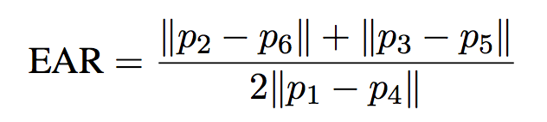
Eye aspect ratio
Each eye is represented by 6 (x, y)-coordinatesThe EAR is calculated using six (x, y) coordinates for the detected eye.The EAR equation

Slide 35
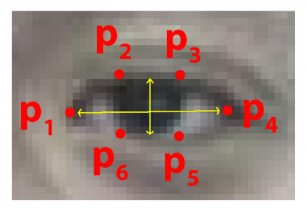
Eye facial landmarks

Slide 36
Calculate the EAR using the equation. The calculated EAR will have a value more than zero when the eyes are open, and a value close to zero when the eyes are closed. This program has set a 50% value from the average EAR value to the threshold value. 1) measures the average EAR value when the eyes are open. 2) measures the average EAR value when the driver is closing his eyes 3) sets the threshold using the above two results.

Slide 37
The computed EAR has a nonzero value when you open your eyes and a value close to zero when you close your eyes. If you set a certain threshold to the threshold (the threshold used to determine drowsy operation), you can detect that the driver is drowsy by checking whether the EAR value is smaller than that value.

Slide 38
In addition, since it is not necessary to examine both eyes separately to determine drowsy driving, the average of EAR values ​​of each eye was used.
Threshold value is set to 50% of EAR value when eyes are opened. If it's smaller (when the eye size is smaller), the driver thinks you're sleepy and cares about whether you're sleepy, so the alarm sounds even if you're not in full sleep.
To apply this algorithm, we applied three steps:
1) Determine average EAR value when driver opens eyes
2) Determine average EAR value when driver closes eyes
3) EAR value that is 50% of eyes open using the above two values.
if EAR < threshold for 20 framethen going alarm off.

Slide 39
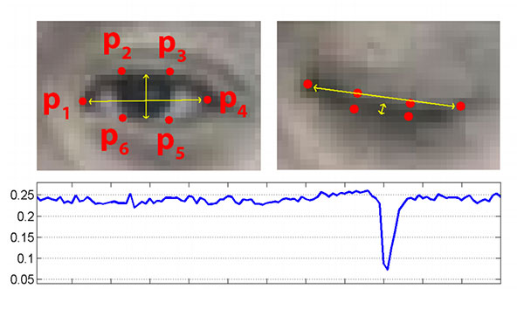
Eye aspect ration Vs time

Slide 40
The drowsiness phase is divided according to the time when the eyes are closed and the time the eyes were opened before the drowsiness operation.To distinguish drowsiness level, we used K-Nearest Neighbor(KNN) supervised learning algorithm.

Slide 41
Face and Eye Detection:

Slide 42
https://github.com/opencv/opencv/tree/master/data/haarcascades

Slide 43
import numpy as np
import cv2
# https://github.com/Itseez/opencv/blob/master/data/haarcascades/haarcascade_frontalface_default.xml
face_cascade = cv2.CascadeClassifier('haarcascade_frontalface_default.xml')
# https://github.com/Itseez/opencv/blob/master/data/haarcascades/haarcascade_eye.xml
eye_cascade = cv2.CascadeClassifier('haarcascade_eye.xml')
cap = cv2.VideoCapture(0)
while 1:
ret, img = cap.read()
gray = cv2.cvtColor(img, cv2.COLOR_BGR2GRAY)
faces = face_cascade.detectMultiScale(gray, 1.3, 1)
for (x, y, w, h) in faces:
cv2.rectangle(img, (x, y), (x + w, y + h), (255, 0, 0), 2)
roi_gray = gray[y:y + h, x:x + w]

Slide 44
roi_color = img[y:y + h, x:x + w]
eyes = eye_cascade.detectMultiScale(roi_gray)
for (ex, ey, ew, eh) in eyes:
cv2.rectangle(roi_color, (ex, ey), (ex + ew, ey + eh), (0, 255, 0), 2)
cv2.imshow('img', img)
k = cv2.waitKey(30) & 0xff
if k == 27:
break
cap.release()
cv2.destroyAllWindows()

Slide 45
Closed And Open Eye Detection:

Slide 46
import cv2 import signal import numpy as np faceCascade = cv2.CascadeClassifier('haarcascade_frontalface_alt.xml') eyeCascade = cv2.CascadeClassifier('haarcascade_eye_tree_eyeglasses.xml') cap = cv2.VideoCapture(0) while 1: ret, img = cap.read() if ret: frame = cv2.cvtColor(img, cv2.COLOR_BGR2GRAY) # Detect faces in the image faces = faceCascade.detectMultiScale( frame, scaleFactor=1.1, minNeighbors=2 # flags = cv2.CV_HAAR_SCALE_IMAGE ) # print("Found {0} faces!".format(len(faces))) if len(faces) > 0: # Draw a rectangle around the faces for (x, y, w, h) in faces: cv2.rectangle(img, (x, y), (x + w, y + h), (0, 255, 0), 2) frame_tmp = img[faces[0][1]:faces[0][1] + faces[0][3], faces[0][0]:faces[0][0] + faces[0][2]:1, :] frame = frame[faces[0][1]:faces[0][1] + faces[0][3], faces[0][0]:faces[0][0] + faces[0][2]:1] eyes = eyeCascade.detectMultiScale( frame, scaleFactor=1.1, minNeighbors=5 # flags = cv2.CV_HAAR_SCALE_IMAGE ) if len(eyes) == 0: print('Closed Eyes') else: print('Open eye') frame_tmp = cv2.resize(frame_tmp, (400, 400), interpolation=cv2.INTER_LINEAR) cv2.imshow('Face Recognition', frame_tmp) waitkey = cv2.waitKey(1) if waitkey == ord('q') or waitkey == ord('Q'): cv2.destroyAllWindows() break

Slide 47
THANK YOU

