Slide 1


Diabetes Analysis
GuideS: Dinkar S
Nirupama M P
EDITORS: Bhavana NS Malepaty
Bindu R
Sponsor: UCI

Slide 2
OBJECTIVE of the project
To develop a prediction system model for diabetic patient for their glucose levels

Slide 3
Current Status
Using UCI diabetes dataset
Missing values: imputed using MICE
Developed model for one patient which seems a good fit
Next steps
Obtain non-intrusive glucose monitor
Develop multi-patient model
Introduce a new factor insulin_sensitivity which will account for difference in response between different patients

Slide 4
INITIAL data available
UCI Diabetes Repository
A dataset specific to the probabilistic model was obtained for 70 patients
Each patient was continuously monitored for around 7 to 14 days
The dataset gives patient glucose details at 20 different circumstances
The attributes include different insulin doses given at each meal, BG measured before and after a meal, Hypoglycemic symptoms, meal ingestion, exercise activity, unspecified special events

Slide 5
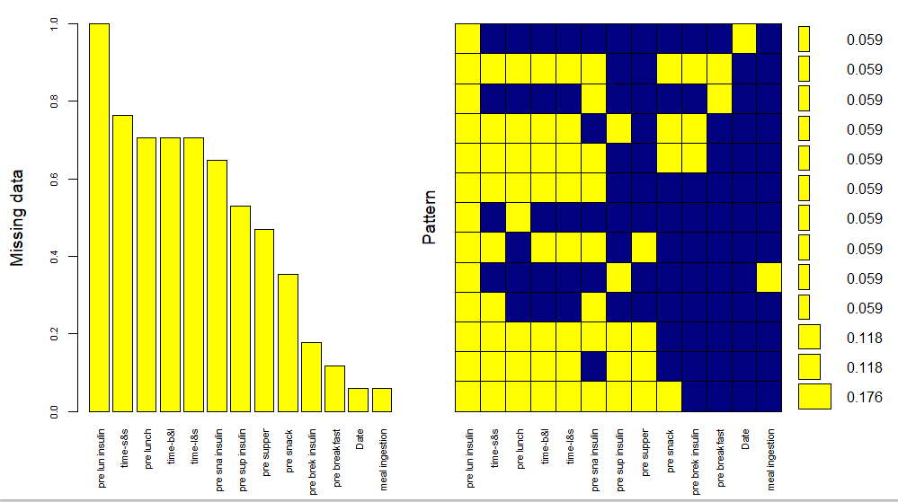
Plot of the missing data

Slide 6
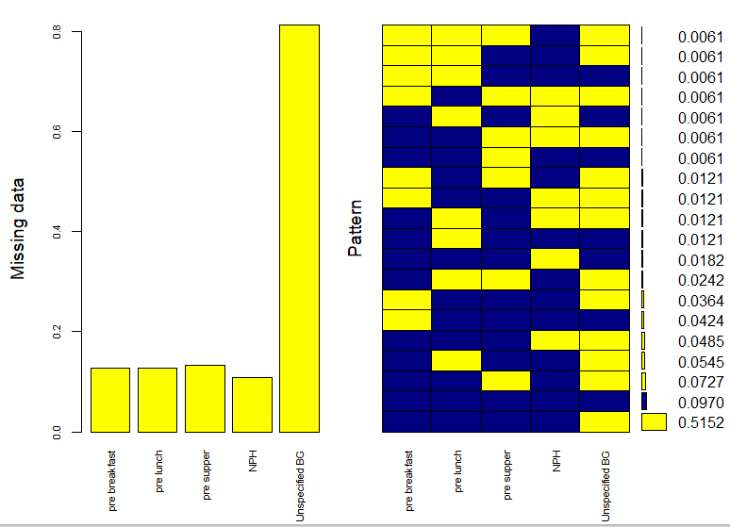
PROGRESS DONE
On performing a detailed study of the UCI Data, it was known that there exists several missing values of the blood glucose measurement before and after the different meals of the day
Hence, on analyzing the data of all 70 patients, the data for the patient containing the most entries for pre-breakfast blood glucose was chosen

Slide 7
MISSING VALUE IMPUTATION
An attempt to impute the missing values using different R libraries(MICE, Amelia, HMISC,MI, MissForest) was made
The MICE library gave the best imputation for the missing values
MICE (Multivariate Imputation via Chained Equations)
Creating multiple imputations as compared to a single imputation (such as mean) takes care of uncertainty in missing values.
MICE assumes that the missing data are Missing at Random (MAR), which means that the probability that a value is missing depends only on observed value and can be predicted using them. It imputes data on a variable by variable basis by specifying an imputation model per variable
Linear regression is used to predict continuous missing values

Slide 8
PREDICTED MODEL
All missing values for the chosen patient dataset were imputed
The data was normalized (mean = 0 and variance = 1) and trained on the model designed using Machine Learning Techniques
A linear regression model with SGD(Stochastic Gradient Descent with Step size =0.000001) was used to train the data and test it on the entire dataset. A mean error > 180 and mean squared error > 40,000

Slide 9
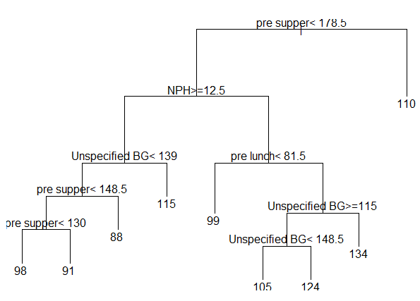
DECISION TREE MODEL
Misclassification Error = 0.84

Slide 10
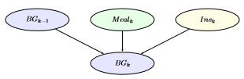
LITERATURE SURVEY
Paper | Summary | How does this impact my project?
A Probabilistic Framework for Blood Glucose Control in Diabetes | BG evolution should be described rather in terms of probabilistic models than in terms of deterministic ones. The paper explains a probabilistic model to ﬁnd an insulin dosing which offers the same quality of treatment than that of standard control strategies, but with less insulin used | Predicting the blood glucose through a probabilistic approach, using conditional probability, Bayesian Network, and Markov’s chain model

