Slide 1

Title: Digital Smart Savings Calculator Tool
Student Name: A. Bhavana Sri
Student ID: 2520030232
Cluster:3
Section: 11
Under the Guidance
of
Supervisor Name: TSP Madhuri
Assistant Professor
Department of CSE

Slide 2
OUTLINE
Abstract
Existing System
Proposed System
System Architecture
Project Modules
Objectives
Co’s Attainments - FWD
Co1
Co2 …….. 5. Co5
Co’s Attainments - DSA
Co1
Co2 …….. 5. Co5
ScreenShots for FWD & DSA
Conclusion
Geo-Tagged Photos

Slide 3
Abstract
The system analyzes user financial inputs using basic calculation logic to generate results like monthly savings and total savings.
It provides a simple and user-friendly interface that helps users understand their spending habits and financial planning.
The main objective is to promote smart financial management and budgeting through an easy-to-use digital calculator.
Developed using HTML, CSS, JavaScript, and Java, the tool helps users improve saving habits and achieve their financial goals.

Slide 4
Existing System
People usually calculate their savings manually using pen and paper.
Some users use basic calculators or simple spreadsheet tools like Excel to calculate income and expenses.
These methods do not automatically track spending or provide clear financial analysis.
Manual calculations can be time-consuming and may lead to errors.
There is no smart system to guide users in planning their savings efficiently.

Slide 5
Proposed System
The proposed system provides a digital platform to calculate savings automatically based on the user’s income and expenses.
Users can enter their financial details, and the system will quickly calculate monthly and total savings.
The tool offers a simple and user-friendly interface so that anyone can easily use it without difficulty.
It helps users plan their budget and manage their finances more effectively.
The system reduces manual calculation errors and saves time by giving accurate results instantly.

Slide 6
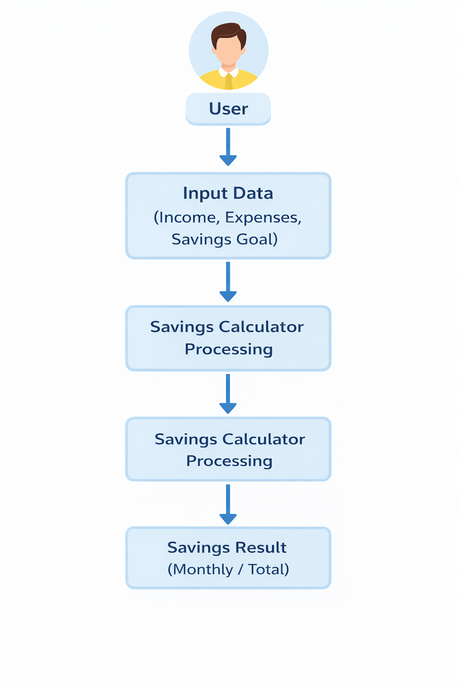
System Architecture
enters financial details such as income, expenses, and savings goals.
The system collects and processes the input data.
The savings calculator performs calculations based on the provided information.
Finally, the system displays the savings results such as The user monthly or total savings to the user.

Slide 7
Project Modules
User Input Module:
Allows the user to enter financial details such as income, expenses, savings goal, and time period.
2. Data Processing Module:
Processes the input data and performs savings calculations based on the given values.
3. Savings Calculation Module:
Calculates the monthly savings and total savings using basic formulas.
4. Result Display Module:
Displays the calculated savings results clearly to the user.
5. User Interface Module:
Provides a simple and user-friendly interface for easy interaction with the system.

Slide 8
Objectives
To develop a digital tool that helps users calculate their savings easily.
To help users manage their income and expenses effectively.
To provide accurate monthly and total savings calculations.
To promote smart financial planning and budgeting.
To design a simple and user-friendly system that anyone can use easily.
.

Slide 9
Co’s Attainments - FWD
CO | Syllabus Topic | How Digital Smart Savings Calculator Achieves It
CO1 | Internet Fundamentals, HTML & CSS | Created a complete HTML page structure with headings, input fields, tables, and buttons. CSS styling is used for layout, colors, spacing, gradients, and responsive UI design.
CO2 | Forms, Semantic Tags & CSS Layouts | Implemented login form and calculator form with input types like text, email, and number. Used CSS styling for form layout, containers, and table display.
CO3 | JavaScript Fundamentals | Used JavaScript functions, variables, and operators to calculate savings. Implemented logic like income − expenses calculation and used arrays to store savings records.
CO4 | DOM & Event Handling | Used DOM manipulation such as getElementById() and innerHTML. Implemented event handling with button clicks for login, calculate savings, and clear data.
CO5 | Advanced Web Development & Deployment | Built an interactive web application with dynamic updates like savings results and record tables. The project can be deployed as a simple browser‑based financial tool.

Slide 10
Co’s Attainments - DSA
CO No | Focus Area | Project Implementation
CO1 | Efficiency | Calculations like income - expenses run in $O(1)$ time. Table updates are linear $O(n)$ relative to entries.
CO2 | ADTs & Arrays | Uses savingsArray as a dynamic array to store history, demonstrating basic ADT operations (Insert/Traverse).
CO3 | Linear Logic | The "Savings Records" table acts as a linear data structure, storing elements in the order they are created.

Slide 11
Co’s Attainments - DSA
CO No | Requirement | Evidence in Project
CO4 | Collections/Lists | Simulated Java-style List behavior by managing a collection of user financial records.
CO5 | Practical Apps | Developed a "Digital Smart Savings Tool" as a real-world application of linear data management.
CO6 | Skill Development | Successfully integrated logic, UI, and data handling into a single functional application.

Slide 12
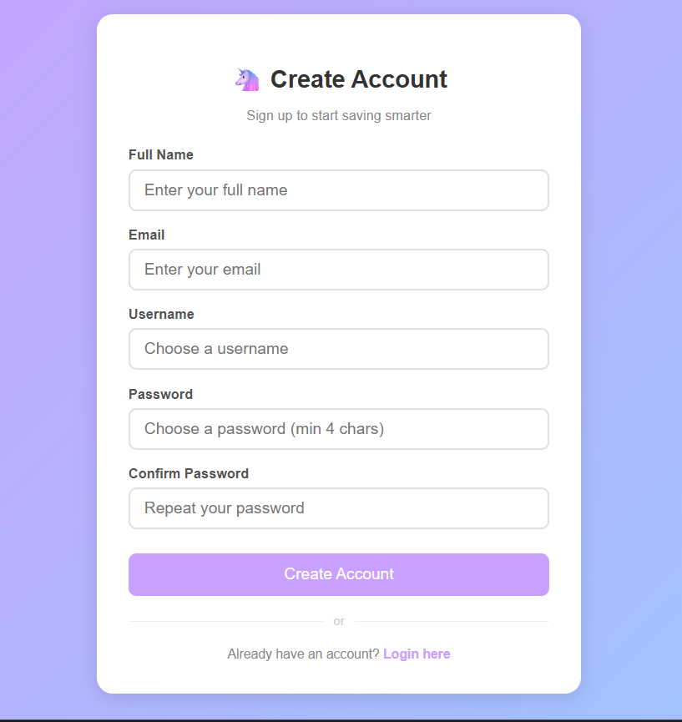
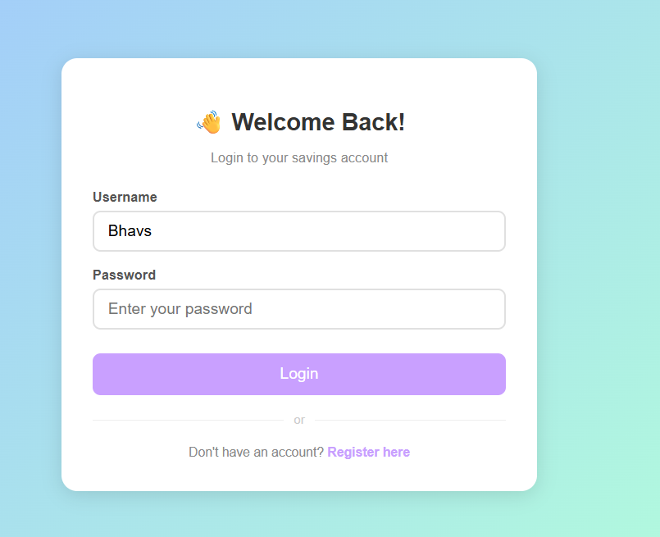
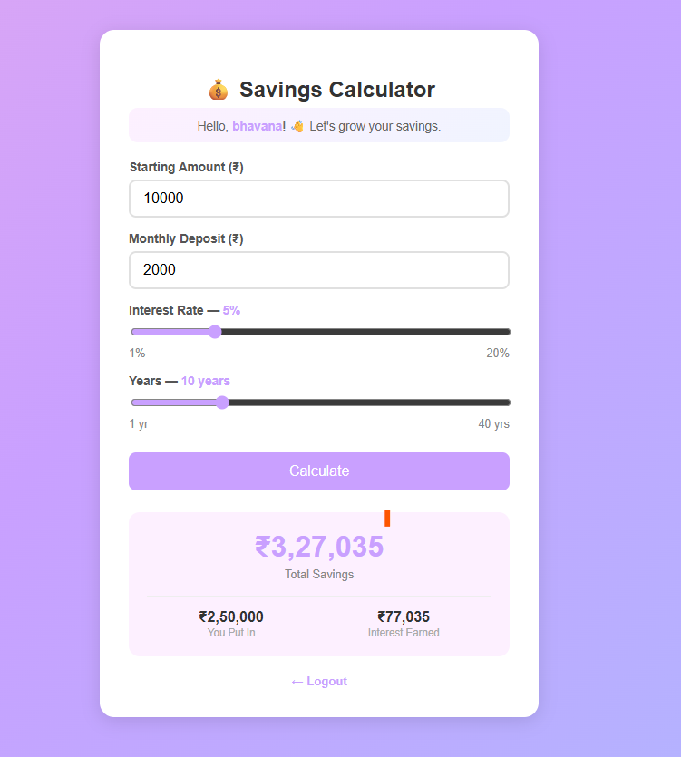
Screenshots for FWD

Slide 13
Conclusion
.
Implemented a basic register/login system with form validation for secure access.
Accurately calculates compound interest using principal, monthly deposits, rate, and duration.
Displays a clear breakdown of Total Savings, Amount Contributed, and Interest Earned.
Uses ₹ (Indian Rupee) formatting with en-IN locale for Indian users.
Fully client-side with no backend — lightweight and fast.
Clean, responsive UI with animated gradient design and interactive sliders.
Serves as a practical tool to promote savings awareness and financial planning

Slide 14
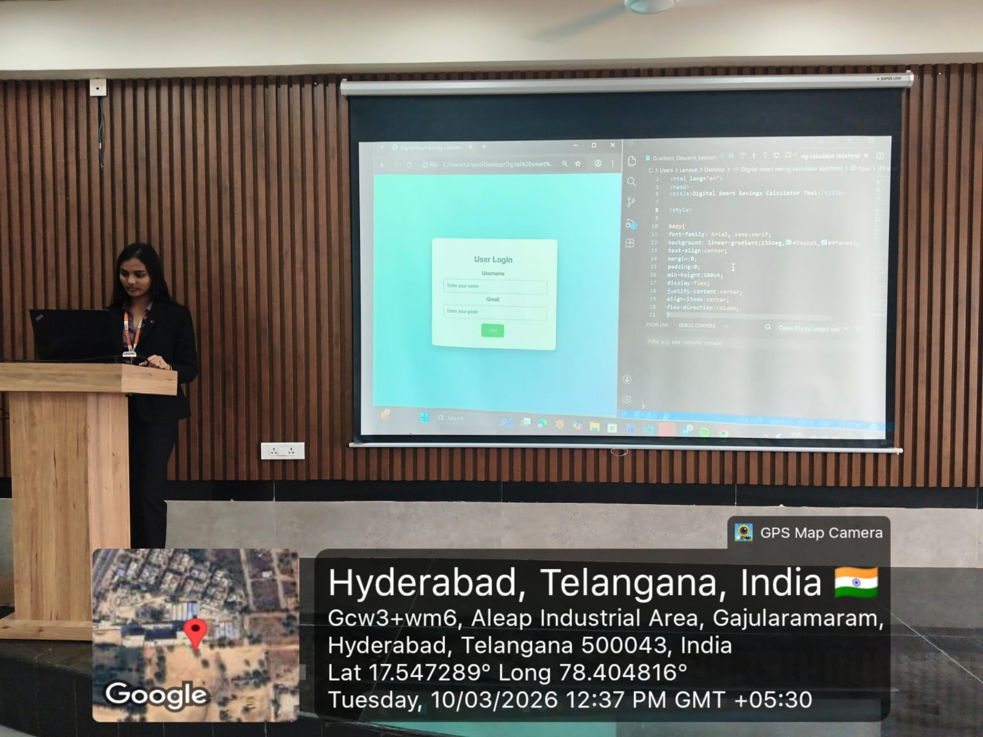
Geo- Tag Photo

Slide 15
THANK YOU

