Slide 1
Disease-Prediction-Toolkit ML project to predict diseases using Logistic Regression & Random Forest
Presented By:
Bhavana C T

Slide 2

Diseases often go undetected until late stages Need for early detection & prediction using patient health data. Manual diagnosis can be time-consuming & error-prone
PROBLEM STATEMENT:

Slide 3
oBJECTIVES
Build an ML-based toolkit for predicting diseases
Use health parameters & symptoms as input
Compare performance of Logistic Regression vs Random Forest
Provide insights for early detection

Slide 4
DATASET
Source: https://www.kaggle.com/datasets/redwankarimsony/heart-disease-data
Sample features:
Age, Blood Pressure, Cholesterol, ECG, Heart Rate, Exercise-induced angina
Format: CSV (structured dataset)

Slide 5
mETHODOLOGY
Step 1: Data Preprocessing (Cleaning, Encoding, Normalization)
Step 2: Train ML Models
Logistic Regression
Random Forest
Step 3: Evaluation (Confusion Matrix, Accuracy, Precision, Recall, F1-score)
Step 4: Visualization & Insights

Slide 6
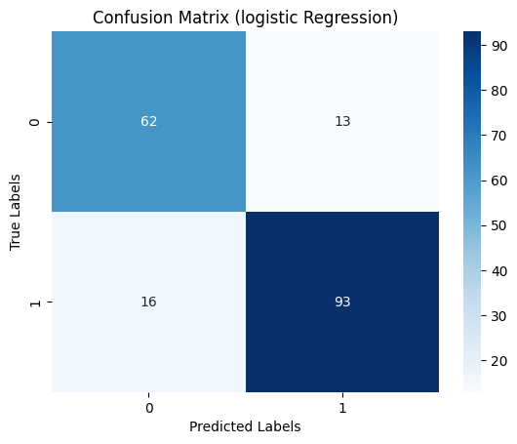
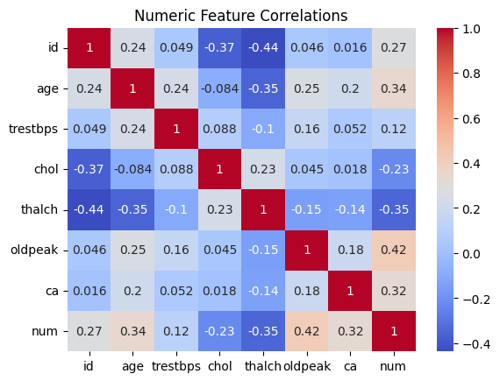
Results & Analysis

Slide 7

Results & Analysis
Accuracy: ~89%
Logistic Regression → interpretable model
Random Forest → better generalization
Metrics:
Precision, Recall, F1-score
Confusion Matrix visualization (insert image/graph)

Slide 8
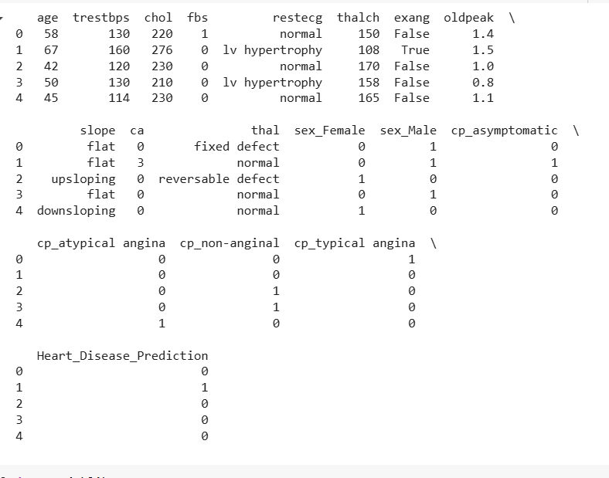
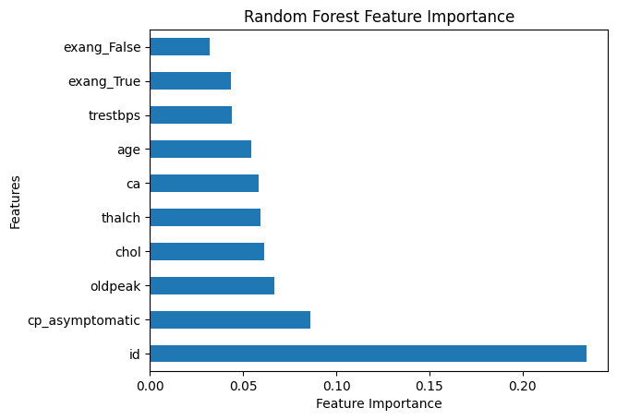
Results & Analysis

Slide 9
Features & Applications
🚀 Features
Runs on Jupyter/Colab
Confusion Matrix visualization
Easy dataset integration
🏥 Applications
Early disease detection
Healthcare decision support
Patient risk monitoring

