Slide 1
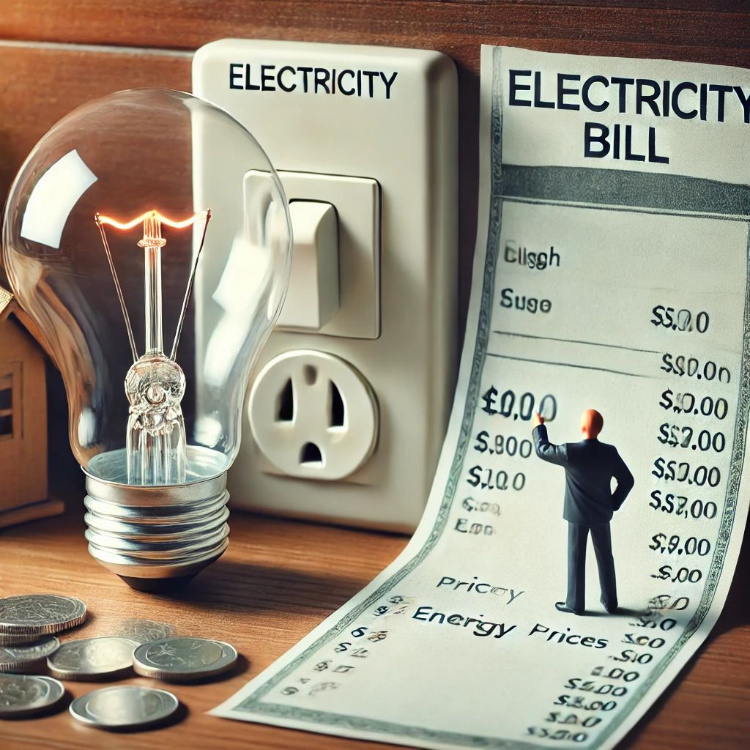

Utility Billing System
CAPSTONE PROJECT
A SECURE FULL-STACK MICROSERVICES APPLICATION FOR UTILITY MANAGEMENT
BUILT WITH SPRING BOOT, ANGULAR, AND MONGODB

Slide 2
Project Overview
This system is a digital platform that helps manage household services like electricity and gas by tracking usage through meter readings, automatically calculating monthly bills, and providing an easy way for people to pay their dues online or at a counter.
Key Features:
Centralized Control: Unified management of Electricity, Gas, and Water utilities.
Billing Accuracy: Automated calculation using dynamic Multi-Slab Tariff logic.
Role-Based Access: Secure dashboards for Admin, Billing, Accounts, and Consumers.
Seamless Payments: Integrated OTP-verified online payments and offline recording.

Slide 3
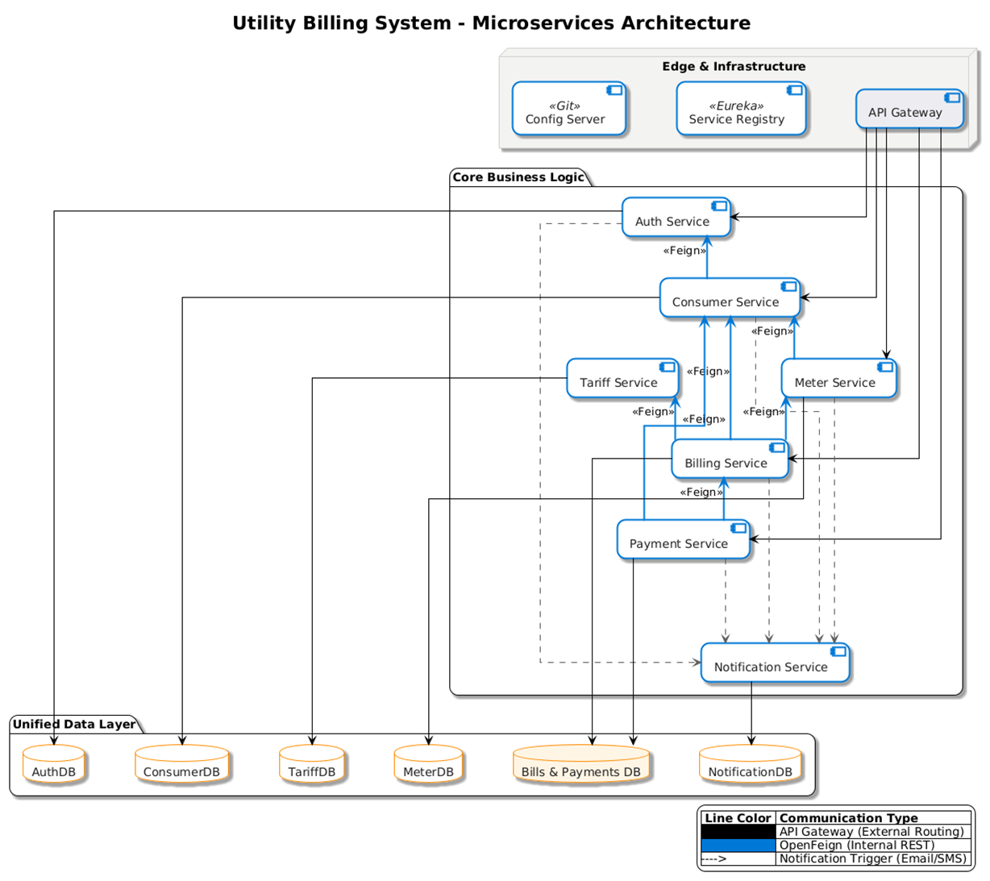
System Architecture

Slide 4
System Architecture
Infrastructure Components:
API Gateway: Single entry point for routing, JWT validation.
Service Registry (Eureka): Dynamically tracks all active microservice instances.
Config Server: Centralized, Git-backed management for service properties.
Microservices Breakdown
Auth Service: Manages user identities and security tokens.
Consumer Service: Handles the lifecycle of ConsumerRequest and consumer profiles.
Meter Service: Manages ConnectionRequests, physical meter mapping, and MeterReadings.
Tariff Service: CRUD operations for utility plans and multi-slab rate logic.
Billing Service: The engine that calculates charges based on consumption and tariff slabs.
Payment Service: Manages OTP-based online payments and offline receipts.
Notification Service: Asynchronous engine for Email/SMS alerts.

Slide 5
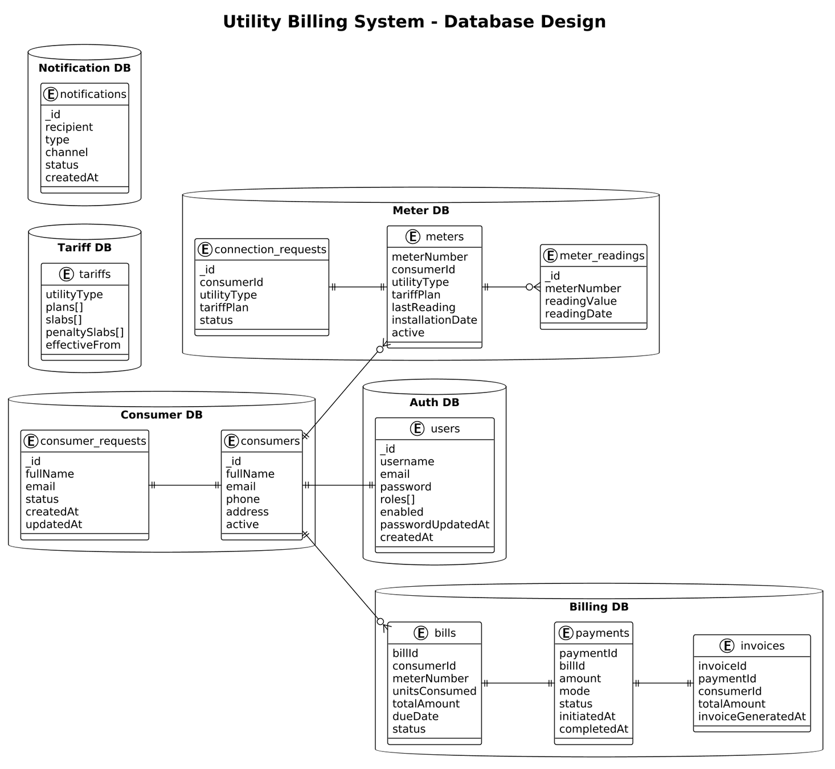
Database
Design

Slide 6
Database Design
Each microservice owns its own database
Prevents tight coupling between services
Allows each service to scale independently
Relationships are managed at the service layer, not database joins
Financial data is immutable once finalized
Updates are handled via status changes, not data modification
Why MongoDB?
Data structures like tariffs, bills, and payments change over time
MongoDB allows flexible schemas without frequent migrations
Works naturally with microservices and document-based data

Slide 7
Functional Roles (Actors)
Admin: Manages tariff plans, approves consumer/connection requests, and monitors system health.
Billing Officer: Records periodic meter readings and triggers bill generation.
Accounts Officer: Tracks outstanding balances and processes offline (walk-in) payments.
Consumer: Views consumption history, pays bills online, and manages connection requests.

Slide 8
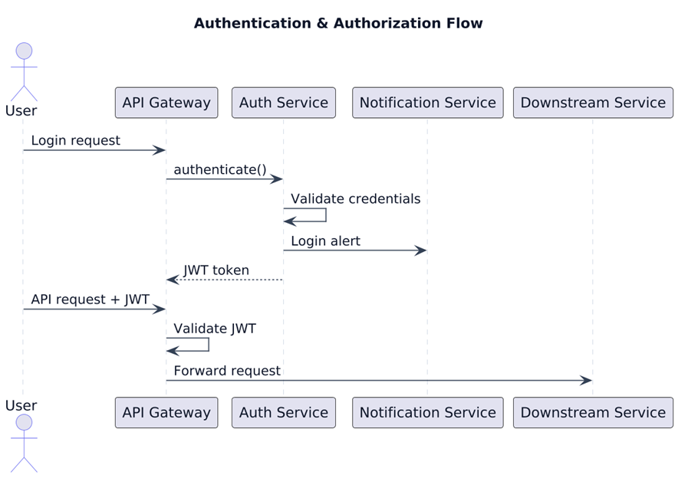
Security - Authentication & Authorization
A user authenticates using valid credentials, receives a JWT token, and accesses secured backend services through the API Gateway.
1. The user submits login credentials to the API Gateway.
2. The API Gateway forwards the authentication request to the Auth Service.
3. The Auth Service validates the user credentials against stored user data.
4. Upon successful authentication, the Auth Service generates a JWT token.
5. The JWT token is returned to the user through the API Gateway.
6. For subsequent requests, the user sends the JWT token along with the API request.
7. The API Gateway validates the JWT token and extracts user role information.
8. If valid, the request is forwarded to the appropriate downstream service.

Slide 9
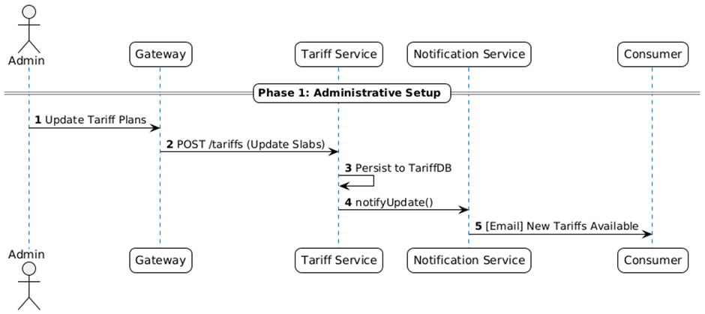
Application Life Cycle
Phase 1: Administrative Setup
The administrator configures or updates tariff plans, which are stored centrally.
1.Admin updates tariff plans through the Gateway.
2.Gateway forwards the request to the Tariff Service.
3.Tariff Service saves the updated tariff configuration.

Slide 10
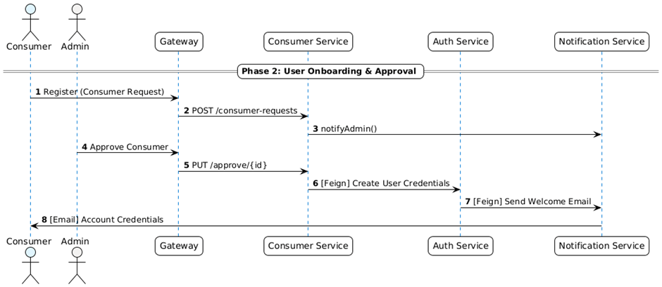
Application Life Cycle
Phase 2: User Onboarding & Approval
A consumer registers in the system and gets approved by the administrator to gain portal access.
1. Consumer submits a registration request through the Gateway.
2. Consumer Service creates a consumer request.
3. Admin approves the consumer request.
4. Auth Service creates login credentials.
5. Credentials are sent to the consumer via email.

Slide 11
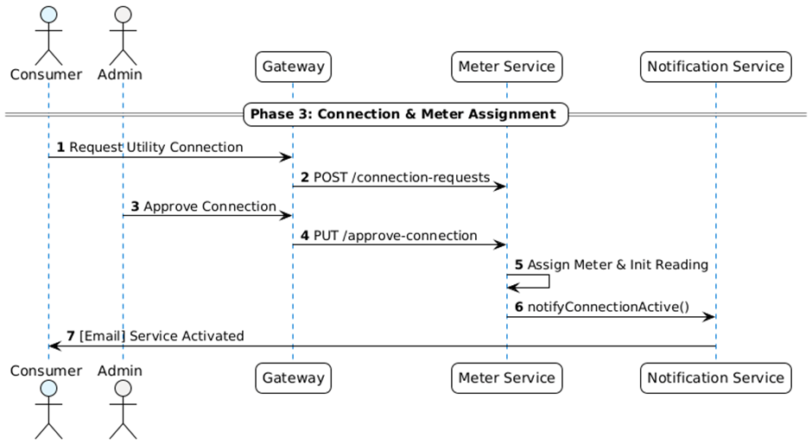
Application Life Cycle
Phase 3: Connection & Meter Assignment
An approved consumer requests a utility connection, which is validated by the administrator and a meter is assigned.
1. Consumer requests a utility connection.
2. Meter Service records the connection request.
3. Admin approves the connection request.
4. A meter is initialized.
5. Consumer is notified about service activation.

Slide 12
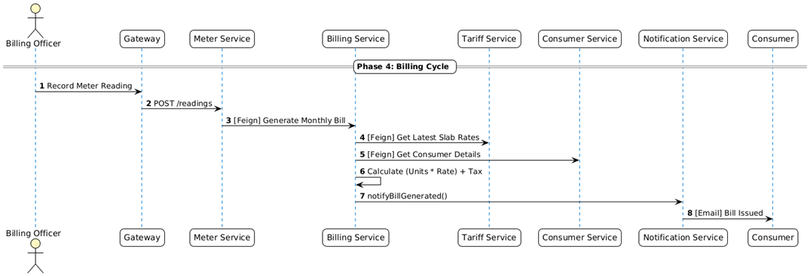
Application Life Cycle
Phase 4: Billing Cycle
Periodic meter readings are recorded by the billing officer and used to generate utility bills for consumers.
1. Billing Officer records meter readings.
2. Meter Service validates and forwards data for billing.
3. Billing Service retrieves tariff and consumer details.
4. Bill amount is calculated based on consumption and slabs.
5. Bill is generated and notified to the consumer.

Slide 13
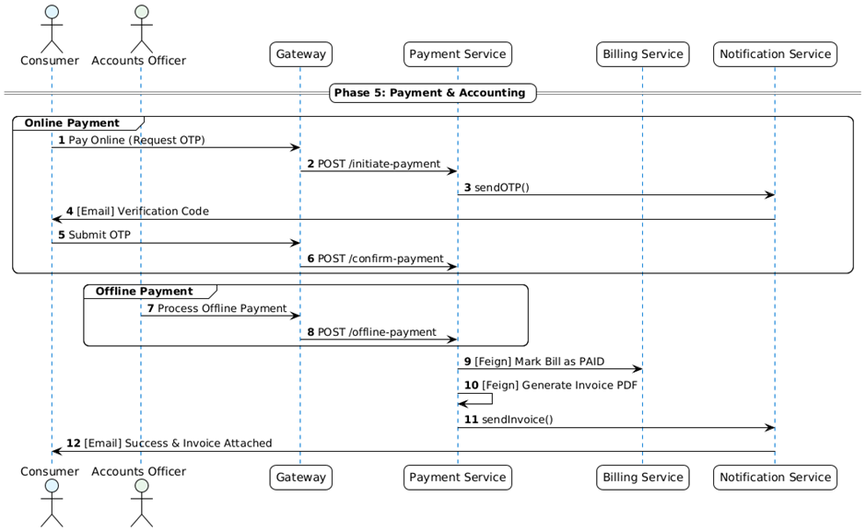
Application Life Cycle
Phase 5: Payments & Accounting
Consumers settle bills through online or offline payment methods, and invoices are generated.
1. Consumer initiates online payment and requests OTP.
2. OTP is sent and verified before confirmation.
3. Accounts Officer can record offline payments.
4. Payment Service marks the bill as paid.
5. Invoice is generated and emailed to the consumer.

Slide 14
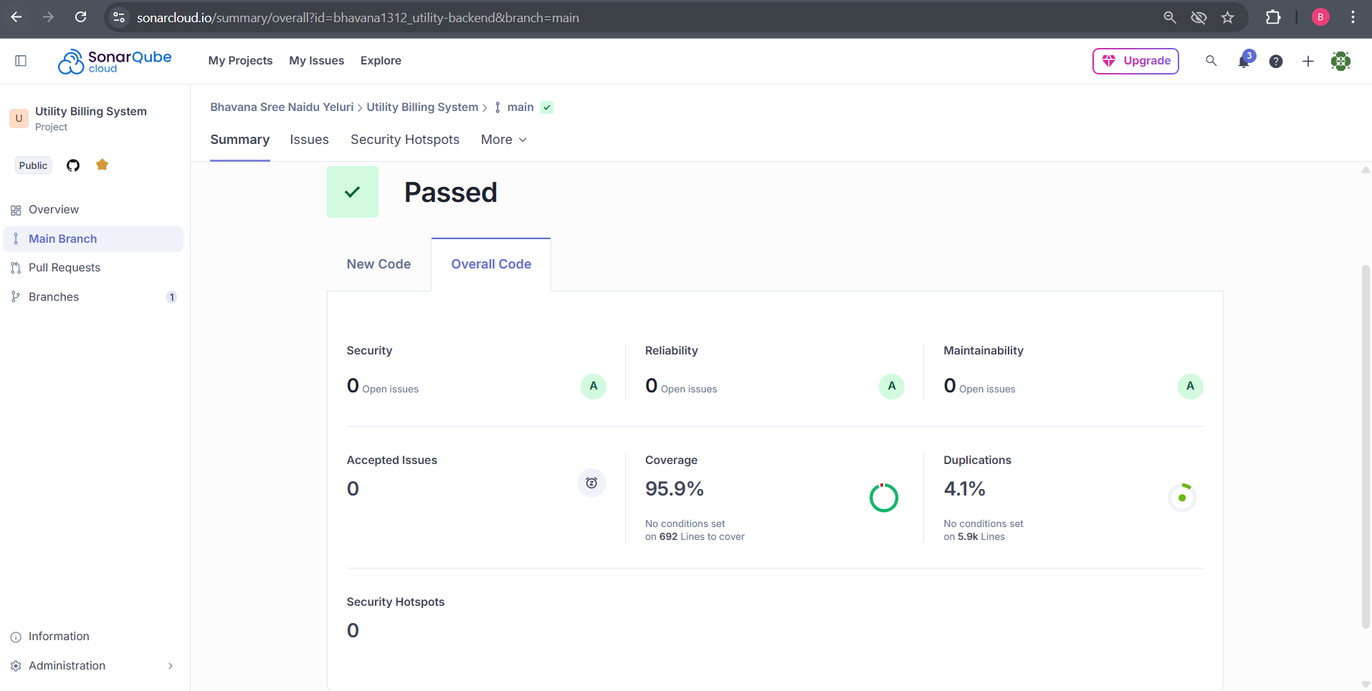
Sonarqube Report

Slide 15
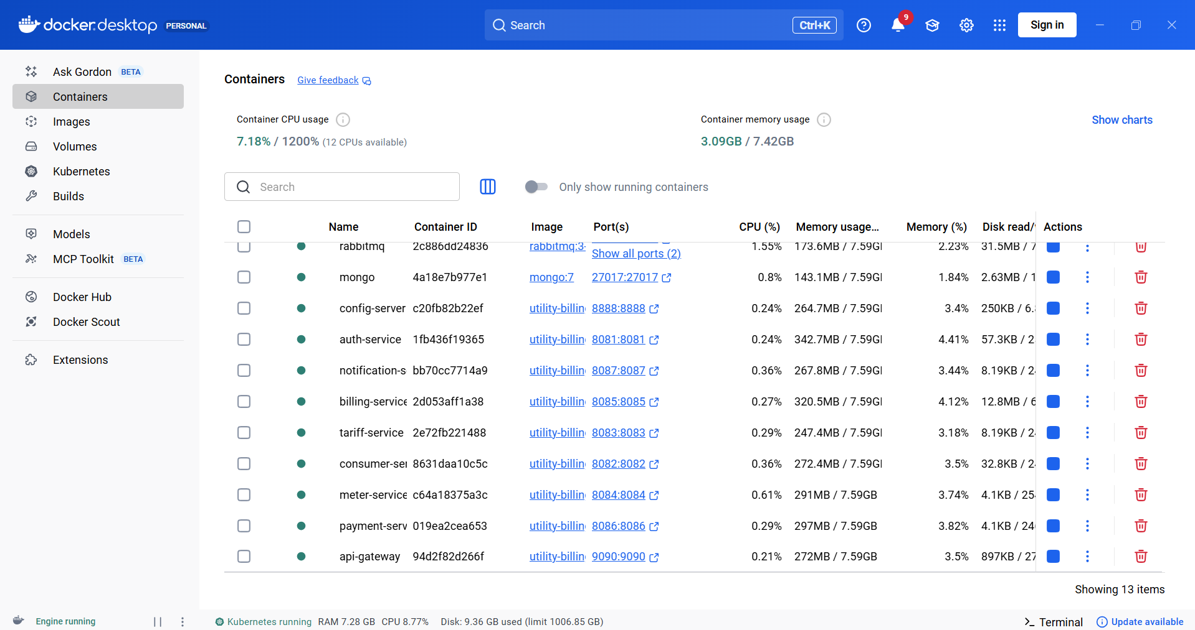
Docker

Slide 16
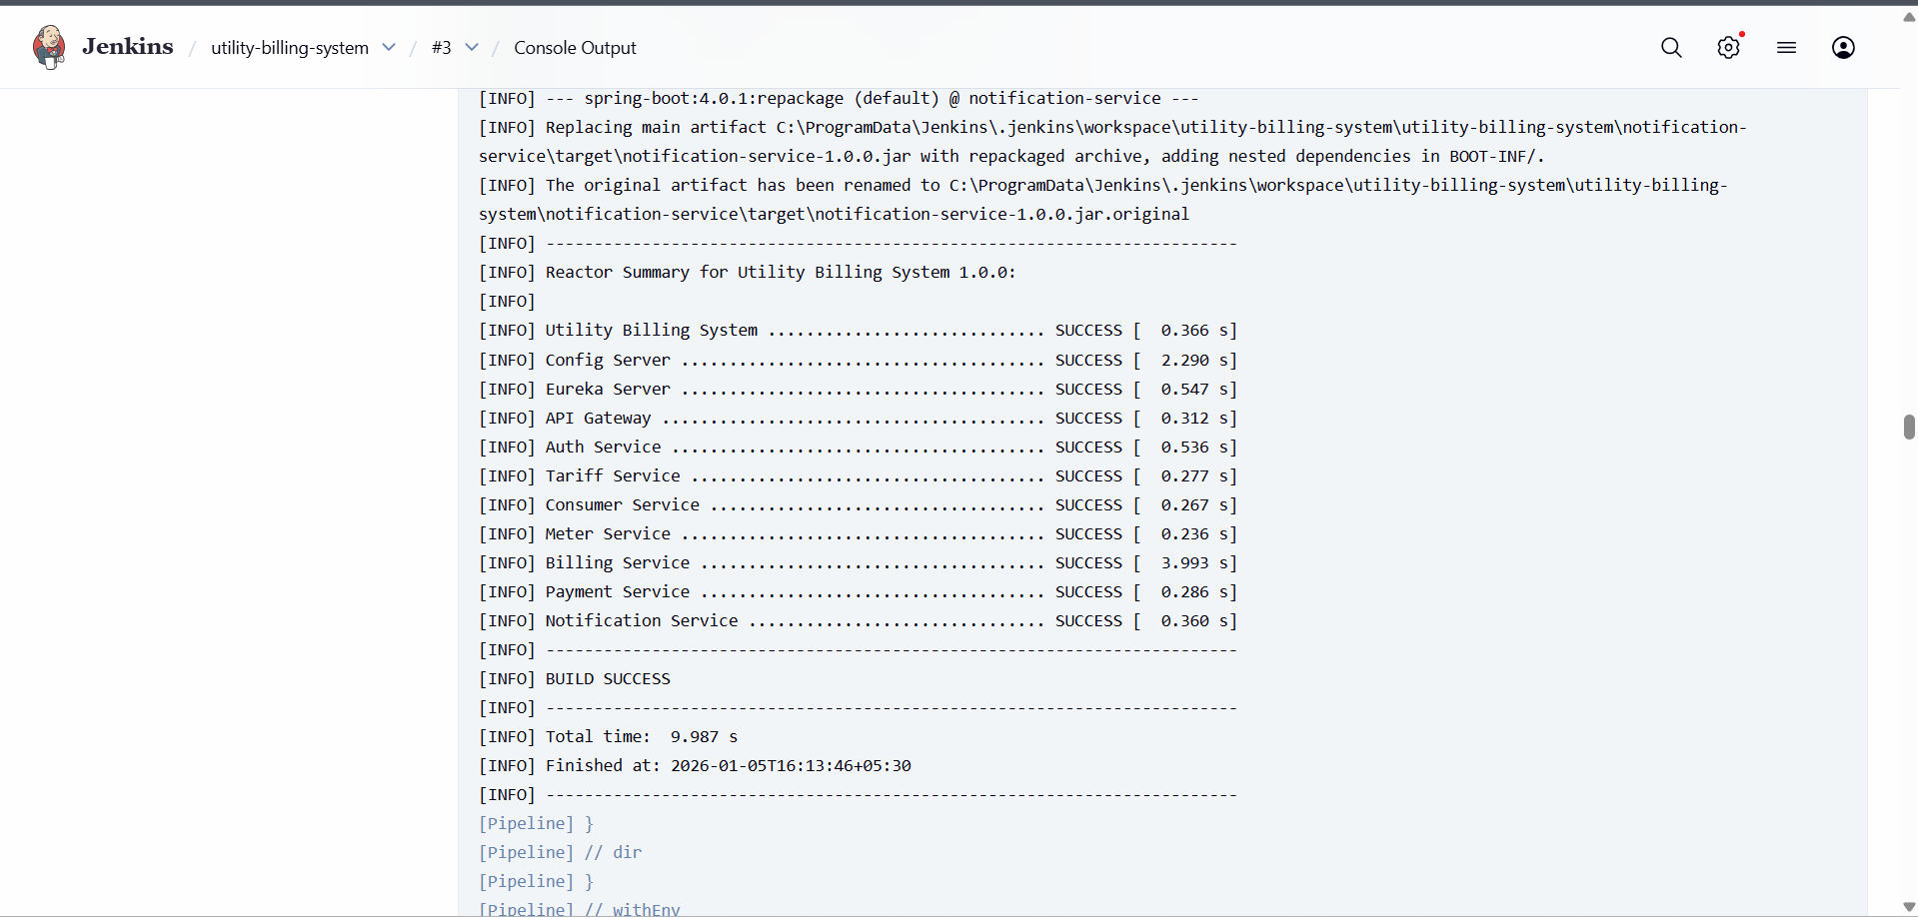
Jenkins

Slide 17
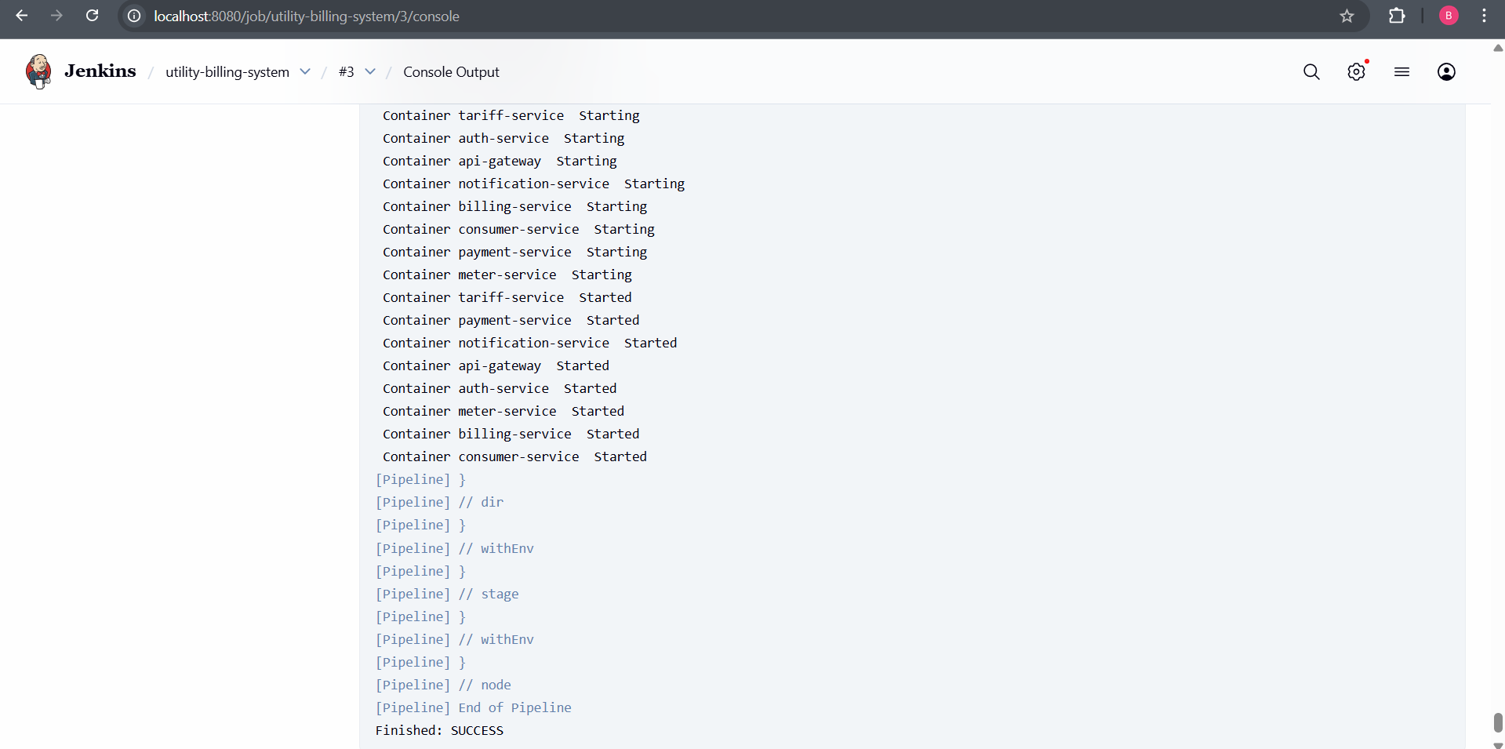
Jenkins

Slide 18
Conclusion
The Utility Billing System provides a modern, cloud-ready solution that eliminates manual errors and increases revenue transparency.
Future Scope:
Mobile App: Dedicated Android/iOS app for consumers.
Kafka Integration: Real-time event streaming for large-scale meter notifications.
Smart Metering: IoT integration for automated reading without human intervention.
THANK YOU

