Slide 1




TITLE PAGE
•Problem Statement Title– Secure Platform For Women’s Incident Reporting And Support
•Theme –Women Safety
•Team ID –BHATUR44
•Team Name (Registered on Website) –Turning Trailblazers
•Participant Names –B. Sai Saranya
B. Sowmya
CH. Bhavana
Sri Indu College of Engg & Tech - Cyber Club, Department of Cyber Security
Page 01

Slide 2

Secure platform for women’s incident reporting and support
Turning trailblazers
Proposed Solution
Many women still face harassment and violence, but fear, stigma, and distrust often prevent them from reporting these incidents.
Despite growing awareness, there’s a real need for a safe, anonymous space where they can seek help without hesitation.
A user-friendly platform could provide immediate support—legal, medical, and emotional—while ensuring privacy and security.
Creating this system would empower women, offering both protection and a pathway to justice.
Sri Indu College of Engg & Tech - Cyber Club, Department of Cyber Security
Page 02

Slide 3
TECHNICAL APPROACH
Turning trailblazers
Frontend: React Native (mobile), React (web)
Backend: Node.js with Express, Python for AI moderation
Database: PostgreSQL (encrypted), Firebase (for real-time features)
Security: AES-256 encryption, biometric login, GDPR compliance
Methodology:
The platform employs end-to-end encryption, anonymous reporting, role-based access, and secure user authentication. Community moderators and verified counselors provide support. Regular security audits and user consent protocols ensure safety, confidentiality, and trust throughout the incident reporting process.
Sri Indu College of Engg & Tech - Cyber Club, Department of Cyber Security
Page 03

Slide 4
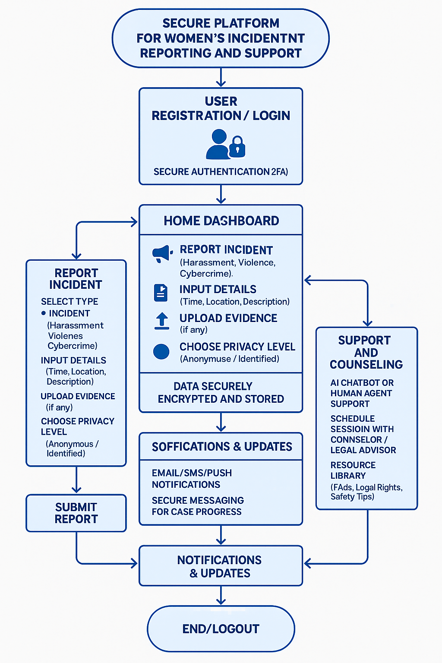
FLOW CHART
Turning trailblazers
Sri Indu College of Engg & Tech - Cyber Club, Department of Cyber Security

Slide 5
FEASIBILITY AND VIABILITY
Turning trailblazers
Safety & Anonymity – A secure platform ensures confidential incident reporting, reducing fear and social stigma.
Immediate Support – AI-driven tools provide real-time legal, medical, and psychological assistance.
Data Privacy – Encrypted communication and secure storage protect victim identities.
Scalability – The system can expand regionally with localized resources.
Sri Indu College of Engg & Tech - Cyber Club, Department of Cyber Security
Page 04

Slide 6
IMPACT AND BENEFITS
Turning trailblazers
Financial Viability – Funding from government, NGOs, and private sectors ensures sustainability.
Policy Impact – Collected data aids policymaking and prevention strategies.
User Adoption – Awareness and accessibility encourage usage, fostering systemic change.
Sri Indu College of Engg & Tech - Cyber Club, Department of Cyber Security
Page 05

Slide 7
RESEARCH AND REFERENCES
Turning trailblazers
• Wikipedia
www.wikipedia.com
Research
www.chatgpt.com
Sri Indu College of Engg & Tech - Cyber Club, Department of Cyber Security
Page 06

Slide 8
Turning trailblazers
FUTURE ENHANCEMENTS
AI-Powered Incident Classification and Risk Assessment
2. Predictive Safety Mapping
3. Blockchain for Evidence Integrity
Sri Indu College of Engg & Tech - Cyber Club, Department of Cyber Security
Page 07

Slide 9
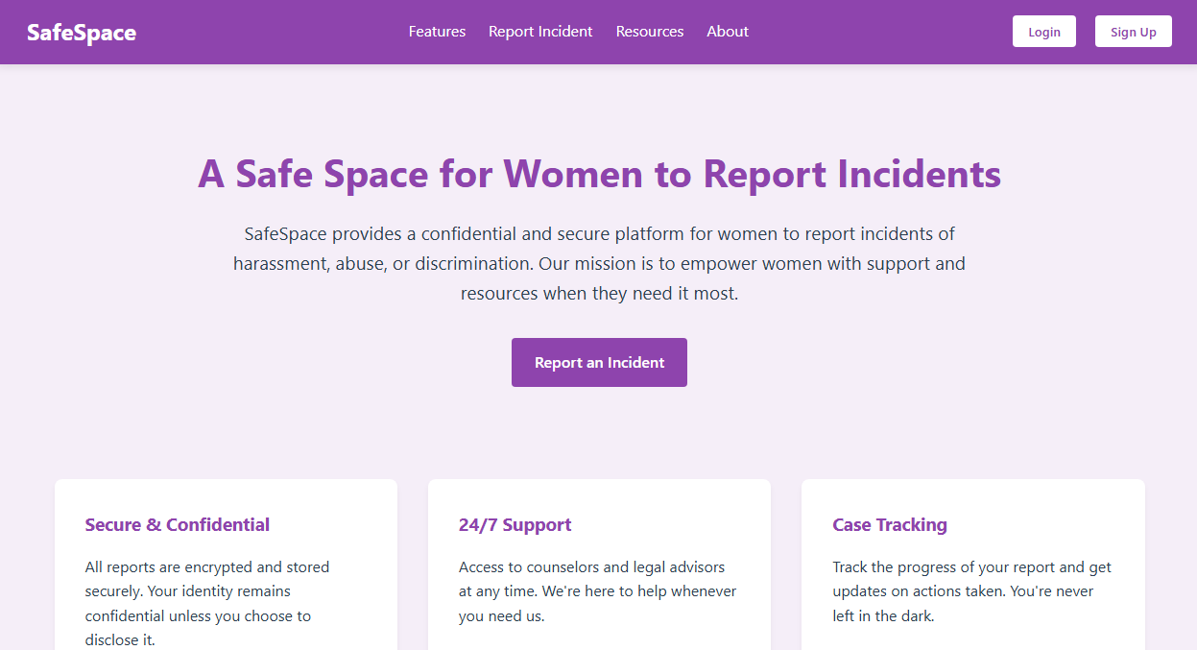
Turning trailblazers
DEMO
Sri Indu College of Engg & Tech - Cyber Club, Department of Cyber Security
Page 08

Slide 10
Turning trailblazers
CONCLUSION & THANK YOU
The Secure Platform for Women’s Incident Reporting and Support provides a safe, confidential way for women to report abuse and seek help.
It integrates anonymous reporting, SOS alerts, and access to legal and emotional support.Multilingual and accessible, it empowers users across diverse backgrounds.
The platform helps authorities respond efficiently using real-time data insights.Overall, it’s a vital tool for protection, justice, and gender equality.
THANK YOU FOR THE ORGANIZERS AND GUIDES
Sri Indu College of Engg & Tech - Cyber Club, Department of Cyber Security
Page 09

